Slide 1
Medicare & Medicaid Fraud, Waste, & Abuse Prevention
Notes:
Presenter Notes​
You can use Microsoft PowerPoint’s presenter view to view your presentation with speaker notes on one computer (your laptop, for example), while only the slides themselves appear on the screen that your audience sees (like a larger screen you're projecting to). See this link for instructions: support.microsoft.com/en-us/office/start-the-presentation-and-see-your-notes-in-presenter-view-4de90e28-487e-435c-9401-eb49a3801257​.
Introduction to Module Content​
The “Medicare & Medicaid Fraud, Waste, & Abuse Prevention” training module explains Medicare and Medicaid fraud, waste, and abuse prevention.​
Disclaimer​
This training module was developed and approved by the Centers for Medicare & Medicaid Services (CMS), the federal agency that administers Medicare, Medicaid, the Children’s Health Insurance Program (CHIP), and the Health Insurance Marketplace®.
The information in this module was correct as of May 2022. To check for an updated version, visit: CMSnationaltrainingprogram.cms.gov. The CMS National Training Program provides this information as a resource for our partners. It’s not a legal document or intended for press purposes. The press can contact the CMS Press Office at press@cms.hhs.gov. Official Medicare Program legal guidance is contained in the relevant statutes, regulations, and rulings.
This communication was printed, published, or produced and disseminated at U.S. taxpayer expense.
Health Insurance Marketplace is a registered service mark of the U.S. Department of Health & Human Services (HHS).

Slide 2
Table of Contents
Lesson 1: Fraud, Waste, & Abuse Overview..............................4–16
Lesson 2: Organizations & Strategies to Detect &
Prevent Fraud & Abuse…………………………………………17–42
Lesson 3: How You Can Fight Fraud..........................................43–59
Key Points to Remember..........................................................60
Appendices:
Examples of Successful Fraud Takedowns………..………....61
Medicare Fraud & Abuse Resource Guide…….…...…………62–64
Acronyms................................................................................65
Notes:
Presenter Notes​
The lessons in this module, “Medicare and Medicaid Fraud, Waste, & Abuse Prevention,” explain common fraud schemes and how CMS and partner organizations combat fraud, waste, and abuse in health care programs.
These materials are for information givers/trainers who are familiar with the Medicare Program, and who use the information for their presentations.
This module consists of 67 slides and speaker’s notes and includes check your knowledge questions. It takes about 1 hour to present. Allow approximately 15-30 more minutes for discussion, questions, and answers. You should consider adding more time for additional activities you want to include.

Slide 3
Session Objectives
At the end of this session, you’ll be able to:
Define health care fraud, waste, and abuse
Identify causes of improper payments
Discuss how the Centers for Medicare & Medicaid Services (CMS) fights fraud and abuse
Explain how you can fight fraud and abuse
Find sources of additional information
Notes:
Presenter Notes​
At the end of this session, you’ll be able to:
Define health care fraud, waste, and abuse
Identify causes of improper payments
Discuss how CMS fights fraud and abuse
Explain how you can fight fraud and abuse
Find sources of additional information

Slide 4
Lesson 1
Fraud, Waste, & Abuse Overview
Notes:
Presenter Notes​
Lesson 1 Provides an overview of fraud, waste, and abuse, including:
Defining health care fraud, waste, and abuse
Protecting the Medicare Trust Funds and other public resources
Examples of Medicare and Medicaid fraud
Who commits fraud
Causes of improper payments

Slide 5
Lesson 1 Objectives
At the end of this lesson, you’ll be able to:
Define health care fraud, waste, and abuse
Discuss how the Centers for Medicare & Medicaid Services (CMS) protects program integrity
Recognize examples of Medicare and Medicaid fraud
Explain who can commit fraud
Describe causes of improper payments
Notes:
Presenter Notes
At the end of this lesson, you’ll be able to:
Define health care fraud, waste, and abuse
Discuss how the Centers for Medicare & Medicaid Services (CMS) protects program integrity
Recognize examples of Medicare and Medicaid fraud
Explain who can commit fraud
Describe causes of improper payments

Slide 6
Fraud, Waste, & Abuse: What’s the Difference?
Fraud
Waste
Abuse
When someone knowingly deceives, conceals, or misrepresents to obtain money or property from any health care benefit program.
Overusing services or other practices that directly or indirectly result in unnecessary costs to any health care benefit program.
When health care providers or suppliers perform actions that directly or indirectly result in unnecessary costs to any health care benefit program.
Notes:
This slide has animation.
Presenter Notes​
Medicare and Medicaid fraud, waste, and abuse, affect every American by draining critical resources from our health care system and contributing to the rising cost of health care. Taxpayer dollars lost to waste, abuse, and fraud harm some of our most vulnerable citizens. The difference between waste, abuse, and fraud depends on circumstances, intent, and knowledge. Let’s take a closer look.
Fraud occurs when someone knowingly deceives, conceals, or misrepresents to get money or property from a health care benefit program. The Centers for Medicare & Medicaid Services (CMS) works to prevent and identify possible fraud. Medicare and Medicaid fraud is considered a criminal act. Ultimately, our judicial system determines if someone committed an act of fraud. An example would be a doctor who repeatedly and intentionally bills Medicare for services or supplies they didn’t provide.
In contrast, waste is overusing services or other practices that directly or indirectly result in unnecessary costs to any health care benefit program. Generally, waste isn’t considered to be a criminal act, but rather the misuse of resources. Examples of waste include:
Using medically-unnecessary services, durable medical equipment (DME), or prescription drugs
Using more disposable DME or drugs (like syringes, diabetic test strips, disposable diapers or underpads) than needed over a period of time
Performing a procedure in a more expensive hospital setting when it can be safely done in a provider’s office
Abuse happens when health care providers or suppliers perform actions that directly or indirectly result in unnecessary costs to any health care benefit program, like billing Medicare for services that aren’t covered or properly coded. In this case, the provider hasn’t knowingly and intentionally misrepresented the facts to obtain payment. Medicare abuse can also expose providers to criminal and civil liability. Abuse includes any practice that doesn’t provide patients with medically necessary services or meet professionally recognized standards.
NOTE: Since fraud is ultimately determined by our judicial system, typically we note "potential fraud" until the judicial system has made a decision.

Slide 7
Level of Intent
Result in waste: Ordering excessive diagnostic tests
Result in abuse: Improper billing practices (like upcoding)
Result in errors: Incorrect coding that’s not widespread
Inefficiencies
Bending the rules
Result in fraud: Billing for services or supplies that weren’t provided
Mistakes
Intentional deceptions
NOTE: Since fraud is ultimately determined by our judicial system, typically we note “potential fraud” until the judicial system has made a decision.
Notes:
This slide has animation.
Presenter Notes​
The Medicare Learning Network’s (MLN) “Medicare Fraud & Abuse: Prevent, Detect, Report” booklet shows these examples to demonstrate the escalating nature of actions that result in errors, waste, abuse, and fraud. To access this booklet, visit CMS.gov/Outreach-and-Education/Medicare-Learning-Network-MLN/MLNProducts/Downloads/Fraud-Abuse-MLN4649244.pdf.
NOTE: Since fraud is ultimately determined by our judicial system, typically we note "potential fraud" until the judicial system has made a decision.

Slide 8
Protecting Patients
We put patients first by:
Supporting innovative approaches
Protecting Medicare Trust Funds
Protecting the public resources that fund Medicaid Programs
Improving program integrity and oversight
Excluding providers with histories of fraud
Preventing provider reimbursement for services without proper documentation
Notes:
This slide has animation.
Presenter Notes​
CMS puts patients first in all of our programs. This includes supporting innovative approaches to improve quality, accessibility, and affordability, while finding the best ways to use innovative technology to support patient-centered care. To improve affordability, CMS must protect the Medicare Hospital Insurance (HI) (Part A) Trust Fund and the Supplementary Medical Insurance (SMI) (Part B) Trust Fund.
The Medicare Hospital Insurance Trust Fund pays for Part A benefits, like inpatient hospital care, skilled nursing facility (SNF) care, home health care, and hospice care. It’s funded by payroll taxes, income taxes paid on Social Security benefits, interest earned on trust fund investments, and Part A premiums from people who aren’t eligible for premium-free Part A.
The Supplementary Medical Insurance Trust Fund pays for Part B benefits including doctor services, outpatient hospital care, home health care not covered under Part A, DME, certain preventive services, lab tests, Medicare drug coverage (Part D), and Medicare Program administrative costs. Its funding is authorized by Congress from Part B premiums, Medicare drug plan (Part D) premiums, and interest earned on trust fund investments.
The federal government contributes to annual Medicaid expenditures, and CMS must protect the public resources that fund the Medicaid Programs operated by the states, the District of Columbia, and U.S. Territories. To view CMS’ Comprehensive Medicaid Integrity Plan, visit CMS.gov/files/document/comprehensive-medicaid-integrity-plan-fys-2019-2023.pdf.
CMS has to manage the careful balance between paying claims quickly and limiting provider burden and conducting reviews that prevent and detect fraud. CMS improves program integrity and oversight by monitoring and analyzing claims data. CMS excludes providers with fraudulent histories that could exploit patients with federally funded health coverage and prevents provider reimbursement for services not supported by evidence.

Slide 9
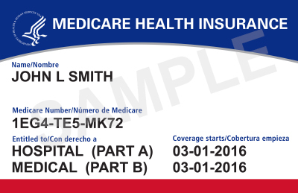
Examples of Possible Fraud
Medicare or Medicaid is billed for services or equipment you never got or you returned
A provider bills Medicare or Medicaid for services that would be considered impossible
Someone changes documents to get a higher payment
Dates, descriptions of services, or your identity are misrepresented
A company uses false information to mislead you into joining a Medicare health or drug plan
Someone else uses your Medicare or Medicaid card
Notes:
This slide has animation.
Presenter Notes​
Some examples of possible fraud include:
Medicare or Medicaid is billed for services you never got, or for equipment you either never got or returned
A provider bills Medicare or Medicaid for services that would be considered impossible (like a provider billing for therapy that totals more than 24 hours within a given day)
Someone changes documents to get a higher payment
Dates, descriptions of furnished services, or your identity are misrepresented
Someone else uses your Medicare or Medicaid card with or without your knowledge
A company uses false information to mislead you into joining a Medicare health or drug plan

Slide 10
Anyone Can Commit Fraud
Doctors, pharmacists, other health care providers, and staff
Durable medical equipment (DME) suppliers, hospitals, pharmacies, home health organizations, ambulance services, and billing companies
Individuals with Medicare and/or Medicaid, or individuals who have stolen their identities
Telemarketing
companies and health plans
Notes:
This slide has animation.
Presenter Notes​
Most individuals and organizations that work with Medicare and Medicaid are honest, but some aren’t. A small minority of doctors or employees of health care providers may commit fraud, or intentionally abuse program rules. We call these individuals and organizations “problematic providers.”
Sometimes organized crime is at the root of the problem, resulting in financial losses that easily climb into millions of dollars. In less common instances, people who have Medicare, or individuals who have stolen their identities, may commit fraud. CMS is continually taking necessary steps to identify and prosecute offenders.
In addition to doctors, pharmacists, and other health care providers and their staff, any of the following are capable of being involved in Medicare and Medicaid fraud, waste, and abuse:
DME suppliers, hospitals, pharmacies, ambulance services, and home health organizations
People with Medicare/Medicaid, or individuals who have stolen their identities
Telemarketing companies
It’s important to be aware of the various entities that have been caught up in fraud schemes. Those who commit fraud could be individuals who are in, or pretend to be in, any of the above-mentioned groups.

Slide 11
Improper Payments
Shouldn’t have been made
Were made in an incorrect amount
Were made due to fraud schemes
NOTE: Most improper payments are due to unintentional errors, like data entry mistakes or inefficiencies
Notes:
This slide has animation.
Presenter Notes​
An improper payment, according to the Government Accountability Office, is “any payment that shouldn’t have been made or that was made in an incorrect amount (including overpayments and underpayments) under statutory, contractual, administrative, or other legally applicable requirements.”
Causes of improper payments include errors, waste, abuse, and fraud—also known as mistakes, inefficiencies, bending the rules, and intentional deception.
CMS’s program integrity activities target all causes of improper payments—from honest mistakes to intentional deception.
Contrary to common perception, not all improper payments are fraud (that is, an intentional misuse of funds). In fact, most improper payments are due to unintentional errors. For example, an error may occur because a program doesn’t have documentation to support someone’s eligibility for a benefit, or an eligible person gets a payment that’s too high—or too low—due to a data entry mistake or inefficiencies.
Also, many of the improper payments are payments that may have been proper, but were labeled improper due to a lack of documentation. CMS believes that having proper documentation would show that many of these overpayments were actually proper, and the amount of improper payments actually lost by the government would be even lower than the estimated loss.
CMS uses provider education and outreach to help avoid billing errors and uses its payment suspension authorities in cases of suspected fraud. CMS also uses claim edits and pre and post-pay medical reviews to verify potential errors and take corrective actions. These activities are designed to make sure legitimate providers and suppliers get paid correctly for the appropriate and reasonable services and supplies they give to people with Medicare.
Visit CMS.gov/Outreach-and-Education/Medicare-Learning-Network-MLN/MLNProducts/Downloads/Fraud-Abuse-MLN4649244.pdf to review the “The Medicare Learning Network’s” educational products on fraud, waste, and abuse.
Visit Medicaid.gov/medicaid/program-integrity/index.html for more information about Medicaid fraud prevention efforts.

Slide 12
Common Causes of Improper Payments
Dollar amounts listed in the chart are in millions
Notes:
Presenter Notes​
CMS must report improper payment information each year in the annual Department of Health and Human Services Agency Financial Report. You may access this report by visiting HHS.gov/sites/default/files/fy-2021-hhs-agency-financial-report.pdf. This chart from HHS’ financial report data shows FY 2021 Medicare FFS Estimated Improper Payments by Type of CERT Error (Dollar Amounts in Millions).
More data for this report and more details about improper payments are available at CMS.gov/files/document/2021-medicare-fee-service-supplemental-improper-payment-data.pdf-0.
Past reports are at HHS.gov/about/agencies/asfr/finance/financial-policy-library/agency-financial-reports/index.html.
Causes (as shown in chart):
64% ($16,052.42 Million) – Insufficient Documentation
13% ($3,393.96 Million) – Medical Necessity
11% ($2,662.71 Million) – Incorrect Coding
7% ($1,715.37 Million) – Other (claims are placed into this category if they don’t fit into any of the other categories, for example, duplicate payment error, non-covered or unallowable service)
5% ($1,209.73 Million) – No Documentation

Slide 13
Improper Payment Transparency: Medicare
10% Statutory Threshold
Medicare Fiscal Year (FY) 2021 Error Rate: 6.26%
Notes:
Presenter Notes​
This graph shows the rate reduction goal for each fiscal year (FY). Under the Accountable Government Initiative, Medicare and Medicaid are considered high-error programs. Medicare processes more than one billion fee-for-service (FFS) claims per year. The FY 2021 improper payment rate was 6.26%.
The Medicare FFS improper payment rate decreased from 6.27% in FY 2020 to 6.26% in FY 2021, which is below the statutory threshold of 10%. Since 2014, CMS’ corrective actions led to an estimated $20.72 billion reduction of Medicare FFS improper payments. Inpatient Rehabilitation Facility claims had a $1.81 billion decrease in estimated improper payments from 2018 to 2021. Durable medical equipment (DME) claims saw $388 million reduction in estimated improper payments since 2020 due to a nationwide expansion of prior authorization of certain DME items as well as the Targeted Probe and Educate program. Visit CMS.gov/newsroom/press-releases/biden-harris-administration-announces-medicare-fee-service-estimated-improper-payments-decline-over for more information.
The factors contributing to improper payments are complex and vary from year to year, but the primary causes of improper payments continue to be insufficient documentation and medical necessity errors.
For error rate information, visit CMS.gov/Research-Statistics-Data-and-Systems/Monitoring-Programs/Improper-Payment-Measurement-Programs/CERT. Paymentaccuracy.gov which also calculates and keeps scorecards for improper payments processed throughout the Federal Government.
For the Department of Health & Human Services (HHS) target rate tables, visit HHS.gov/about/budget/fy2021/performance/performance-plan-goal-5-objective-1/index.html.

Slide 14
Improper Payment Transparency: Medicaid
Medicaid FY 2021 Error Rate: 21.36%
NOTE: CMS targets not available for 2019 and 2020.
Notes:
Presenter Notes​
Medicaid is the primary health coverage for more than 75 million Americans. The FY 2021 improper payment rate was 21.69%. The FY 2020 rate was 21.36%. Medicaid and the Children’s Health Insurance Program (CHIP) 2021 estimated improper payments aren’t comparable to years prior to 2019, due to the reintegration of the Payment Error Rate Measurement (PERM) eligibility component.
Areas driving the recent Medicaid improper payment rates include:
The continued reintegration of the PERM eligibility component, which was revamped to incorporate the Affordable Care Act requirements in the PERM eligibility reviews. CMS will complete the review of the remaining 17 states and the District of Columbia under the new eligibility requirements over the next year and establish a baseline once all states are measured under the new requirements.
Based on the measurement of the first 2 cycles of states, the major drivers of the increased Medicaid and CHIP eligibility improper payments are a result of the following:
Eligibility errors are mostly because of insufficient documentation to verify eligibility determinations or non-compliance with eligibility redetermination requirements. Most insufficient documentation errors represent situations where:
The required verification of eligibility data, such as income, wasn’t done at all.
There’s indication the eligibility verification was initiated but there was no documentation to validate the verification process was completed, and non-compliance with eligibility redetermination requirements.
The CHIP improper payment rate was also driven by claims where the beneficiary was incorrectly determined to be eligible for CHIP, but after review was determined eligible for Medicaid, mostly related to beneficiary income calculations, household composition, and third-party liability coverage.
Non-compliance with requirements for provider revalidation of enrollment and rescreening.
Continued non-compliance with provider enrollment, screening, and National Provider Identifier requirements.
For more information, visit CMS.gov/Research-Statistics-Data-and-Systems/Monitoring-Programs/Improper-Payment-Measurement-Programs/PERM
NOTE: These measures are being suspended until 3 years of new eligibility data are gathered and can be inserted into a new baseline in FY 2021.

Slide 15
Check Your Knowledge: Question 1
_______ occurs when someone intentionally deceives or makes misrepresentations to get money or property from any health care benefit program.
Abuse
Improper payment
Fraud
None of the above
Notes:
This slide has animation.
Presenter Notes​
Check Your Knowledge—Question 1
____ occurs when someone intentionally deceives or makes misrepresentations to get money or property from any health care benefit program.
Abuse
Improper payment
Fraud
None of the above
ANSWER: c. Fraud
Fraud occurs when someone intentionally deceives or makes misrepresentations to get money or property of any health care benefit program.

Slide 16
Check Your Knowledge: Question 2
Billing errors always show a health care provider’s or supplier’s intent to commit fraud.
True
False
Notes:
This slide has animation.
Presenter Notes​
Check Your Knowledge—Question 2
Billing errors always show a health care provider’s or supplier’s intent to commit fraud.
a. True
b. False
ANSWER: b. False
Contrary to common belief, not all improper payments are fraud (that is, an intentional misuse of funds). In fact, most improper payments are due to unintentional errors. For example, an error may occur because a program doesn’t have documentation to support someone’s eligibility for a benefit, or an eligible person gets a payment that’s too high—or too low—because of a data entry mistake or inefficiencies.

Slide 17
Lesson 2
Organizations & Strategies to Detect & Prevent Fraud & Abuse
Notes:
Presenter Notes​
Lesson 2 discusses the following organizations and strategies to detect and prevent fraud and abuse:
The Centers for Medicare & Medicaid Services (CMS)
CMS’ Center for Program Integrity (CPI)
CMS Program Integrity Contractors
CMS administrative actions
Law enforcement actions
The Health Care Fraud Prevention Partnership (HFPP)
Health Care Fraud Prevention & Enforcement Action Team (HEAT)
Education efforts

Slide 18
Lesson 2 Objectives
At the end of this lesson, you’ll be able to:
Recognize fraud schemes
Explain how to protect yourself from fraud
Describe what to do if you have quality of care concerns
Describe organizations and strategies to detect and prevent fraud
Notes:
Presenter Notes
At the end of this lesson, you’ll be able to:
Recognize fraud schemes
Explain how to protect yourself from fraud
Describe what to do if you have quality of care concerns
Describe organizations and strategies to detect and prevent fraud

Slide 19
COVID-19 Fraud Schemes
Be suspicious if you’re asked:
To pay out-of-pocket to get a vaccine
For your Medicare Number to get the vaccine, booster, or a free COVID-19 test
Always:
Guard your Medicare card like a credit card
Check Medicare claims summary forms for errors
Hang up if someone calls asking for your Medicare Number
Notes:
This slide has animation.
Presenter Notes​
The U.S. Department of Health & Human Services (HHS) Office of the Inspector General (OIG) is alerting the public about fraud schemes involving the novel coronavirus 2019 (COVID-19).
Scammers may use the COVID-19 public health emergency to take advantage of people while they’re distracted. Medicare covers the vaccine at no cost to you, so if anyone asks you for your Medicare Number to get the vaccine, booster, or to get a free COVID-19 test, it’s probably a scam.
People with Medicare are at higher risk. If they’re unaware of these schemes, they may give away their medical and financial data. The personal information collected can be used to fraudulently bill federal health care programs and commit medical identity theft.
COVID-19 fraud is rapidly evolving. Check the HHS OIG page for the full alert and the most current information at OIG.hhs.gov/coronavirus/fraud-alert-covid19.asp.

Slide 20
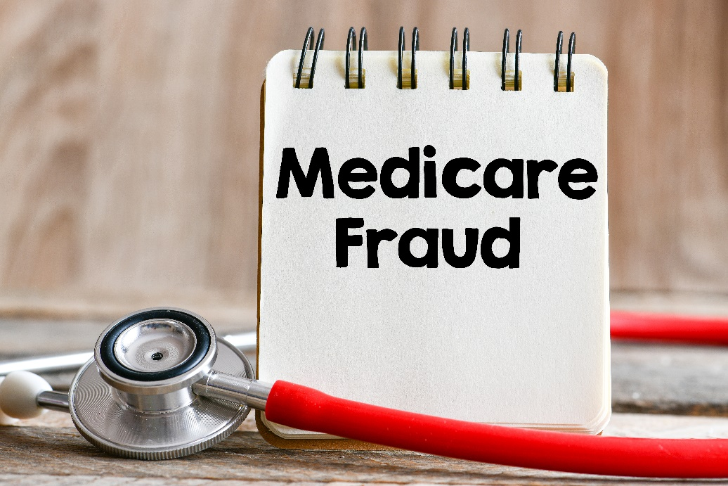
Consequences of Sharing Your Health Care Card or Number
Your medical records could be wrong
You could be charged with health care fraud
You might lose your benefits
You could be placed into a lock-in program if you have Medicaid
Notes:
This slide has animation.
Presenter Notes​
There are consequences if you share your health care card or number with anyone other than your health care providers or a trusted caregiver.
Your medical records could be wrong—the next time you go to the doctor, you’ll have to explain what happened so you don’t get the wrong kind of care.
If you intentionally participated, you could be charged with health care fraud and spend time in jail if found guilty.
You might lose your benefits.
If you have Medicaid, you can be limited to certain doctors, drug stores, or hospitals. This is called a lock-in program.
Lock-in may be used for people with Medicaid who are:
Visiting hospital emergency department for non-emergency health concerns
Using 2 or more hospitals for emergency department services
Using 2 or more doctors resulting in duplicated medications and/or treatments
Exhibiting possible drug-seeking behavior, like:
Requesting a specific scheduled medication (narcotics)
Requesting early refills of scheduled medications
Reporting frequent losses of scheduled medications
Using multiple pharmacies to fill prescriptions
The Medicaid and CHIP Payment Access Committee (MACPAC) published the “Pharmacy and Provider Lock-in Programs in Medicaid Fee for Service” briefing paper. It’s available at macpac.gov/publication/pharmacy-and-provider-lock-in-programs-in-medicaid-fee-for-service/.
For more information about Medicaid fraud prevention efforts, visit Medicaid.gov/medicaid/program-integrity/index.html.

Slide 21
Preventing Fraud in Medicare Health & Drug Plans
The plan’s giving free meals at a marketing event.
A plan representative visited my home uninvited and encouraged me to enroll.
Who to call if you have a concern:
1-800-MEDICARE:
(1-800-633-4227)
TTY:
1-877-486-2048
I got an unwanted email without an “opt-out” function.
A plan’s offering cash if I join.
A representative tried to talk with me about their plan in the hospital patient room.
I’m getting calls and texts from a plan without my permission, and I’m not a member.
Notes:
This slide has animation.
Presenter Notes​
Providers aren’t the only focus in preventing Medicare fraud. Medicare health and drug plans have responsibilities beyond billing. Plans are responsible for marketing to people with Medicare in responsible ways that protect them and the Medicare Program from fraud. This includes the plan’s agents or brokers who represent them.
Here are some examples of activities that Medicare plans and people who represent them aren’t allowed to do:
Send unwanted emails without an “opt-out” function
Visit homes uninvited to encourage enrollment in their plan
Call or text non-members (unless given permission)
Offer cash to join their plan (nominal, noncash gifts under $15 are allowed)
Give free meals at sales or marketing events
Talk about their plan in restricted areas like exam rooms, hospital patient rooms, treatment areas, and pharmacy counters (areas where people get health care)
For more information, view the Medicare Communications and Marketing Guidelines at CMS.gov/files/document/medicare-communications-marketing-guidelines-2-9-2022.pdf.
To report plans that ask for your personal information over the telephone or that call you without your permission to enroll you in a plan, call 1-800-MEDICARE (1-800-633-4227); TTY: 1-877-486-2048.

Slide 22
Common Fraud Examples: Genetic Testing & Braces
Protect yourself:
I don’t accept genetic testing kits or orthotic braces that arrive in the mail; I return them to sender
HHS-OIG Hotline:
1-800-HHS-TIPS (1-800-447-8477) or oig.hhs.gov/fraud/hotline
I’m suspicious of anyone who offers “free” genetic testing or medical equipment and then requests my Medicare Number
I keep a record of any encounters
Notes:
This slide has animation.
Presenter Notes​
The HHS OIG is alerting the public about fraud schemes involving genetic testing and orthotic braces. Genetic testing fraud occurs when Medicare is billed for a test or screening that wasn’t medically necessary and/or wasn’t ordered by the treating physician. Similarly, Durable Medical Equipment (DME) fraud happens when Medicare is billed for an orthotic brace or other DME that you didn’t need and/or wasn’t ordered by your treating physician.
Medicare only covers these items when they’re medically necessary and ordered by your doctor.
Scammers may advertise “free” screenings for genetic testing and/or medical equipment like back or knee braces in exchange for your Medicare information. These screenings and equipment aren’t free and aren’t legitimate. They may come in the form of an in-person screening, a cheek swab, or a testing kit in the mail. Braces may arrive in the mail or be advertised on TV, radio, or by a direct phone call. If you agree to this testing or equipment and Medicare denies the claim, you would have to pay for the entire cost of the item, which could be thousands of dollars. Be suspicious of anyone who offers “free” genetic testing or medical equipment and then requests your Medicare Number. If you get a genetic testing kit or orthotic braces in the mail, return them to the sender.
Keep a record of any suspicious encounters and report them to 1-800-HHS-TIPS (1-800-447-8477) or oig.hhs.gov/fraud/hotline.

Slide 23
Telemarketing & Fraud: Durable Medical Equipment (DME)
Potential DME scams:
Calls or visits from people saying they represent Medicare
Phone or door-to-door selling techniques
Requests for your Medicare Number
Notes:
This slide has animation.
Presenter Notes​
There are telemarketing rules for DME. DME suppliers (people who sell equipment like diabetic supplies and power wheelchairs), and anyone representing the supplier are prohibited by law from directly selling their products to people with Medicare (unless given prior consent). This includes contacting you by telephone, text message, computer, e-mail, instant messaging, and in-person contact. DME suppliers must be in compliance with the supplier standards of 42 C.F.R. 424.57(c). See CMS.gov/Medicare/Provider-Enrollment-and-Certification/MedicareProviderSupEnroll/Downloads/DMEPOSSupplierStandards.pdf for complete details.
Potential DME scams include:
Calls or visits from people saying they represent Medicare
Phone or door-to-door selling techniques
Equipment or service, like genetic testing, is offered for free and then you're asked for your Medicare Number for what they claim is “record-keeping purposes”
Being told that Medicare will pay for the item or service if you give them your Medicare Number
A main goal of these scams is to get your Medicare Number and bill Medicare for services or items that you don’t need or never get. It’s important to review your Medicare Summary Notice (MSN) or claims statements from your Medicare plan for charges that you don’t recognize. If you suspect fraud, report it to Medicare. To report suspected DME scams or any other suspected Medicare fraud, call 1-800-MEDICARE (1-800-633-4227); TTY: 1-877-486-2048.

Slide 24
Competitive Bidding Program (CBP)
Suppliers compete to become Medicare contract suppliers
An essential tool to help Medicare:
Set market-based payment rates for DMEPOS items
Save money for people with Medicare and taxpayers
Limit fraud, waste, and abuse in the Medicare Program
Notes:
This slide has animation.
Presenter Notes​
The Durable Medical Equipment, Prosthetics, Orthotics, and Supplies (DMEPOS) Competitive Bidding Program (CBP) was established by the Medicare Prescription Drug, Improvement, and Modernization Act of 2003 (MMA). Implemented on January 1, 2011, the CBP has been an essential tool to help Medicare set market-based payment rates for DMEPOS items, save money for people with Medicare and taxpayers, and limit fraud, waste, and abuse in the Medicare Program. The CBP has saved billions of dollars since started, while ensuring access to quality items and services. After consecutive rounds of re-competing contracts in the Competitive Bidding Areas (CBAs), all DMEPOS CBP contracts expired on December 31, 2018. There was a temporary gap period in the DMEPOS CBP from 2019–2020.
On October 27, 2020, CMS announced single payment amounts (SPAs) for 2 product categories (off-the-shelf back and knee braces), the start of the contracting process, and announcement of the new Competitive Bidding Implementation Contractor (CBIC, Palmetto GBA). Round 2021 started on January 1, 2021 and will run through December 31, 2023. Visit CMS.gov/newsroom/fact-sheets/medicare-cy-2021-durable-medical-equipment-prosthetics-orthotics-and-supplies-dmepos-policy-issues for more information about that announcement.

Slide 25
Competitive Bidding Program (CBP): Round 2021
Quality: Ensures people with Medicare have access to quality items
Protection: Limits fraud and abuse in Medicare
Savings: Saves taxpayer dollars
Efficiency: Medicare sets a Single Payment Amount (SPA)
People with Medicare who live in or travel to a Competitive Bidding Area (CBA) must use an approved supplier for Medicare to cover their back or knee brace.
Notes:
This slide has animation.
Presenter Notes​
As of January 1, 2021, people with Medicare in 127 CBAs who get off-the-shelf (OTS) back and knee braces pay prices lower on average than Medicare currently pays for the same items. Because people with Medicare pay 20% coinsurance on the cost of these items, they directly benefit from the savings. Medicare expects to save $600 million for the CBP and people with Medicare over the 3-year Round 2021 contract performance period (ending on December 31, 2023).
People with Medicare who live in or travel to a CBA need to obtain OTS back and knee braces from a contract supplier for Medicare to help pay for the item. Previously, they could get these items from any Medicare-approved supplier in order to have Medicare help pay.
People with Medicare who need custom-fitted back and knee braces don’t need to use a contract supplier; Medicare covers these devices when a Medicare-approved supplier is used.
To participate in the CBP, suppliers are required to meet Medicare’s quality and financial standards that make sure participating suppliers are able to meet the needs of people with Medicare and the terms of their contracts with Medicare.
For more information, visit:
dmecompetitivebid.com/cbic/cbic.nsf/DocsCat/Home
CMS.gov/Medicare/Medicare-Fee-for-Service-Payment/DMEPOSCompetitiveBid/Round-2021
Fact Sheet CMS.gov/files/document/round-2021-dmepos-cbp-single-payment-amts-fact-sheet.pdf
Medicare Supplier Directory Medicare.gov/medical-equipment-suppliers

Slide 26
Quality of Care Concerns
Your Beneficiary and Family Centered Care-Quality Improvement Organization (BFCC-QIO) can address:
Medication errors
Change in condition not treated
Discharged from the hospital too soon
Incomplete discharge instructions and/or arrangements
Notes:
This slide has animation.
Presenter Notes​
There’s a specific Quality Improvement Organization (QIO) dedicated to addressing the concerns of people with Medicare and their families called the Beneficiary and Family Centered Care (BFCC)-QIO.
Patient quality of care concerns aren’t necessarily fraud. Examples of quality of care concerns that your BFCC-QIO can address include:
Medication errors, like being given the wrong medication; being given medication at the wrong time; being given a medication to which you’re allergic; or being given medications that interact in a negative way. The BFCC-QIO can evaluate if the situation merits Medicare Drug Integrity Contractor (MEDIC) intervention.
A change in your condition that’s not treated, like not getting treatment after abnormal test results or when you developed a complication.
Being discharged from the hospital too soon.
Incomplete discharge instructions and/or arrangements.
To get the address and phone number of the BFCC-QIO for your state or territory, visit Medicare.gov/talk-to-someone and search for information on the topic of “Complaints about my care or services.” Or, call 1-800-MEDICARE (1-800-633-4227); TTY: 1-877-486-2048.

Slide 27
Efforts to Stop Fraud, Waste, & Abuse
CMS actions include:
Conducting rigorous screenings for health care providers and suppliers
Temporarily stopping enrollment in high-risk areas
Barring or terminating providers and suppliers from all Medicaid Programs and Children’s Health Insurance Programs (CHIPs) who have their Medicare billing privileges revoked
Temporarily stopping Medicare payments in cases of credible allegations of fraud
Providing outreach and education to reach program objectives
Coordinating with private and public health payers and other stakeholders to detect and deter fraudulent behaviors within the health care system
Notes:
This slide has animation. Presenter Notes​
CMS moved beyond the “pay and chase” approach to health care fraud to a more proactive and transparent approach by:
Creating a rigorous screening process for providers and suppliers enrolling in Medicare, Medicaid, and Children’s Health Insurance Program (CHIP).
Temporarily stopping enrollment of new providers and suppliers in high-risk areas. Medicare and state agencies watch for trends that may indicate a significant potential for health care fraud, and can temporarily stop enrollment of a category of providers or suppliers, or enrollment of new providers or suppliers, in a geographic area that has been identified as high risk. The Market Saturation and Utilization Data Tool includes an interactive map and a data set that show national, state, and county-level provider services and utilization data for selected health service areas. The interactive trend graph shows the nation and state-level trends for the user-selected geographies over time for the available metrics and health service areas. CMS can use the data to monitor market saturation as a means to help prevent potential fraud, waste, and abuse. The data can also be used to reveal the degree to which use of a service is related to the number of providers servicing a geographic region. Visit, Data.CMS.gov/market-saturation/states-and-counties to access the Market Saturation and Utilization Data Tool.
Requiring cross-termination among federal and state health programs, so providers and suppliers whose participation has been terminated by a Medicaid Program or a CHIP may have their Medicare billing privileges revoked. Providers and suppliers who have their Medicare billing privileges revoked are barred or terminated from all other CHIPs and Medicaid Programs.
Temporarily stopping Medicare payments in cases of credible allegations of fraud.
Providing outreach and education to key stakeholders to reach key program objectives.
Coordinating with private and public health payers and other stakeholders to detect and deter fraudulent behaviors within the health care system.

Slide 28
CMS’ Center for Program Integrity (CPI)
Provider Enrollment
Data Analysis
Medical Reviews & Audits
Collaboration with States
Notes:
This slide has animation.
Presenter Notes​
Within CMS, the Center for Program Integrity (CPI) coordinates the Medicare and Medicaid Program integrity activities focused on detecting and preventing fraud, waste, and abuse.
Provider Enrollment
CPI builds systems and manages programs to enroll providers in the Medicare and Medicare Programs.
Visit CMS.gov/Medicare/Provider-Enrollment-and-Certification for more information about provider enrollment.
Data Analysis
CPI identifies and seeks to prevent fraud, waste, and abuse though predictive analytics like the Market Saturation and Utilization map tool.
Visit Data.CMS.gov/summary-statistics-on-use-and-payments/program-integrity-market-saturation-by-type-of-service/market-saturation-utilization-state-county to use the Market Saturation and Utilization tool.
Medical Reviews & Audits
CPI oversees medical reviews and audits to safeguard the Medicare and Medicaid Programs.
Visit CMS.gov/Research-Statistics-Data-and-Systems/Monitoring-Programs/Medicare-FFS-Compliance-Programs/Medical-Review for more information about the medical review program.
Collaboration with States
CPI offers support and venues for states to collaborate and share best practices to fight fraud.
Visit CMS.gov/medicaid-integrity-institute to see resources for state Medicaid employees.

Slide 29
Program Integrity Contractors
Unified Program Integrity Contractors
(UPIC)
Plan Program Integrity Medicare Drug Integrity Contractor (PPI MEDIC)
Recovery Audit Program
Investigations Medicare Drug Integrity Contractor (I-MEDIC)
Notes:
This slide has animation.
Presenter Notes​
Program Integrity Contractors are a nationally coordinated Medicare/Medicaid Program integrity team of contractors that cut across regions. They include:
Unified Program Integrity Contractors (UPIC)
Recovery Audit Program
Plan Program Integrity Medicare Drug Integrity Contractor (PPI MEDIC)
Investigations Medicare Drug Integrity Contractor (I-MEDIC)
For an interactive listing of Medicare Program Integrity Contractors, visit CMS.gov/Research-Statistics-Data-and-Systems/Monitoring-Programs/Medicare-FFS-Compliance-Programs/Review-Contractor-Directory-Interactive-Map.

Slide 30
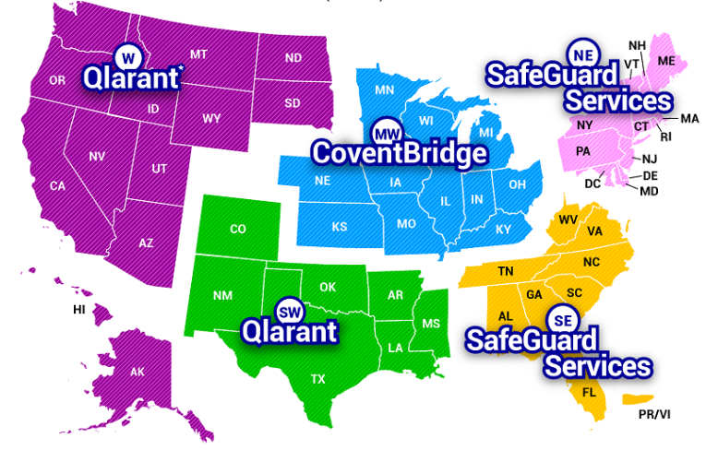
Unified Program Integrity Contractor (UPIC)
Notes:
Presenter Notes​
The UPIC operates in a geographical area or jurisdiction defined by individual task orders to maintain Medicare and Medicaid Program integrity by detecting, preventing, and proactively discouraging healthcare fraud, waste, and abuse. The UPIC brings together the former functions of Zone Program Integrity Contractors (ZPICs), Medicare-Medicaid Data Match Contractors, and the Medicaid Integrity Contractors into a single contractor to perform Medicare and Medicaid Program integrity work on behalf of CMS. Such activities include coordinating program audits, conducting provider investigations for potential referral to federal and state law enforcement, performing Medicare-Medicaid claims data analysis, and recommending administrative actions. The UPIC contracts operate in 5 separate geographical jurisdictions in the U.S. The map shows the current UPIC contractors for the 5 geographical jurisdictions.
*Other territories in the Western Jurisdiction include American Samoa, Northern Marianas Islands, and Guam.

Slide 31
Medicare-Medicaid (Medi-Medi) Data Matching
Collaboration between State Medical Assistance (Medicaid) offices
Conduct data analyses and investigations
State participation is voluntary
Activities are separate tasks under the UPIC contracts
Notes:
This slide has animation.
Presenter Notes​
Medicare-Medicaid (Medi-Medi) funding allows for CMS to match Medicaid and Medicare claims and other related data to identify improper billing and utilization patterns. This data matching can show trends that aren’t obvious from each program’s claims data alone. Medi-Medi is a funding stream that has been incorporated into the regular activities of the UPICs as they collaborate with states on investigations and audits that have the greatest potential for uncovering fraud, waste, and abuse. UPICs use the matched data to identify fraud, waste, and abuse to conduct investigations with state Medicaid agencies.
States voluntarily choose to participate in Medi-Medi, and Medi-Medi activities are carried out as separate tasks under the CMS program integrity contracts.

Slide 32
Recovery Audit Programs
Mission
Reduce improper Medicare payments by:
Detecting and collecting overpayments
Identifying underpayments
Implementing actions that will prevent future improper payments
State Programs
Medicaid Recovery Audit Contractor (RAC) programs:
Identify overpayments and underpayments
Coordinate efforts with federal and state auditors
Notes:
This slide has animation.
Presenter Notes​
The Recovery Audit Program’s mission is to reduce improper Medicare payments by efficiently detecting and collecting overpayments, identifying underpayments, and implementing actions that will prevent future improper payments.
States must establish Medicaid Recovery Audit Contractor (RAC) programs, and the programs must:
Identify and recover overpayments and identify underpayments.
Coordinate their efforts with other auditing entities, including state and federal law enforcement agencies. CMS and states work to minimize the likelihood of overlapping audits.
States are required to report all overpayments and underpayments to CMS. For more information, visit Medicaid.gov/medicaid/finance/state-expenditure-reporting/index.html.

Slide 33
Medicare Drug Integrity Contractors (MEDICs)
Key responsibilities include:
Being Responsive
Investigating potential fraud, waste, and abuse in Medicare plans
Investigating complaints alleging Medicare fraud
Referring potential fraud cases to law enforcement agencies
Being Proactive
Analyzing data
Identifying program vulnerabilities
Auditing Medicare Advantage Plans and Medicare drug plans
Providing outreach and education to plan sponsors
Notes:
Presenter Notes​
CMS has 2 Medicare Drug Integrity Contractors (MEDICs). The Plan Program Integrity (PPI) MEDIC and the Investigations MEDIC (I-MEDIC) monitor fraud, waste, and abuse in Medicare health and drug plans. The I-MEDIC has investigators throughout the country who work with federal, state, and local law enforcement authorities and other stakeholders.
Qlarant is the program integrity contractor for CMS under the PPI MEDIC contract as well as the I-MEDIC contract. Qlarant’s key responsibilities include:
Investigating potential fraud, waste, and abuse.
Investigating complaints alleging Medicare fraud.
Performing proactive data analyses.
Identifying program vulnerabilities.
Referring potential fraud cases to law enforcement agencies.
Conducting Medicare Advantage Plan and Medicare drug plan audits.
Providing outreach and education to plan sponsors.
Qlarant’s website at qlarant.com/contracts has all forms (Data Analysis Request for Information, Request for Assistance, Investigations MEDIC Complaint, and Compromised ID Report) under the I-MEDIC section. Referrals should be submitted to the I-MEDIC Complaints email address at I-MEDICComplaints@qlarant.com. Items forwarded from the Office of Inspector General (OIG) Hotline should be submitted to the I-MEDIC OIG Hotline email address at I-MEDIC_OIG_Hotline@qlarant.com.
To view an interactive U.S. map representing the various contractors that work with CMS, including UPICs, and the PPI MEDIC, visit, CMS.gov/Research-Statistics-Data-and-Systems/Monitoring-Programs/Medicare-FFS-Compliance-Programs/Review-Contractor-Directory-Interactive-Map.

Slide 34
CMS Administrative Actions
When CMS suspects fraud, administrative actions include:
Automatically denying payments
Suspending payments
Editing prepayments
Revoking billing privileges
Conducting post-payment reviews
Making referrals to law enforcement
Notes:
This slide has animation.
Presenter Notes​
When CMS suspects fraud, administrative actions include:
Automatic denials—a “don’t pay claim” status for items or services ordered or prescribed by a specific provider.
Payment suspensions—a “hold on paying claims” status until an investigation or request for information is completed.
Prepayment edits—coded system logic that either automatically pays, denies, or suspends all or part of a claim, so a trained analyst can review the claim and associated documentation to make coverage and payment determinations.
Revocation of billing privileges—occurs for noncompliance, misconduct, felonies, falsifying information, and other such reasons set forth in 42 CFR§424.535 (ecfr.federalregister.gov/current/title-42/chapter-IV/subchapter-B/part-424/subpart-P/section-424.535). Revoked providers are barred from participating in the Medicare Program for a minimum of 1 year, but not greater than 10 years, depending on the severity of the basis for revocation. If providers are revoked from Medicare a second time, the bar can last for up to 20 years. Providers may appeal a revocation determination by submitting a corrective action plan (only in cases of noncompliance) or by submitting a request for reconsideration.
Post-payment reviews, to see if there were overpayments and potential overpayment collection actions.
Referrals to law enforcement.

Slide 35
Law Enforcement & Judicial System Actions
Barring providers/companies from the programs
Restricting providers/companies from billing Medicare, Medicaid, or CHIP
Fining providers/companies
Making arrests and convictions
Negotiating Corporate Integrity Agreements
Notes:
This slide has animation.
Presenter Notes​
When law enforcement and the judicial system determine fraudulent activities, the following enforcement actions may occur:
Providers/companies are barred from the programs. The U.S. Department of Health & Human Services (HHS) OIG has the authority to exclude individuals and entities from participating in federally-funded health care programs.
Providers/companies can’t bill Medicare, Medicaid, or CHIP once they’re excluded.
Providers/companies are fined.
Arrests and convictions.
Corporate Integrity Agreements may be negotiated between OIG and health care providers and other entities as part of the settlement of federal health care program investigations arising under a variety of civil false claims statutes. Providers or entities agree to the obligations, and in exchange, OIG agrees not to seek their exclusion from participation in Medicare, Medicaid, or other federal health care programs.

Slide 36
Health Care Fraud & Abuse Control (HCFAC) Program
Jointly directed by U.S. Attorney General and the Secretary of the Department of Health and Human Services
Designed to coordinate federal, state, and local law enforcement actions with respect to health care fraud and abuse
Reports annually on efforts
Efforts include
Health Care Fraud Strike Force Teams
Health Care Fraud Prevention and Enforcement Action Team (HEAT)
Health Care Fraud Prevention Partnership (HFPP)
Major Case Coordination
Notes:
This slide has animation.
Presenter Notes​
The Health Care Fraud & Abuse Control (HCFAC) Program was established in 1996 as part of the Health Insurance Portability and Accountability Act (HIPAA). The U.S. Attorney General and the Secretary of Department of Health and Human Services (HHS), acting through the Inspector General jointly direct and collaborate federal, state, and local law enforcement activities with respect to health care fraud and abuse.
HCFAC reports on its efforts each year. To see the latest report, visit FY2020 HCFAC Report.
HCFAC’s efforts include (but aren’t limited to):
Health Care Fraud Strike Force Teams
Health Care Fraud Prevention and Enforcement Team (HEAT)
Health Care Fraud Prevention Partnership (HFPP)
Major Case Coordination

Slide 37
Medicare Fraud Strike Force Teams
Are located in fraud “hot spot” areas
Use advanced data analysis to identify high-billing levels in health care fraud hot spots
Coordinate national takedowns
Notes:
This slide has animation.
Presenter Notes​
The joint HHS/DOJ Medicare Fraud Strike Force is a multi-agency team of federal, state, and local investigators designed to fight Medicare fraud.
The wide geographic spread of Medicare Fraud Strike Force team locations shows that Medicare Fraud is a nationwide problem. Current operations are running in identified fraud hot spots including Baton Rouge, Brooklyn, Chicago, Dallas, Detroit, Houston, Los Angeles, Miami-Dade, and Tampa Bay.
Strike Force teams use advanced data analysis techniques to identify high-billing levels in health care fraud hot spots.
Interagency teams can target emerging or wandering schemes, along with chronic fraud by criminals masquerading as health care providers or suppliers.
CMS is working collaboratively with federal and state law enforcement partners to increase the recovery of improper payments and fraud by giving data and other support during Health Care Fraud Prevention & Enforcement Action investigations and prosecutions, and by suspending payments to providers subject to credible allegations of fraud. For Strike Force news and activities, visit oig.hhs.gov/fraud/strike-force.

Slide 38
Health Care Prevention & Enforcement Action Team (HEAT)
Helps prevent fraud, waste, and abuse in Medicare and Medicaid Programs
Reduces health care costs and improves the quality of care
Highlights best practices of providers and public sector employees seeking to end waste, fraud, and abuse in Medicare
Builds on existing partnerships between the U.S. Department of Health & Human Services (HHS) and the U.S. Department of Justice (DOJ) to reduce fraud and recover taxpayer dollars
Notes:
This slide has animation.
Presenter Notes​
The Health Care Fraud Prevention & Enforcement Action Team (HEAT) is a joint anti‐fraud initiative between HHS and the U.S. Department of Justice (DOJ). HEAT task forces are interagency teams comprised of top-level law enforcement and professional staff members. The team builds on existing partnerships, including those with state and local law enforcement organizations, to prevent fraud and enforce anti-fraud laws. HEAT uses interagency collaboration to reduce and prevent fraud in federal health care programs. By deploying law enforcement and trained agency personnel, HHS and DOJ increase coordination, data sharing, and training among investigators, agents, prosecutors, analysts, and policymakers. Project HEAT has been highly successful in bringing forth health care fraud cases and prosecuting them quickly and effectively.
The mission of HEAT is to:
Gather resources across the government to help prevent fraud, waste, and abuse in the Medicare and Medicaid Programs, and crack down on fraud perpetrators who abuse and cost the system billions of dollars.
Reduce health care costs and improve the quality of care, by ridding the system of perpetrators who prey on people with Medicare and Medicaid.
Highlight best practices of providers and public sector employees dedicated to ending fraud, waste, and abuse in Medicare.
Build upon existing partnerships between HHS and DOJ to reduce fraud and recover taxpayer dollars.

Slide 39
Health Care Fraud Prevention Partnership (HFPP)
Improves the detection and prevention of health care fraud by:
Exchanging data and information between public and private sectors
Leveraging analytic tools against data sets provided by HFPP partners
Providing a forum for public/private leaders and subject matter experts to share successful anti-fraud practices
Notes:
This slide has animation.
Presenter Notes​
The Health Care Fraud Prevention Partnership (HFPP) is a voluntary public-private partnership between the federal government, state and local agencies, law enforcement, private health insurance plans, employer organizations, and health care anti-fraud associations.
The HFPP aims to foster a proactive approach to detect and prevent health care fraud through data and information sharing.
The HFPP’s purpose is to improve the detection and preventions of health care fraud by:
Exchanging data and information between the public and private sectors.
Leveraging various analytic tools against data sets provided by HFPP partners.
Providing a forum for public and private leaders and subject matter experts to share successful anti-fraud practices and effective methodologies for detecting and preventing health care fraud.
For more HFPP information, visit CMS.gov/hfpp/about.

Slide 40
Major Case Coordination
Provides an opportunity for Medicare and Medicaid policy experts, law enforcement officials, clinicians, and fraud investigators to collaborate before, during, and after the development of fraud leads, resulting in:
2,200 reviews
1,750 law enforcement referrals
A historic nationwide enforcement action in September 2020
345 charged defendants (including more than 100 doctors)
Across 51 federal districts
Notes:
This slide has animation.
Presenter Notes​
In FY 2018, CMS began a Major Case Coordination initiative that includes representation from the HHS-OIG, DOJ, and CMS. This initiative provides an opportunity for Medicare and Medicaid policy experts, law enforcement officials, clinicians, and fraud investigators to collaborate before, during, and after the development of fraud leads.
This level of collaboration has contributed to several successful coordinated law enforcement actions and helped CMS to better identify national fraud trends and program vulnerabilities. As a result of the MCC, there has been a marked increase in the number and quality of law enforcement referrals from CMS. As of FY 2020, there have been nearly 2,200 MCC reviews and 1,750 law enforcement referrals through the MCC. CMS program integrity activities and investigations will continue to contribute to law enforcement investigations, CMS administrative actions and CMS initiatives. In FY 2020, CMS conducted over 1,100 MCC reviews and 800 referrals to law enforcement partners.
An example of CMS-provided support to the OIG and DOJ in FY2020 is:
In September 2020, DOJ announced a historic nationwide enforcement action involving 345 charged defendants across 51 federal districts, including more than 100 doctors, nurses and other licensed medical professionals. The largest amount of alleged fraud loss charged in connection with those cases relate to telemedicine schemes (the use of telecommunications technology to provide health care services remotely).
In addition to the criminal charges announced related to the enforcement action, CMS’ CPI separately announced it has taken a record-breaking number of administrative actions related to telemedicine fraud, revoking the Medicare billing privileges of 256 additional medical professionals for their involvement in telemedicine schemes.
This represents the largest number of adverse administrative actions resulting from a single administrative health care fraud investigative initiative.

Slide 41
Education
Helps correct vulnerabilities so that providers:
Maintain proper documentation
Reduce inappropriate claim submissions
Protect patient and provider identity information
Establish a broader culture of compliance
Helps people with Medicare identify and report suspected fraud
Notes:
This slide has animation.
Presenter Notes​
CMS is using education efforts to shift focus on to the prevention of improper payments and fraud while continuing to be vigilant in detecting and pursuing problems when they occur. For provider resources, visit CMS.gov/About-CMS/Components/CPI/CPI-Resources.html.
Provider education helps correct vulnerabilities so that providers:
Maintain proper documentation.
Reduce inappropriate claim submissions by educating providers on common billing mistakes.
Protect patient and provider identity information.
Establish a broader culture of compliance.
Educating people with Medicare and Medicaid helps strengthen the fight against fraud, by teaching them to identify and report suspected fraud.
For a copy of the “Medicaid Program Integrity: Beneficiary Card Sharing Toolkit,” visit CMS.gov/medicare-medicaid-coordination/fraud-prevention/medicaid-integrity-education/beneficiary-education-toolkits/beneficiary-toolkit.html.
“Protecting Yourself & Medicare from Fraud” is a free publication to help people with Medicare get information on how to detect and protect against fraud and identity theft. To read or download this pub, visit Medicare.gov/Pubs/pdf/10111-Protecting-Yourself-and-Medicare.pdf.

Slide 42
Check Your Knowledge: Question 3
The Health Care Fraud Prevention & Enforcement Action Team (HEAT) is a joint anti-fraud initiative between the U.S. Department of Health & Human Services (HHS) and the U.S. Department of Justice (DOJ).
True
False
Notes:
This slide has animation.
Presenter Notes​
Check Your Knowledge—Question 3
The Health Care Fraud Prevention & Enforcement Action Team (HEAT) is a joint anti-fraud initiative between the U.S. Department of Health & Human Services (HHS) and the U.S. Department of Justice (DOJ).
ANSWER: a. True
HEAT is a joint anti-fraud initiative between HHS and DOJ. HEAT task forces are interagency teams comprised of top-level law enforcement and professional staff members. The team builds on existing partnerships, including those with state and local law enforcement organizations, to prevent fraud and enforce anti-fraud laws. HEAT uses interagency collaboration to reduce and prevent fraud in federal health care programs. By deploying law enforcement and trained agency personnel, HHS and DOJ increase coordination, data sharing, and training among investigators, agents, prosecutors, analysts, and policymakers.

Slide 43
Lesson 3
How People with Medicare & Medicaid Can Fight Fraud
Notes:
Presenter Notes​
Lesson 3 discusses how people with Medicare and Medicaid can fight fraud:
Senior Medicare Patrol (SMP)
Medicare.gov/fraud
Medicare Summary Notices (MSNs)
Secure Medicare Account
“4 Rs” for fighting Medicare fraud
1-800-MEDICARE
Protecting Personal Information, ID, and Medical ID Theft
Reporting Medicaid Fraud

Slide 44
Lesson 3 Objectives
At the end of this lesson, you’ll be able to:
Identify resources to help you fight fraud
Explain the 4 Rs for fighting Medicare fraud
Describe how to prevent and report identity theft
Know how to report suspected Medicare and Medicaid fraud
Notes:
Presenter Notes
At the end of this lesson, you’ll be able to:
Identify resources to help you fight fraud
Explain the 4 Rs for fighting Medicare fraud
Describe how to prevent and report identity theft
Know how to report suspected Medicare and Medicaid fraud

Slide 45
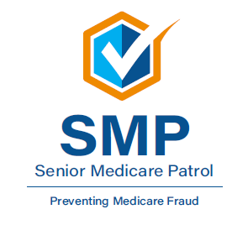
The Senior Medicare Patrol (SMP)
Educates people with Medicare on preventing, identifying, and reporting health care fraud
Seeks volunteers to represent their communities
Hears complaints from people with Medicare
NOTE: SMP Has active programs in all states, the District of Columbia, Puerto Rico, U.S. Virgin Islands, and Guam
Notes:
This slide has animation.
Presenter Notes​
Through outreach, counseling, and education, the Senior Medicare Patrols (SMPs) empower and help people with Medicare, their families, and caregivers to prevent, detect, and report health care fraud, errors, and abuse. SMPs are grant-funded projects of the U.S. Department of Health & Human Services (HHS), Administration for Community Living (ACL). Their work covers 3 main areas:
Conduct Outreach and Education. SMPs give presentations to groups, show materials at event exhibits, and work one-on-one with people with Medicare. Since 1997, more than 30 million people have been reached during community education events and more than 6.5 million people with Medicare have been educated and served by more than 46,000 volunteers.
Engage Volunteers to protect older persons’ health, finances, and medical identity while saving Medicare dollars. The SMP program engages over 5,200 volunteers nationally who collectively contribute more than 155,000 hours each year.
Get Complaints from people with Medicare. When people with Medicare, caregivers, and family members bring their complaints to the SMP, the SMP makes a determination about whether or not they suspect fraud, errors, or abuse. When they suspect fraud or abuse, they make referrals to the appropriate state and federal agencies for investigation.
There are SMP programs in each state, the District of Columbia, Puerto Rico, Guam, and the Virgin Islands. Each CMS office location has an SMP liaison. SMPs seek volunteers to represent the program in their communities.
For an in-depth overview of the SMP program, and for information for your local area, visit smpresource.org, or call the nationwide toll-free number at 1-877-808-2468. Callers get information about the SMP program and are connected to the SMP in their state for individualized assistance. You can also email them at info@smpresource.org.

Slide 46
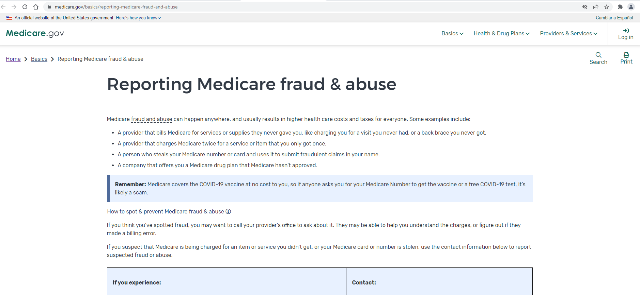
Fraud & Abuse Information on Medicare.gov
Notes:
This slide has animation.
Presenter Notes​
You’re the first line of defense against Medicare fraud, and Medicare.gov/basics/reporting-medicare-fraud-and-abuse is a good place to learn about resources available to protect yourself, your loved ones, and Medicare, like:
Tips to prevent fraud
How to spot fraud
How to report fraud
Rules for people selling Medicare plans
You can also learn the marketing rules for Medicare health plans and what people selling these plans are and aren’t allowed to do.

Slide 47
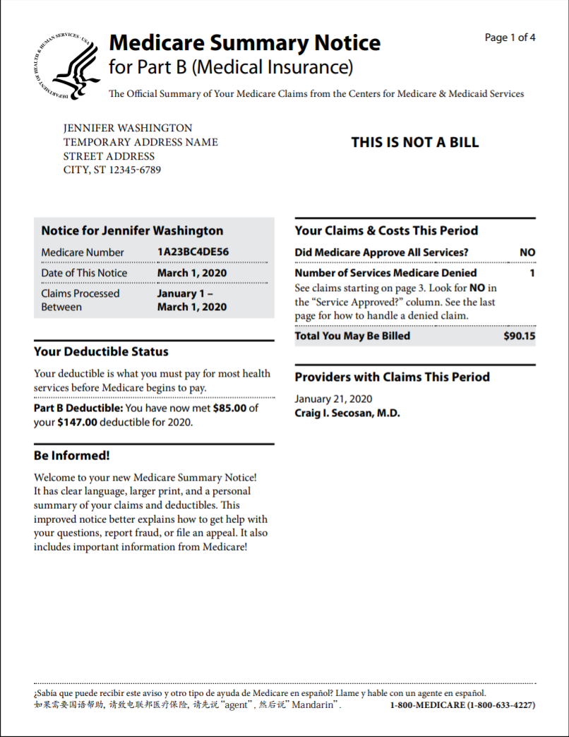
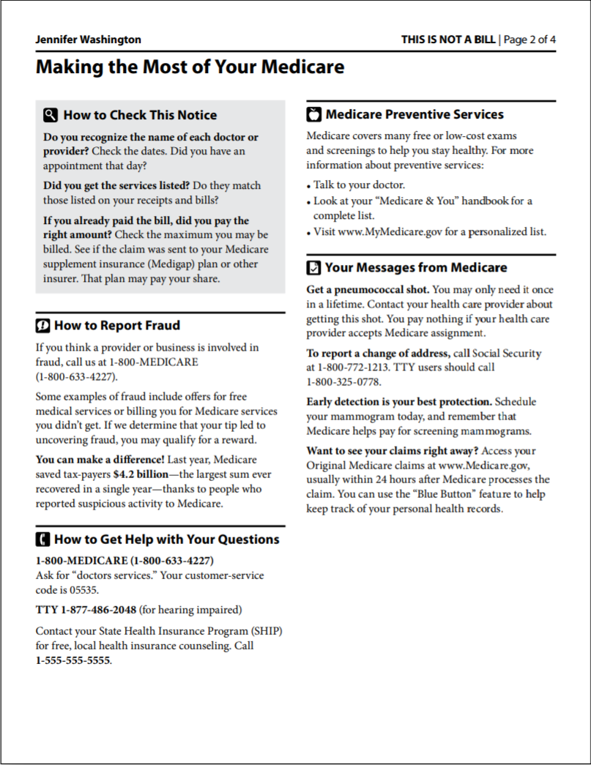
Medicare Summary Notice (MSN)
Notes:
This slide has animation. Presenter Notes​:
There are Medicare Summary Notices (MSNs) for Medicare Part A (Hospital Insurance), Medicare Part B (Medical Insurance), and durable medical equipment (DME). The MSN shows
All services and supplies that were billed to Original Medicare
What Medicare paid
What you owe each provider.
Review your MSNs carefully to make sure you got all of the services and supplies listed. If you have other insurance, check to see if it covers anything Medicare didn’t. Keep your receipts and bills, and compare them to your MSN to be sure you got all the services, supplies, or equipment. If you paid a bill before you got your notice, compare your MSN with the bill to make sure you paid the right amount. If an item or service is denied, call your doctor’s or health care provider’s office to make sure they submitted the correct information. If not, the office may resubmit. If you disagree with any decision made, you can file an appeal. If you find items listed in your claims that you don’t have a record of, it’s possible that you or Medicare may have been billed for services or items you didn’t get. If you think a charge is incorrect and you know the provider, you may want to call their office to ask about it. The person you speak to may help you better understand the services or supplier you got. Or, your provider may realize a billing error was made. If you’ve contacted the provider and you suspect that Medicare is being charged for items or services you didn’t get, or you don’t know the provider on the claim, report the suspected fraud to 1-800-MEDICARE (1-800-633-4227); TTY: 1-877-486-2048. For more information or to view samples of the Part A, Part B, and/or DME MSNs, visit Medicare.gov/forms-help-resources/mail-you-get-about-medicare.
Part A MSN: Medicare.gov/pubs/pdf/summarynoticea.pdf
Part B MSN: Medicare.gov/pubs/pdf/summarynoticeb.pdf
DME MSN: Medicare.gov/pubs/pdf/SummaryNoticeDME.pdf
You can also access MSNs electronically (eMSNs) by logging into (or creating) your secure account on Medicare.gov (see the next slide).
NOTE: Medicare Advantage Plans and Medicare drug plans provide an Explanation of Benefits (EOB) that offers similar information. The EOB is an enrollee communication that gives enrollees clear and timely information about their medical and/or drug claims, to support informed decisions about their health care options. Plans are required to issue EOBs that include the information reflected in the CMS-developed templates. To see the templates and instructions, visit CMS.gov/Medicare/Health-Plans/ManagedCareMarketing/MarketngModelsStandardDocumentsandEducationalMaterial.html. Medicare Part D sponsors must make sure that enrollees who use their Medicare drug coverage get their EOBs by the end of the month following the month in which they used their drug coverage.

Slide 48
Electronic Medicare Summary Notice (eMSN)
You can sign up to get your MSNs electronically (eMSN)
You’ll get an email every month when your MSNs are available in your Medicare account
You don’t have to wait 3 months
You’ll no longer get the mailed paper copy
Notes:
This slide has animation.
Presenter Notes​:
The eMSN is an electronic version of your Original Medicare claims statements, called a Medicare Summary Notice (MSN). If you choose eMSNs, you won’t get printed copies of your MSNs in the mail. You’ll get an email every month when MSNs are available in your Medicare account, instead of waiting 3 months for a paper copy. With eMSNs, you can:
Eliminate stacks of paper – save or print only what you need
Track your monthly claims and costs
Check your remaining deductible amount
Catch errors in billing and services
Help prevent fraud by making sure you’re billed only for the services you’ve gotten
How to sign-up for eMSNs:
Log into (or create) your Medicare account at Medicare.gov/account/login.
Select "Get your Medicare Summary Notices (MSNs) electronically" under the "My messages" section at the top of your account homepage.
You'll come to the "My communication preferences" page where you can select "Yes" under "Change eMSN preference," then "Submit."

Slide 49
Explanation of Benefits (EOB)
Provided by Medicare Advantage Plans and Medicare drug plans
Gives enrollees clear and timely information about their medical and/or drug claims
Notes:
This slide has animation.
Presenter Notes​
Medicare Advantage Plans and Medicare drug plans provide an Explanation of Benefits (EOB) that offers similar information.
The EOB is an enrollee communication that gives enrollees clear and timely information about their medical and/or drug claims, to support informed decisions about their health care options.
Plans are required to issue EOBs that include the information reflected in the CMS-developed templates. To see the templates and instructions, visit CMS.gov/Medicare/Health-Plans/ManagedCareMarketing/MarketngModelsStandardDocumentsandEducationalMaterial.html. Medicare Part D sponsors must make sure that enrollees who use their Medicare drug coverage get their EOBs by the end of the month following the month in which they used their drug coverage.

Slide 50
Medicare Account on Medicare.gov
Access your Medicare information anytime to:
Print an official copy of your Medicare card
Access and share your electronic health information
Pay your Original Medicare premiums online
View your Original Medicare claims
Find plans in your area
Create a list of your drugs
Get help through live chat
Notes:
This slide has animation.
Presenter Notes​
Create a secure personal account to access your Medicare information anytime and have a more personalized experience. With your account, you can:
Print an official copy of your Medicare card.
Access and share your electronic health information.
Pay your Original Medicare premiums online.
Review personal Medicare information, like Original Medicare claims, as soon as they’re processed and check for fraudulent claims. You don’t have to wait to get your MSN in the mail to view your Medicare claims. Use your Medicare account to track your Medicare claims or view eMSNs.
If you believe there’s an error, you should call your doctor or supplier. Call 1-800-MEDICARE (1-800-633-4227); TTY: 1-877-486-2048 if you suspect fraud.
Check your health and drug plans or find new plans in your area.
Create a list of your drugs.
Get help through live chat.

Slide 51
“4 Rs” for Fighting Medicare Fraud
Record appointments and services
Review services provided
Report suspected fraud
Remember to protect personal information (“guard your card”)
For more information, visit Medicare.gov/publications to review “4 Rs for Fighting Medicare Fraud (Medicare Product No. 11610)
Notes:
This slide has animation.
Presenter Notes​
The 4 Rs for fighting Medicare fraud are:
Record the dates of doctor’s appointments on a calendar. Note the tests and services you get, and save the receipts and statements from your providers. If you need help, ask a friend or family member. Contact your local Senior Medicare Patrol (SMP) program to get a free “Personal Health Care Journal.” Use the SMP locator at smpresource.org, or call 1-877-808-2468 to find the SMP program in your area.
Review your MSNs or similar statements from your plan for signs of fraud, including claims you don’t recognize. Compare the dates and services on your calendar with the statements your get from Medicare or your Medicare plan to make sure you got each service listed and that all the details are correct. If you see items listed in your claims that you don’t have a record of, it’s possible you, Medicare, or your Medicare plan may have been billed for services or items you didn’t get. To review your Medicare Part A and Part B claims, log into (or create) your secure Medicare account at Medicare.gov, or call 1-800-MEDICARE (1-800-633-4227); TTY: 1-877-486-2048. You can get help from your local SMP program with checking your MSNs for errors or suspected fraud. If you’re in a Medicare Advantage Plan or Medicare drug plan, call your plan for more information about a claim.
Report suspected Medicare fraud by calling 1-800-MEDICARE (1-800-633-4227); TTY: 1-877-486-2048. Have your Medicare card or Number and the claim or MSN ready. If you identify errors or suspect fraud, the SMP can also help you make a report to Medicare.
Remember to protect your Medicare Number. Don’t give it out, except to people you know should have it, like your doctor or other health care provider. Never give your Medicare Number in exchange for a special offer. Medicare will never contact you and ask for personal information, like your Medicare or bank account numbers. Never let someone use your Medicare card, and never use another person’s card.
For more information, visit Medicare.gov/publications to review “4 Rs for Fighting Fraud,” (CMS Product No. 11610).

Slide 52
Contact Medicare
Call to make a complaint and report fraud
Have this information ready:
Provider’s name and any identifying number you have
Information about the item or service, including date and payment amount
Date on your MSN
Your name and Medicare Number
If you have concerns call Medicare at 1-800-MEDICARE (1-800-633-4227); TTY: 1-877-486-2048
Notes:
This slide has animation.
Presenter Notes​
People with Medicare can call 1-800-MEDICARE (1-800-633-4227); TTY: 1-877-486-2048 to make a complaint and report fraud.
1-800-MEDICARE has an Interactive Voice Response (IVR) system available for people who haven’t signed up for access to their secure account on Medicare.gov/account/login.
The IVR can access 15 months of Original Medicare claims processed on their behalf, if they’re available.
The data gathered helps the Centers for Medicare & Medicaid Services (CMS) to:
Target providers or suppliers with multiple consumer complaints for further review.
Track fraud complaints to show when fraud scams are heating up in new areas. Using existing data in this innovative way lets CMS target providers and suppliers with multiple consumer complaints for further investigation.
Carefully review the facts before you report errors, fraud, or abuse, and have the following information ready when you call 1-800-MEDICARE:
Provider’s name and any identifying number you may have
Information on the service or item you’re questioning
The date the service or item was supposedly given or delivered
Payment amount approved and paid by Medicare
The date on your MSN
Your name and Medicare Number (as listed on your Medicare card)

Slide 53
Fighting Fraud Can Pay
You may get a reward if:
The fraud you report is proven as potential fraud and formally referred to the HHS Office of the Inspector General (OIG)
You aren’t an “excluded individual”
The person or organization being reported isn’t already under investigation by law enforcement
Your report leads directly to the recovery of at least $100 of Medicare money
To report suspected fraud, call:
1-800-HHS-TIPS (1-800-447-8477), or
1-800-MEDICARE (1-800-633-4227); TTY: 1-877-486-2048
Notes:
This slide has animation.
Presenter Notes​
To report suspected fraud you call either 1-800-HHS-TIPS (1-800-447-8477), or 1-800-MEDICARE (1-800-633-4227); TTY: 1-877-486-2048.
You may get a reward of up to $1,000 if you meet all of these conditions:
The suspected Medicare fraud you report must be proven as potential fraud by the Medicare contractors responsible for investigating potential fraud and abuse, and formally referred to the U.S. Department of Health & Human Services (HHS) Office of Inspector General (OIG) for further investigation as part of a case by one of the contractors.
You aren’t an “excluded individual.” For example, you didn’t participate in the fraud offense being reported. Or, there isn’t another reward that you qualify for under another government program.
The person or organization you’re reporting isn‘t already under investigation by law enforcement.
Your report leads directly to the recovery of at least $100 of Medicare money.
For more information, call 1-800-MEDICARE.
Review the Code of Federal Regulations at 42 CFR 420.405 “Rewards for information relating to Medicare fraud and abuse” at ecfr.io/Title-42/se42.3.420_1405.

Slide 54
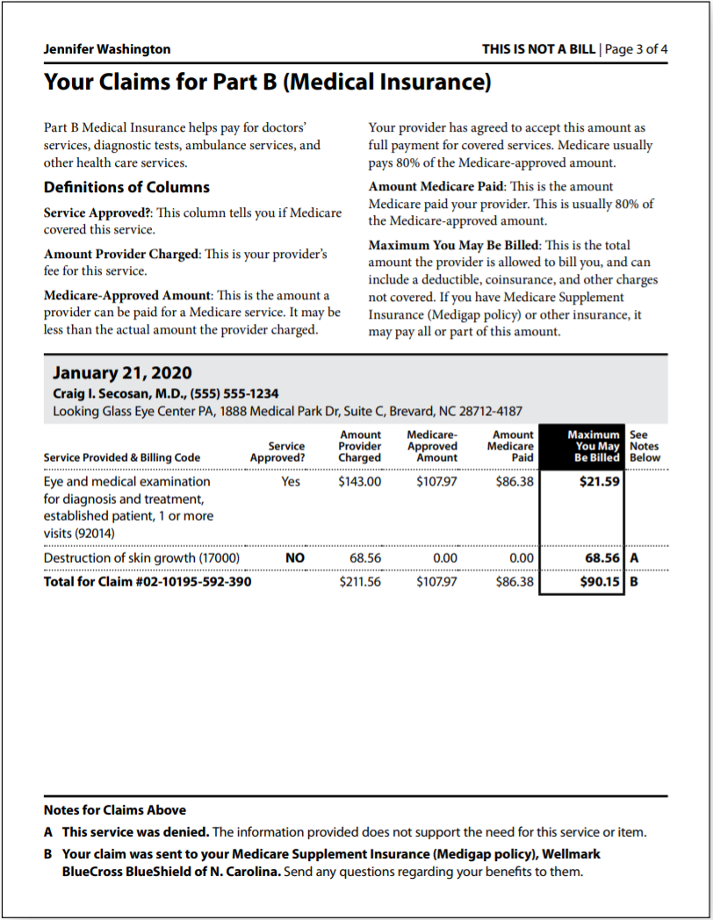
Learning Activity
Jennifer has concerns and wants to discuss her MSN with you.
What are some things that might indicate fraud?
Notes:
This slide has animation.
Presenter Notes​
Learning Activity:
Jennifer has concerns and wants to discuss her MSN with you.
What parts of the MSN should she look at to be sure there were no mistakes or fraud?
(Discussion is on the next slide.)

Slide 55
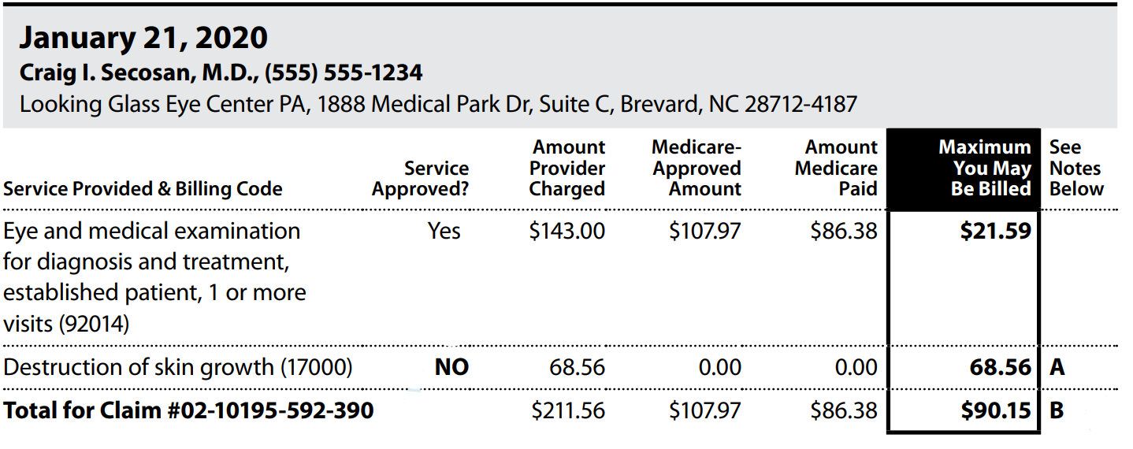
Learning Activity (continued)
Does she know the provider/facility?
Did she get these services?
Is the date of service correct?
Do any services appear twice when they shouldn’t?
3
1
2
4
Notes:
This slide has animation.
Presenter Notes​
MSN Activity—What questions should you ask while reviewing the MSN?
Does she know the provider/facility?
Did she get these services? Was she charged for any medical services she didn’t get?
Is the date of service correct?
Do any services appear twice when they shouldn’t?
After reviewing the MSN:
What other documents should Jennifer check?
Does her credit report show any unpaid bills for medical services or equipment she didn’t get?
Has she gotten any collection notices for medical services or equipment she didn’t get?

Slide 56
Protecting Personal Information
Your Medicare card has a number that’s unique to you
Only share personal information with people you trust:
Doctors, other health care providers, and plans approved by Medicare
Insurers who pay benefits on your behalf
Trusted people in the community who work with Medicare
Notes:
This slide has animation.
Presenter Notes​
Your Medicare card has a Medicare Number that’s unique to you, instead of your Social Security Number. Providers may refer to your Medicare Number as your Medicare Beneficiary Identifier (MBI).
Keep your personal information like your Medicare Number, Social Security Number, credit card and bank account numbers safe. Only share this information with people you trust, like:
Your doctors, other health care providers, and plans approved by Medicare
Insurers who pay benefits on your behalf
Trusted people in the community who work with Medicare, like your State Health Insurance Assistance Program (SHIP) or Social Security office
If you aren’t sure if a provider is approved by Medicare or someone calls you and asks for your Medicare Number or other personal information, call 1-800-MEDICARE (1‑800‑633‑4227); TTY: 1‑877‑486‑2048.

Slide 57
Identity Theft
Identity theft is when someone else uses your personal information, like your Social Security Number
If you think someone is using your information:
Visit identitytheft.gov
Visit ftc.gov/idtheft for more information about identity theft or to file a compliant online
Call the Federal Trade Commission’s ID Theft Hotline at 1-877-438-4338; TTY: 1-866-653-4261
Notes:
This slide has animation.
Presenter Notes​
Identity theft occurs when someone else uses your personal information, like your Social Security Number. If they’re using your Medicare or Medicaid Numbers, it’s considered Medical Identity theft. It’s a serious crime.
If you suspect identity theft, or feel like you gave your personal information to someone you shouldn’t have, you can:
Visit identitytheft.gov
Call the Federal Trade Commission’s ID Theft Hotline at 1-877-438-4338; TTY: 1-866-653-4261
Visit ftc.gov/idtheft for more information about identity theft or to file a complaint online

Slide 58
Medical Identity Theft
To replace your card, call Medicare at 1-800-MEDICARE
(1-800-633-4227); TTY: 1-877-486-2048
Medical identity theft can result in:
False or missed diagnoses
Treatment for conditions you don’t have
Incorrect lab results
Bills for services you didn’t get
Denied services or prescriptions
Inaccurate medical history records
View OIG’s Public Service Announcement about medical identity theft
Notes:
This slide has animation.
Presenter Notes​
Medical identify theft is a special type of identity theft where someone uses your Medicare or Medicaid Number to submit fraudulent claims to Medicare, Medicaid, or other insurers without your permission.
Medical identity theft can result in:
False or missed diagnoses.
Treatment for conditions you don’t have.
Incorrect lab results.
Bills for services you didn’t get.
Denied services or prescriptions.
Inaccurate medical history record.
If you need to replace your card because you think that someone else is using your Medicare Number, report it right away:
Call 1-800-MEDICARE (1-800-633-4227); TTY: 1-877-486-2048.
View a Public Service Announcement about Medical Identity Theft from OIG at youtube.com/watch?time_continue=4&v=r_RNBFGgw1Q&feature=emb_logo.

Slide 59
Reporting Suspected Medicaid Fraud
You can report suspected Medicaid fraud to:
Medicaid Fraud Control Unit
(MFCU)
Office of Inspector General
(OIG)
State Medical Assistance (Medicaid)
office
Notes:
This slide has animation.
Presenter Notes​
You may report suspected Medicaid errors, fraud, or abuse to these organizations:
Medicaid Fraud Control Units (MFCUs) investigate and prosecute Medicaid fraud as well as patient abuse and neglect in health care facilities. You may file complaints of suspected Medicaid fraud directly to an MFCU. Download contacts at OIG.hhs.gov/fraud/medicaid-fraud-control-units-mfcu/files/contact-directors.pdf.
OIG certifies and annually re-certifies each MFCU.
Contact OIG or HHS
Report fraud online: tips.oig.hhs.gov
Report fraud by mail: HHS Tips Hotline, P.O. Box 23489, Washington, DC 20026-3489
Call: 1-800-447-8477; TTY: 1-800-377-4950 to report fraud
You can also report suspected fraud and abuse to your State Medical Assistance (Medicaid) office. You may locate them at CMS.gov/apps/contacts.
Learn more about Medicaid fraud at Medicaid.gov/medicaid/program-integrity/index.html.

Slide 60
Key Points to Remember
Differences between fraud, waste, and abuse depend on circumstances, intent, and knowledge
Improper payments are often mistakes
Program Integrity Contractors and partnerships with organizations help CMS fight fraud, waste, and abuse
Check online resources for the most up-to-date fraud schemes information
Fight fraud, waste, and abuse by recording details about your visits, reviewing statements, reporting suspicious activity, and remembering to protect your information (the 4 Rs)
Notes:
This slide has animation.
Presenter Notes​
Here are some key points to remember:
Differences between fraud, waste, and abuse depend on circumstances, intent, and knowledge.
Fraud occurs when someone intentionally deceives, conceals, or makes misrepresentations to get money or property from a health care benefit program. Ultimately, our judicial system determines if someone committed an act of fraud.
In contrast, waste is the overuse of services, or other practices that, directly or indirectly, add avoidable costs to the Medicare Program. Generally, waste isn’t considered to be a criminal act, but rather the misuse of resources.
Abuse happens when health care providers or suppliers perform actions that directly or indirectly result in unnecessary costs to any health care benefit program.
While there are many causes of improper payments, many are honest mistakes.
The most common error is insufficient documentation.
CMS fights fraud, waste, and abuse with support from Program Integrity Contractors and through partnerships with organizations like SMPs.
Suspected fraud must be forwarded to law enforcement for additional investigation and prosecution.
Fraud schemes can change frequently. Check online resources for the most up-to-date information.
You can help fight fraud, waste, and abuse with the 4 Rs: record, review, report, and remember.
You are the first line of defense.
Education and outreach about fraud helps combat the problem.

Slide 61
Examples of Successful Fraud Takedowns
COVID-19 Coordinated Law Enforcement Action
National Health Care Fraud Enforcement Action Results in Charges Involving over $1.4 Billion in Alleged Losses
Justice Department Takes Action Against COVID-19 Fraud
National Health Care Fraud and Opioid Takedown Results in Charges Against 345 Defendants Responsible for More than $6 Billion in Alleged Fraud Losses
Notes:
Presenter Notes​
Examples of Successful Fraud Takedowns
COVID-19 Coordinated Law Enforcement Action (Justice.gov/opa/pr/doj-announces-coordinated-law-enforcement-action-combat-health-care-fraud-related-covid-19)
National Health Care Fraud Enforcement Action Results in Charges Involving over $1.4 Billion in Alleged Losses (Justice.gov/opa/pr/national-health-care-fraud-enforcement-action-results-charges-involving-over-14-billion)
Justice Department Takes Action Against COVID-19 Fraud (Justice.gov/opa/pr/justice-department-takes-action-against -covid-19-fraud)
National Health Care Fraud and Opioid Takedown Results in Charges Against 345 Defendants Responsible for More than $6 Billion in Alleged Fraud Losses (Justice.gov/opa/pr/national-health-care-fraud-and-opioid-takedown-results-charges-against-345-defendants)

Slide 62
Medicare & Medicaid Fraud & Abuse Resource Guide
Centers for Medicare & Medicaid Services (CMS) | Call 1-800-MEDICARE (1-800-633-4227); TTY: 1-877-486-2048 CMS.gov Medicare.gov/fraud CMS.gov/Medicare-Medicaid-Coordination/Fraud-Prevention/Medicaid-Integrity-Education/edmic-landing.html
Social Security | Call 1‑800‑772‑1213 TTY: 1‑800‑325‑0778 socialsecurity.gov/fraud
Senior Medicare Patrol (SMP) | Call 1-877-808-2468 smpresource.org
National Health Care Anti-Fraud Association | NHCAA.org
PPI MEDIC and I-MEDIC Parts C and D Fraud Investigations Contractor | Call 1-877-7SAFERX (1-877-772‑3379) I-MEDICComplaints@qlarant.com I-MEDIC_OIG_Hotline@qlarant.com
Notes:
Presenter Notes​
This slide (and the two that follow) provides information about additional resources. You may want to highlight those that are most relevant to your audience.​
Continued on next slide.​

Slide 63
Medicare & Medicaid Fraud & Abuse Resource Guide (continued)
U.S. Department of Health & Human Services Office of the Inspector General | Call 1-800-HHS-TIPS; (1-800-447-8477); TTY: 1-800-377-4950 tips.oig.hhs.gov
Competitive Bidding Areas (CBAs) | dmecompetitivebid.com/cbic/cbic2021.nsf/DocsCat/H5O2KFK4HO
Notes:
Continued on next slide.​

Slide 64
Medicare Fraud & Abuse Resource Guide
“Medicare Fraud: Don’t Give Them a Chance” (Guard Your Medicare Card Campaign) | youtube.com/watch?v=vScAG7rtPe8&list=PLaV7m2-zFKpiuxlWwMfKHNUrQ2Mxhay4b
“Medicare & You: Preventing Medicare Fraud” (CMS Video) | youtube.com/watch?v=zKZuVdL-GC0
“Medicare Fraud: Coronavirus Scams” (CMS Video) | youtube.com/watch?v=N_iI1IkTQZo
“Protecting Yourself & Medicare from Fraud” | CMS Product No. 10111
“4 Rs for Fighting Fraud” | CMS Product No. 11610
To access these and other helpful products:
View or download at Medicare.gov/publications and search by keyword or product number.
Order multiple copies (partners only) at Productordering.cms.hhs.gov. You must register your organization.

Slide 65
Acronyms
BFCC-QIO Beneficiary and Family-Centered Care Quality Improvement Organization
CBA Competitive Bidding Area
CBP Competitive Bidding Program
CHIP Children’s Health Insurance Program
CMS Centers for Medicare & Medicaid Services
COVID-19 Novel Coronavirus 2019
CPI Center for Program Integrity
DME Durable Medical Equipment
DOJ U.S. Department of Justice
EOB Explanation of Benefits
FFS Fee-for-Service
FY Fiscal Year
HCFAC Health Care Fraud & Abuse Control
HEAT Health Care Fraud Prevention & Enforcement Action Team
HFPP Health Care Fraud Prevention Partnership
HHS U.S. Department of Health & Human Services
MEDIC Medicare Drug Integrity Contractor
MFCU Medicaid Fraud Control Unit
MSN Medicare Summary Notice
NTP National Training Program
OIG Office of Inspector General
PPI Plan Program Integrity
QIO Quality Improvement Organization
SMP Senior Medicare Patrol
TTY Teletypewriter
UPIC Unified Program Integrity Contractor
ZPIC Zone Program Integrity Contractor

Slide 66
Stay Connected
To view available training materials, or subscribe to our email list, visit
CMSnationaltrainingprogram.cms.gov.
Contact us at training@cms.hhs.gov.
Notes:
Presenter Notes​
Stay connected. Visit CMSnationaltrainingprogram.cms.gov to view NTP training materials and to subscribe to our email list. Contact us at training@cms.hhs.gov.

