Slide 1
NTP Medicare Open Enrollment Period (OEP) Bootcamp 2023 (Day 1)
Notes:
Medicare Open Enrollment is from October 15 to December 7, 2023. Coverage begins January 1, 2024, if you enroll or change plans.
Disclaimer​
This training module was developed and approved by the Centers for Medicare & Medicaid Services (CMS), the federal agency that administers Medicare, Medicaid, the Children’s Health Insurance Program (CHIP), and the Health Insurance Marketplace®. ​
The information in this module was correct as of September 2023. To check for an updated version, visit CMSnationaltrainingprogram.cms.gov. The CMS National Training Program provides this information as a resource for our partners. It’s not a legal document or intended for press purposes. The press can contact the CMS Press Office at press@cms.hhs.gov. Official Medicare Program legal guidance is contained in the relevant statutes, regulations, and rulings.​
This communication was printed, published, or produced and disseminated at U.S. taxpayer expense.​
Health Insurance Marketplace® is a registered service mark of the U.S. Department of Health & Human Services (HHS).​

Slide 2
CMS National Training Program
Medicaid
Medicare
We provide training & resources
for partners about these programs
Children’s Health
Insurance Program (CHIP)
Health Insurance Marketplace®
Notes:
NTP is the official source for consistent, accurate, and reliable information about the Centers for Medicare & Medicaid Services (CMS) administered programs—Medicare, Medicaid, the Children’s Health Insurance Program (CHIP), and the Health Insurance Marketplace®. Our resources and tools are designed to help our partners, stakeholders, not-for-profit professionals, and volunteers (who work with consumers and their families) help others make informed decisions about their health care coverage.

Slide 3
Refreshed NTP Website & Word Mark
You can:
Download documents
Watch videos
Access tools
Take courses
Sign up for the CMS NTP Listserv
Register for live events
View webinar recordings
CMSnationaltrainingprogram.cms.gov
Notes:
This slide has animation.
You may have noticed that the National Training Program recently launched a new look and feel, with a redesigned wordmark featured on our materials and a refreshed website! We’ve modernized the website to improve your browsing and training experience. A prominent carousel of upcoming training events and announcements greets you on our home page, along with an optimized menu categorizing our robust catalog—Live Events, Past Events, E-Courses, and Resources.
The NTP website enables you to download documents, watch videos, and access other helpful tools. It also has a built-in Learning Management System (LMS) for you to register for and launch courses and access your course completion certificates.
You can sign up for the listserv, contact us, and view a video on how to use the new site under the “Help” menu options (question mark icon) at the top of the NTP web page.
CMSnationaltrainingprogram.cms.gov

Slide 4
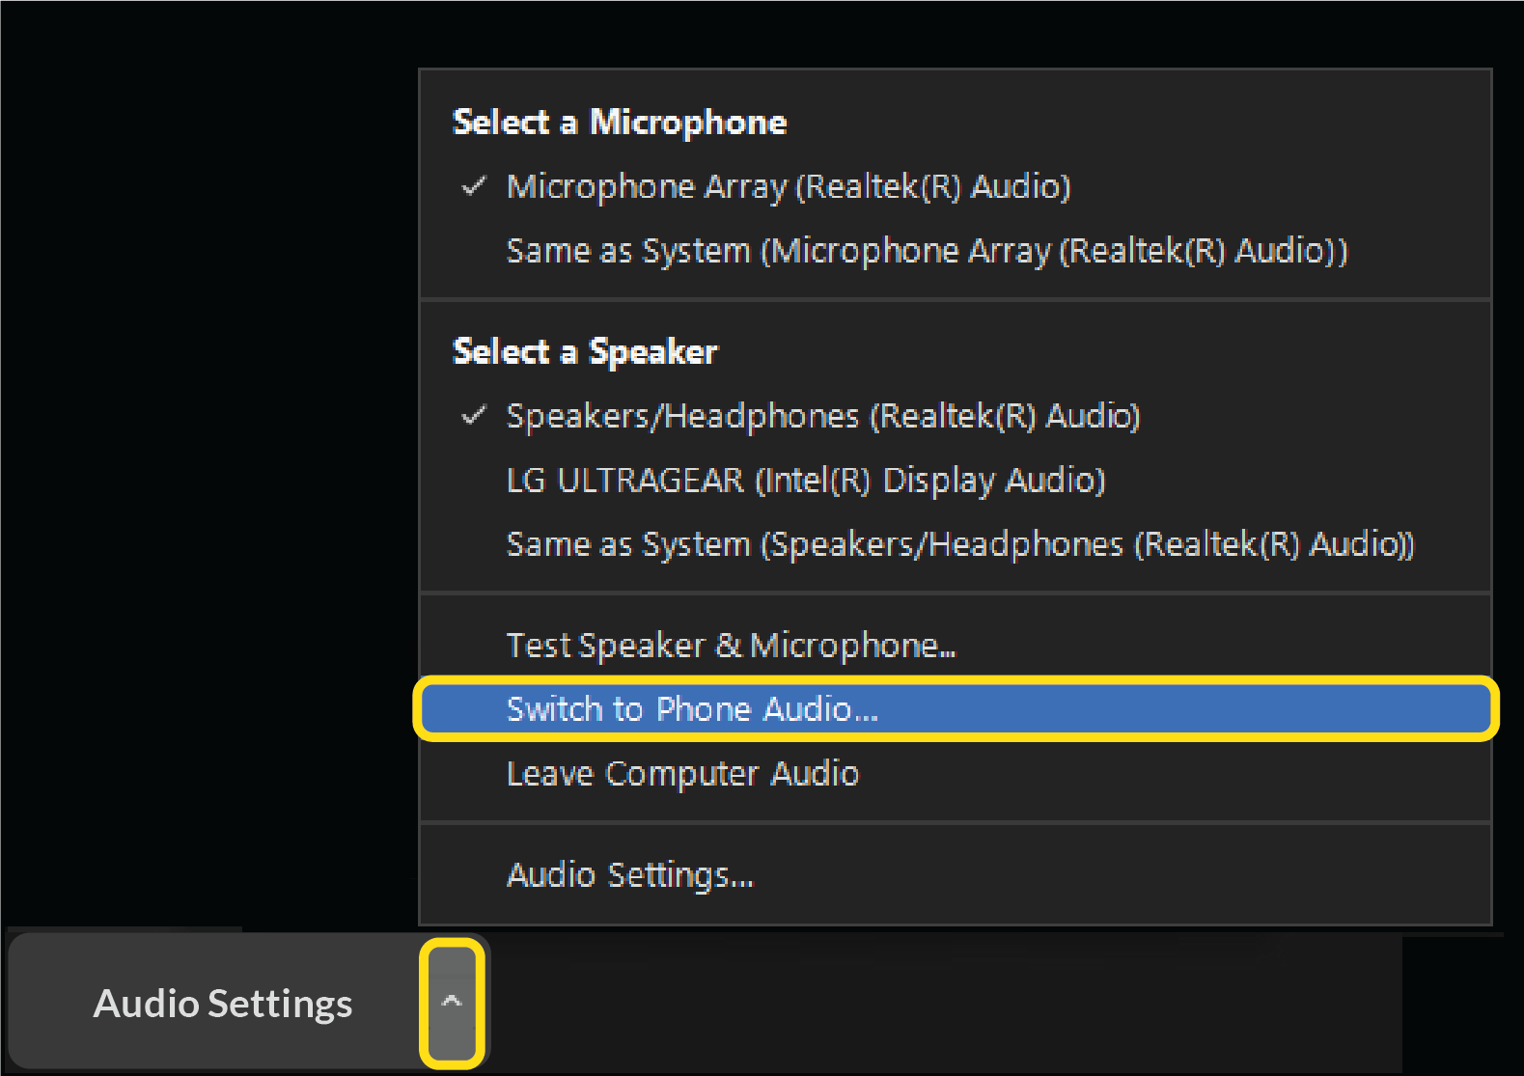
Webinar Audio
Lines have been muted
Audio depends on what option you’ve chosen
You can change your selection if desired
1
2
2
1
Notes:
Lines have been muted.
Audio depends on what option you chose:
To change your selection, select the arrow on the un/mute icon on the bottom left side of your screen.
Hang up if you’re on a phone line and want to switch to computer.
Use your computer speakers or phone settings to adjust your volume level.

Slide 5
Webinar Viewing Tips
You can adjust your view
To view slides in “full screen,” select
Q&A
Closed Captioning (CC)
1
2
1
2
Notes:
Make the most of your training experience. Participate in polls and chat when indicated.
You can toggle between full-screen slides and the option to view the Zoom icons. If you don’t see the icons at the bottom of your screen, you may need to select the “View“ icon at the top right to exit the full-screen view. To reverse your view and see a larger, full-screen version of the slides, again, use the “View” icon at the top right of your screen and select “full screen.”
If you’d like to ask a question, please type it into the Q&A box located on the bottom of the webinar screen. We’ll reply to some questions throughout the webinar, and we’ll select some that we’ll ask our presenter after the presentation. If we don’t get to all the questions, you can send them to our mailbox, which is training@cms.hhs.gov. We’ll share that with you again toward the end of the presentation.
The closed captioning option is located at the bottom of your screen. Select the “CC” icon labeled “Live Transcript” and then “Show Subtitle.”

Slide 6
More Webinar Tips
Today’s presentation is available for download at the same location you launched today’s webinar
This webinar is being recorded
Notes:
Today’s presentation slides are available for download at the same location you launched today’s webinar.
This webinar is being recorded so it can be posted to our NTP website later. We need time to review the recordings prior to posting on our website, so please allow a 1- to 2-week turnaround time.

Slide 7
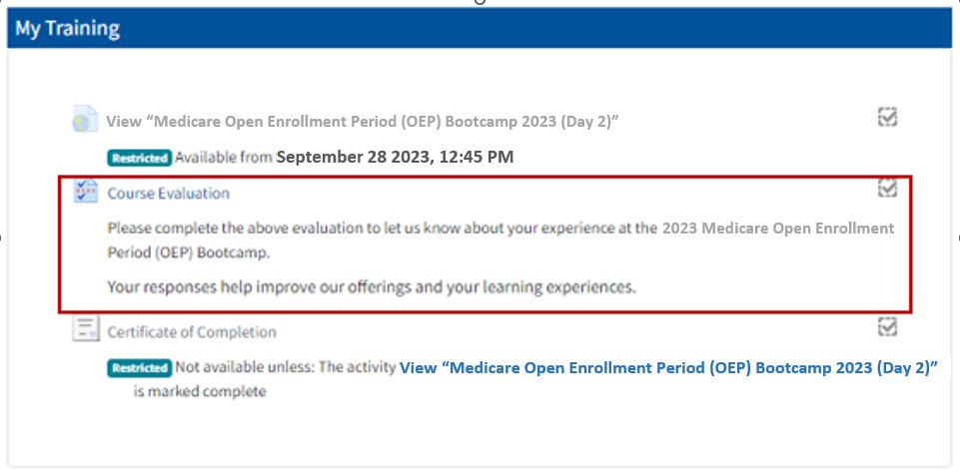
Evaluations
One for each date you attend (Day 1 and/or Day 2)
Available in the NTP LMS—at the same location you launched today’s webinar
Notes:
After the webinar has concluded, we encourage you to complete an evaluation survey that will be available in the NTP LMS. You’ll see it in the same location (or link) you used to register for and launch this training.
These surveys help us continue to improve and offer sessions that are helpful to our partners.

Slide 8
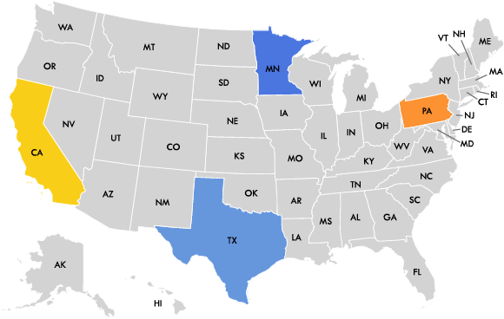
Checking In
Where are you joining us from today?
What’s your experience with the Medicare OEP?
Thanks for joining!
Notes:
This slide has animation.

Slide 9
Today’s NTP Team
Sylvia Gary
Melissa Moreno
Leslie Long
Mohamad Al-Issa
Joseph Warden
Notes:
I’m joined by my NTP colleagues Leslie Long, Mohamad Al-Issa, and Joseph Warden, who’ll be providing technical assistance.
Today’s presenters are Kristi Martin, Senior Advisor in the CMS Office of the Administrator for the Center for Medicare, Sylvia Gary with the CMS National Training Program, and Mary McGeary, Director of the New Jersey State Health Insurance Assistance Program (or SHIP), within the NJ Department of Human Services.
For help with Plan Finder Q&A, we have our subject mater experts: Srujana Nadella and Chuck Nethery both with the CMS Division of Web Development.
Thanks to everyone for your support in this event.

Slide 10
Today’s Agenda
Welcome
Medicare Plan Finder―2023 Updates
Using the Medicare Plan Finder―Basics & Tips
Break
Using Medicare Plan Finder―Basics & Tips (Medicare Advantage Plans)
Inflation Reduction Act (IRA)―Overview of 2023 & 2024 Impacts
Appendices―Resources & Products
Closing

Slide 11
A Note
This CMS National Training Program recorded webinar provides basic information on Medicare, Medicaid, the Children’s Health Insurance Program (CHIP), and the Health Insurance Marketplace.
You should always consult the relevant statutes, regulations, and rulings for official legal guidance.
This is intended as an informational resource for partners. It isn’t meant for press purposes and isn’t on the record.
If you’re a member of the press, you can email press@cms.hhs.gov.

Slide 12
NTP Medicare Open Enrollment Period (OEP) Bootcamp 2023 (Day 1)

Slide 13
Medicare Plan Finder 2023 Updates & Enhancements
Sylvia Gary
Health Insurance Specialist
Office of Communications

Slide 14
Session Objectives
This session should help you:
Recognize and navigate Plan Finder user-facing features
Identify 2023 improvements and enhancements
Notes:
This session should help you:
Recognize and navigate Plan Finder user-facing features
Identify 2023 improvements and enhancements

Slide 15
User-Facing Features
Notes:
This section discusses the Medicare Plan Finder’s user-facing features.

Slide 16
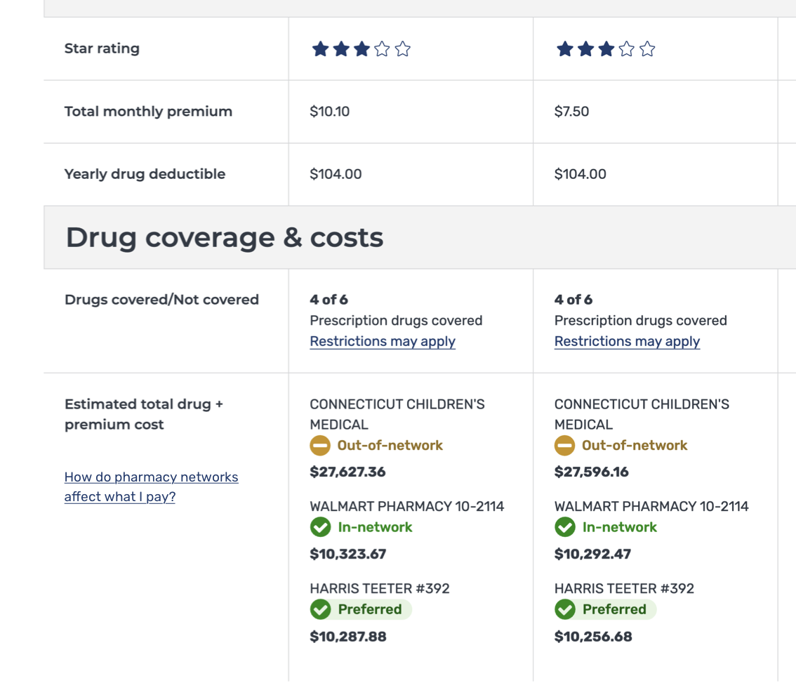
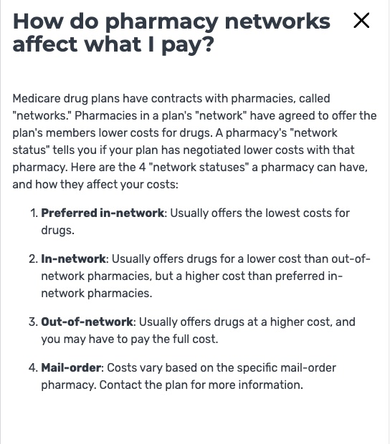
User Interface Updates—Help Drawers
Status: Launched January 5, 2023
Added help drawers to clarify the meaning of pharmacy network labels
Viewable on the logged-in Summary page, Plan Compare, and Plan Details page (anonymous and logged-in)
Notes:
Most people with Medicare were familiar with the concept of in and out-of-network and could infer what that meant for drug costs. Some individuals thought "preferred" referred to a selection they made, as opposed to the plan's recommended pharmacy.
Medicare Plan Finder User Experience considered where and how best to add context about pharmacy network status to clarify what the new labels mean and avoid confusion for people with Medicare.
Help drawers are added to clarify the meaning of pharmacy network labels.
Help drawers are viewable on the logged-in Summary page, Plan Compare and Plan Details page.
This is accessible to both anonymous users and people with Medicare who are logged-in.

Slide 17
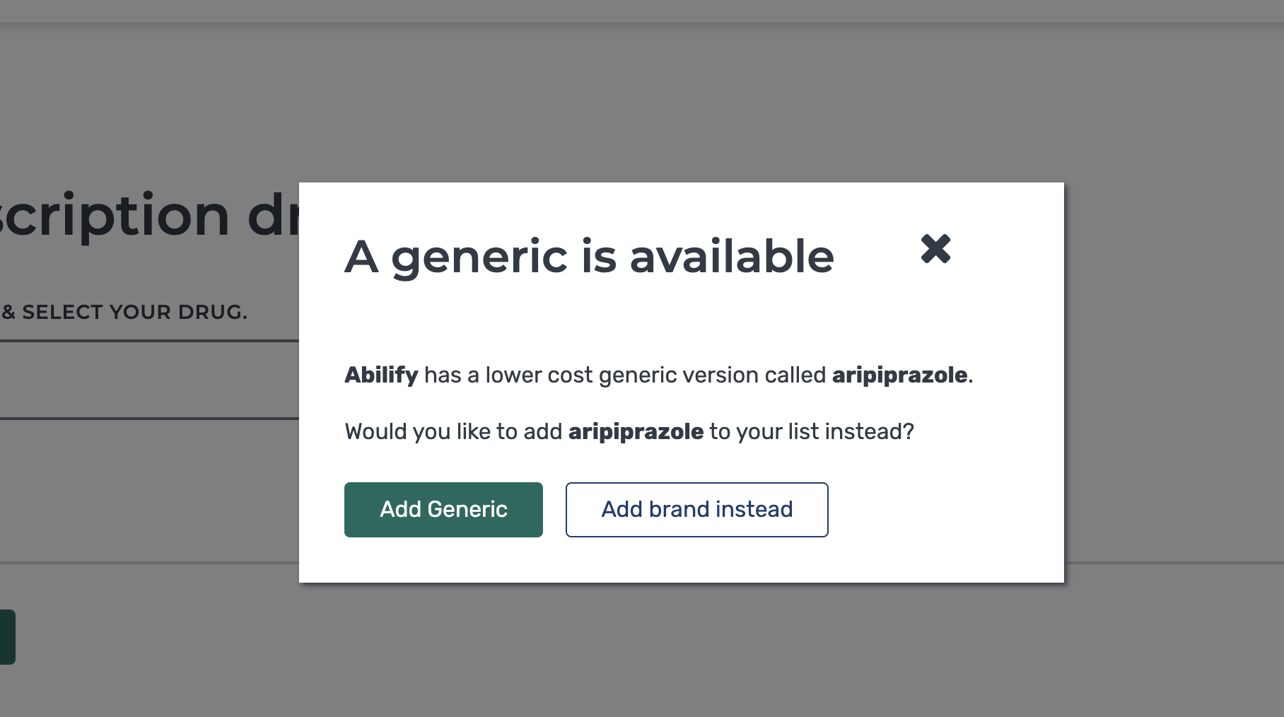
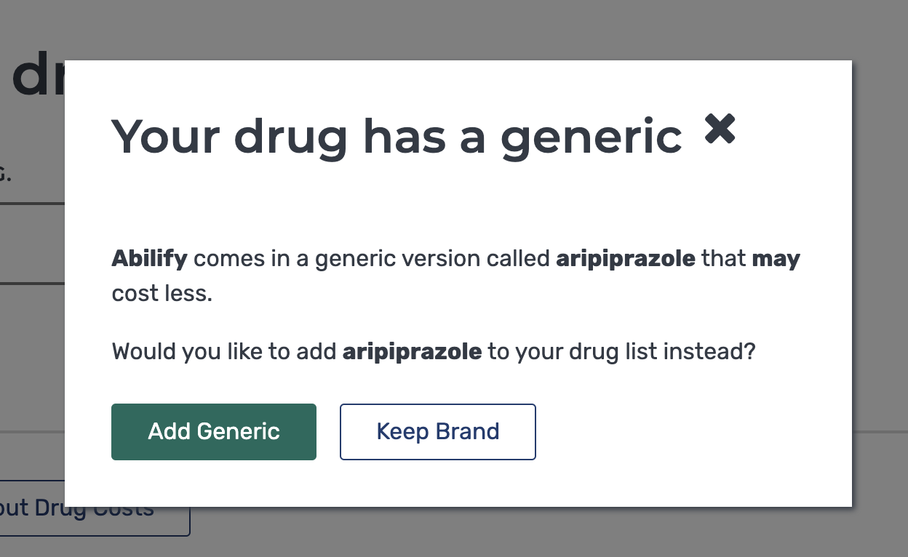
User Interface Updates—Generic Available
Status: Launched February 23, 2023
Updated language used on the generic drug modal to better reflect potential drug costs
Accessible when people with Medicare are adding drugs (anonymous or logged-in)
Notes:
When a person with Medicare adds a brand name drug to their list, a pop up appears encouraging them to switch to a generic for lower costs.
Updated the language used on the generic drug modal that makes individuals aware of the possible lower drug costs without guaranteeing cost is definitively lower.
This is accessible to both anonymous users and people with Medicare who are logged-in.

Slide 18
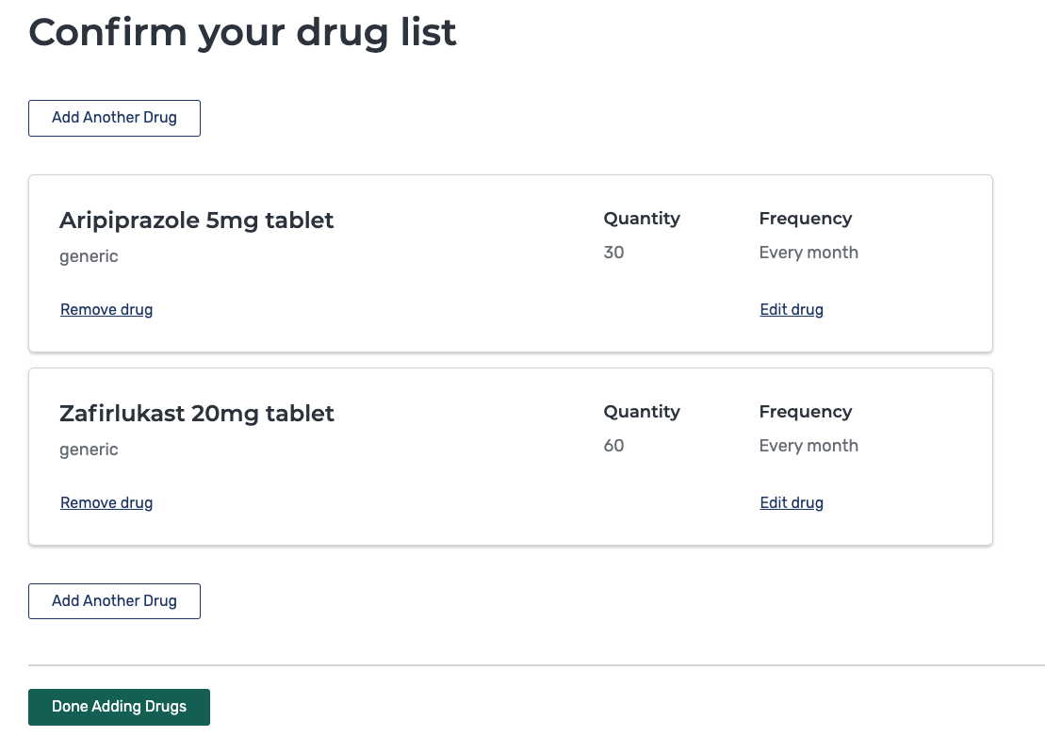
User Interface Updates—Add Another Drug
Status: Launched May 2, 2023
Where a person with Medicare’s drug list is long, CMS has added another ‘add another drug’ button in response to user feedback
Accessible for all users (anonymous, logged-in)
Addition “Add Another Drug” button now displays at the top of the drug lists as a user adds more drugs
Notes:
Considering user feedback CMS added additional ‘add another drug’ button, where a person with Medicare’s drug list is long.
The new button displays at the top of the drug lists as the individual adds more drugs.
This is accessible to both anonymous users and people with Medicare who are logged-in.

Slide 19
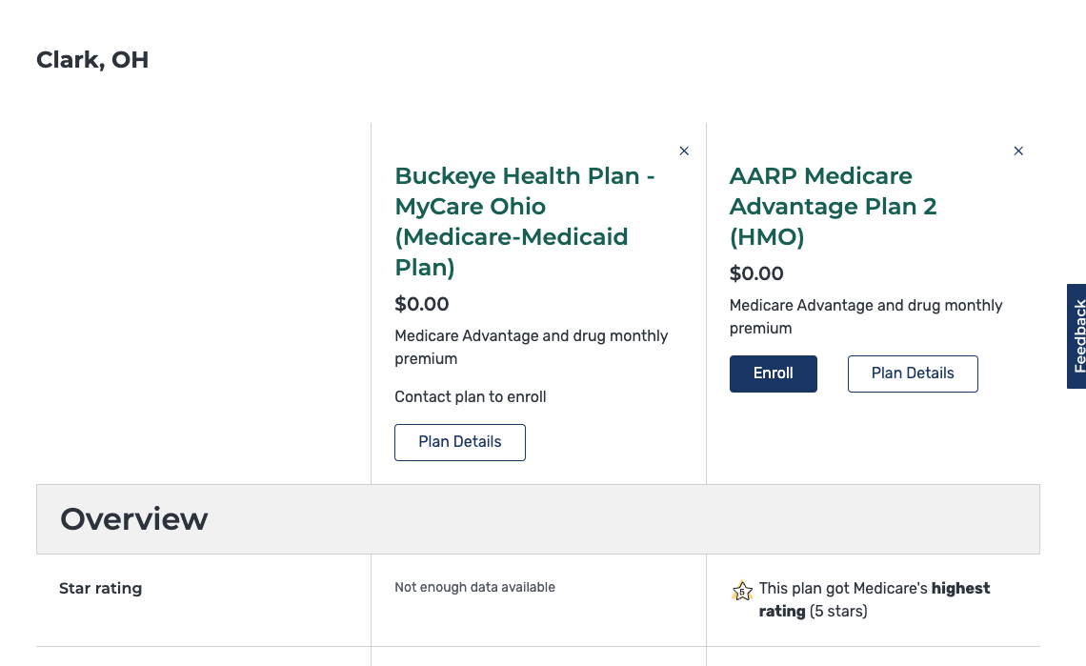
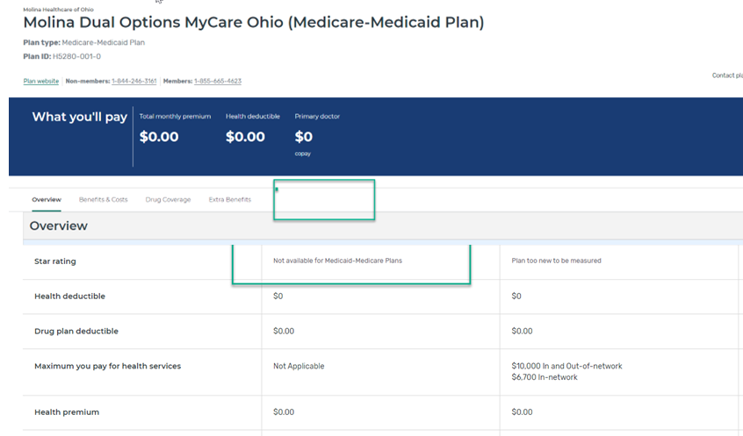
User Interface Updates—Removed Star Ratings from MMP Plan Display
Status: Launched May 24th, 2023
Removed Star Ratings feature from displaying on Medicare-Medicaid Plans (MMPs) who do not participate in the program
Previously, Plan finder would display “Not enough data available” for MMPs
Notes:
Medicare-Medicaid Plans (MMPs) do not participate in star ratings. Previously in Medicare Plan Finder, if you select and scroll through an MMP, you see the full star ratings section with "not enough data available" listed.
Star Ratings feature is removed from displaying on MMPs who do not participate in the program.
Replaced "Not enough data available" with "Not available for Medicaid-Medicare Plans."

Slide 20
User Interface Updates—Removed IRA Footnote
Status: Launching October 1st when CY24 plan information is available
Removed old Inflation Reduction Act messaging and ACIP admin footnote for CY24 plans on the Plan Details page (for anonymous and logged-in)
Removing from Plan Details
Notes:
Part of Inflation Reduction Act changes for CY24, the IRA disclaimer footnote will no longer be needed because the API will return $0 cost-sharing for ACIP vaccines and accurate cost-sharing information for covered insulins.
Old Inflation Reduction Act messaging and ACIP admin footnote is removed for CY24 plans on the Plan Details page.
Removed for CY24 plans on the Plan Details page.
This is accessible to both anonymous users and people with Medicare who are logged-in.

Slide 21
“Find Plans Now” Update
Status: launched on March 23rd, 2023
Previous experience:
After launching the new Landing and Summary page before OE in 2022, we discovered that users were not scrolling and missing the “Apply" button because of the longer Plan Type drop-down menu
New experience:
We removed the drop-down menu and “Apply” button, and replaced it with a 2-step process of entering your ZIP code and then selecting your Plan Type
Notes:
After launching the new Landing and Summary page before Open Enrollment (OE) in 2022, we discovered that users were not scrolling and missing the “Apply" button because of the longer Plan Type drop-down menu.
After OE, we removed the drop-down menu and “Apply” button, and replaced it with a 2-step process of entering your ZIP code and then selecting your Plan Type.

Slide 22
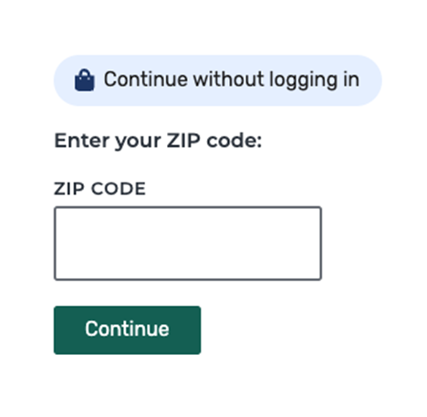
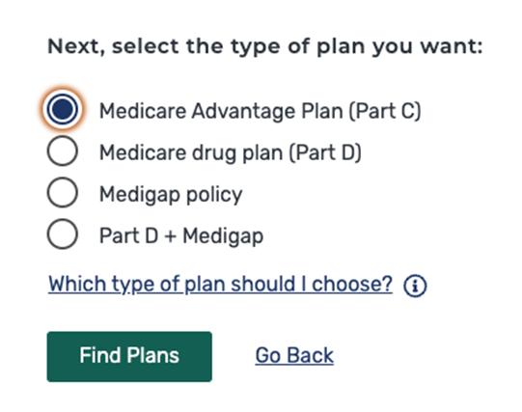
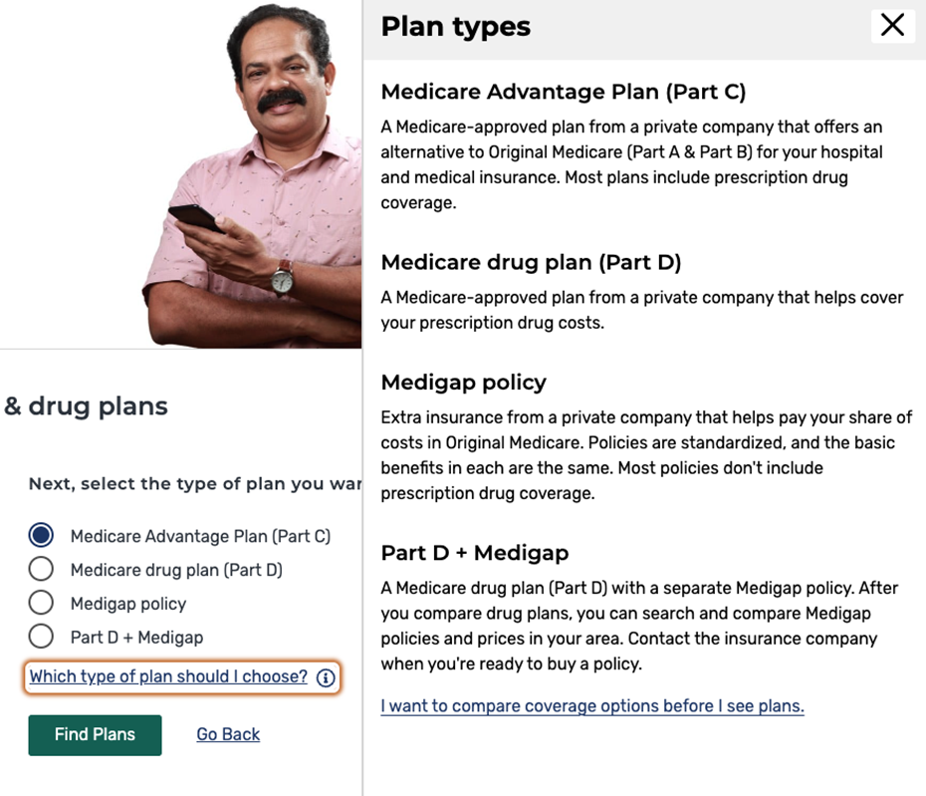
“Find Plans Now” Update—Landing Page
Step 1: A person will input their ZIP code, followed by county code (if applicable)
Step 2: After continuing, person will select their appropriate plan type for their search
If a person wants to learn more about the different plan types, they can click “Which type plan should I choose?” to open a help drawer that contains more information about each plan type
Clicking “I want to compare coverage options before I see plans” will take people through a comparison of Original Medicare and Medicare Advantage with the ZIP already filled out.
Notes:
Find Plans Now on the Landing Page
Left: A person with Medicare will input their ZIP code, followed by county code (if applicable)
Middle: After continuing, the individual will select their appropriate plan type for their search
Right: If a person with Medicare wants to learn more about the different plan types, they can click “Which type plan should I choose?”
Lastly clicking “ I want to compare coverage options before I see plans” will take individuals to the to the comparison of Original Medicare and Medicare Advantage with the ZIP already filled out

Slide 23
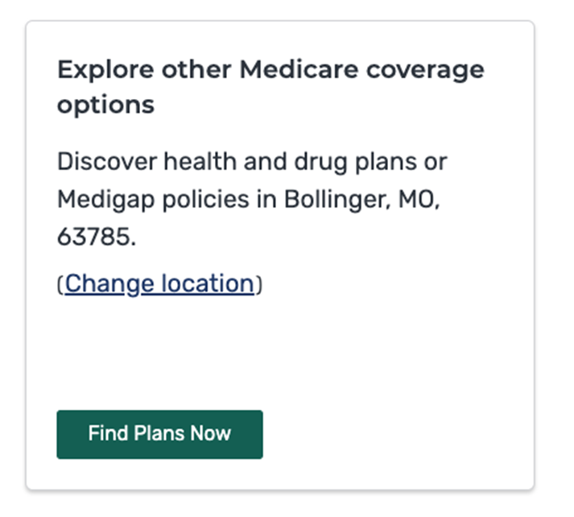
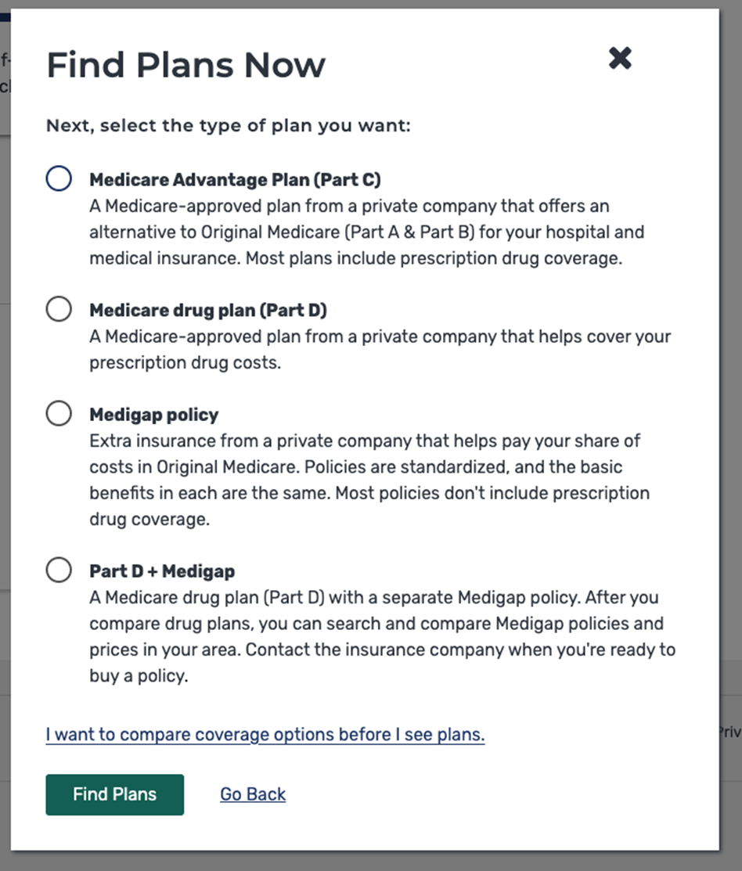
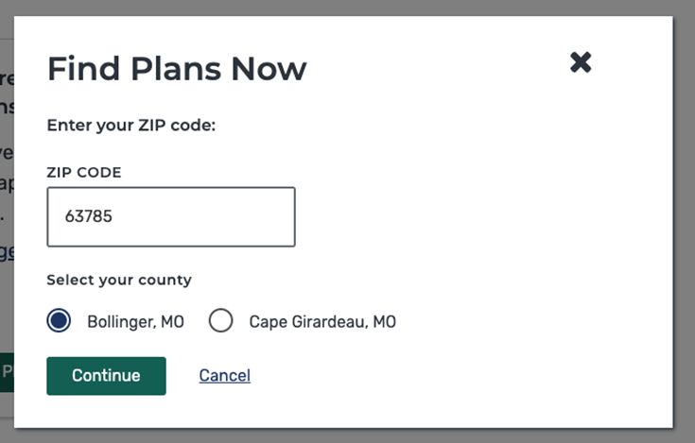
“Find Plans Now” Update—Summary Page
Notes:
“Find Plans Now” on the Summary Page
Left: A person with Medicare will input their ZIP code, followed by county code (if applicable)
Right: Clicking“ I want to compare coverage options before I see plans” will take individuals to the comparison of Original Medicare and Medicare Advantage with the ZIP already filled out

Slide 24
LIS Updates
Status: Launched on June 8th, 2023
Updated Medicare Plan Finder to reflect the LIS statutory copayment amounts until the plan's drug deductible is met for person with Medicare in Low Income Subsidy (LIS) levels 1-3.
Viewable in the Plan Details page (for anonymous and logged-in)
Updated behavior
Previous behavior
Notes:
Medicare Plan Finder was previously not calculating cost-sharing accurately for LIS levels 1-3, and the front end was also hiding the "Cost before deductible" column for these people with Medicare. This has led to a confusing experience for LIS individuals.
Updated Medicare Plan Finder to more accurately reflect what LIS 1-3 individuals will pay for their drugs.
First screenshot is the updated behavior of the drug coverage phases table to show the deductible phase column for people with Medicare with LIS levels 1-3.
Second screenshot is the previous behavior of the drug coverage phases table on the plan details page.
This is accessible to both anonymous users and people with Medicare who are logged-in.

Slide 25
Summary Page Redesign
Status: Launched on July 13th, 2023
Last year, Plan Finder launched the Plan Finder Summary Page, an experience that provides a high-level overview for people with Medicare who are logged-in, to review information related to their coverage. As part of post-launch research some user pain points are identified and UX changes are proposed
New experience:
Summary Page redesign is focused on improving the display of current plan information at the top of the page and making enrollment options more clear and easier to navigate
Notes:
Last year, Plan Finder launched the Plan Finder Summary Page, an experience that provides a high-level overview for people with Medicare who are logged-in, to review information related to their coverage.
As part of research some user pain points are identified and UX changes are proposed.
Summary Page redesign is focused on improving the display of current plan information at the top of the page and making enrollment options more clear and easier to navigate.

Slide 26
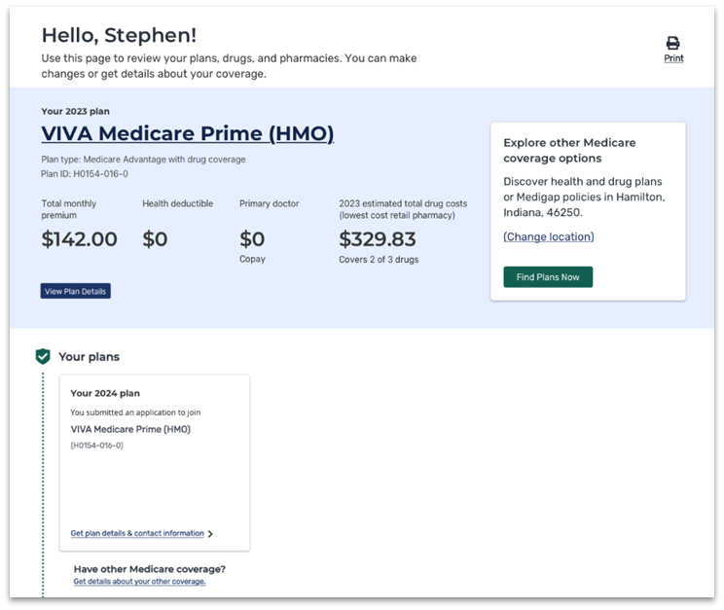
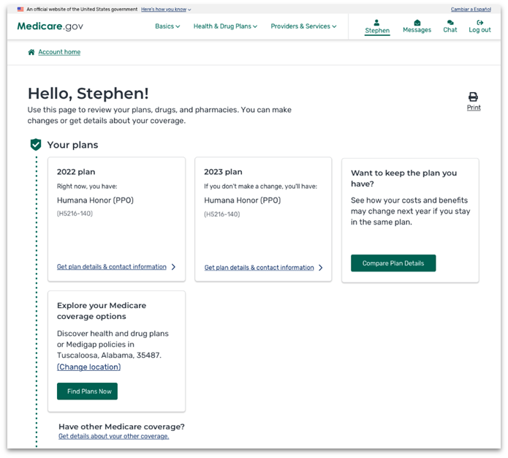
Summary Page Redesign— New Top-of-Page Plan Summary
New Top-of-Page Plan Summary
Reminds the individual of their existing coverage information so they can determine whether to learn more (by clicking View plan details) or to look for new plan.
Notes:
Left: Old Summary Page
Right: New Summary page redesign with top-of-page Summary
New Top-of-Page Plan Summary reminds the person with Medicare of their existing coverage information so they can determine whether to learn more (by clicking View plan details) or to look for a new plan.

Slide 27
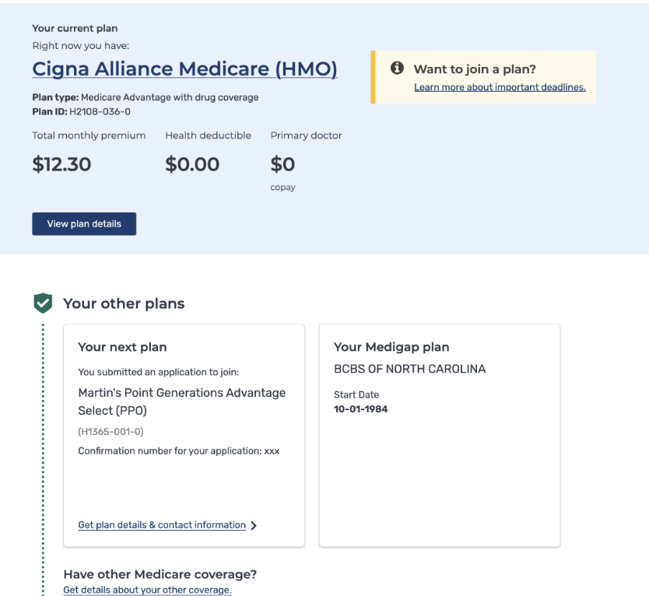
Summary Page Redesign— Displaying Medigap Enrollment
Status: On schedule for October 2023
To align with information displayed on the Medicare Account Home page, Medicare Plan Finder will also be displaying Medigap enrollment information on the Summary Page
A person with Medicare’s Medigap information would display alongside their other existing enrollments on the Summary Page
Notes:
To align with information displayed on the person with Medicare’s Account Home page, Medicare Plan Finder will also be displaying Medigap enrollment information on the Summary Page.
A person with Medicare’s Medigap information would display alongside their other existing enrollments on the Summary Page.

Slide 28
Inflation Reduction Act (IRA) Changes
Status: On schedule for October 2023
Medicare Plan Finder will be updated to account for the following IRA changes:
Part D insulin copay cap
People with Medicare see no more than $35 copay per month supply of covered insulin
Visible via the Plan details page > Estimated Drug cost table
Part B insulin coinsurance cap
People with Medicare will be shown a message related to coinsurance in the drug coverage section > Part B drug table
Notes:
Medicare Plan Finder will be updated to account for the Inflation Reduction Act changes
Part D insulin copay cap
People with Medicare see no more than $35 copay per month supply of covered insulin
Visible via the Plan details page > Estimated Drug cost table
Part B insulin coinsurance cap
People with Medicare will be shown a message related to coinsurance in the drug coverage section > Part B drug table

Slide 29
Inflation Reduction Act (IRA) Changes (continued)
$0 catastrophic phase cost sharing
Visible via the Plan details page > Estimated Drug cost table
People with Medicare see $0 in the cost after coverage cap column for covered drugs
Notes:
$0 catastrophic phase cost sharing
Visible via the Plan details page > Estimated Drug cost table
People with Medicare see $0 in the cost after coverage cap column for covered drugs
The screenshot is for CY24 plan which shows both insulin copay caps and $0 catastrophic.

Slide 30
IRA Changes (continued)
$0 out-of-pocket costs for ACIP-recommended vaccines
Visible via the Plan details page > Estimated Drug cost table
People with Medicare see $0 copays for covered ACIP vaccines
Elimination of LIS partial subsidy status in favor of full subsidy benefits
In 2024, any person with Medicare who qualifies for LIS subsidy will get full subsidy benefits
Notes:
$0 out-of-pocket costs for ACIP-recommended vaccines
Visible via the Plan details page > Estimated Drug cost table
People with Medicare see $0 copays for covered ACIP-recommended vaccines
The screenshot is for CY24 plan which shows both insulin copay caps and $0 catastrophic.
Elimination of LIS partial subsidy status in favor of full subsidy benefits
In 2024, any person with Medicare who qualifies for LIS subsidy will get full subsidy benefits

Slide 31
Extra Help Page Updates
Status: On schedule for October 2023
Background:
Starting in CY2024, the partial subsidy LIS status will be eliminated, and all LIS individuals will receive full subsidy benefits
Medicare Plan Finder still needs to collect information about full vs. partial subsidy to price CY 23 drug costs accurately in case people with Medicare toggle to CY23 plans during routing
New Experience:
CMS will add messaging to the Extra Help page to educate people with Medicare about the upcoming replacement of partial LIS in favor of full LIS
Informational alert message is targeted to reach all individuals who select “Extra Help from Social Security” option during routing on the Extra Help page
Notes:
Starting in CY2024, the partial subsidy LIS status will be eliminated, and all LIS individuals will receive full subsidy benefits.
Medicare Plan Finder still needs to collect information about full vs. partial subsidy to price CY23 drug costs accurately in case people with Medicare toggle to CY23 plans during routing.
CMS will add messaging to the Extra Help page to educate people with Medicare about the upcoming replacement of partial LIS in favor of full LIS.
Informational alert message is targeted to reach all individuals who select “Extra Help from Social Security” option during routing on the Extra Help page.

Slide 32
Extra Help Page Updates (continued)
Modify current “Extra Help from Social Security” question to “Helps people with limited income and resources pay Medicare drug coverage premiums, deductibles, coinsurance, and other costs. Learn about Extra Help.”
Modify current “I’m not sure” question to “Programs are available that can help with your Medicare costs. If you log in, we may be able to see if you already get help from one of these programs. Learn about available programs.”
Add new alert for “I don’t get help from any of these programs” question to “Programs are available for people with limited income and resources to help pay Medicare costs. Learn if you qualify for available programs.”
Notes:
Modify current “Extra Help from Social Security” question to “Helps people with limited income and resources pay Medicare drug coverage premiums, deductibles, coinsurance, and other costs. Learn about Extra Help.”
Modify current “I’m not sure” question to “Programs are available that can help with your Medicare costs. If you log in, we may be able to see if you already get help from one of these programs. Learn about available programs.”
Add new alert for “I don’t get help from any of these programs” question to “Programs are available for people with limited income and resources to help pay Medicare costs. Learn if you qualify for available programs.”

Slide 33
Q&A
To submit a question, select the Q&A icon on your Zoom control bar.
Notes:
To submit a question, select the Q&A icon on your Zoom control bar.

Slide 34
Using the Medicare Plan Finder for Drug Coverage this Open Enrollment Period (OEP) Mary McGeary Director-State Health Insurance Assistance Program NJ Department of Human Services

Slide 35
Information & Help in the Open Enrollment Period (OEP)
Medicare.gov
Medicare Plan Finder at Medicare.gov/plan-compare
1-800-MEDICARE (1-800-633-4227); TTY: 1-877-486-2048
Customer service assistance for choosing a plan & enrolling
Available 24 hours a day, 7 days a week (closed Thanksgiving Day)
Language line interpreters for more than 200 languages
State Health Insurance Assistance Programs (SHIPs)
Provides free personalized help in your local area
Call 1-877-839-2675 to get phone number for your state
shiphelp.org
Notes:
You can get help during Open Enrollment through the Medicare.gov homepage or directly by visiting Medicare.gov/plan-compare. You can also call 1-800-MEDICARE; TTY: 1-877-486-2048 for assistance with your Medicare account.

Slide 36
Can also use the “Chat” link on Medicare.gov
Found on top of every page, for on-line help

Slide 37
Medicare.gov Homepage
Notes:
Note: This homepage will display starting on Oct 1.

Slide 38
What is the Medicare Plan Finder?
An online searchable tool on the official government Medicare.gov website
Available for users logged in to their Medicare Account (best experience) and for guest users
Allows users to compare Medicare health and drug plan options
Medicare Advantage Plans
Medicare drug plans
Provides detailed information on coverage, costs, and benefits of different plan options in your area based on your prescriptions
Visit Medicare.gov/plan-compare to find plans in your area
Notes:
Each plan can vary in cost and specific drugs covered. Visit Medicare.gov/plan-compare to find and compare plans in your area.

Slide 39
What You Need Before You Get Started
ZIP code
List of prescription drugs with dose
Pharmacy preferences
Login information if have a Medicare Account
Other helpful information
Medicare card (Medicare Number)
Other health or drug insurance cards
Information about any assistance programs you use (Medicaid, Extra Help (also known as Low Income Subsidy (LIS)), State Pharmacy Assistance Program)
Notes:
It’s helpful to have the necessary information before you start using the Medicare Plan Finder. You can use the Plan Finder yourself, or you can assist another as a counselor or caregiver in using the search tool. Be sure to have personal information like ZIP code, pharmacy, login and Medicare information on-hand.

Slide 40
Plan Finder Steps
Enter personal information
Enter/review drugs by name, dose, and quantity
Select pharmacies
Review search results
Compare plans using default sort (total cost)
Review plan details
Identify the lowest-cost plan options
Save or print plan details
Enroll

Slide 41
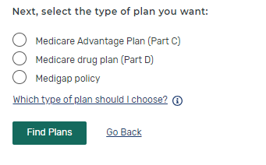
Medicare Plan Finder Home Page
Choose type of plan to review
Log into Medicare account or create an account
3
Or continue without logging in and enter zip code
1
2
Notes:
Here’s the Plan Finder landing page. Note that you’re still on Medicare.gov—this is part of that website, not a different one. You can choose to login or browse plans by ZIP code and plan type. For step “Choose type of plan to review”, you will have several options, including Medigap Policy. For comparing drug prices, you need to start with either Medicare Advantage or Part D Plan.

Slide 42
Things to Consider
Can’t save drug list if you “continue without logging in”
Will be able to see plan and coverage information to make an enrollment choice
To save the drug list, you must login or create a Medicare Account
Doing this will show your drugs filled in the last 12 months
You need to update it with any new drugs/dosages
Can view current plan and subsidy information
Notes:
You won’t be able to save or access your drug list unless you login. If you create and use your Medicare account, you can save your drug list and will be able to view and compare your current coverage to your enrollment choices.

Slide 43
Question on “Extra Help”
Notes:
Identify any help you get paying your Medicare costs.

Slide 44
Search Preferences—Drug Costs
Always select “Yes” if entering drugs
Notes:
To find the best plan options for you, you’ll want to consider how much you’ll pay for your drugs in each plan. Select “Yes” to see your drug costs when you compare plans.

Slide 45
Edit Drug List if Logging into Medicare Account
Notes:
If you have a drug list, you may need to update it to remove prescriptions you no longer need or add new ones. You can also automatically add drugs that were recently paid for by Medicare using the “Add recently filled drugs” button.

Slide 46
If Logging into Account Adding Drugs from Claims Data
Notes:
If you log in to your Medicare Account, the Medicare Plan Finder can suggest drugs to add that were recently paid for via claims activity.

Slide 47
Entering Drugs if not Using Medicare Account
Type in the drug name in the box
Or you can search for the name of drug by first letter
A
B
Don’t enter over-the-counter drugs or drugs covered by Medicare Part B (Medical Insurance)
Notes:
To enter new drugs, you can type or use the browse function. Only include drugs covered by Medicare Part D. Don’t add any over-the-counter medications or drugs paid for by Medicare Part B (Medical Insurance).

Slide 48
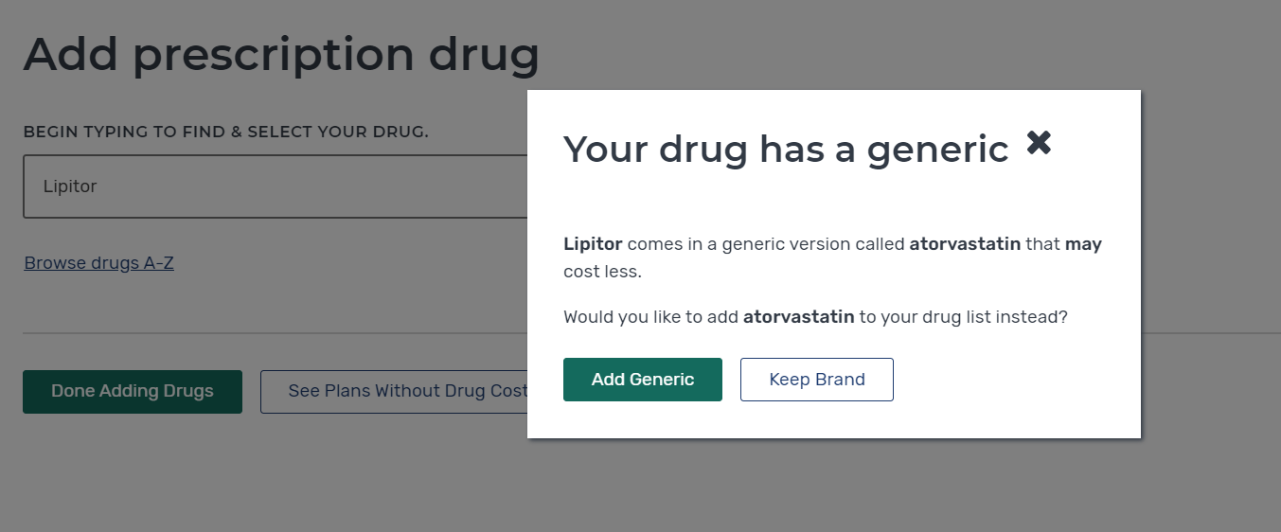
Pop Up—Generic or Brand Name Drug Used?
Notes:
The Plan Finder will automatically alert you to possible generics as you enter brand-name drugs.

Slide 49
Enter the Drug Dosage
Adjust Dosage
Then select “Add to My Drug List”
1
2
Notes:
Select the appropriate dosage, desired quantity, and frequency to complete your drug list addition.

Slide 50
Tip—Letters Included with Drug Dose are Important
Shown on medicine bottle as 100mg ER
Notes:
If you’re uncertain about the dosage, check the prescription bottle for specifics.

Slide 51
Add Additional Medications
Select “Find and Add Drug” to add any additional medications
Select “Done Adding Drugs” after all medications have been entered.
A
B
Enter all drugs with same refill frequency (monthly or every 3 months) for best results
Notes:
Continue adding medicines to your drug list until it’s complete.

Slide 52
Select Pharmacies
Include some retail chains to see preferred pharmacy pricing
Notes:
Next, select your pharmacy preferences. You can use a mile radius to view options close to you. Be sure to include some retail chain options to see preferred pharmacy pricing.

Slide 53
View Results
NOTE: During OEP Plan Finder will show costs for a full year. If comparing after January, the costs shown will be calculated for the remaining months of the year.
Notes:
In the plan results, note the yearly drug and premium cost. This will provide you a good estimate of your costs for a full year. While viewing during OEP, you’ll see the full year cost. If you search after January, the costs will be adjusted to show the total only for the remaining months of the calendar year.

Slide 54
Filter Drug Plan List if Desired
Select “add to compare”
Notes:
You can also use filter options to help narrow your search. For example, you can search by “Insurance Carrier” or “Star Ratings”. Select the box next to “Add to compare” to see that plan in a side-by-side comparison for up to 3 plans.

Slide 55
Compare Plans Side-by-Side
Review total cost at different pharmacies
Notes:
Ensure all your drugs are covered on the plans’ formularies. Review the total costs when using the pharmacy options you selected. Make note of the lowest yearly cost and pharmacy options.

Slide 56
Estimated Total DRUG + Premium Cost
Includes all of the following:
Yearly premium
Annual deductible
Drug costs before the deductible is met
Drug costs after the deductible and before the gap (Initial Coverage Phase)
Drug costs during the Coverage gap (Donut Hole)
Drug costs after the gap (Catastrophic Coverage phase)
Costs of any non-formulary drugs you will need to purchase

Slide 57
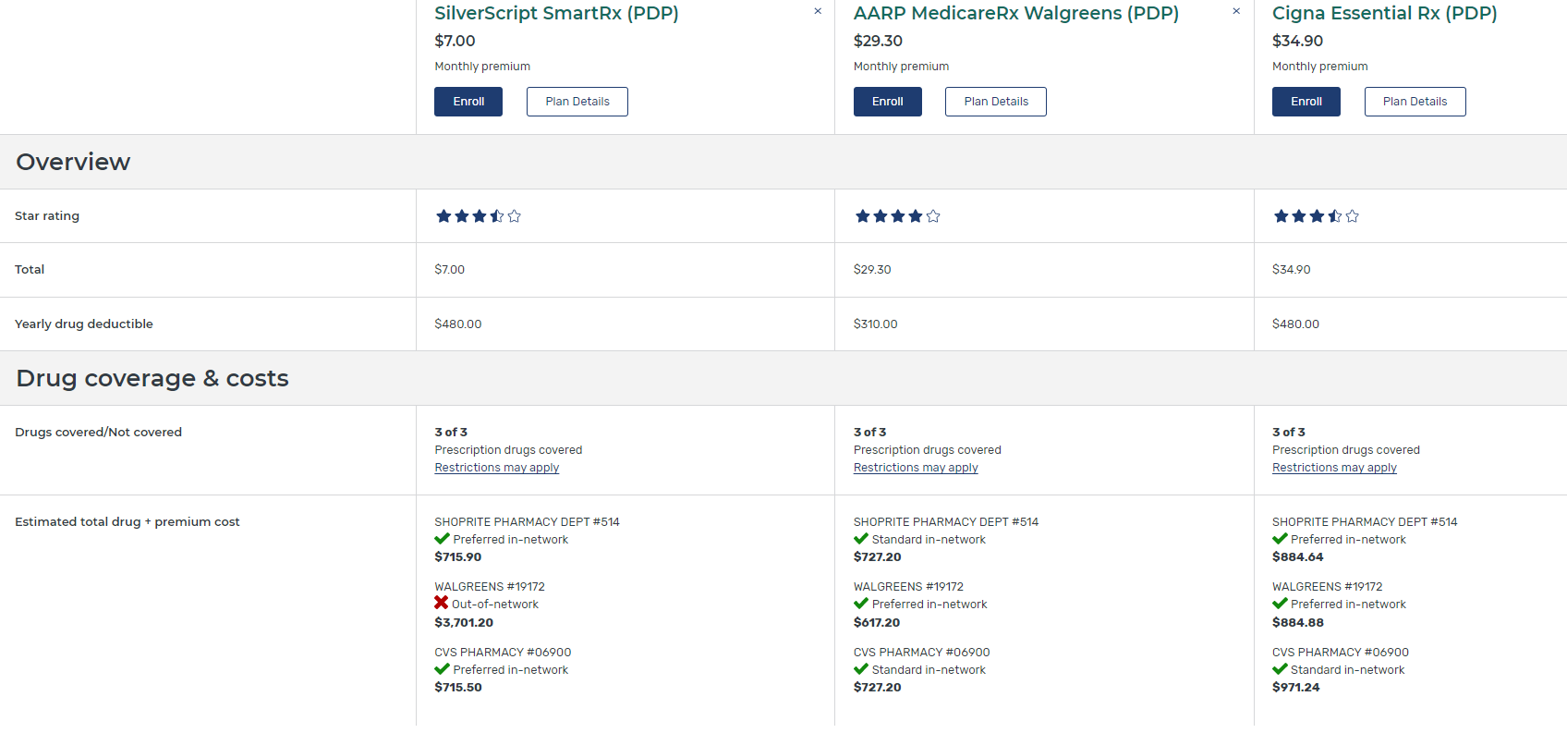
View Plan Details Page
Notes:
From the plan comparison screen, you can still access the plan details of any particular plan by selecting the “Plan Details” button. Note that on this page, the estimated price is only for total drug costs. It does not include the premium.

Slide 58
Plan Details—Yearly Costs
*
Notes:
Total drug costs can vary greatly depending on which pharmacy you use. Check “Yearly Drug Costs by Pharmacy” as well as the “Estimated Total Drug + Premium Cost.”

Slide 59
Plan Details—Look for Months When Costs Change
ESTIMATED TOTAL DRUG + PREMIUM COST
 | CVS Pharmacy #07656 Preferred | Walgreens #11313 In-network
Total yearly drug + premium cost | $942.84 | $995.50
When you’ll meet your deductible | February 2024 | February 2024
When you’ll enter the coverage gap | October 2024 | October 2024
When you’ll get out of the coverage gap | You won’t get out of the coverage gap in 2024 | You won’t get out of the coverage gap in 2024
Notes:
In the “Plan Details” section, check to see which months your costs change. For example, check to see which month you will meet your yearly deductible (if your plan has one). If you take insulin, the deductible won’t apply to the cost of your insulin.

Slide 60
Can Choose to Show Only Preferred Pharmacies for a Specific Plan by Clicking “Change Pharmacies”
NOTE: Some plans do NOT have Preferred Pharmacies. Offer best price at all standard network pharmacies.
Notes:
When selecting your pharmacies, you can use the selection box to see only the “preferred in-network pharmacies” options. Using preferred pharmacies, will result in lower out-of-pocket costs.

Slide 61
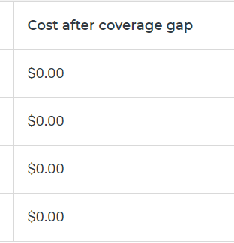
Plan Details—Estimated Costs During Coverage Phases
Click + to expand the info
New benefit for 2024
Notes:
Expand the name of the pharmacy to see how costs will change in the different benefit phases. New for 2024- all covered drugs will have $0 copay in the Catastrophic phase.

Slide 62
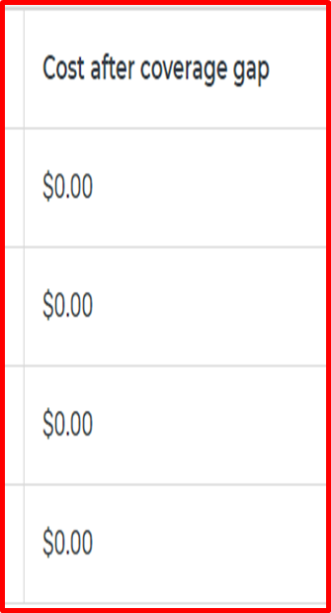
Plan Details—View Plan Cost by Drug Tier
2023
Notes:
Plans have lists of covered drugs, called formularies. The formularies are tiered, with different cost-sharing amounts on different tiers. Plans can arrange medications on different tier levels. The amount you pay for a drug could be more in one plan if that drug is on a more expensive tier than it is in a different plan.

Slide 63
Plan Details—View Other Drug Information
Notes:
Plans can also have prior authorization, quantity limits, and step therapy requirements for drugs on their formulary. Review the details for each drug on your drug list so you’re aware of any of these requirements before selecting the plan.

Slide 64
Can Edit Drug List
Notes:
Even after you’ve begun your comparison, you can always go back to your drug list and make edits.

Slide 65
Plan Details—Star Ratings
Notes:
Members rate Medicare health and drug plans based on quality and customer service. You can view each plan’s star ratings on a variety of categories to consider overall value.

Slide 66
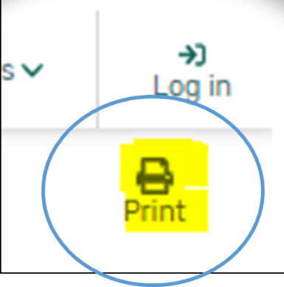
Printing Plan Finder Results
Notes:
If you’re not ready to select a plan yet and would like to save and print your results, you can do so by using the “Print” icon from the plan comparison screen.

Slide 67
Tip for Printing Plan Finder Results
Set “Scale” to 67-75% to reduce number of pages printed
Notes:
If you want to reduce the number of pages printed, adjust the “Scale” to 67–75%.

Slide 68
Saving Plan Finder Results
Save as PDF, instead of sending to a printer.
Notes:
Instead of printing, you can also save the results as a PDF.

Slide 69
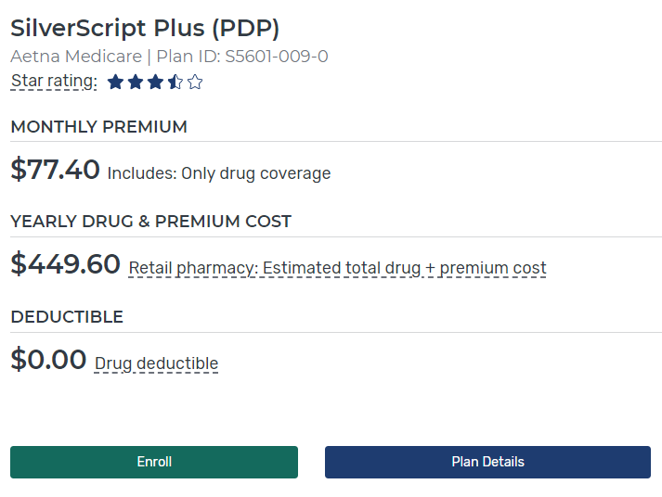
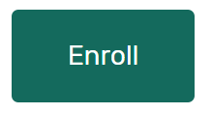
Enroll in a Plan
Select the best plan for you considering quality, costs, and coverage
Plan Results Page
Plan Details Page
Plan Compare Page
Over the phone with plan
Green ENROLL buttons found on multiple pages
Notes:
If you’re ready to enroll, the Plan Finder has “enroll” buttons on several screens or you can always contact the plan directly.

Slide 70
Enroll in a Plan (continued)
Complete the enrollment form
When completed you’ll get a confirmation number and, if you’re logged in, a confirmation email
Print confirmation page or copy the number for proof of enrollment
Notes:
Make sure you complete the entire enrollment form. When you submit it, you’ll get a confirmation number, as well as a confirmation email. Print the confirmation page or save the number for proof of enrollment.

Slide 71
After You Enroll
New plan will start January 1 if enrolling during the OEP
No need to take action to disenroll from prior Part D or Medicare Advantage Plan
SHIP Counselors: Remember to complete “Beneficiary Contact Form” in STARS and check both “plans compare” and “enrollment” under Topics Discussed!
Notes:
Your new plan’s coverage starts on January 1. Plans will mail out membership materials. The act of enrolling in a new plan automatically disenrolls you from any prior plans.
However, the first time you use your new Medicare plan, you should come to the pharmacy/provider with as much information as possible, especially if you need to use your new coverage before you get a plan membership card. Here’s what you need to bring to the pharmacy:
Your red, white, and blue Medicare card
A photo ID
You can bring an acknowledgement or confirmation letter from the plan if you have one, or an enrollment confirmation number from the plan
NOTE: Only confirmation numbers from the plan will work, not those from Medicare’s Online Enrollment Center at Medicare.gov. If you haven’t gotten a plan membership card or any plan enrollment materials, let the provider/pharmacist know the name of the Medicare health or drug plan you joined. If you qualify, bring your Medicaid card (if you have one), or a letter from your state Medicaid Program, or Social Security that shows you’re eligible for Extra Help (a Medicare Program to help people with limited income and resources pay Medicare drug costs).
If you’re a SHIP counselor assisting a person with Medicare who just enrolled, be sure to complete the Beneficiary Contact Form in STARS.

Slide 72
10-Minute Break
Notes:
Start this countdown timer after you announce a break.

Slide 73
Medicare Advantage Plans on Medicare Plan Finder

Slide 74
Switch from Stand Alone Drug Plan Search to Medicare Advantage Search from Results Page

Slide 75
Medicare Advantage Results Page

Slide 76
Filter Plan List if Desired 2

Slide 77
Compare Side-by-Side Up to 3 Plans

Slide 78
Medicare Advantage Plan Details Page

Slide 79
Medicare Advantage Plan Details Page (continued)
Check with the plan to see if deductible applies to in-network or out-of-network health services.

Slide 80
Plan Details Page—Benefits & Costs Tab

Slide 81
Plan Details Page—Extra Benefits Tab
Check plan documents to see details on the limits

Slide 82
Plan Details Page—“Optional Packages” Tab May Also Show

Slide 83
Plan Rating

Slide 84
See Plan’s Website for More Details
Once on plan’s website search for plan document called “SUMMARY OF BENEFITS”

Slide 85
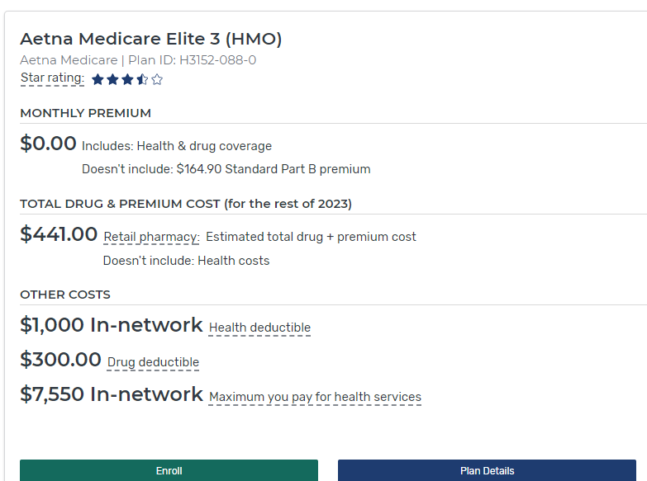
Enroll in a Plan
Select the best plan for you considering quality, costs, and coverage
Plan Results Page
Plan Details Page
Plan Compare Page
Over the phone with plan
Green ENROLL buttons found on multiple pages
Notes:
If you’re ready to enroll, the Plan Finder has “enroll” buttons on several screens or you can always contact the plan directly.

Slide 86
After You Enroll
New plan will start January 1 if enrolling during the OEP
No need to take action to disenroll from prior Part D or Medicare Advantage Plan
Remind client: You can change Medicare Advantage Plans or return to Original Medicare during Medicare Advantage Open Enrollment Period, January 1 – March 31.
SHIP Counselors: Remember to complete “Beneficiary Contact Form” in STARS and check both “plans compare” and “enrollment” under Topics Discussed!
Notes:
Your new plan’s coverage starts on January 1. Plans will mail out membership materials. The act of enrolling in a new plan automatically disenrolls you from any prior plans.
However, the first time you use your new Medicare plan, you should come to the pharmacy/provider with as much information as possible, especially if you need to use your new coverage before you get a plan membership card. Here’s what you need to bring to the pharmacy:
Your red, white, and blue Medicare card
A photo ID
You can bring an acknowledgement or confirmation letter from the plan if you have one, or an enrollment confirmation number from the plan
NOTE: Only confirmation numbers from the plan will work, not those from Medicare’s Online Enrollment Center at Medicare.gov. If you haven’t gotten a plan membership card or any plan enrollment materials, let the provider/pharmacist know the name of the Medicare health or drug plan you joined. If you qualify, bring your Medicaid card (if you have one), or a letter from your state Medicaid Program, or Social Security that shows you’re eligible for Extra Help (a Medicare Program to help people with limited income and resources pay Medicare drug costs).
If you’re a SHIP counselor assisting a person with Medicare who just enrolled, be sure to complete the Beneficiary Contact Form in STARS.

Slide 87
Q&A
To submit a question, select the Q&A icon on your Zoom control bar.
Notes:
To submit a question, select the Q&A icon on your Zoom control bar.

Slide 88
The Inflation Reduction Act (IRA) Kristi Martin Senior Advisor Office of the Administrator Center for Medicare
Notes:
This section provides information about changes resulting from the Inflation Reduction Act.
The new law makes improvements to Medicare that will expand benefits, lower drug costs, and improve the sustainability of the Medicare program for generations to come. The law provides meaningful financial relief for millions of people with Medicare by improving access to affordable treatments and strengthening Medicare, both now and in the long run.

Slide 89
Inflation Reduction Act (IRA) CMS Provisions
Places a $35 monthly out-of-pocket cap on Medicare-covered insulins
Makes ACIP-recommended vaccines free under Medicare Part D prescription drug coverage
Temporarily increases Medicare payment for qualifying biosimilars to encourage use
Requires manufacturers to pay rebates to Medicare if their price increases for certain drugs exceed inflation
Makes Medicare Part D prescription drug coverage more affordable
Notes:
This slide has animation
Inflation Reduction Act of 2022 (IRA) was signed into law on August 16, 2022. Among many other provisions, this landmark legislation will meaningfully lower health care costs for people across the country. In summary, IRA provisions relevant to CMS programs include:
Places a $35 monthly out-of-pocket cap on Medicare-covered insulins
Makes ACIP-recommended vaccines free under Medicare Part D prescription drug coverage
Temporarily increases Medicare payment for qualifying biosimilars to encourage use
Requires manufacturers to pay rebates to Medicare if their price increases for certain drugs exceed inflation
Makes Medicare Part D prescription drug coverage more affordable
(continued on following slide)

Slide 90
Inflation Reduction Act CMS Provisions (continued)
2024: People with very high prescription drug costs will no longer pay once they reach the “catastrophic phase”
2024: Full low-income subsidy expanded for people with low incomes, lowering premiums and out-of-pocket costs for their prescription drug coverage
2025: All people with Medicare Part D will have a $2,000 annual out-of-pocket cap on their drug costs
2026: Allows Medicare to negotiate the price of certain high-cost, brand name prescription drugs
Notes:
This slide has animation
In summary, IRA provisions relevant to CMS programs include (continued from previous slide):
2024: People with very high prescription drug costs will no longer pay once they reach the “catastrophic phase”
2024: Full low-income subsidy expanded for people with low incomes, lowering premiums and out-of-pocket costs for their prescription drug coverage
2025: All people with Medicare Part D will have a $2,000 annual out-of-pocket cap on their drug costs; the annual cap on Part D OOP costs is $2,000 only in 2025. Thereafter, the cap will increase each year based on the annual percentage increase in average per capita aggregate expenditures for covered Part D drugs
Allows Medicare to negotiate the price of certain high-cost, brand name prescription drugs

Slide 91
Drug Inflation Rebates in Medicare
Requires drug companies that raise prices for certain products faster than the rate of inflation to pay Medicare Part B or Part D a rebate
Rebates calculated quarterly (Part B) or annually (Part D)
Liability for rebates began as of October 1, 2022 for Part D and as of January 1, 2023 for Part B
Lower out-of-pocket costs under Part B: this quarter (July 1 - Sept. 30), beneficiaries will pay reduced inflation-adjusted coinsurance rates for 43 Part B rebatable drugs
Notes:
This slide has animation
Requires drug companies that raise prices for certain products faster than the rate of inflation to pay Medicare Part B or Part D a rebate
Rebates calculated quarterly (Part B) or annually (Part D)
Liability for rebates began as of October 1, 2022 for Part D and as of January 1, 2023 for Part B
Lower out-of-pocket costs under Part B: this quarter (July 1 - Sept. 30), beneficiaries will pay reduced inflation-adjusted coinsurance rates for 43 Part B rebatable drugs
Recent stats for the latest quarter are available at CMS.gov/files/document/reduced-coinsurance-part-b-rebatable-drugs-6823.pdf

Slide 92
Drug Inflation Rebates in Medicare (continued)
Requires CMS to monitor drug prices during the applicable period, compare them to the benchmark price (adjusted for inflation), make adjustments in certain cases (e.g. drugs shortages), and invoice manufacturers for the remaining difference
In each case, we are to identify and exclude 340B units from rebate billings (starting January 1, 2023 for Part B and January 1, 2026 for Part D). This is to avoid manufacturers paying a Medicare inflation rebate and a 340B discount on the same drug.
Under the Medicare Part B Drug Inflation Rebates, beginning April 1, 2023, if the Medicare payment amount for a calendar quarter exceeds the inflation-adjusted payment amount, beneficiary coinsurance is equal to 20% of the inflation-adjusted payment amount
Notes:
This slide has animation
Requires CMS to monitor drug prices during the applicable period, compare them to the benchmark price (adjusted for inflation), make adjustments in certain cases (e.g. drugs shortages), and invoice manufacturers for the remaining difference
In each case, we are to identify and exclude 340B units from rebate billings (starting January 1, 2023, for Part B and January 1, 2026, for Part D). This is to avoid manufacturers paying a Medicare inflation rebate and a 340B discount on the same drug
Under the Medicare Part B Drug Inflation Rebates, beginning April 1, 2023, if the Medicare payment amount for a calendar quarter exceeds the inflation-adjusted payment amount, beneficiary coinsurance is equal to 20% of the inflation-adjusted payment amount

Slide 93
Part D Improvements
Redesigns the Part D benefit and revises its parameters as follows:
People with very high prescription drug costs will no longer pay once they reach the “catastrophic phase”
Provides for Part D premium stabilization beginning in 2024, by capping base beneficiary premium increases per year to no more than 6% through 2029
Notes:
This slide has animation
Redesigns the Part D benefit and revises its parameters as follows:
People with very high prescription drug costs will no longer pay once they reach the “catastrophic phase”
Provides for Part D premium stabilization beginning in 2024, by capping base beneficiary premium increases per year to no more than 6%

Slide 94
Part D Coverage of Adult Vaccines Recommended by the Advisory Committee on Immunization Practices (ACIP)
Requires Part D sponsors to eliminate the deductible and other cost sharing with respect to the ACIP-recommended adult vaccines
IRA requires a temporary subsidy payment to Medicare plans during 2023, to cover deductible or cost-sharing amounts that beneficiaries otherwise would have paid but for the IRA for ACIP-recommended adult vaccines and Part D insulin
In 2023, the deductible or cost-sharing amounts that beneficiaries otherwise would have paid but for the IRA will count toward the beneficiary's incurred costs
Effective Date: January 1, 2023
Notes:
This slide has animation
Requires Part D sponsors to eliminate the deductible and coinsurance or other cost sharing with respect to the ACIP-recommended vaccines
IRA requires a temporary subsidy payment to Medicare health and drug plans during 2023, for the reduction in cost sharing and deductible for ACIP recommended adult vaccines
In 2023, the cost sharing amounts, including deductible, paid by the Part D plans count toward incurred costs for people with Medicare
Effective Date: January 1, 2023

Slide 95
Improving Access to Adult Vaccines Under Medicaid & CHIP
State Medicaid and CHIP programs will be required to provide coverage for approved adult vaccines recommended by the ACIP (and their administration) without cost sharing
Effective Date: October 1, 2023 (the first day of the first fiscal quarter that begins on or after the date that is one year after enactment)
Notes:
This slide has animation
Section 11405 of the IRA requires states to cover approved vaccines recommended by the Advisory Committee on Immunization Practices (ACIP) and such vaccines’ administration, with no cost sharing, for most adult Medicaid beneficiaries. It also provides states that were covering such vaccines as of the date of enactment with an additional eight-quarters of the one percentage point FMAP increase made available under current law (and described above). The FMAP increase is applicable to a state’s regular FMAP and the Newly Eligible FMAP for such vaccines and their administration.
States are also required to cover such vaccines and their administration, with no cost sharing, for individuals who are 19 years of age or older in CHIP (i.e., pregnant and postpartum individuals covered by CHIP).
Effective Date: October 1, 2023 (the first day of the first fiscal quarter that begins on or after the date that is one year after enactment).
For additional guidance, review State Health Official letter #23-003 at Medicaid.gov/federal-policy-guidance/downloads/sho23003.pdf.

Slide 96
Expansion of Extra Help
Beginning January 1, 2024, nearly 300,000 low-income people with Medicare currently enrolled in the Extra Help program will be newly eligible for expanded benefits including no deductible, no premiums and fixed, lowered copayments for certain medications. An additional 3 million people could benefit from the Extra Help program now but aren’t currently enrolled
Expands eligibility for the full low-income subsidy (LIS) benefit (also known as “Extra Help”) to individuals with limited resources and incomes up to 150% of the federal poverty level
People with Medicare who are currently enrolled in partial Extra Help will automatically be converted to full Extra Help; they won’t need to take any action
Notes:
This slide has animation
Beginning January 1, 2024, nearly 300,000 low-income people with Medicare currently enrolled in the Extra Help program will be newly eligible for expanded benefits including no deductible, no premiums and fixed, lowered copayments for certain medications. An additional 3 million people could benefit from the Extra Help program now but aren’t currently enrolled
Expands eligibility for the full low-income subsidy (LIS) benefit (also known as “Extra Help”) to individuals with limited resources and incomes up to 150% of the federal poverty level
People with Medicare who are currently enrolled in partial Extra Help will automatically be converted to full Extra Help; they won’t need to take any action

Slide 97
Insulin & Medicare Coverage
The cost of a month’s supply of each covered insulin product is currently capped at $35, and you don’t have to pay a deductible for insulin
As of January 1, 2023, people enrolled in a Medicare prescription drug plan won’t pay more than $35 for a month’s supply of each insulin covered by their Medicare prescription drug plan and dispensed at a pharmacy or through a mail-order pharmacy. Also, Part D deductibles no longer apply to the covered insulin product
As of July 1, 2023, for insulin (delivered through a durable medical equipment pump) covered by Part B and Medicare Advantage Plans
If you get a 60- or 90-day supply of insulin, your costs can’t be more than $35 for each month’s supply of each covered insulin
If you use a covered insulin product you can add, drop, or change your Part D coverage one time between now and December 31, 2023
If you change plans mid-year, your TrOOP costs will carry over from one plan to the next
Call 1-800-MEDICARE if you take insulin and want to change your plan
Notes:
This slide has animation
The cost of a month’s supply of each covered insulin product is capped at $35, and you don’t have to pay a deductible for insulin
As of January 1, 2023, people enrolled in a Medicare prescription drug plan won’t pay more than $35 for a month’s supply of each insulin covered by their Medicare prescription drug plan and dispensed at a pharmacy or through a mail-order pharmacy. Also, Part D deductibles no longer apply to the covered insulin product
As of July 1, 2023, people with Original Medicare and Medicare Advantage who take insulin through a traditional pump won’t pay more than $35 for a month’s supply of insulin, and the deductible will not apply to the insulin
If you get a 60- or 90-day supply of insulin, your costs can’t be more than $35 for each month’s supply of each covered insulin
If you use a covered insulin product you can add, drop, or change your Part D coverage one time between now and December 31, 2023
If you change plans mid-year, your TrOOP costs will carry over from one plan to the next
Call 1-800-MEDICARE if you take insulin and want to change your plan
Related resources:
5 Things to Know About Medicare Insulin Costs at Medicare.gov/media/publication/12172-medicare-insulin-costs-facts.pdf?linkit_matcher=1.
Frequently Asked Questions About Medicare Insulin Cost-Sharing Changes in the Prescription Drug Law at CMS.gov/files/document/frequently-asked-questions-medicare-part-d-insulin-benefit.pdf
Frequently Asked Questions: Inflation Reduction Act Changes to Cost Sharing for Part B Drugs for Medicare Advantage and 1876 Cost Plans CMS.gov/files/document/ira-part-b-rebatable-drugs-and-insulin-faq.pdf

Slide 98
Affordable Care Act Subsidies for Marketplace Plans Under Inflation Reduction Act (IRA)
Improve Affordability and Reduce Premium Costs of Health Insurance for Consumers
The American Rescue Plan Act (ARPA)
Set at 0% the percent of household income eligible consumers with household income below 150% FPL must contribute to their monthly premium for a benchmark
Extended eligibility to consumers with household incomes above 400% FPL
Limits at 8.5% how much of a family’s household income any eligible family would be required to pay towards the premiums for a benchmark plan
IRA extends the ARPA premium tax credit modifications for an additional 3 years, through 2025
Effective Date: January 1, 2023
Notes:
This slide has animation
Section 12001. Improve Marketplace Plan Affordability and Reduce Premium Costs of Health Insurance for Consumers
Previous Law: Sec. 9661: Improve affordability by expanding premium assistance for consumers. Applicable taxpayers with household income below 150% of the federal poverty level (FPL) won’t need to contribute any portion of their household income towards purchasing the second-lowest cost Silver Plan. Removed 400% Premium Tax Credit Cap for consumers with household income above 400% of the Federal poverty level (FPL). Limits how much of a family’s household income any eligible family would have to pay towards the premiums for a benchmark plan at 8.5%. Applies to 2021 and 2022 plan year. This provision was effective for 2021 and 2022.
Provision: The Inflation Reduction Act extends the ARPA premium tax credit modifications for an additional three years, through 2025.
Effective Date: January 1, 2023

Slide 99
Q&A
To submit a question, select the Q&A icon on your Zoom control bar.
Notes:
To submit a question, select the Q&A icon on your Zoom control bar.

Slide 100
Appendices
Resources & Products

Slide 101
Appendix A Your Medicare Options
Original Medicare
Medicare Advantage (also known as Part C)
Notes:
When you first sign up for Medicare, and during certain times of the year, you can choose how you get your Medicare coverage. There are 2 main ways to get Medicare:
Original Medicare
Medicare Advantage (also known as Part C)
Original Medicare
Coverage includes Part A and Part B.
You can join a separate Medicare drug plan to get Medicare drug coverage (Part D).
You can use any doctor or hospital that takes Medicare, anywhere in the U.S.
To help pay your out-of-pocket costs in Original Medicare (like your 20% coinsurance), you can also shop for and buy supplemental coverage. This includes Medicare Supplement Insurance (Medigap) policies, which only work with Original Medicare. Or, you can use coverage from a former employer or union, or Medicaid. Medicaid is a joint federal and state program that helps with medical costs for some people with limited income and (in some cases) resources. It also offers benefits that Medicare doesn’t normally cover, like nursing home care and personal care services. The coinsurance is an amount you may be required to pay as your share of the cost for services after you pay any deductibles. Coinsurance is usually a percentage.
Medicare Advantage (also known as Part C)
A Medicare-approved plan from a private company that offers an alternative to Original Medicare for your health and drug coverage. These “bundled” plans include Part A, Part B, and usually Part D.
In most cases, you can only use doctors who are in the plan’s network.
In many cases, you may need to get approval from your plan before it covers certain drugs or services.
Plans may have lower out-of-pocket costs than Original Medicare.
Plans may offer some extra benefits that Original Medicare doesn’t cover—like vision, hearing, and dental services.

Slide 102
Appendix A Original Medicare vs. Medicare Advantage: Doctor & Hospital Choice
Original Medicare | Medicare Advantage (Part C)
You can use any doctor or hospital that takes Medicare, anywhere in the U.S. | In many cases, you can only use doctors and other providers who are in the plan’s network and service area (for non-emergency care). Some plans offer non-emergency coverage out of network, but typically at a higher cost.
In most cases, you don’t need a referral to use a specialist. | You may need to get a referral to use a specialist.
Notes:
This chart lets you compare Original Medicare and Medicare Advantage Plans side by side. Let’s compare doctor and hospital choice:
Original Medicare
You can go to any doctor or hospital that takes Medicare, anywhere in the U.S.
In most cases, you don’t need a referral to see a specialist.
Medicare Advantage (Part C)
In many cases, you can only use doctors and other providers who are in the plan’s network and service area (for non-emergency care). Some plans offer non-emergency coverage out of network, but typically at a higher cost.
You may need to get a referral to see a specialist.

Slide 103
Appendix A Original Medicare vs. Medicare Advantage: Cost
Original Medicare | Medicare Advantage (Part C)
For Part B-covered services, you usually pay 20% of the Medicare-approved amount after you meet your deductible. This amount is called your coinsurance. | Out-of-pocket costs vary—plans may have lower or higher out-of-pocket costs for certain services.
You pay a premium (monthly payment) for Part B. If you choose to join a Medicare drug plan, you’ll pay a separate premium for your Medicare drug coverage (Part D). | You pay the monthly Part B premium and may also have to pay the plan’s premium. Some plans may have a $0 premium and may help pay all or part of your Part B premium. Most plans include Medicare drug coverage (Part D).
There’s no yearly limit on what you pay out of pocket, unless you have supplemental coverage—like Medicare Supplement Insurance (Medigap). | Plans have a yearly limit on what you pay out of pocket for services Medicare Part A and Part B cover. Once you reach your plan’s limit, you’ll pay nothing for services Part A and Part B cover for the rest of the year.
You can choose to buy Medigap to help pay your remaining out-of-pocket costs (like your 20% coinsurance). Or, you can use coverage from a former employer or union, or Medicaid. | You can’t buy and don’t need Medigap.
Notes:
Costs
Original Medicare
For Part B-covered services, you usually pay 20% of the Medicare-approved amount after you meet your deductible. This amount is called coinsurance.
You pay a premium (monthly payment) for Part B. If you choose to join a Medicare drug plan, you’ll pay a separate premium for your Medicare drug coverage (Part D).
There’s no yearly limit on what you pay out of pocket, unless you have supplemental coverage—like Medicare Supplement Insurance (Medigap).
You can choose to buy Medigap to help pay your remaining out-of-pocket costs (like your 20% coinsurance). Or, you can use coverage from a former employer or union, or Medicaid.
Medicare Advantage Plans (Part C)
Out-of-pocket costs vary—plans may have lower or higher out-of-pocket costs for certain services.
You pay the monthly Part B premium and may also have to pay the plan’s premium. Some plans may have a $0 premium and may help pay all or part of your Part B premium. Most plans include Medicare drug coverage (Part D).
Plans have a yearly limit on what you pay out of pocket for services Medicare Part A and Part B cover. Once you reach your plan’s limit, you’ll pay nothing for services Part A and Part B cover for the rest of the year.
You can’t buy and don’t need Medigap.

Slide 104
Appendix A Original Medicare vs. Medicare Advantage: Coverage
Original Medicare | Medicare Advantage (Part C)
Original Medicare covers most medically necessary services and supplies in hospitals, doctors’ offices, and other health care facilities. Original Medicare doesn’t cover some benefits like eye exams, most dental care, and routine exams. | Plans must cover all medically necessary services that Original Medicare covers. Plans may also offer some extra benefits that Original Medicare doesn’t cover—like vision, hearing, and dental services.
You can join a separate Medicare drug plan to get Medicare drug coverage (Part D). | Medicare drug coverage (Part D) is included in most plans. In most types of Medicare Advantage Plans, you can’t join a separate Medicare drug plan.
In most cases, you don’t need approval for Original Medicare to cover your services or supplies. | In many cases, you may need to get approval from your plan before it covers certain services or supplies.
Notes:
Coverage
Original Medicare
Covers most medically necessary services and supplies in hospitals, doctors’ offices, and other health care facilities. Original Medicare doesn’t cover some benefits like eye exams, most dental care, and routine exams.
You can join a separate Medicare drug plan to get Medicare drug coverage (Part D).
In most cases, you don’t need approval for Original Medicare to cover your services or supplies.
Medicare Advantage Plans (Part C)
Plans must cover all medically necessary services that Original Medicare covers. Plans may also offer some extra benefits that Original Medicare doesn’t cover—like vision, hearing, and dental services.
Medicare drug coverage (Part D) is included in most plans. In most types of Medicare Advantage Plans, you can’t join a separate Medicare drug plan.
In many cases, you may need to get approval from your plan before it covers certain services or supplies.

Slide 105
Appendix A Original Medicare vs. Medicare Advantage: Foreign Travel
Original Medicare | Medicare Advantage (Part C)
Original Medicare generally doesn’t cover medical care outside the U.S. You may be able to buy a Medicare Supplement Insurance (Medigap) policy that covers emergency care outside the U.S. | Plans generally don’t cover medical care outside the U.S. Some plans may offer a supplemental benefit that covers emergency and urgently needed services when traveling outside the U.S.
Notes:
Foreign Travel
Original Medicare generally doesn’t cover medical care outside the U.S. You may be able to buy a Medicare Supplement Insurance (Medigap) policy that covers emergency care outside the U.S.
Medicare Advantage Plans (Part C) generally don’t cover medical care outside the U.S. Some plans may offer a supplemental benefit that covers emergency and urgently needed services when traveling outside the U.S.
Medicare may pay for inpatient hospital, doctor, ambulance services, or dialysis you get in a foreign country in these rare cases:
You’re in the U.S. when a medical emergency occurs, and the foreign hospital is closer than the nearest U.S. hospital that can treat your medical condition.
You're traveling through Canada without unreasonable delay by the most direct route between Alaska and another state when a medical emergency occurs, and the Canadian hospital is closer than the nearest U.S. hospital that can treat the emergency.
You live in the U.S. and the foreign hospital is closer to your home than the nearest U.S. hospital that can treat your medical condition, regardless of whether an emergency exists.
In some cases, Medicare may cover medically necessary health care services you get on board a ship within the territorial waters adjoining the land areas of the U.S. Medicare won't pay for health care services you get when a ship is more than 6 hours away from a U.S. port. Medicare drug plans don't cover drugs you buy outside the U.S. Medigap policies may cover you when you travel outside the U.S.
Source: Medicare.gov/coverage/travel

Slide 106
Appendix B Guide to Consumer Mailings
Notes:
Available at CMS.gov/Medicare/Prescription-Drug-Coverage/LimitedIncomeandResources/Downloads/Consumer-Mailings.pdf.

Slide 107
Appendix B Guide to Consumer Mailings (continued 1)
Notes:
Available at CMS.gov/Medicare/Prescription-Drug-Coverage/LimitedIncomeandResources/Downloads/Consumer-Mailings.pdf.

Slide 108
Appendix B Guide to Consumer Mailings (continued 2)
Notes:
Available at CMS.gov/Medicare/Prescription-Drug-Coverage/LimitedIncomeandResources/Downloads/Consumer-Mailings.pdf.

Slide 109
Appendix B Guide to Consumer Mailings (continued 3)
Notes:
Available at CMS.gov/Medicare/Prescription-Drug-Coverage/LimitedIncomeandResources/Downloads/Consumer-Mailings.pdf.

Slide 110
Appendix B Guide to Consumer Mailings (continued 4)
Notes:
Available at CMS.gov/Medicare/Prescription-Drug-Coverage/LimitedIncomeandResources/Downloads/Consumer-Mailings.pdf.

Slide 111
Appendix C Enrollment Periods
Election Period | Occurs From | Coverage Starts | Notes
Initial Enrollment Period (IEP) | Three months before the month you turn 65 and ends 3 months after the month you turn 65 | Varies | After your Initial Enrollment Period is over, you may have a chance to sign up for Medicare during a Special Enrollment Period (SEP).
Open Enrollment Period (OEP) | Oct 15 – Dec 7 | January 1 | Plan marketing begins on Oct 1.
Medicare Advantage (MA) Open Enrollment Period (OEP) | Jan 1 – Mar 31, or first 3 months after initial Medicare entitlement | First day of the month after request is made | Must have MA. Can switch to any MA Plan (except MSA), or go to OM. If go to OM, have SEP to enroll in Part D. Can add or drop Part D when switching.
General Enrollment Period (GEP) | January 1–March 31 | First day of the month after you sign up | If you have to pay for Part A but don’t sign up for it and/or don’t sign up for Part B during your IEP, and you don’t qualify for an SEP, you can sign up during the GEP.
Notes:
The chart on this slide explains enrollment periods with specifics about timing and circumstances.

Slide 112
Appendix C Special Enrollment Periods (SEPs)
After your Initial Enrollment Period is over, you may have a chance to enroll in a Medicare Advantage Plan or Medicare Prescription Drug Plan during an SEP.
Election Period | Occurs From | Coverage Starts | Notes
5-Star Special Enrollment Period (SEP) | For enrollments effective during the year in which that plan has the 5-star rating | First day of the month after request is made | Only enroll into a 5-Star plan. Part D coverage not guaranteed.
Other Special Enrollment Periods (SEPs) | Varies based on situation (like residence changes, Special Needs status, dual eligible/LIS eligible, etc.) and exceptional circumstances (like incarceration, losing Medicaid coverage, etc.) | Varies | Visit Other Special Enrollment Periods (SEPs) to view the full list.
Using the GEP for SEP/Part D & Medicare Advantage Enrollment | If you enroll in Part B during the GEP, you can join a Medicare Drug plan or Medicare Advantage Plan with drug coverage | First day of the month after plan receives the request | You must have to pay for Part A. The SEP lasts for 2 months after you submit the application for Part B.
Notes:
The chart on this slide explains enrollment periods with specifics about timing and circumstances.

Slide 113
Appendix D Medicare Resources
2024 Medicare Part A & Part B Costs announcement –(Link will be added once the costs are released)
Plan Finder – Medicare.gov/plan-compare
The “Medicare & You” handbook – Medicare.gov/Publications/Pubs/pdf/10050.pdf
SHIP – shiphelp.org
1-800-MEDICARE (1-800-633-4227); TTY: 1‑887-486-2048

Slide 114
Appendix D Medicare Resources (continued)
Open Enrollment Center on CMS.gov at CMS.gov/Medicare-Open-Enrollment
Visit the product ordering website at Productordering.cms.hhs.gov
Posters, conference cards, and publications
View the Medicare Communications & Marketing Guidance (MCMG) at CMS.gov/Medicare/Health-Plans/ManagedCareMarketing/ Final PartCMarketingGuidelines.html
CMS Program Data ‒ data.CMS.gov
CMS Research ‒ CMS.gov/Research-Statistics-Data-and-Systems/Research-Statistics-Data-and-Systems
CMS updates ‒ CMS.gov/newsroom

Slide 115
Appendix E Medicare Products
CMS Product Name | CMS Product Number
Choosing Medicare Drug Coverage | 11163
Have You Done Your Yearly Medicare Plan Review? | 11220
Understanding Medicare Part C & D Enrollment Periods | 11219
3 Ways to Help Lower Your Medicare Prescription Drug Costs | 11417
Understanding Medicare Advantage Plans | 12026
Medicare Open Enrollment Palm Card | 12196
Notes:
“Choosing Medicare Drug Coverage,” visit Medicare.gov/publications/11163-Compare-Medicare-Drug-Coverage.pdf
“Have You Done Your Yearly Medicare Plan Review?,” visit Medicare.gov/Pubs/pdf/11220-Medicare-Yearly-Review.pdf
“Understanding Medicare Advantage & Medicare Drug Plan Enrollment Periods,” visit Medicare.gov/Pubs/pdf/11219-understanding-medicare-part-c-d.pdf
“3 Ways to Help Lower Your Medicare Prescription Drug Costs,” visit Medicare.gov/media/9696
“Understanding Medicare Advantage Plans,” visit Medicare.gov/Pubs/pdf/12026-Understanding-Medicare-Advantage-Plans.pdf
“Medicare Open Enrollment Palm Card,” visit Medicare.gov/media/publication/12196-open-enrollment-palm-card.pdf

Slide 116
Appendix F NTP Workshop Recordings
Social Security
Medicare Enrollment, Eligibility, Part A and Part B
Medicare Advantage
Drug Coverage When Using Medicare
Medicare Supplement Insurance (Medigap)
Medicare for People with Disabilities
Medicare Current Topics
Medicare for People with End-Stage Renal Disease (ESRD)
Coordination of Benefits
Medicare Scenarios (Casework Session)
Medicare & Tax-Favored Health Programs
Medicare Plan Finder
Notes:
From July through August 2023, NTP invited subject matter experts and presenters to explain a variety of health care topics. These sessions were recorded and are available for viewing on the Course Catalog tab of the NTP website at CMSnationaltrainingprogram.cms.gov/?q=ntp-courses. You must login or create an account to view the recordings. Presentation materials and 1-pager aid are also attached to the appropriate recording and can be downloaded.

Slide 117
Stay Connected

