Slide 1
NTP Medicare Open Enrollment Period (OEP) Bootcamp 2023 (Day 2)
Notes:
Medicare Open Enrollment is from October 15 to December 7, 2023. Coverage begins January 1, 2024, if you enroll or change plans.
Disclaimer​
This training module was developed and approved by the Centers for Medicare & Medicaid Services (CMS), the federal agency that administers Medicare, Medicaid, the Children’s Health Insurance Program (CHIP), and the Health Insurance Marketplace®. ​
The information in this module was correct as of September 2023. To check for an updated version, visit CMSnationaltrainingprogram.cms.gov. The CMS National Training Program provides this information as a resource for our partners. It’s not a legal document or intended for press purposes. The press can contact the CMS Press Office at press@cms.hhs.gov. Official Medicare Program legal guidance is contained in the relevant statutes, regulations, and rulings.​
This communication was printed, published, or produced and disseminated at U.S. taxpayer expense.​
Health Insurance Marketplace® is a registered service mark of the U.S. Department of Health & Human Services (HHS).​

Slide 2
CMS National Training Program
Medicaid
Medicare
We provide training & resources
for partners about these programs
Children’s Health
Insurance Program (CHIP)
Health Insurance Marketplace®
Notes:
Welcome to today’s NTP Medicare Open Enrollment Period Bootcamp –Day 2! This is Melissa Moreno with the CMS National Training Program or “NTP”
NTP is the official source for consistent, accurate, and reliable information about the Centers for Medicare & Medicaid Services (CMS) administered programs—Medicare, Medicaid, the Children’s Health Insurance Program (CHIP), and the Health Insurance Marketplace®. Our resources and tools are designed to help our partners, stakeholders, not-for-profit professionals, and volunteers (who work with consumers and their families) help others make informed decisions about their health care coverage.

Slide 3
Refreshed NTP Website & Word Mark
You can:
Download documents
Watch videos
Access tools
Take courses
Sign up for the CMS NTP Listserv
Register for live events
View webinar recordings
CMSnationaltrainingprogram.cms.gov
Notes:
This slide has animation.
You may have noticed that the National Training Program recently launched a new look and feel, with a redesigned wordmark featured on our materials and a refreshed website! We’ve modernized the website to improve your browsing and training experience. A prominent carousel of upcoming training events and announcements greets you on our home page, along with an optimized menu categorizing our robust catalog—Live Events, Past Events, E-Courses, and Resources.
The NTP website enables you to download documents, watch videos, and access other helpful tools. It also has a built-in Learning Management System (LMS) for you to register for and launch courses and access your course completion certificates.
You can sign up for the listserv, contact us, and view a video on how to use the new site under the “Help” menu options (question mark icon) at the top of the NTP web page.
CMSnationaltrainingprogram.cms.gov

Slide 4
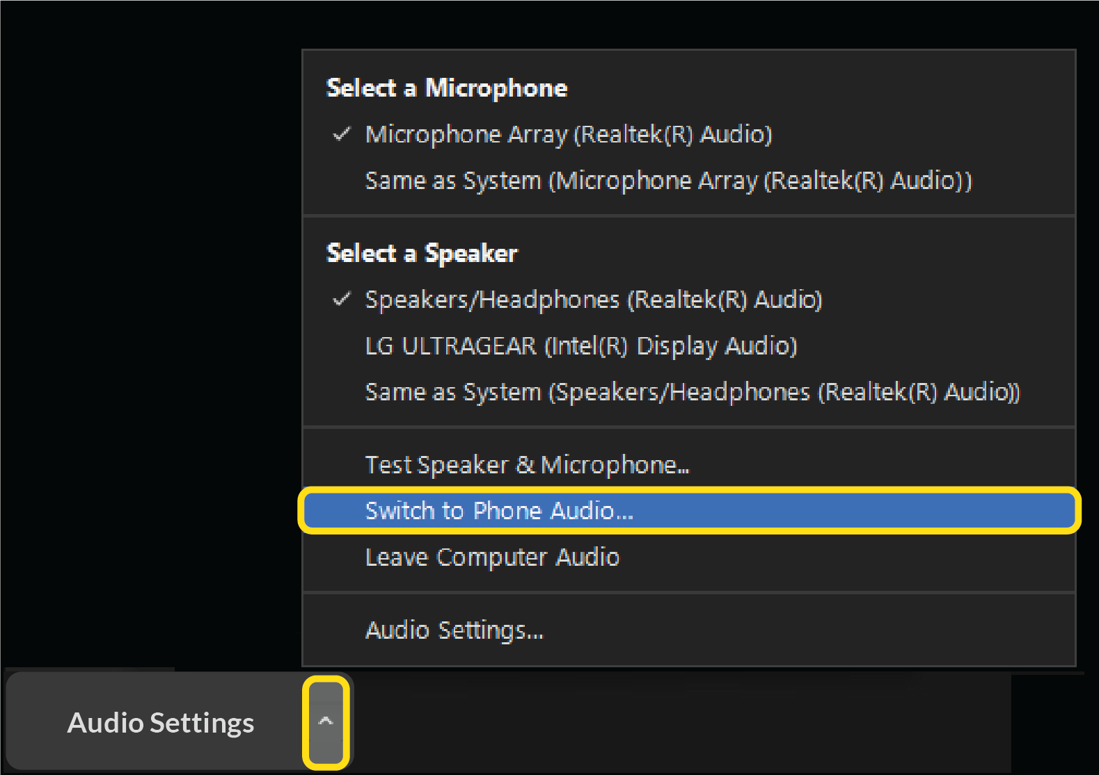
Webinar Audio
Lines have been muted
Audio depends on what option you’ve chosen
You can change your selection if desired
1
2
2
1
Notes:
Before we get started, I’d like to go over a few technical issues with you:
Lines have been muted.
Audio depends on what option you chose:
To change your selection, select the arrow on the un/mute icon on the bottom left side of your screen.
Hang up if you’re on a phone line and want to switch to computer.
Use your computer speakers or phone settings to adjust your volume level.

Slide 5
Webinar Viewing Tips
You can adjust your view
To view slides in “full screen,” select
Q&A
Closed Captioning (CC)
1
2
1
2
Notes:
Make the most of your training experience. Participate in polls and chat when indicated.
You can toggle between full-screen slides and the option to view the Zoom icons. If you don’t see the icons at the bottom of your screen, you may need to select the “View“ icon at the top right to exit the full-screen view. To reverse your view and see a larger, full-screen version of the slides, again, use the “View” icon at the top right of your screen and select “full screen.”
If you’d like to ask a question, please type it into the Q&A box located on the bottom of the webinar screen. We’ll reply to some questions throughout the webinar, and we’ll select some that we’ll ask our presenter after the presentation. If we don’t get to all the questions, you can send them to our mailbox, which is training@cms.hhs.gov. We’ll share that with you again toward the end of the presentation.
The closed captioning option is located at the bottom of your screen. Select the “CC” icon labeled “Live Transcript” and then “Show Subtitle.”

Slide 6
More Webinar Tips
Today’s presentation is available for download at the same location you launched today’s webinar
This webinar is being recorded
Notes:
Today’s presentation slides are available for download at the same location you launched today’s webinar.
This webinar is being recorded so it can be posted to our NTP website later. We need time to review the recordings prior to posting on our website, so please allow a 1- to 2-week turnaround time.

Slide 7
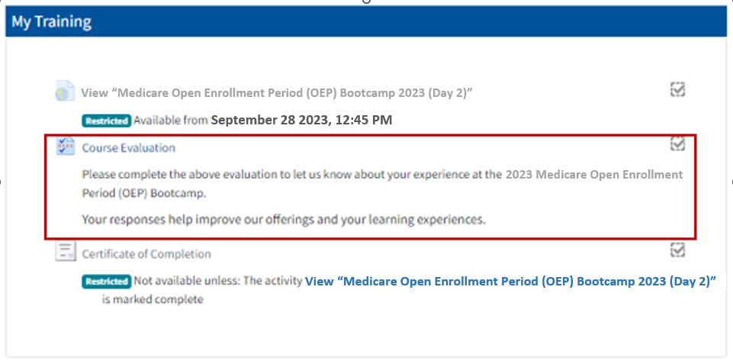
Evaluations
One for each date you attend (Day 1 and/or Day 2)
Available in the NTP LMS—at the same location you launched today’s webinar
Notes:
After the webinar has concluded, we encourage you to complete an evaluation survey that will be available in the NTP LMS. You’ll see it in the same location (or link) you used to register for and launch this training.
These surveys help us continue to improve and offer sessions that are helpful to our partners.

Slide 8
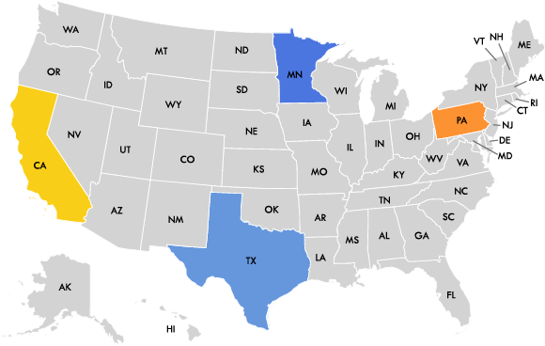
Checking In
Where are you joining us from today?
What’s your experience with the Medicare OEP?
Thanks for joining!
Notes:
This slide has animation.
We’d like to learn more about you. So, using the poll, please tell us………
Icebreaker questions:
Where are you joining us from today? (POLL)
Are there specific points you’re hoping to learn today? (OPEN CHAT)
Introduce speakers…

Slide 9
Today’s NTP Team
Sylvia Gary
Mohamad Al-Issa
Joseph Warden
Karie Watson
Doria Diacogiannis
Melissa Moreno
Notes:
I’m joined by my NTP colleagues Sylvia Gary and Karie Watson, who’ll be presenting today. And, we also have NTP team members Doria Diacogiannis, Mohamad Al-Issa, and Joseph Warden, who’ll be providing technical assistance.
We have a wide range of presenters and subject matters experts joining us from different areas within CMS and from other agencies. We’ll introduce you to them individually before they present their specific agenda topic.
Thanks to everyone for your support in this event.

Slide 10
Today’s Agenda
Welcome
NTP OEP Overview & Program Updates
Medicare Savings Programs (MSPs)
1-800-MEDICARE
Break
OEP Outreach—Media, Social Media, and Email
SHIP Community Partners & Virtual Counseling toolkit
Medicare Account Experience Live Demonstration
Fraud Awareness
Plan Marketing Updates
Closing

Slide 11
A Note
This CMS National Training Program recorded webinar provides basic information on Medicare, Medicaid, the Children’s Health Insurance Program (CHIP), and the Health Insurance Marketplace.
You should always consult the relevant statutes, regulations, and rulings for official legal guidance.
This is intended as an informational resource for partners. It isn’t meant for press purposes and isn’t on the record.
If you’re a member of the press, you can email press@cms.hhs.gov.

Slide 12
NTP Medicare Open Enrollment Period (OEP) Bootcamp 2023 (Day 2)

Slide 13
Medicare OEP Overview & Original Medicare 2024 Updates
Karie Watson
Program Training Specialist
Office of Communications
Notes:
The Medicare Open Enrollment Period (OEP) overview and Original Medicare 2024 updates, includes:
Where to find 2024 Medicare Part A, Part B, and Part D cost updates
What the Medicare OEP is and why it’s important for people with Medicare
Where to get information to compare health and drug plan options
Key OEP considerations
How to join a Medicare health or drug plan
Key OEP 2023 dates and calendar highlights through March 31, 2024

Slide 14
Resources for 2024 Medicare Cost Updates
Medicare Part A, Part B, and Part D costs change from year to year
The 2024 costs haven’t been released yet but when they are, CMS incorporates any changes into online and print resources:
Medicare.gov/basics/costs
Medicare.gov/plan-compare
Medicare.gov/basics/forms-publications-mailings
CMSnationaltrainingprogram.CMS.gov/Resources
For updates to Medicare costs, visit CMS.gov/Newsroom
Notes:
Medicare Part A, Part B, and Part D costs, like premiums, coinsurance, and deductibles, change from year to year.
The 2024 costs haven’t been released yet but when they are, CMS updates various online and print resources. These resources include:
Medicare.gov/basics/costs
Medicare.gov/plan-compare (Plan Finder)
Medicare.gov/basics/forms-publications-mailings (A wide variety of publications, including the Medicare & You handbook)
CMSnationaltrainingprogram.CMS.gov/Resources (NTP Medicare Amounts Job Aid)
To check for updates to the Medicare costs, visit CMS.gov/Newsroom

Slide 15
Yearly OEP for People with Medicare
Notes:
Every year you have the opportunity to review and compare your plan choices and pick the coverage that’s best for you. You can choose to:
Join or switch a Medicare Prescription Drug Plan (PDP)
Join or switch a Medicare Advantage (MA) Plan
Leave an MA Plan and return to coverage under Original Medicare Part A and Part B
Open Enrollment starts on October 15 and ends December 7 each year.
This gives you a full 7 weeks to compare and make decisions and helps ensure that you’ll have essential plan materials and membership cards in hand on January 1, when your new coverage starts.

Slide 16
Comparing Plans
Each year
Medicare plans can change costs and coverage
Plans mail or provide electronically
Annual Notice of Change (ANOC) explains changes from last years’ coverage, (electronically—if enrollee has opted into receiving electronic version)
Explanation of Coverage (EOC) explains coverage and costs for following year’s coverage
Some plans may choose to leave Medicare
Notes:
Each year, Medicare plans can change what they cost and cover. They must inform you of the coverage and changes each year. Plans mail or provide electronically, the Annual Notice of Change (ANOC) (if the enrollee has opted into receiving electronic version) and the EOC.
The ANOC includes changes in coverage, costs, or service area effective in January of the following year. The EOC gives details about plan coverage, costs, etc.
Some plans may choose to leave the Medicare Program.

Slide 17
Things to Consider
There are important differences between coverage options. Before making any changes to your coverage, consider things like:
Cost
Coverage—See Appendix A for comparison chart (Original Medicare vs. Medicare Advantage)
Supplemental coverage
Prescription drugs—See Appendix A for comparison chart (Original Medicare vs. Medicare Advantage)
Doctor and hospital choice
Quality of care
Travel
Notes:
There are important differences between coverage options. Before making any changes, you should consider the following:
Cost – In Original Medicare there’s no limit to how much you pay out-of-pocket per year unless you have supplemental coverage. MA Plans have a yearly limit on your out-of-pocket costs. If you join an MA Plan, once you reach a certain limit, you’ll pay nothing for covered services for the rest of the year.
Coverage* – Original Medicare covers medical services and supplies in hospitals, doctor’s offices, and other health care settings. Services are either covered under Part A or Part B. MA Plans must cover all of the services that Original Medicare covers. Plans may offer benefits that Original Medicare doesn’t cover like vision, hearing, or dental.
Supplemental coverage – With Original Medicare you can add a Medigap policy to help pay your out-of-pocket costs in Original Medicare, like your deductible and coinsurance. You can’t use (and can’t be sold) a Medigap policy if you’re in an MA Plan.
Prescription drugs* – In Original Medicare you’ll need to join a Medicare PDP to get drug coverage. Medicare Advantage usually includes drug coverage.
Doctor and hospital choice – In Original Medicare you can go to any doctor that accepts Medicare. In a Medicare Advantage Plan, you may need to use providers who participate in the plan’s network. If so, find out how close the network’s doctors or pharmacies are to your home. Some plans offer out-of-network coverage.
Quality of care – In Original Medicare you can get a snapshot of the quality of care that health care providers (and facilities) give their patients by visiting Medicare.gov. The Medicare Plan Finder at Medicare.gov/plan-compare features a star rating system for Medicare plans.
Travel – Original Medicare generally doesn’t cover care outside the United States (U.S.) You may be able to buy supplemental insurance that offers travel coverage. Medicare Advantage Plans usually don’t cover care you get outside of the U.S.
*If you have other types of health or prescription drug coverage, check to see how it works with the type of coverage you’re considering before you make any decisions or changes.
NOTE: *A chart that compares Original Medicare and MA Plans is available in Appendix A.

Slide 18
If You Have Other Coverage
IMPORTANT
If you have other coverage, like from an employer or union:
Check with your plan’s benefits administrator before making any changes to your coverage
Otherwise, you could lose coverage for you and your dependents
Notes:
IMPORTANT: If you have other coverage, like employer or union coverage, check with your plan’s benefits administrator before making any changes to your coverage. Otherwise, you could lose coverage for you and your dependents.

Slide 19
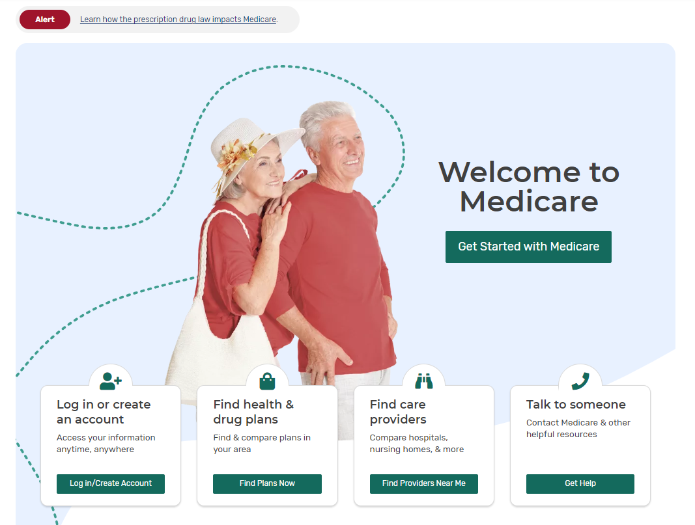
Research, Compare, & Choose
2024 “Medicare & You” Handbook
Plan’s Annual Notice of Change (ANOC) and Evidence of Coverage (EOC)
State Health Insurance Assistance Program (SHIP)
1-800-MEDICARE (1-800-633-4227); TTY: 1-877-486-2048
Medicare.gov/plan-compare
Health and drug plans websites
Notes:
The Medicare OEP gives you a chance to research, compare, and choose a Medicare Advantage Plan or Prescription Drug Plan that is right for you.
Here are some key ways to do this and some of these are addressed in more detail on the slides that follow:
Review your 2024 Medicare & You handbook
Read your Medicare Plan’s Annual Notice of Change (ANOC) and Evidence of Coverage (EOC)
Call your State Health Insurance Assistance Program (SHIP)
Call 1-800-MEDICARE (1-800-633-4227); TTY: 1-877-486-2048
Visit Medicare.gov/plan-compare
Review Medicare health and drug plans websites

Slide 20
The “Medicare & You” Handbook
Has basic plan information
Mailed to people with Medicare each September
Good for quick comparison
Plan information isn’t comprehensive
CMS Product No. 10050
NOTE: The quality rating in the handbook is the “Members’ Rating of Plan” (how plan members rated the plan from the 2020 Consumer Assessment of Healthcare Providers and Systems [CAHPS] survey).
Notes:
For more basic plan information use the “Medicare & You” handbook. The information in the handbook isn’t comprehensive, so check the plan’s website or Medicare Plan Finder for additional information.
Mailed each September to beneficiary households unless they elected to have the handbook sent electronically. Available in alternate languages (Spanish, Chinese, Vietnamese, and Korean) and formats.
Highlights from page 2 of the 2024 “Medicare and You” handbook include:
Saving money on your prescription drugs̶―Go to page 40.
Lower costs for insulin and vaccines―Go to pages 39, 50, and 88.
Changes to telehealth coverage―Go to page 51.
Managing and treating chronic pain―Go to page 34.
Better mental health care―Go to pages 46–47.
More times to sign up for Medicare―Go to page 18.
COVID-19 care―Go to page 37.
NOTE: The star ratings listed in the “Medicare & You” handbook are the percent of people who rated their plan as the best. It isn’t to be used for the purpose of the 5-Star SEP. The overall star rating is used for the 5-Star SEP. To view or download this publication, visit Medicare.gov/Pub10050/Medicare-and-You.pdf.

Slide 21
Plan Websites
Plan websites have the most comprehensive information
Unlike Medicare Plan Finder, you can’t use a plan’s website to compare their coverage to other companies or organizations
Find the plan phone number and website information
On Medicare Plan Finder
Contact information in the “Medicare & You” handbook
Plans send a plan “ANOC” each fall showing changes in coverage, costs, or service area
Changes are effective January 1
Notes:
Health and drug plans have the most comprehensive information about the plans they offer, but you often can’t use the plan’s website to compare their coverage to other companies or organizations.
Call the plan. Contact information, including the plan phone number and web address, can be found on the Medicare Plan Finder and in the back of the “Medicare & You” handbook.
If you're in a Medicare plan, your plan will send you a plan ANOC each fall (by October). The ANOC includes any changes in coverage, costs, or service area that will be effective January 1. Review this notice for any changes to decide whether the plan will continue to meet your needs in the next year. If you don't get this important document, contact your plan.

Slide 22
How to Join a New Plan
May be able to enroll in a Medicare health or drug plan by
Calling the plan
Enrolling on the plan’s website or on Medicare.gov/plan-compare
Call 1-800-MEDICARE (1-800-633-4227); TTY: 1-877-486-2048
Paper application
Enrolling in a new plan will disenroll you from your previous plan
Notes:
There are several different ways that you may be able to enroll in a Medicare health or drug plan during OEP, including:
Calling the plan
Enrolling on the plan’s website or on Medicare.gov/plan-compare
Calling 1-800-MEDICARE (1-800-633-4227); TTY: 1-877-486-2048
Completing and mailing a paper application
Enrolling in a new MA Plan or drug plan will automatically disenroll you from your previous plan. This includes MA-only Health Maintenance Organization (HMO) and Preferred Provider Organization (PPO) plans. However, there are limited exceptions for members of MA-only Private Fee-For-Service, Cost, and Medicare Medical Savings Account Plans (MSAs).

Slide 23
Need a Service or a Prescription Before Getting Your Membership Materials?
Take as much information to the pharmacy/provider as possible, including:
Red, white, and blue Medicare card
A photo ID
An acknowledgement or confirmation letter, or an enrollment confirmation number from the plan
Medicaid card or letter showing eligibility for Extra Help
If enrollment can’t be confirmed, can pay out of pocket and work with the plan to get reimbursed
Notes:
With OEP beginning in October, most people will get their membership materials before January 1.
However, the first time you use your new Medicare plan, you should come to the pharmacy/provider with as much information as possible, especially if you need to use your new coverage before you get a plan membership card. Here’s what you need to bring to the pharmacy:
Your red, white, and blue Medicare card
A photo ID
You can bring an acknowledgement or confirmation letter from the plan if you have one, or an enrollment confirmation number from the plan
NOTE: Only confirmation numbers from the plan will work, not those from Medicare’s Online Enrollment Center at Medicare.gov. If you haven’t gotten a plan membership card or any plan enrollment materials, let the provider/pharmacist know the name of the Medicare health or drug plan you joined. If you qualify, bring your Medicaid card (if you have one), or a letter from your state Medicaid Program, or the Social Security Administration (SSA) that shows you’re eligible for Extra Help (a Medicare Program to help people with limited income and resources pay Medicare Prescription Drug Plan costs).

Slide 24
Calendar Highlights
September | “Medicare & You” handbooks mailed to households with Medicare
September | Announce health/drug plan offerings and MA Plan premiums (Landscape of Plans)
September 30 | All Medicare drug plans must send an Annual Notice Of Change (ANOC) to members to get no later than September 30
September/October | Part A and Part B 2024 amounts announced
October 1 | Plans may begin marketing Calendar Year 2023 plan options
Early October | 2024 plan data displayed on Medicare Plan Finder
October 2 | Plan members notified of plan non-renewals by CMS
October | Updated plan star ratings displayed on Medicare Plan Finder
October 15 | OEP begins; ANOC posted to plan websites; Evidence of Coverage (EOC) due to enrollees
December 7 | OEP ends
January 1, 2024 | Coverage begins; most members will have their new plan materials
January 1-March 31 | Medicare Advantage Open Enrollment Period (MA OEP)

Slide 25
Part D 2024 Program Updates & Costs
Sylvia Gary
Program Training Specialist
Office of Communications
Notes:
The Part D 2024 Program Updates and Costs lesson includes:
Prescription Drug 2024 Overview
Using the GEP to get Medicare Drug coverage in 2024
LINET policy update
2024 Specialty Tiers Threshold
Lowering drug cost sharing at the pharmacy counter

Slide 26
Prescription Drug 2024: Overview
The Part D estimated average basic premium
Projected to be $34.50 in 2024 ($32.09 in 2023)
Announced on July 31, 2023
People who reach the coverage gap or “donut hole” in 2023 pay
25% of covered brand-name drugs
25% of covered generic drugs
People with very high prescription drug costs will no longer pay once they reach the “catastrophic phase”
 | 2023 | 2024
Standard Benefit
Deductible | $505 | $545
Initial Coverage Limit | $4,660 | $5,030
Notes:
The 2024 Medicare Part D premium and bid information was announced July 31, 2023.
To see the Newsroom announcement, visit CMS.gov/newsroom/news-alert/cms-releases-2024-projected-medicare-part-d-premium-and-bid-information
To see the associated fact sheet, visit CMS.gov/newsroom/fact-sheets/cms-releases-2024-projected-medicare-part-d-premium-and-bid-information
The Part D estimated average basic premium
Projected to be $34.50 in 2024 ($32.09 in 2023)
People who reach the “donut hole” in 2023 pay
25% on covered brand name drugs
25% on covered generic drugs
Beginning January 1, 2024, people with very high prescription drug costs will no longer pay once they reach the “catastrophic phase.”
Visit CMS.gov/files/document/2024-announcement.pdf, for 2024 Part D deductible and cost-sharing amounts
NOTE: For American Indians and Alaska Natives who are enrolled in Medicare Part D and get their prescription drugs from an Indian Health Service (IHS) or tribal pharmacy, the incurred costs of those drugs will count toward meeting the “donut hole” expenses.

Slide 27
Prescription Drug 2024: Overview (continued)
The 2024 Part D base beneficiary premium is $34.70
De minimis amount is $2
For regional benchmark amounts and Extra Help (also called low-income premium subsidy) amounts, visit
CMS.gov/files/document/regional-rates-and-benchmarks-2024.pdf
Notes:
With a premium stabilization-capped 2024 base beneficiary premium of $34.70. Without premium stabilization, the 2024 base beneficiary premium would have been $39.35, or $4.65 higher.
Plan-specific basic premiums across all plans that submit bids are averaged together to calculate the average basic Part D premium.
When a person with Medicare is subject to pay a Part D late enrollment penalty (LEP), this amount is used to calculate their LEP, which is added to their monthly Part D premium. The Part D base beneficiary premium amount can change each year, which means the penalty amount that a person has to pay can also change each year. For more information about the Part D base beneficiary premium and de minimis amount, visit CMS.gov/newsroom/news-alert/cms-releases-2024-projected-medicare-part-d-premium-and-bid-information.
The 2024 de minimis amount is $2.00. The de minimis premium policy applies to Medicare Prescription Drug Plans and Medicare Advantage Plans with prescription drug coverage (MA-PDs) and requires them to charge people with Medicare who are eligible for full-premium subsidy, a Part D monthly premium equal to the applicable low-income premium subsidy amount, if the plan’s premium for basic drug coverage exceeds their region’s low-income premium subsidy benchmark amount by $2 or less.
This policy helps maintain enrollment stability by allowing people with Medicare who get the full premium subsidy to remain enrolled in these plans and essentially pay no Part D monthly premium. However, plans that qualify for the de minimis policy won’t get new CMS auto/facilitated enrollments for the plan year.

Slide 28
Using the General Enrollment Period (GEP) to get Medicare Drug Coverage: Change in 2024
If you enroll after your IEP, you may pay a late enrollment penalty
If you get Part B during the GEP, you can get an SEP for Medicare drug coverage:
Notes:
This slide has animation
For 2023, if you don’t have premium-free Part A coverage and sign up for Part B during the General Enrollment Period (GEP) (January 1–March 31), you can join a Medicare drug plan from April 1–June 30. Your coverage begins on July 1. Using the GEP instead of your IEP to sign up for Part B means you could have a Part B late enrollment penalty. If you don’t join Part D when you’re first eligible, you could also have to pay a Part D late enrollment penalty unless you had creditable drug coverage.
Final Rule CMS-4201, (published in the Federal Register on April 12, 2023, and effective for 2024), modifies the current Medicare enrollment rules for Medicare Part A (if you have to buy it), Part B, Part D, and Medicare Advantage (also called Part C) during the GEP. After January 1, 2024, if you enroll in Part B during the GEP, you’re eligible to use the SEP for Individuals Who Enroll in Part B during the Part B GEP to request enrollment in a Part D plan or a Medicare Advantage Plan. That SEP will begin when you submit the application for Part B, and will continue for the first 2 months of enrollment in Part B. For more information about Part D and Medicare Advantage enrollment timeframes during the GEP (SEP for exceptional conditions), visit: Federalregister.gov/public-inspection/2023-07115/medicare-program-contract-year-2024-policy-and-technical-changes-to-the-medicare-advantage-program.

Slide 29
LI NET Permanent (CY24 Final Rule)
Medicare’s Limited Income (LI) Newly Eligible Transition (NET) Program currently operates as a demonstration program that provides immediate and retroactive Part D coverage for eligible low-income beneficiaries who do not yet have prescription drug coverage
Effective January 1, 2024, the LI NET program will be a permanent part of Medicare Part D, as required by section 118 of the Consolidated Appropriations Act (CAA)
Notes:
This slide has animation
CMS-4201-F
423.2500-423.2536
Federalregister.gov/documents/2023/04/12/2023-07115/medicare-program-contract-year-2024-policy-and-technical-changes-to-the-medicare-advantage-program#sectno-reference-423.2500
CMS has operated the LI NET demonstration since 2010. The LI NET demonstration provides transitional, point-of-sale coverage for low-income beneficiaries who demonstrate an immediate need for prescriptions, but who have not yet enrolled in a Part D plan, or whose enrollment is not yet effective. LI NET also provides retroactive and/or temporary prospective coverage for beneficiaries determined to be eligible for the Part D low-income subsidy (LIS) by the Social Security Administration (SSA) or a State. In this final rule, we are making the LI NET program a permanent part of Medicare Part D, as required by the Consolidated Appropriations Act, 2021 (CAA). We’re finalizing the regulation largely as proposed, with a few minor clarifying modifications.
Both the permanent program and the implementing regulations are effective on January 1, 2024.

Slide 30
2024 Specialty Tiers Threshold
Medicare drug coverage (Part D) sponsors may exempt a formulary tier from its tiering exceptions process
Sponsor-negotiated price must exceed a dollar-per-month threshold established by CMS
2024 specialty tier threshold is $950 for the ingredient cost of a 30-day equivalent supply
Notes:
Specialty Tiers
Part D sponsors may exempt a formulary tier in which it places very high cost Part D drugs and biological products from its tiering exceptions process, consistent with 42 C.F.R. §423.578(a)(6)(iii). For a Part D drug to be placed on a specialty tier, the Part D sponsor’s negotiated price must exceed a dollar-per-month threshold established by CMS. For Contract Year (CY) 2024, the specialty tier threshold is increased from $830 in 2023 to $950 in 2024 for the full cost of the 30-day equivalent negotiated price.
42 CFR 423.104(d)(2)(iv): ecfr.gov/current/title-42/chapter-IV/subchapter-B/part-423/subpart-C/section-423.104
CY 2024 Final Part D Bidding Memo and Instructions:
CMS.gov/files/document/2023partdbiddinginstructions.pdf

Slide 31
Lowering Beneficiary Cost Sharing at the Pharmacy Counter
Requires Medicare drug plans to apply all price concessions they get from network pharmacies to the negotiated price at the point of sale
Redefining the negotiated price as the lowest possible reimbursement a network pharmacy will receive, in total, for a particular drug
Reduces the out-of-pocket costs for a person with Medicare and improves price transparency and market competition in the Part D program
Effective January 1, 2024
Notes:
This slide has animation
CMS-4192-F
In recent years, more Medicare drug plans have been entering into arrangements with pharmacies that may pay less money for dispensed drugs if pharmacies don’t meet certain criteria. The negotiated price for a drug is the price reported to CMS at the point of sale, which is used to calculate cost sharing for people with Medicare and generally adjudicate the Part D benefit. With the emergence of these payment arrangements, the negotiated price is frequently higher than the final payment to pharmacies. Higher negotiated prices lead to higher cost sharing for people with Medicare and faster advancement through the Part D benefit. CMS is finalizing a policy that requires Medicare drug plans to apply all price concessions they receive from network pharmacies to the negotiated price at the point of sale, so that the person with Medicare can also share in the savings.
Specifically, CMS is redefining the negotiated price as the baseline, or lowest possible, payment to a pharmacy, effective January 1, 2024. CMS is applying the finalized policy across all phases of the Part D benefit. This policy reduces out-of-pocket costs for people with Medicare and improves price transparency and market competition in the Part D program.
Medicare Program; Contract Year 2023 Policy and Technical Changes to the Medicare Advantage and Medicare Prescription Drug Benefit Programs; Policy and Regulatory Revisions in Response to the COVID–19 Public Health Emergency; Additional Policy and Regulatory Revisions in Response to the COVID–19 Public Health Emergency. Final Rule: govinfo.gov/content/pkg/FR-2022-05-09/pdf/2022-09375.pdf
42 CFR 423.100 “Negotiated prices”: ecfr.gov/current/title-42/chapter-IV/subchapter-B/part-423#p-423.100(Negotiated%20prices)

Slide 32
Medicare Advantage Program Updates
Notes:
The Medicare Advantage Program Updates Highlights changes in Medicare Advantage (MA), including:
Change in opportunity to get Medicare Advantage with drug coverage after using the General Enrollment Period (GEP) in 2024 to enroll
Changes in plan websites and directories. and requirements for digital health education related to accessing telehealth benefits

Slide 33
Using the General Enrollment Period (GEP) to get Medicare Drug Coverage: Change in 2024
If you enroll after your IEP, you may pay a late enrollment penalty
If you get Part B during the GEP, you can get an SEP for Medicare drug coverage:
Notes:
This slide has animation
For 2023, if you had Part A and sign up for Part B during the GEP, you can join a Medicare Advantage Plan from April 1–June 30. Your coverage begins on July 1. Using the GEP instead of your IEP to sign up for Part B means you could have a Part B late enrollment penalty. If you don’t join Part D when you’re first eligible, you could also have to pay a Part D late enrollment penalty unless you had creditable drug coverage.
Final Rule CMS-4199-F, modifies the current Medicare enrollment rules for Medicare Part A (if you have to buy it), Part B, Part D, and Medicare Advantage (also called Part C) during the GEP. CMS-4201 finalized corresponding changes to the Part D SEP at 423.38(c)(16). After January 1, 2024, if you enroll in Part B during the GEP, you’re eligible to use the SEP for Individuals Who Enroll in Part B during the Part B GEP to request enrollment in a Medicare Advantage Plan. That SEP will begin when you submit the application for Part B, and will continue for the first 2 months of enrollment in Part B. For more information about Part D and Medicare Advantage enrollment timeframes during the GEP (SEP for exceptional conditions), visit: Federalregister.gov/public-inspection/2023-07115/medicare-program-contract-year-2024-policy-and-technical-changes-to-the-medicare-advantage-program.

Slide 34
Medicaid & the Children’s Health Insurance Program (CHIP) Updates
Notes:
The Medicaid and the Children’s Health Insurance Program (CHIP) updates, includes:
What’s happening now with Medicaid
What partners can do to help individuals during the renewal process
Medigap enrollment opportunities related to continued Medicaid unwinding

Slide 35
What Is Happening Right Now With Medicaid?
All states have initiated unwinding-related renewals.
Some individuals might not qualify for Medicaid and will lose coverage.
During a 12-month period, states will be spreading out renewals. Not everyone will have their Medicaid coverage renewed at the same time.
Notes:
All states have initiated unwinding-related renewals.
If an individual is no longer eligible for Medicaid, they can transition to another form of health insurance coverage, such as finding coverage on HealthCare.gov, Medicare, or employer-sponsored insurance coverage.
Over the next 12 months, states will spread out renewals, which means not everyone will have their Medicaid and CHIP coverage renewed at the same time.
Each state has a different renewal timeline, and you can find that timeline on Medicaid.gov/unwinding under the Planning Tools & Templates section. You can add your own state’s timeline here.

Slide 36
What Partners Can Do NOW To Help Prepare for the Renewal Process
Partners can inform Medicaid and CHIP beneficiaries what they can do to prepare for renewing their coverage and available health coverage options
There are 3 main messages that partners should focus on now when communicating with people that are enrolled in Medicaid and CHIP:
Update your contact information – Make sure the state has your current mailing address, phone number, email, or other contact information
Check your mail – State will mail you a letter about your Medicaid or CHIP coverage
Complete your renewal form (if you get one) – Fill out the form and return it to the State Medicaid or CHIP program right away to help avoid a gap in your Medicaid or CHIP coverage
If they no longer qualify for Medicaid or CHIP, they may be able to buy a health plan through the Health Insurance Marketplace®, and get help paying for it
Notes:
What partners can do now:
Right now, partners can help prepare for the renewal process and educate Medicaid and CHIP enrollees about the upcoming changes. This includes making sure that enrollees have updated their contact information with their State Medicaid or CHIP Program, and are aware that they need to act when they receive a letter from their state about completing a renewal form.
There are 3 main messages that partners should focus on now when communicating with people that are enrolled in Medicaid and CHIP.
Update your contact information – Make sure [Name of State Medicaid or CHIP program] has your current mailing address, phone number, email, or other contact information. This way, they’ll be able to contact you about your Medicaid or CHIP coverage.
Check your mail – [Name of State Medicaid or CHIP program] will mail you a letter about your Medicaid or CHIP coverage. This letter will also let you know if you need to complete a renewal form to see if you still qualify for Medicaid or CHIP.
Complete your renewal form (if you get one) – Fill out the form and return it to [Name of State Medicaid or CHIP program] right away to help avoid a gap in your Medicaid or CHIP coverage.
Those who no longer qualify for Medicaid or CHIP may be able to purchase a health plan through the Health Insurance Marketplace® and receive financial assistance. Marketplace Plans cover things like prescription drugs, doctor visits, urgent care, hospital visits, and more.
Preparing for the End of the COVID-19 Public Health Emergency: What Partners Need to Know About Medicaid and CHIP Coverage:
https://www.medicaid.gov/resources-for-states/downloads/unwinding-webinar-05252022.pdf

Slide 37
Medigap Enrollment Opportunities Due to Unwinding: Vary by State
Medicare Supplement Insurance (Medigap) is extra insurance you can buy from a private health insurance company to help pay your share of out-of-pocket costs in Original Medicare
In most cases, you have a guaranteed issue right to buy a Medigap policy when your other health coverage changes in some way, like if you lose your other coverage
If you have a guaranteed issue right, an insurance company:
Must sell you a Medigap policy
Must cover all your pre-existing health conditions
Can't charge you more for a Medigap policy because of past or present health problems
Some states may provide Medigap flexibilities to coordinate with those losing Medicaid coverage due to the end of the public health emergency (PHE)
Check with your state’s Department of Insurance: naic.org/state-insurance-departments
Notes:
This slide has animation
In most cases, you have a guaranteed issue right when your other health coverage changes in some way, like if you lose your other coverage.
If you have a guaranteed issue right, an insurance company:
Must sell you a Medigap policy
Must cover all your pre-existing health conditions
Can't charge you more for a Medigap policy because of past or present health problems
Check with your state’s Department of Insurance: naic.org/state-insurance-departments
Some states may provide Medigap protections to coordinate with those losing Medicaid coverage due to the end of the PHE. The Medigap open enrollment period when a plan must sell to an individual (guaranteed issue) starts when you’re both 65 and have Medicare Part B. To assist individuals who may have missed their initial enrollment period to enroll in Medicare during the PHE but can now enroll using the Medicare SEP or duals who lost Medicaid due to Medicaid redeterminations several states are allowing a Special Enrollment Period (SEP) or guaranteed issue protection to enable the individuals to enroll in a Medigap policy: Indiana, New Hampshire, Vermont, Delaware, Pennsylvania, Montana, Colorado, Michigan, Alaska, Idaho, Arkansas, New Mexico, Kentucky, Oregon, Ohio, Illinois, and Virginia. Wisconsin and Utah have existing laws that already cover this situation. North Dakota is planning to issue a bulletin imminently opening guaranteed issue protection for individuals for up to 63 days after their date of their letter from Medicaid tells them they are no longer eligible for Medicaid. Wyoming is researching an option for all Medicare enrollees, but plans did on their own open an enrollment period for those coming off Medicaid.

Slide 38
Q&A
To submit a question, select the Q&A icon on your Zoom control bar.
Notes:
To submit a question, select the Q&A icon on your Zoom control bar.

Slide 39
Medicare Savings Programs (MSPs)
Kim Glaun
Technical Director
Program Alignment Group
Medicare-Medicaid Coordination Office

Slide 40
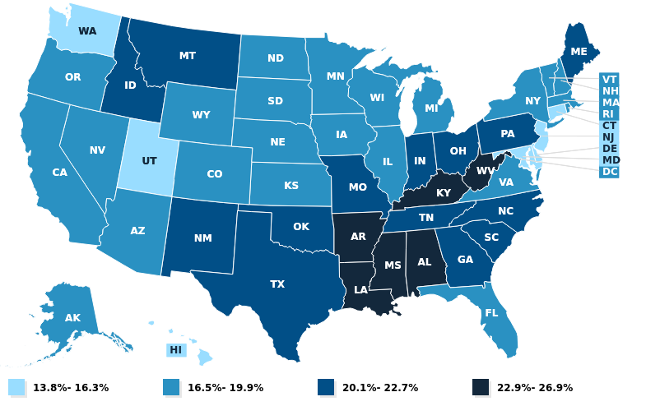
Poverty is Pervasive in Medicare
Distribution of Medicare Beneficiaries Living with Income under the Poverty Level
In 2021,13% of Medicare beneficiaries (7.5 million) are living under the poverty line, and another 19% (another 11 million) are living just above it
Kaiser Family Foundation’s State Health Facts Distribution of Medicare Beneficiaries by Federal Poverty Level

Slide 41
Medicare Savings Programs Offer Significant Benefits
The MSPs promote access to health care and free up individuals’ limited income for food, housing & other necessities.
MSP Eligibility Group° | Benefit | Financial Eligibility 2023 (single/couple)* | Enrollees June 2022
Qualified Medicare Beneficiary (QMB) | Part A & B premiums, deductibles, cost-sharing | Monthly Income: 100% FPL $1,133/$1,525** Resources: $9,090/$13,630 | 8.1m
Specified Low Income Beneficiary (SLMB) | Part B premium | Monthly Income: 101 to 120% FPL $1,478/$1,992** Resources: $9,090/$13,630 | 1.4m
Qualifying Individual (QI) | Part B premium | Monthly Income: 121 to 135% FPL $1,660/$2,239** Resources: $9,090/$13,630 | 0.6m
* Some states have effectively expanded MSP financial eligibility beyond the limits listed here. Check with your Medicaid agency for eligibility in your state.
** Includes a $20 standard income disregard. Limits slightly higher in Alaska and Hawaii.
° A fourth MSP, the Qualified Disabled Working Individual (QDWI) group, pays the Part A premium for individuals under 65 with limited incomes and resources who are otherwise ineligible for Medicaid, have a qualifying disability, and have lost premium-free Part A coverage after returning to work.

Slide 42
Medicare Savings Programs (MSPs) are Underutilized
Although the MSPs are essential to the economic health and security of millions of Americans, millions more are eligible but not enrolled. macpac.gov/wp-content/uploads/2017/08/MSP-Enrollees-and-Eligible-Non-Enrollees.pdf

Slide 43
Q&A
To submit a question, select the Q&A icon on your Zoom control bar.
Notes:
To submit a question, select the Q&A icon on your Zoom control bar.

Slide 44
1-800-MEDICARE
Maria Fe Franciscus
Health Communications Specialist
Office of Communications

Slide 45
1-800-MEDICARE Overview
Call centers & Web Chat available 24 x 7
1-800-MEDICARE receives about 25 million calls annually and another 1.5 million web chats
English, Spanish and TTY
Provides support for over 200 languages
Mondays and Tuesdays are busiest days
10:00am – 4:00pm EST are busiest hours
Web Chat
Provides answers to Medicare questions and technical support to users of the Medicare.gov website.

Slide 46
Call Topics
In addition to supporting the annual Medicare Open Enrollment, 1-800-MEDICARE also continues to support other Medicare inquiries
The most common calls are related to Medicare Premiums, Part B coverage, Part C/D Enrollment Periods, Medicare numbers and cards, and Original Medicare claims

Slide 47
1-800-MEDICARE OEP Overview
1-800-MEDICARE will continue to follow all of the best practices used in previous years to ensure a successful Open Enrollment Period.
Pace of enrollments increases each year the week after Thanksgiving then surges during the final week of OEP as beneficiaries make their final decisions.
The Call Center is ramping up to support the projected call volumes based on previous years. We are projecting a slight increase over last year to 4.5 million calls.
Plan Year 2024 (October 15 – December 7, 2023) – Projected calls forecasted 4,518,278
Plan Year 2023 (October 15 – December 7, 2022) – Calls Offered was 4,256,444
Plan Year 2022 (October 15 – December 7, 2021) – Calls Offered was 4,898,516
Plan Year 2021 (October 15 – December 7, 2020) – Calls Offered was 4,824,897
Plan Year 2020 (October 15 – December 7, 2019) – Calls Offered was 4,747,102

Slide 48
Things to Remember for OEP
General Tips:
Remember to have all the beneficiary’s prescriptions and dosages available when calling to enroll. This expedites the enrollment process and ensures the individual is getting the best plan to meet their needs.
To obtain Part D information or submit an enrollment, beneficiary must verify their identity or authorize anyone calling on their behalf.
1-800-MEDICARE CSRs are only permitted to provide information to beneficiaries about plan options. They are not permitted to advise beneficiaries on which plan may be the best for them.
Historically, due to a surge in volume on the last day, we tend to have longer than expected waits. We encourage callers to not wait until the last minute if needing assistance.

Slide 49
Q&A 2
To submit a question, select the Q&A icon on your Zoom control bar.
Notes:
To submit a question, select the Q&A icon on your Zoom control bar.

Slide 50
5-Minute Break
Notes:
Start this countdown timer after you announce a break.

Slide 51
OEP Outreach Messages, Paid & Earned Media
Maya Owens
Public Affairs Specialist
Office of Communications

Slide 52
Open Enrollment Goals
Encourage people with Medicare to review and compare Medicare drug and health coverage options
Emphasize the October 15 – December 7 dates
Promote the Medicare Plan Finder tool that makes it easy to compare coverage options and shop for Medicare health and drug plans
Emphasize Medicare.gov as the official source for information about Medicare and Open Enrollment
Promote enrollment in the Low Income Subsidy or “Extra Help” program
Educate people with Medicare who take insulin that they will pay no more than $35 for a month’s supply of each covered insulin
Target audiences with traditionally lower access to health care

Slide 53
Key Media Messages
Open Enrollment is the time to review your current health and drug coverage options and make changes if you want.
Plans can change their offerings every year, and so can your health or finances so review to make sure your plan still works for you.
Even if you’re happy with your current coverage, you might find a better fit for your budget or health needs – you might be able to save money.
Comparing drug and health options is easy at Medicare.gov. You can input the list of prescriptions you’re taking and do a side-by-side comparison of plan coverage, costs, and quality ratings.
If you are struggling with your prescription drug costs, Extra Help is a program that can pay for your drug coverage (Part D), premiums, deductibles, coinsurance, and other costs. Visit ssa.gov/extrahelp or call Social Security at 1-800-772-1213 to apply.

Slide 54
Key Media Messages (continued)
If you take insulin, you’ll pay no more than $35 for a month’s supply of each covered insulin. Go to Medicare.gov, enter all your drugs, and make sure your plan still covers your insulin in 2024.
If you need further assistance, call 1-800-MEDICARE. We’re here to help 24 hours a day, including weekends. You can also find free, personalized health insurance counseling in your community from your State Health Insurance Assistance Program (or SHIP). Visit shiphelp.org for locations near you.
Medicare.gov is the official source for Medicare. Start here to get unbiased information to find the type of coverage that best meets your needs.
Open Enrollment ends December 7th so review and compare your options now.

Slide 55
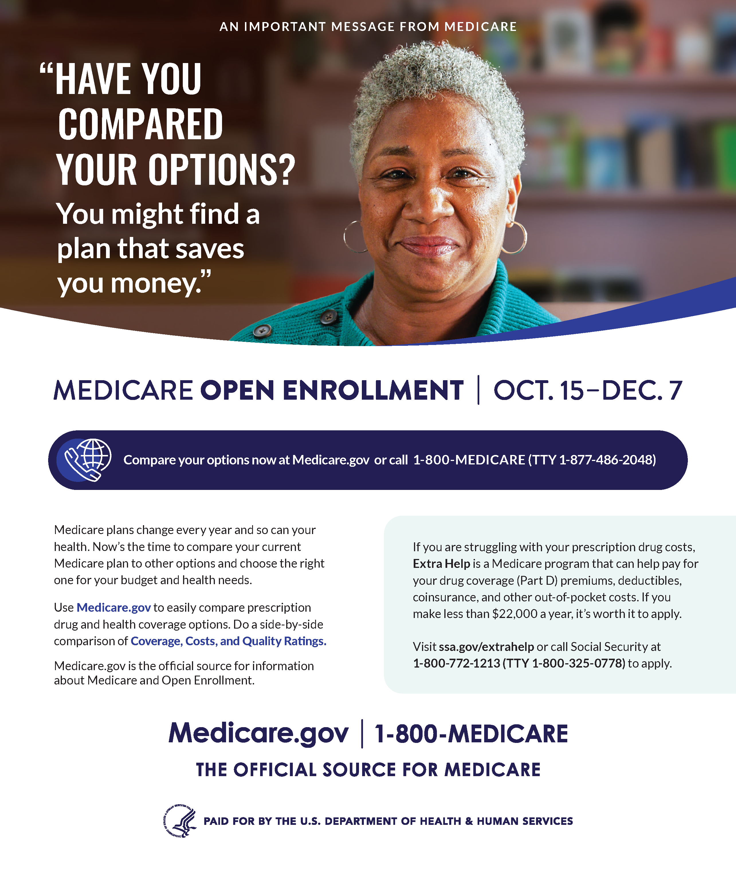
Paid Media Campaign
Builds on considerable message testing over 10+ years
Major drivers of plan review include idea that plan options change every year and that people may find a better plan at a lower cost.
General Market
National broadcast (network TV, cable TV and streaming)
National search, digital video, social, display
National print
African American
National broadcast (cable TV, radio)
National digital video, social, display
Local print
Hispanic
National TV, streaming, radio, search, digital video, social display
Local TV, Local print

Slide 56
Earned Media
National
Launch of Open Enrollment
National/Regional SMT/RMT
Pre-Thanksgiving Week
National/Regional SMT/RMT
Push the week before December 7 deadline
National/Regional SMT/RMT late Nov./Early Dec.
Drop-in article distribution

Slide 57
Communications Materials
2023 OEP outreach materials will be posted at CMS.gov/outreach-and-education/reach-out/find-tools-to-help-you-help-others/open-enrollment-outreach-and-media-materials
Ready-made articles (English & Spanish)
Live read public service announcement scripts (English & Spanish)
Social media graphics
Flyer
Open Enrollment Palm Card

Slide 58
OEP SOCIAL MEDIA
Courtney Hyde
Health Communications Specialist
Office of Communications

Slide 59
2023 Social Media Objectives
Encourage Medicare beneficiaries to review & compare coverage options
Create sharable content to maximize posts’ reach & engagement
Drive beneficiaries to use the Plan Finder to compare drug & health options
Remind beneficiaries how to identify & avoid fraud
Inform beneficiaries how to get help with Medicare drug costs through Extra Help

Slide 60
Social Media
As of September 2023:
Medicare Facebook
485,813 followers
@MedicareGov X/Twitter
54,817 followers
Social Media Toolkit
Will be available soon in English & Spanish
Graphics available for download
#MedicareOE
*2023 Open Enrollment social media toolkit
Notes:
Will be available here when uploaded: https://www.cms.gov/Outreach-and-Education/Reach-Out/Find-tools-to-help-you-help-others/Medicare-Open-Enrollment

Slide 61
OEP EMAIL OUTREACH
Aditi Jhaveri
Health Communications Specialist
Office of Communications

Slide 62
Email Outreach
Continue segmentation/personalization efforts to send tailored emails to beneficiaries
Targeted messages including emails to beneficiaries:
Whose plan is leaving their area
Who don’t have drug coverage to avoid the Part D Lifetime Late Enrollment Penalty
Who use insulin and may not already be in a plan with insulin covered at $35 per month
Who are experiencing Open Enrollment for the first time
Explain how beneficiaries can use the Plan Finder to compare coverage options
Highlight how people can get help with Medicare drug costs through Extra Help
Frequency: ~1 email/week per 10 audience segments
Audience: ~19 million unique email subscribers
*Sample email to beneficiaries who are experiencing Open Enrollment for the first time

Slide 63
Q&A 3
To submit a question, select the Q&A icon on your Zoom control bar.
Notes:
To submit a question, select the Q&A icon on your Zoom control bar.

Slide 64
Community Partners & Virtual Counseling Toolkit
Maggie Flowers
SHIP/MIPPA Program Manager
Administration for Community Living (ACL)

Slide 65
Administration for Community Living (ACL)
Learn more: www.acl.gov
Notes:
The Administration for Community Living, a division of the Department of Health and Human Services, was created around the fundamental principle that all people, regardless of age or disability, should be able to live independently and fully participate in their communities.
ACL provides funding to the states to provide services for a broad range of individuals. Our programs support Medicare beneficiaries, older adults, nursing home residents, people who are Medicaid eligible, family caregivers and younger people with disabilities.
ACL uses a person-centered approach to services – offering a range of community-based services through a network of state and local partners. ACL programs help older adults and people with disabilities find supports and services that they need in order to successfully live in their communities. Services such as Medicare education and counseling, like today’s event, meals at home or in community centers, activities at senior centers, transportation, and assistance with medication management are only a small sample of the services provided by our partners.
You can learn more about our work at www.acl.gov

Slide 66
State Health Insurance Assistance Program (SHIP) Overview
Notes:
ACL manages the State Health Insurance Assistance Program or SHIP. SHIP provides unbiased help to Medicare beneficiaries, their families, and caregivers.
Working with state offices, local agencies, and community providers, SHIP establishes community-based networks of counselors who provide assistance in-person and by phone, make group presentations, and use a variety of media sources to educate people about Medicare.
When a beneficiary contacts their local SHIP, a certified counselor will give them one-on-one guidance based on their unique situation and needs. SHIP helps with understanding costs and coverage; comparing options; and completing the enrollment process.
Depending on your area, you may know your local SHIP by another name, but the support it provides is the same.

Slide 67
State Health Insurance Assistance Program (SHIP)
54 SHIPs
One in every state, Puerto Rico, Guam, DC, and US Virgin Islands
2,200 local programs
12,500 counselors
4 million individuals educated
2.5 million counseling sessions
Notes:
There are 54 SHIP grantees (one in all 50 states, Puerto Rico, Guam, the District of Columbia, and the U.S. Virgin Islands). SHIP services are delivered by State Units on Aging or State Departments of Insurance in partnerships with their local Area Agencies on Aging and other community-based partners.
Nationally, SHIP oversees a network of more than 2,200 local sites and over 12,500 team members, including staff, in-kind professionals, and volunteers.
SHIP conducts outreach by providing presentations, distributing information, conducting enrollment events, and participating in health fairs, senior fairs, and other community events. SHIP outreach helps to inform groups and individuals about Medicare benefits, coverage rules, written notices and forms, appeal rights and procedures, and more.
The most recent data available shows SHIP provided:
One-on-one health insurance counseling to more than 2.5 million Medicare beneficiaries, their families, and caregivers, including over 330,000 adults under 65 with disabilities.
Outreach to more than 4 million individuals at public presentations, enrollment events, health fairs, senior fairs, or other community events.

Slide 68
SHIP Contact Information
Use the orange buttons at www.shiphelp.org to find the SHIP in your state.
If you call, say “Medicare” when prompted to be transferred to your state SHIP.
Notes:
The SHIP TA Center serves as a central source of information, expertise, and technical assistance for grantees. The TA Center disseminates knowledge and best practices through the development of new products, tools, and provides one-on-one assistance to the network. They also host the SHIP Locator. To partner with SHIP in your community visit shiphelp.org and use the orange button to find the SHIP in your state. Or call 877.839.2675 and say “Medicare” when prompted to be transferred to your state SHIP.
Roughly 40% of contacts occur during OEP, so we anticipate that capacity may be reached early, so if you’d like to partner with your local SHIP, please reach out soon to learn more about how they are offering services at this time.

Slide 69
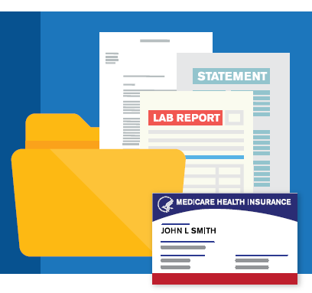
Senior Medicare Patrol (SMP)
SMP goals:
To prevent Medicare fraud before it happens via public outreach and one-on-one assistance and
To report suspected issues as quickly as possible to the proper investigators
SMP is known as a trusted OIG & CMS partner and provides a direct link from Medicare beneficiaries to fraud investigators
Notes:
In addition to SHIP services, many grantees provide Senior Medicare Patrol or SMP program services, which help Medicare beneficiaries protect, detect, and report healthcare fraud, errors, and abuse.
There are SMP 54 Grantees (one in all 50 states, Puerto Rico, Guam, the District of Columbia, and the U.S. Virgin Islands).
SMP is known as a trusted OIG & CMS partner and provides a direct link from Medicare beneficiaries to fraud investigators

Slide 70
SMP
Visit smpresource.org and use the orange button to find your state’s SMP.
Or call 877-808-2468 to be connected to the SMP in your state.
Notes:
The SMP Resource Center serves as a central source of information, expertise, and technical assistance for grantees. The Center disseminates knowledge and best practices through the development of new products, tools, and provides one-on-one assistance to the network. They also host the SMP Locator. To partner with SMP in your community visit smpresource.org. Or call 877-808-2468 to be connected to the SMP in your state.

Slide 71
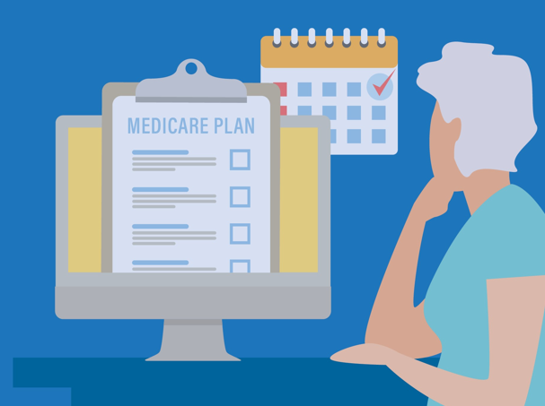
2023 Medicare Open Enrollment
DELIVERING SERVICES REMOTELY
Toollkit
Partner Toolkit: shiphelp.org/ship-resources/covid-19/toolkit
Contents: Best practices, templates, and checklists created by ACL’s grantee network
Notes:
At this phase of COVID-19, in-person services are widely available again. However, many programs that serve the Medicare population continue to offer virtual options. Throughout this toolkit, you will find sample guidelines for using technology to reach beneficiaries, delivering sensitive information safely, managing volunteers or staff working remotely, and more.
This toolkit was first published in September 2020 to help U.S. Administration for Community Living (ACL) grantees modify their service delivery systems and expand their technologies for everyone's safety during the COVID-19 Public Health Emergency (PHE). It was originally titled "COVID-19 Toolkit for ACL Grantees." Though the PHE ended May 11, 2023, many programs that serve the Medicare population continue to offer virtual options and may continue to find this toolkit helpful.

Slide 72
Toolkit Contents
Virtual Service Delivery
Confidentiality
Virtual Counseling
Virtual Events
Volunteer and Staff Support
Find the toolkit at
shiphelp.org/ship-resources/covid-19/toolkit
Notes:
Throughout this toolkit, you will find sample guidelines for using technology to reach beneficiaries, delivering sensitive information safely, managing volunteers or staff working remotely, preparing for future public health emergencies, and more.
The virtual service delivery section of the toolkit is organized into four sections: Confidentiality, Virtual Counseling, Virtual Events, and Volunteer and Staff Support.
The section on Confidentiality includes resources for delivering personal protected information remotely and Tips for ensuring privacy and confidentiality
In the Virtual Counseling section, you’ll find a Pre-appointment form for clients to complete, tips for Getting ready for a virtual Medicare counseling session, guides for Counseling by phone and in person, as well as a counseling companion guide in English and Spanish.
The Virtual Events section includes a Virtual event planning and production checklist, production PowerPoints, presenter guides and virtual event etiquette and preparation checklist.
The last section is focused on Volunteer and Staff Support and includes tips for Managing your program and team remotely
There are also additional resources to explore and a section on health and safety which is important to consider as we enter cold and flu season with covid cases on the rise.
The toolkit can be found at shiphelp.org/ship-resources/covid-19/toolkit

Slide 73
Example: Tips for Privacy and Confidentiality
Notes:
This tip sheet provides tips and questions to consider related to privacy and confidentiality when working online vs. offline in programs where grantees and clients would typically meet face-to-face, in the same physical space.
This tip sheet walks through considerations and tech tips to ensure privacy in a virtual setting.

Slide 74
Example: Getting Ready for a Virtual Counseling Session
Notes:
Counseling virtually can seem overwhelming, but it doesn’t have to be. The trick is to be well organized and have the counseling sessions planned, in advance. This guide shares tips for useful applications that are easily accessible and free to use.

Slide 75
Use and Feedback
Available to all community-based organizations and state agencies serving Medicare beneficiaries
Ideas, comments, or questions related to the toolkit?
Email me at Margaret.flowers@acl.hhs.gov

Slide 76
Q&A 4
To submit a question, select the Q&A icon on your Zoom control bar.
Notes:
To submit a question, select the Q&A icon on your Zoom control bar.

Slide 77
Medicare Account Experience
Aaron Lartey
Product Manager, Web Development Team
Office of Communications

Slide 78
Live Demo
This portion of the presentation will be a live demonstration of the Medicare Account experience.

Slide 79
Q&A 6
To submit a question, select the Q&A icon on your Zoom control bar.
Notes:
To submit a question, select the Q&A icon on your Zoom control bar.

Slide 80
FRAUD AWARENESS
Althea Matthews
Statistician (Health)
Division of Modeling and Analytics
CMS Center for Program Integrity (CPI)

Slide 81
New Card Scheme Examples
“New card for free, add dental, vision, offered coverage of a Medicare Advantage Plan with out calling it MA.”
“Someone saying they were from Medicare asking for the
Medicare Number to get a new card with better benefits.”
“Female named Jerri called the person with Medicare asking for her Medicare Number in exchange for a new card with extra benefits, so person gave her number and then the caller gave her a new Medicare Number (i.e., #xx#xx#xx##).”

Slide 82
Flex cards and Grocery Cards Scams
Some advertisements claim that Medicare is giving out flex cards containing several hundred dollars to apply toward food and other items.
This scam directs you to a website where you’ll be asked to provide personal information that can be stolen, such as a Social Security Number, credit card number or bank account information.
If a caller offers a flex card from Medicare, it’s a scam. Medicare doesn’t issue flex cards. Some private Medicare Advantage Plans offer flex cards, but you must first qualify for one.
Medicare Flex Card Scams by AARP
Notes:
Example complaint call from 1-800-MEDICARE: The person with Medicare is calling to let us know he gets many fraudulent calls from agents trying to switch his Medicare Advantage Plan. They talk about the flex card and over-the-counter benefits. He has provided his Medicare Number to them before, and they switched him without his consent. He hasn’t given them the Medicare Number again since, he says that they have a strong foreign accent, and it sounds like a call center. They know his name. Some of the agents that have called actually have read his Social Security Number back to him. He says that every day he received around 35 calls. These are some of the phone numbers that they’ve called from 8656019497, 8652931901, 8652088732, 6039685253.

Slide 83
Unethical Sales Practices: Unsolicited Calls and Visits
“Woman called trying to say that she was with a Medicare insurance company and wanted to enroll them in a plan with extra benefits. Unsolicited caller.”
“Someone came by the beneficiary’s home…his name was PF…offered the bene that he can give his $148.50 back on his SSA through the plan they offer. PF stated Medicare is sending him to door-to-door to offer this benefit.”
“A woman and a man knocked on the beneficiary’s door saying they were going door-to-door and that her ZIP code qualified her for benefits to help her keep the $144 from being taken out of her check. They told her they were with SSA.”

Slide 84
Unethical Sales Practices: Lack of Consent
“Ms. D received an in-person visit from "Medicare health ins." who wanted to talk to her about extra benefits available. Ms. D declined any services but did give the visitor her Medicare card when asked. Days later, she had a MyMedicare.gov account opened w/out her consent.”
“Your application to the XXX plan has been approved. Letter says that they called, and beneficiary says she did not receive a call from XXX. She did not enroll in XXX plan and wants to stay with her current coverage due to the dental coverage.”
“Callers from the offshore call center…caller asks for the beneficiary by name. If bene responds “yes,” the caller transfers the bene to another representative who’s a licensed agent who enrolls the bene into a MA Plan. Caller then has beneficiary on record as saying “yes” and company uses that as permission to switch the bene’s plan. Company switches people from MA Plans without the knowledge or permission of the beneficiary, then drags out the process of switching the beneficiary back to the original MA Plan when the bene discovers that their original plan has been changed.”
Frank from unknown company called telling Mrs. P she will be switched to XXX even though she stated she was happy with her current XXXX plan and told her he already had her information.

Slide 85
Unethical Sales Practices: Misrepresentation
“Medicare Savings Program of $170.10 each month from SSA…beneficiary states JB is going to come tomorrow at 11am to go over how to sign up for these savings services.”
“Received card in the mail stating that she would be charged a late penalty for a lifetime if she didn't provider her personal information so an insurance agent could contact her.”
“The caller said that she was from Medicare... the caller said that the beneficiary had Medicare Part A and Part B and wanted to know if she wanted to upgrade her plan.”

Slide 86
Q&A 7
To submit a question, select the Q&A icon on your Zoom control bar.
Notes:
To submit a question, select the Q&A icon on your Zoom control bar.

Slide 87
2023 Medicare Advantage Marketing Updates
Jim Canavan
Health Insurance Specialist
Division of Surveillance, Compliance, & Marketing

Slide 88
New Regulatory Changes
CMS-4201-F Marketing Provisions
Published April 12, 2023
Effective June 5, 2023
Applicable September 30, 2023, for calendar year 2024

Slide 89
Categories of Changes
Beneficiary Contact
Marketing Requirements
Third-Party Marketing Organization (TPMO) Requirements

Slide 90
Beneficiary Contact
Prohibiting distribution of Business Reply Cards (BRC) and Scope of Appointments (SOAs) at educational events. May leave out BRCs in a common area and collect them.
Prohibition on marketing events following within 12 hours of an educational event at the same venue.
Requiring that enrollees be notified annually in writing of the ability to opt-out of plan business calls.

Slide 91
Beneficiary Contact (continued)
Requiring 48 hours between scheduling a personal marketing appointment/filling out the SOA and the meeting with the beneficiary.
Limiting the authority for an agent to talk to a member based on a request for more information (e.g., BRC or SOA) to 12 months.

Slide 92
Marketing Requirements
Prohibition on marketing unrealistic savings (e.g., touting $9600 in drug savings when it would only apply to the uninsured – very rare circumstance).
Limits placed on marketing use of the Medicare name and logo as well as the image of the Medicare ID card.
Door-to-door contact considered unsolicited even when a BRC or SOA is in effect (prohibited).
Prohibiting superlatives in marketing copy without accompanying evidence to support the statement.

Slide 93
Marketing Requirements (continued)
Prohibiting marketing of benefits not available by any of the plans in that service area.
To provide meaningful comparisons, requiring medical benefits to be in a specific order and listed at the top of a plan’s Summary of Benefits (SB).
Prohibiting marketing of any product/plan unless the marketing names are identified in the material.
Requiring (online) provider directories to be searchable by every element.

Slide 94
Third-Party Marketing Organization Requirements
Requiring plans to have an oversight program to monitor agent/broker activity and report incidences of non-compliance to CMS.
Clarifying that the requirement to ensure that TPMOs record all marketing calls with beneficiaries includes technology like Zoom.
Requiring TPMO disclaimer to include all plans the TPMO sells (in print) or mention how many organizations the TPMO sells (when spoken).

Slide 95
Third-Party Marketing Organization Requirements: (continued)
Adding the Senior Health Insurance Assistance Program (SHIP) to the TPMO disclaimer.
Requiring agents to explain the effect of enrollment on current coverage (e.g., primary care provider status).
Requiring agents to go through a CMS-developed list of items with beneficiaries before enrollment.
Requiring TPMOs to submit their plan marketing materials to CMS for approval.

Slide 96
New MCMS
Medicare Communications & Marketing Guidelines
Currently in development
Target date for release – Prior to October 1, 2023.

Slide 97
Q&A 8
To submit a question, select the Q&A icon on your Zoom control bar.
Notes:
To submit a question, select the Q&A icon on your Zoom control bar.

Slide 98
Appendices
Resources & Products

Slide 99
Appendix A Your Medicare Options
Original Medicare
Medicare Advantage (also known as Part C)
Notes:
When you first sign up for Medicare, and during certain times of the year, you can choose how you get your Medicare coverage. There are 2 main ways to get Medicare:
Original Medicare
Medicare Advantage (also known as Part C)
Original Medicare
Coverage includes Part A and Part B.
You can join a separate Medicare drug plan to get Medicare drug coverage (Part D).
You can use any doctor or hospital that takes Medicare, anywhere in the U.S.
To help pay your out-of-pocket costs in Original Medicare (like your 20% coinsurance), you can also shop for and buy supplemental coverage. This includes Medicare Supplement Insurance (Medigap) policies, which only work with Original Medicare. Or, you can use coverage from a former employer or union, or Medicaid. Medicaid is a joint federal and state program that helps with medical costs for some people with limited income and (in some cases) resources. It also offers benefits that Medicare doesn’t normally cover, like nursing home care and personal care services. The coinsurance is an amount you may be required to pay as your share of the cost for services after you pay any deductibles. Coinsurance is usually a percentage.
Medicare Advantage (also known as Part C)
A Medicare-approved plan from a private company that offers an alternative to Original Medicare for your health and drug coverage. These “bundled” plans include Part A, Part B, and usually Part D.
In most cases, you can only use doctors who are in the plan’s network.
In many cases, you may need to get approval from your plan before it covers certain drugs or services.
Plans may have lower out-of-pocket costs than Original Medicare.
Plans may offer some extra benefits that Original Medicare doesn’t cover—like vision, hearing, and dental services.

Slide 100
Appendix A Original Medicare vs. Medicare Advantage: Doctor & Hospital Choice
Original Medicare | Medicare Advantage (Part C)
You can use any doctor or hospital that takes Medicare, anywhere in the U.S. | In many cases, you can only use doctors and other providers who are in the plan’s network and service area (for non-emergency care). Some plans offer non-emergency coverage out of network, but typically at a higher cost.
In most cases, you don’t need a referral to use a specialist. | You may need to get a referral to use a specialist.
Notes:
This chart lets you compare Original Medicare and Medicare Advantage Plans side by side. Let’s compare doctor and hospital choice:
Original Medicare
You can go to any doctor or hospital that takes Medicare, anywhere in the U.S.
In most cases, you don’t need a referral to see a specialist.
Medicare Advantage (Part C)
In many cases, you can only use doctors and other providers who are in the plan’s network and service area (for non-emergency care). Some plans offer non-emergency coverage out of network, but typically at a higher cost.
You may need to get a referral to see a specialist.

Slide 101
Appendix A Original Medicare vs. Medicare Advantage: Cost
Original Medicare | Medicare Advantage (Part C)
For Part B-covered services, you usually pay 20% of the Medicare-approved amount after you meet your deductible. This amount is called your coinsurance. | Out-of-pocket costs vary—plans may have lower or higher out-of-pocket costs for certain services.
You pay a premium (monthly payment) for Part B. If you choose to join a Medicare drug plan, you’ll pay a separate premium for your Medicare drug coverage (Part D). | You pay the monthly Part B premium and may also have to pay the plan’s premium. Some plans may have a $0 premium and may help pay all or part of your Part B premium. Most plans include Medicare drug coverage (Part D).
There’s no yearly limit on what you pay out of pocket, unless you have supplemental coverage—like Medicare Supplement Insurance (Medigap). | Plans have a yearly limit on what you pay out of pocket for services Medicare Part A and Part B cover. Once you reach your plan’s limit, you’ll pay nothing for services Part A and Part B cover for the rest of the year.
You can choose to buy Medigap to help pay your remaining out-of-pocket costs (like your 20% coinsurance). Or, you can use coverage from a former employer or union, or Medicaid. | You can’t buy and don’t need Medigap.
Notes:
Costs
Original Medicare
For Part B-covered services, you usually pay 20% of the Medicare-approved amount after you meet your deductible. This amount is called coinsurance.
You pay a premium (monthly payment) for Part B. If you choose to join a Medicare drug plan, you’ll pay a separate premium for your Medicare drug coverage (Part D).
There’s no yearly limit on what you pay out of pocket, unless you have supplemental coverage—like Medicare Supplement Insurance (Medigap).
You can choose to buy Medigap to help pay your remaining out-of-pocket costs (like your 20% coinsurance). Or, you can use coverage from a former employer or union, or Medicaid.
Medicare Advantage Plans (Part C)
Out-of-pocket costs vary—plans may have lower or higher out-of-pocket costs for certain services.
You pay the monthly Part B premium and may also have to pay the plan’s premium. Some plans may have a $0 premium and may help pay all or part of your Part B premium. Most plans include Medicare drug coverage (Part D).
Plans have a yearly limit on what you pay out of pocket for services Medicare Part A and Part B cover. Once you reach your plan’s limit, you’ll pay nothing for services Part A and Part B cover for the rest of the year.
You can’t buy and don’t need Medigap.

Slide 102
Appendix A Original Medicare vs. Medicare Advantage: Coverage
Original Medicare | Medicare Advantage (Part C)
Original Medicare covers most medically necessary services and supplies in hospitals, doctors’ offices, and other health care facilities. Original Medicare doesn’t cover some benefits like eye exams, most dental care, and routine exams. | Plans must cover all medically necessary services that Original Medicare covers. Plans may also offer some extra benefits that Original Medicare doesn’t cover—like vision, hearing, and dental services.
You can join a separate Medicare drug plan to get Medicare drug coverage (Part D). | Medicare drug coverage (Part D) is included in most plans. In most types of Medicare Advantage Plans, you can’t join a separate Medicare drug plan.
In most cases, you don’t need approval for Original Medicare to cover your services or supplies. | In many cases, you may need to get approval from your plan before it covers certain services or supplies.
Notes:
Coverage
Original Medicare
Covers most medically necessary services and supplies in hospitals, doctors’ offices, and other health care facilities. Original Medicare doesn’t cover some benefits like eye exams, most dental care, and routine exams.
You can join a separate Medicare drug plan to get Medicare drug coverage (Part D).
In most cases, you don’t need approval for Original Medicare to cover your services or supplies.
Medicare Advantage Plans (Part C)
Plans must cover all medically necessary services that Original Medicare covers. Plans may also offer some extra benefits that Original Medicare doesn’t cover—like vision, hearing, and dental services.
Medicare drug coverage (Part D) is included in most plans. In most types of Medicare Advantage Plans, you can’t join a separate Medicare drug plan.
In many cases, you may need to get approval from your plan before it covers certain services or supplies.

Slide 103
Appendix A Original Medicare vs. Medicare Advantage: Foreign Travel
Original Medicare | Medicare Advantage (Part C)
Original Medicare generally doesn’t cover medical care outside the U.S. You may be able to buy a Medicare Supplement Insurance (Medigap) policy that covers emergency care outside the U.S. | Plans generally don’t cover medical care outside the U.S. Some plans may offer a supplemental benefit that covers emergency and urgently needed services when traveling outside the U.S.
Notes:
Foreign Travel
Original Medicare generally doesn’t cover medical care outside the U.S. You may be able to buy a Medicare Supplement Insurance (Medigap) policy that covers emergency care outside the U.S.
Medicare Advantage Plans (Part C) generally don’t cover medical care outside the U.S. Some plans may offer a supplemental benefit that covers emergency and urgently needed services when traveling outside the U.S.
Medicare may pay for inpatient hospital, doctor, ambulance services, or dialysis you get in a foreign country in these rare cases:
You’re in the U.S. when a medical emergency occurs, and the foreign hospital is closer than the nearest U.S. hospital that can treat your medical condition.
You're traveling through Canada without unreasonable delay by the most direct route between Alaska and another state when a medical emergency occurs, and the Canadian hospital is closer than the nearest U.S. hospital that can treat the emergency.
You live in the U.S. and the foreign hospital is closer to your home than the nearest U.S. hospital that can treat your medical condition, regardless of whether an emergency exists.
In some cases, Medicare may cover medically necessary health care services you get on board a ship within the territorial waters adjoining the land areas of the U.S. Medicare won't pay for health care services you get when a ship is more than 6 hours away from a U.S. port. Medicare drug plans don't cover drugs you buy outside the U.S. Medigap policies may cover you when you travel outside the U.S.
Source: Medicare.gov/coverage/travel

Slide 104
Appendix B Guide to Consumer Mailings
Notes:
Available at CMS.gov/Medicare/Prescription-Drug-Coverage/LimitedIncomeandResources/Downloads/Consumer-Mailings.pdf.

Slide 105
Appendix B Guide to Consumer Mailings (continued 1)
Notes:
Available at CMS.gov/Medicare/Prescription-Drug-Coverage/LimitedIncomeandResources/Downloads/Consumer-Mailings.pdf.

Slide 106
Appendix B Guide to Consumer Mailings (continued 2)
Notes:
Available at CMS.gov/Medicare/Prescription-Drug-Coverage/LimitedIncomeandResources/Downloads/Consumer-Mailings.pdf.

Slide 107
Appendix B Guide to Consumer Mailings (continued 3)
Notes:
Available at CMS.gov/Medicare/Prescription-Drug-Coverage/LimitedIncomeandResources/Downloads/Consumer-Mailings.pdf.

Slide 108
Appendix B Guide to Consumer Mailings (continued 4)
Notes:
Available at CMS.gov/Medicare/Prescription-Drug-Coverage/LimitedIncomeandResources/Downloads/Consumer-Mailings.pdf.

Slide 109
Appendix C Enrollment Periods
Election Period | Occurs From | Coverage Starts | Notes
Initial Enrollment Period (IEP) | Three months before the month you turn 65 and ends 3 months after the month you turn 65 | Varies | After your Initial Enrollment Period is over, you may have a chance to sign up for Medicare during a Special Enrollment Period (SEP).
Open Enrollment Period (OEP) | Oct 15 – Dec 7 | January 1 | Plan marketing begins on Oct 1.
Medicare Advantage (MA) Open Enrollment Period (OEP) | Jan 1 – Mar 31, or first 3 months after initial Medicare entitlement | First day of the month after request is made | Must have MA. Can switch to any MA Plan (except MSA), or go to OM. If go to OM, have SEP to enroll in Part D. Can add or drop Part D when switching.
General Enrollment Period (GEP) | January 1–March 31 | First day of the month after you sign up | If you have to pay for Part A but don’t sign up for it and/or don’t sign up for Part B during your IEP, and you don’t qualify for an SEP, you can sign up during the GEP.
Notes:
The chart on this slide explains enrollment periods with specifics about timing and circumstances.

Slide 110
Appendix C Special Enrollment Periods (SEPs)
After your Initial Enrollment Period is over, you may have a chance to enroll in a Medicare Advantage Plan or Medicare Prescription Drug Plan during an SEP.
Election Period | Occurs From | Coverage Starts | Notes
5-Star Special Enrollment Period (SEP) | For enrollments effective during the year in which that plan has the 5-star rating | First day of the month after request is made | Only enroll into a 5-Star plan. Part D coverage not guaranteed.
Other Special Enrollment Periods (SEPs) | Varies based on situation (like residence changes, Special Needs status, dual eligible/LIS eligible, etc.) and exceptional circumstances (like incarceration, losing Medicaid coverage, etc.) | Varies | Visit Other Special Enrollment Periods (SEPs) to view the full list.
Using the GEP for SEP/Part D & Medicare Advantage Enrollment | If you enroll in Part B during the GEP, you can join a Medicare Drug plan or Medicare Advantage Plan with drug coverage | First day of the month after plan receives the request | You must have to pay for Part A. The SEP lasts for 2 months after you submit the application for Part B.
Notes:
The chart on this slide explains enrollment periods with specifics about timing and circumstances.

Slide 111
Appendix D Medicare Resources
2024 Medicare Part A & Part B Costs announcement –(Link will be added once the costs are released)
Plan Finder – Medicare.gov/plan-compare
The “Medicare & You” handbook – Medicare.gov/Publications/Pubs/pdf/10050.pdf
SHIP – shiphelp.org
1-800-MEDICARE (1-800-633-4227); TTY: 1‑887-486-2048

Slide 112
Appendix D Medicare Resources (continued)
Open Enrollment Center on CMS.gov at CMS.gov/Medicare-Open-Enrollment
Visit the product ordering website at Productordering.cms.hhs.gov
Posters, conference cards, and publications
View the Medicare Communications & Marketing Guidance (MCMG) at CMS.gov/Medicare/Health-Plans/ManagedCareMarketing/ Final PartCMarketingGuidelines.html
CMS Program Data ‒ data.CMS.gov
CMS Research ‒ CMS.gov/Research-Statistics-Data-and-Systems/Research-Statistics-Data-and-Systems
CMS updates ‒ CMS.gov/newsroom

Slide 113
Appendix E Medicare Products
CMS Product Name | CMS Product Number
Choosing Medicare Drug Coverage | 11163
Have You Done Your Yearly Medicare Plan Review? | 11220
Understanding Medicare Part C & D Enrollment Periods | 11219
3 Ways to Help Lower Your Medicare Prescription Drug Costs | 11417
Understanding Medicare Advantage Plans | 12026
Medicare Open Enrollment Palm Card | 12196
Notes:
“Choosing Medicare Drug Coverage,” visit Medicare.gov/publications/11163-Compare-Medicare-Drug-Coverage.pdf
“Have You Done Your Yearly Medicare Plan Review?,” visit Medicare.gov/Pubs/pdf/11220-Medicare-Yearly-Review.pdf
“Understanding Medicare Advantage & Medicare Drug Plan Enrollment Periods,” visit Medicare.gov/Pubs/pdf/11219-understanding-medicare-part-c-d.pdf
“3 Ways to Help Lower Your Medicare Prescription Drug Costs,” visit Medicare.gov/media/9696
“Understanding Medicare Advantage Plans,” visit Medicare.gov/Pubs/pdf/12026-Understanding-Medicare-Advantage-Plans.pdf
“Medicare Open Enrollment Palm Card,” visit Medicare.gov/media/publication/12196-open-enrollment-palm-card.pdf

Slide 114
Appendix F NTP Workshop Recordings
Social Security
Medicare Enrollment, Eligibility, Part A and Part B
Medicare Advantage
Drug Coverage When Using Medicare
Medicare Supplement Insurance (Medigap)
Medicare for People with Disabilities
Medicare Current Topics
Medicare for People with End-Stage Renal Disease (ESRD)
Coordination of Benefits
Medicare Scenarios (Casework Session)
Medicare & Tax-Favored Health Programs
Medicare Plan Finder
Notes:
From July through August 2023, NTP invited subject matter experts and presenters to explain a variety of health care topics. These sessions were recorded and are available for viewing on the Course Catalog tab of the NTP website at CMSnationaltrainingprogram.cms.gov/?q=ntp-courses. You must login or create an account to view the recordings. Presentation materials and 1-pager aid are also attached to the appropriate recording and can be downloaded.

Slide 115
Stay Connected

