Slide 1
NTP Medicare Open Enrollment Period (OEP) Bootcamp 2024 (Day 1)
Notes:
Medicare Open Enrollment is from October 15 to December 7, 2024. Coverage begins January 1, 2025, if you enroll or change plans.
Disclaimer​
This training module was developed and approved by the Centers for Medicare & Medicaid Services (CMS), the federal agency that administers Medicare, Medicaid, the Children’s Health Insurance Program (CHIP), and the Health Insurance Marketplace®. ​
The information in this module was correct as of September 2024. To check for an updated version, visit CMSnationaltrainingprogram.cms.gov. The CMS National Training Program provides this information as a resource for our partners. It’s not a legal document or intended for press purposes. The press can contact the CMS Press Office at https://www.cms.gov/newsroom/press-contacts. Official Medicare Program legal guidance is contained in the relevant statutes, regulations, and rulings.​
This communication was printed, published, or produced and disseminated at U.S. taxpayer expense.​
Health Insurance Marketplace® is a registered service mark of the U.S. Department of Health & Human Services (HHS).​

Slide 2
Today’s Agenda
Welcome
Using the Medicare Plan Finder―Basics and Tips & 2024 Updates
Break
Part D Redesign
Medicare Prescription Payment Plan
Communication and Outreach
Wizard and Resources
Cost Preview
Answers to Your Policy Questions
Appendices and Resources
Closing
Notes:
Today’s training agenda:
Welcome
Using the Medicare Plan Finder―Basics and Tips & 2024 Updates
Break
Part D Redesign
Medicare Prescription Payment Plan
Communication and Outreach
The Wizard and Resources
Cost Preview
Answers to Your Policy Questions
Appendices and Resources
Closing

Slide 3
Session Objectives
This session should help you:
Recognize and navigate Plan Finder user-facing features
Identify 2024 improvements and enhancements
Understand Part D Redesign elements
Explain the Medicare Prescription Payment Plan
Notes:
This session should help you:
Recognize and navigate Plan Finder user-facing features
Identify 2024 improvements and enhancements
Understand Part D Redesign elements
Explain the Medicare Prescription Payment Plan

Slide 4
Using the Medicare Plan Finder: Basics, Tips, 2024 Updates & Enhancements
Rajul A. Patel, PharmD, PhD
Professor of Pharmacy Practice
University of the Pacific-School of Pharmacy

Slide 5
Rajul A. Patel, PharmD, PhD Professor- Pharmacy Practice University of the Pacific School of Pharmacy
Medicare Plan Finder September 25, 2024

Slide 6
Session Objectives
This session should:
Give you an overview of Medicare prescription drug coverage
Enable you to effectively navigate the Medicare Plan Finder
Illustrate functions and features of the Plan Finder
Familiarize you with updates to the Plan Finder
Teach you how to evaluate Medicare drug plans
Highlight factors to consider when using the Plan Finder
Provide Plan Finder user pearls
Pearl

Slide 7
Medicare Prescription Drug Coverage (Part D)
TWO ways to get prescription drug coverage through Medicare:
Medicare Advantage Prescription Drug Plan (MA-PD)
Must have Part A and Part B to join a MA-PD
A stand-alone Prescription Drug Plan (PDP)
Must have Medicare Part A and/or Part B to join a PDP
Which is then added to traditional Medicare
NOTE: A patient cannot add a PDP to a MA-PD or SNP
Notes:
A patient can’t combine a PDP and a MA-PD .
As an example, if a pt chooses an MA-PD in order to get the addnl outpt and hospital coverage and the rx drug coverage w/ that MA-PD does not cover some of the pts rx drugs, that pt cannot add a stand-alone Part D plan to this MA-PD in order to improve their rx drug coverage.

Slide 8
Medicare Drug Plan Choices in California (2024)
MA-PDs
Each county has different available plans
San Joaquin County has 35 plans
San Francisco County 35 plans
San Diego County has 66 plans
Los Angeles County has 74 plans
PDPs
23 plans- each of which is available throughout the region
Notes:
Sf= 94102; SD = 92020; LA = 91344
58 counties in CA
PDPs are available region wide. CA is just one of the 34 regions for Part D plans. California is region 9. If a Part D plan is available in the CA region, it is not necessarily available in another of the Medicare regions.

Slide 9
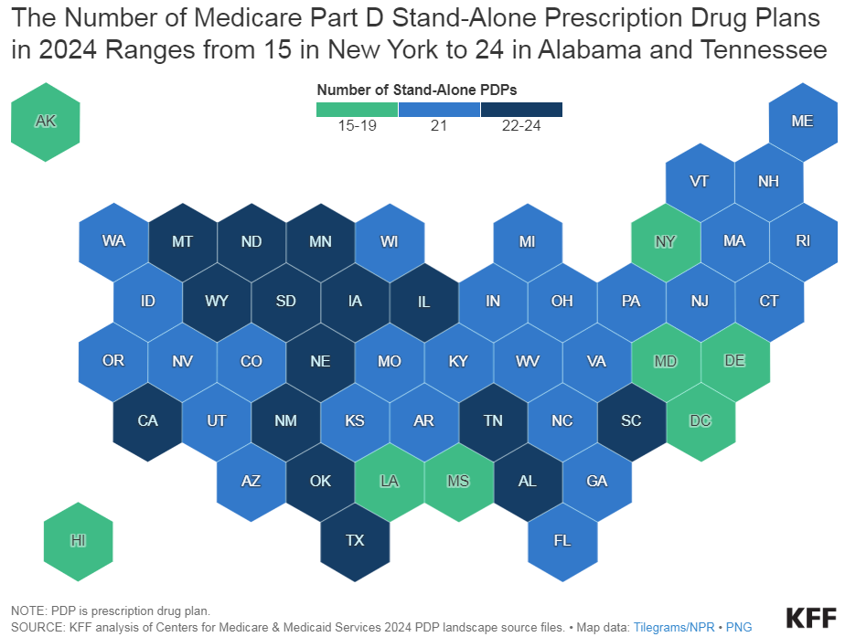
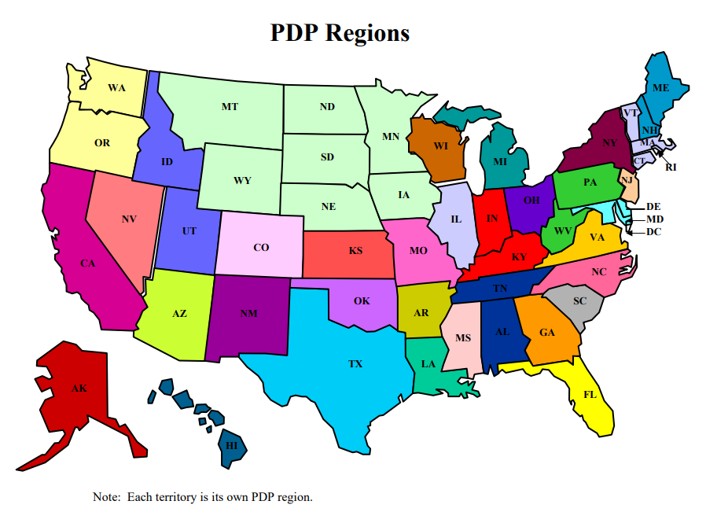
PDP Offerings in 2024
Notes:
Country broken up into 34 regions with regards to Part D

Slide 10
Prescription Drug Coverage
Most beneficiaries need to actively sign up for a Medicare Rx drug plan (MA-PD or PDP) or face a late-enrollment penalty.
Exceptions:
Medicaid or Low-Income Subsidy recipients
Those who have “creditable coverage”
Creditable Coverage: Drug coverage > Standard Part D benefit
Creditable coverage is provided by:
Some employer benefits or union programs
VA, TRICARE, FEHBP, IHS
Notes:
CMS requires all PDP sponsors offering EGWPs to ensure that the total employer/union sponsored plan (including adjusting for any supplemental coverage) provides at least the standard Part D coverage, including a deductible no higher than that of defined standard Part D and catastrophic coverage after the true out-of-pocket limit is met.

Slide 11
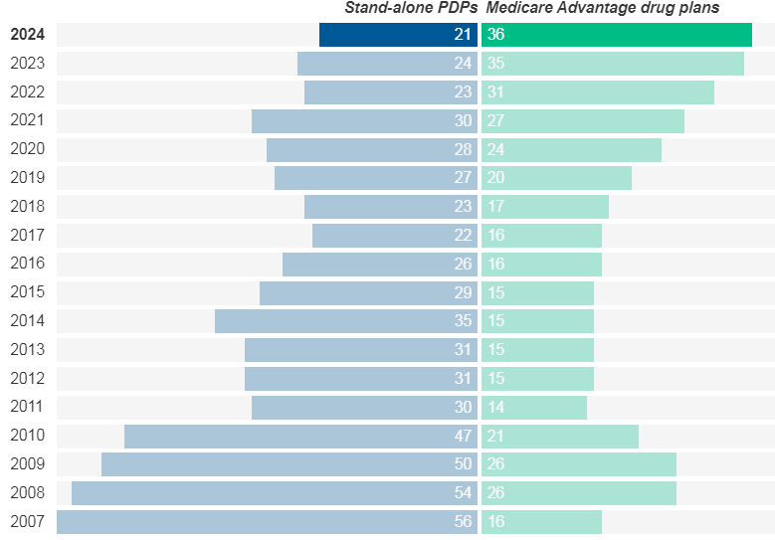
Stand-alone PDP’s vs Medicare Advantage Drug Plans
The average Medicare beneficiary has a choice of ~60 Medicare drug plan offerings in 2024;
Including 21 Stand-Alone Drug Plans (PDPs) and
36 Medicare Advantage Drug Plans (MA-PDs)
Graphic Source: Kaiser Family Foundation (kff.org)
Notes:
https://www.kff.org/medicare/issue-brief/medicare-part-d-a-first-look-at-medicare-drug-plans-in-2023/

Slide 12
Joining, Switching, or Dropping a Medicare DRUG (PDP or MA-PD) Plan
Initial Enrollment Period:
You can join a Medicare drug plan when you are 1st eligible for Medicare
Open Enrollment Period:
Between Oct 15th–Dec 7th anyone can join or switch Medicare drug plans
Coverage begins on Jan 1st
Special Enrollment Periods:
Retired or Employer Coverage Ends
Moved
Duals/Extra Help
5-Star plans
Medicare Advantage Open Enrollment
From 1/1-3/31 each year
MA-PD → MA-PD or
MA-PD → Original Medicare + PDP
Notes:
Special enrollment periods = You move out of your plan’s service area, You have Medicaid, you qualify for Extra Help, you live in an institution like a nursing home
5-Star Special Enrollment Period
Adding a Monthly PDP SEP for Dual Eligible Beneficiaries
A new SEP to allow a dual-eligible beneficiary a once per month SEP to enroll in a standalone PDP
Anytime you’re still covered by the GHP
During the 8-month period that begins the month after the employment ends or the coverage ends, whichever happens first

Slide 13
MEDICARE.GOV
Select

Slide 14
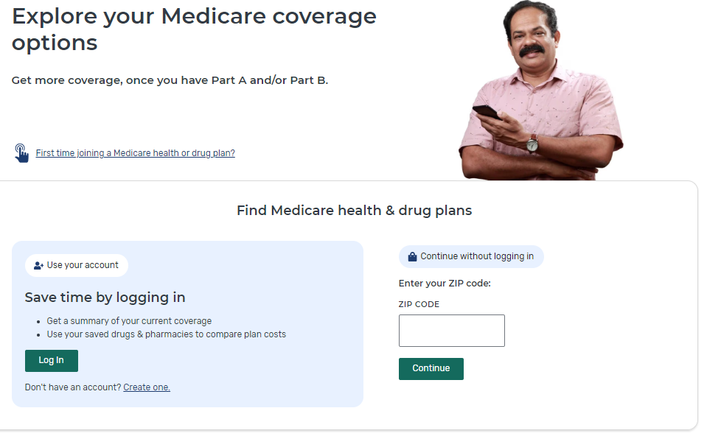
General Search

Slide 15
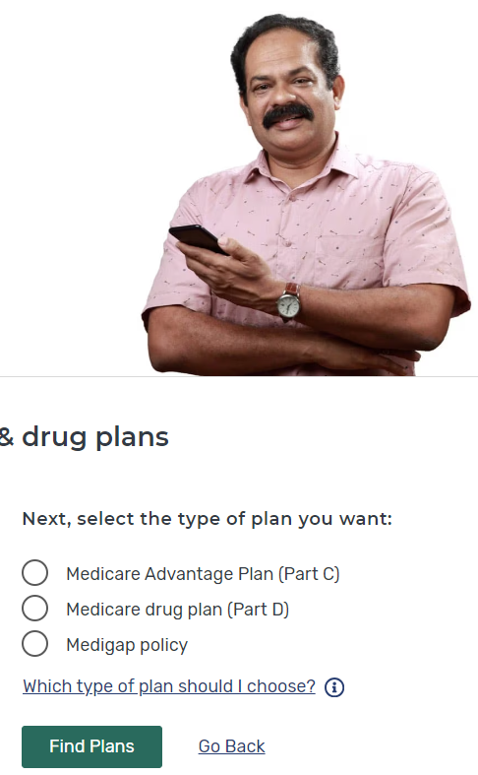
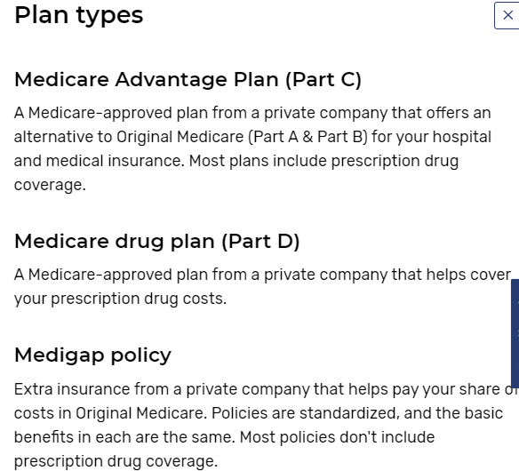
Medicare Plan Types

Slide 16
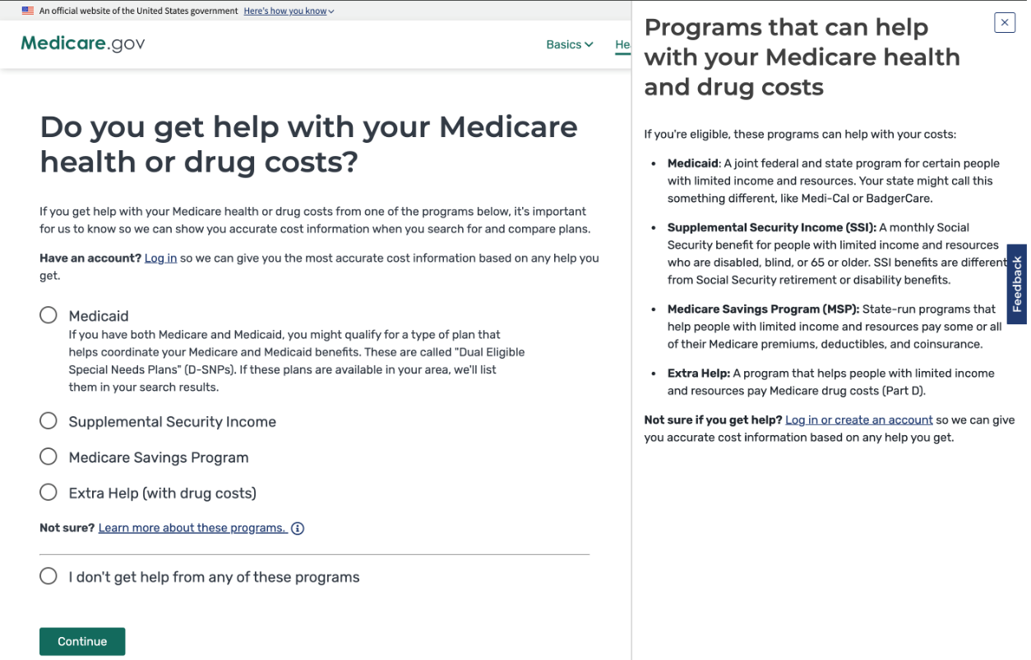
Additional Governmental Assistance?

Slide 17
Prescription Drug Entry
Pearl

Slide 18
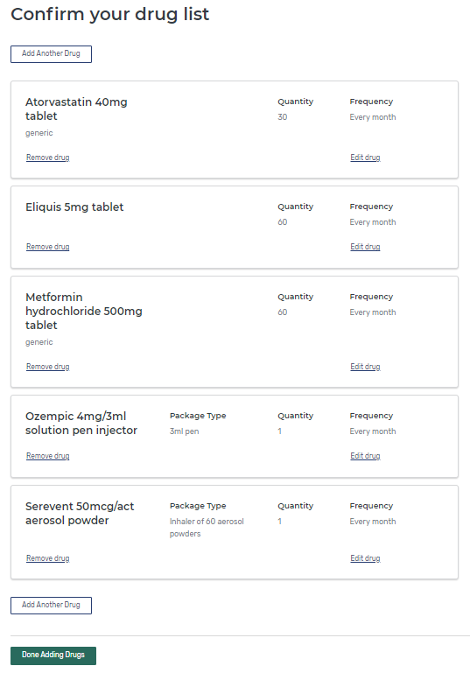
Drug Entry Verification
Over-the-Counter drugs CANNOT be added!
After verifying that ALL of the drug information is correct, select ‘Done Adding Drugs’

Slide 19
Pharmacies

Slide 20
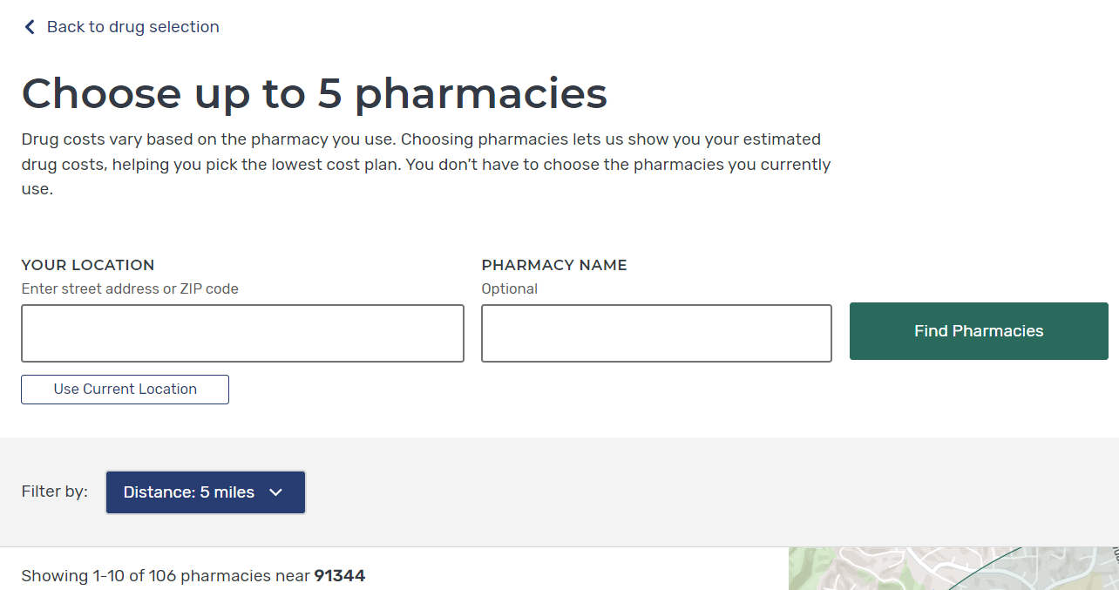
Pharmacy Preferences

Slide 21
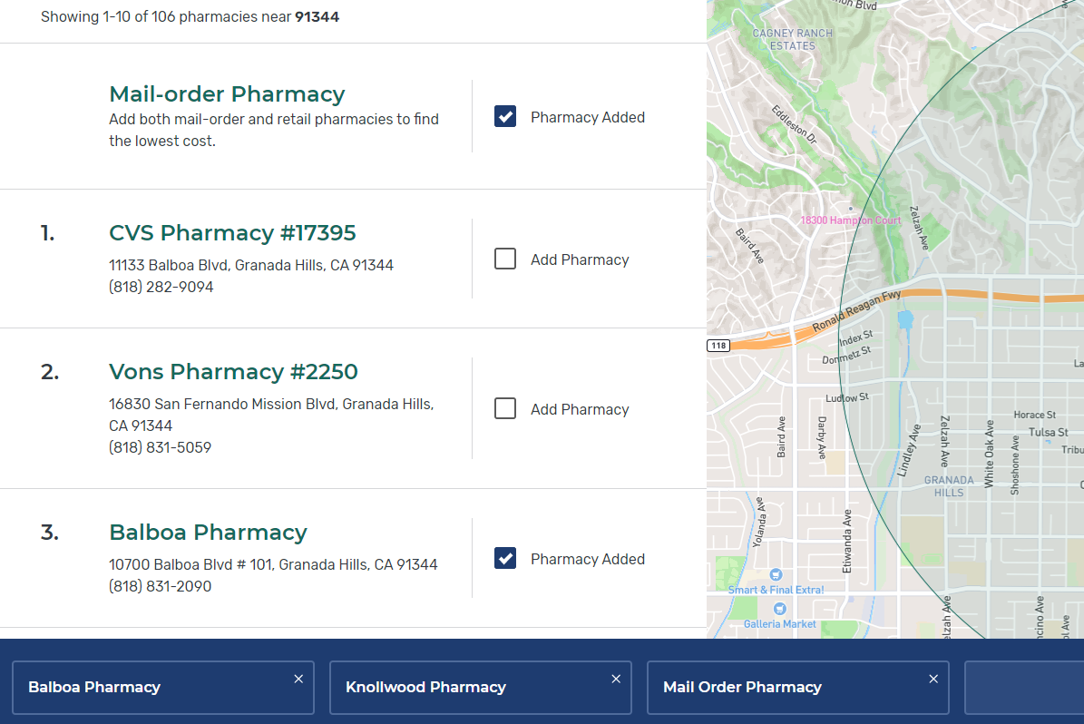
Selecting a Pharmacy(ies)
Notes:
When you find your pt’s pharmacy, select it to add it to the blue bar at the bottom of the page. The blue bar shows the pharmacies you currently have selected. You can remove pharmacies from the blue bar by clicking the “x” in the top right corner of any pharmacy listed.

Slide 22
Plan Filters
Notes:
Plan type→ PDP or MA

Slide 23
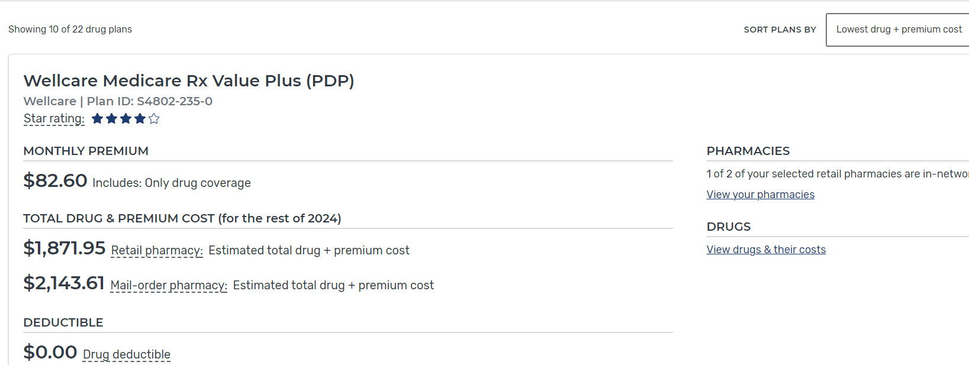
Plan Sorting

Slide 24
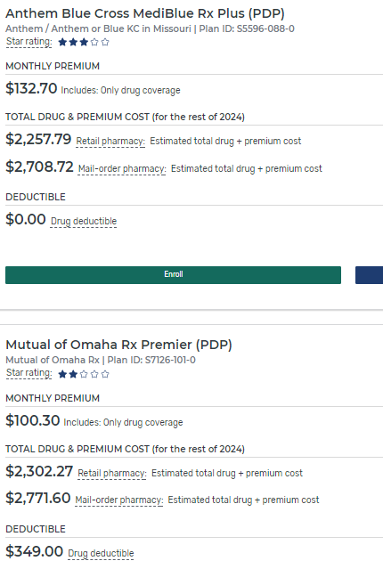
Plan Results

Slide 25
Dissecting the Plan Finder
Pearl
General Search- lowest cost retail plan is listed first
Personalized Search- the beneficiary’s plan is listed first
All plans are listed from least to most expensive (based on estimated annual costs- RETAIL)
Have to manually scroll to find if mail-order is lower
NOTE: Sometimes the beneficiary’s current plan is the least expensive!!!

Slide 26
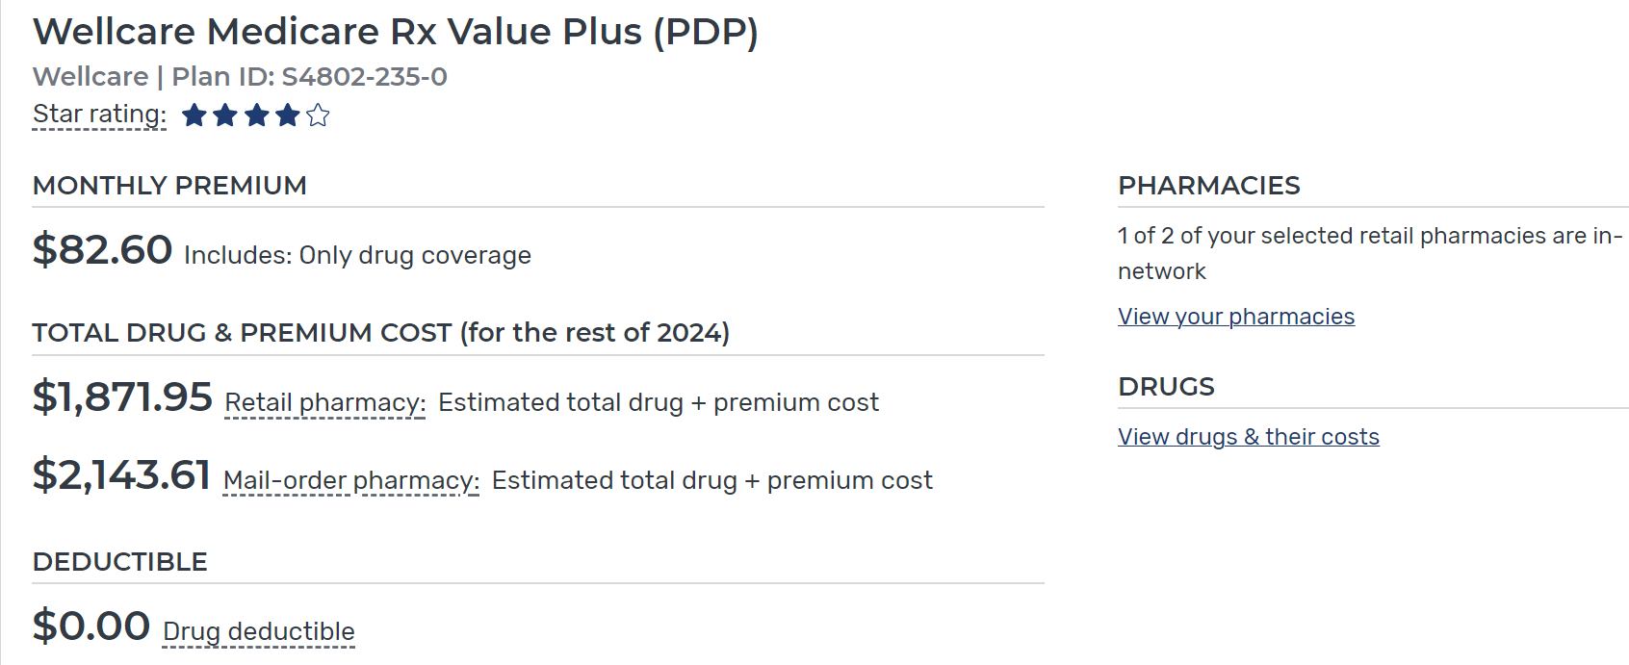
Total Drug + Premium Cost

Slide 27
Estimated Total DRUG + Premium Cost
Includes all of the following:
Yearly premium
Annual deductible
Drug costs before the gap (Co-insurance/Co-pay phase)
Drug costs during the gap (Donut Hole)
Drug costs after the gap (Catastrophic Coverage phase)*
Cash costs of any non-formulary drugs
= aka “Total out-of-pocket costs”

Slide 28
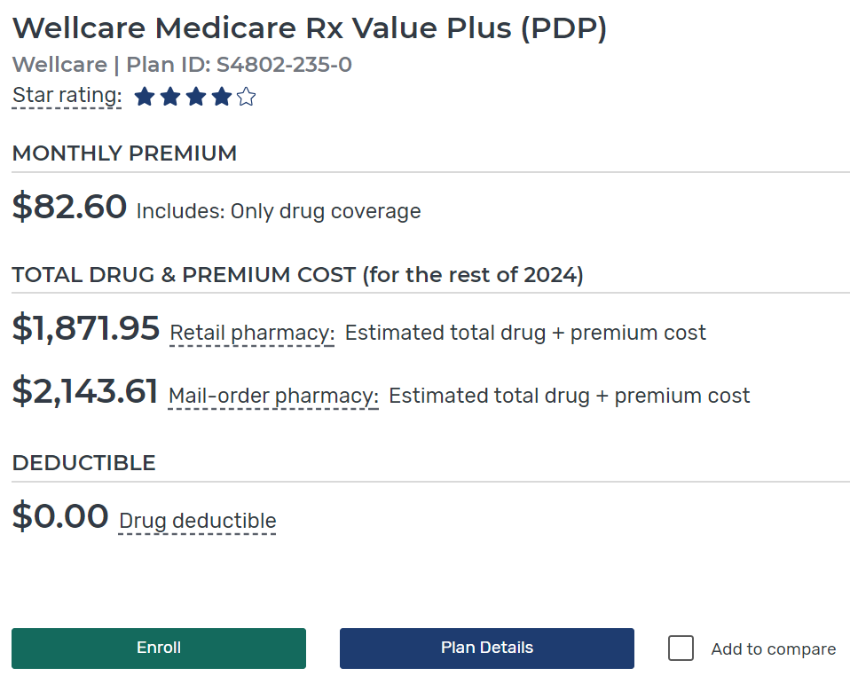
Plan Details

Slide 29
Costs
Notes:
Beneficiaries wanted to see which drugs were and were not covered by an individual plan on plan details page
Added the anchor link next "Covers X of X Drugs" and have the link scroll to "Yearly drug cost by pharmacy“ section under Drug Coverage

Slide 30
DRUG LIST

Slide 31
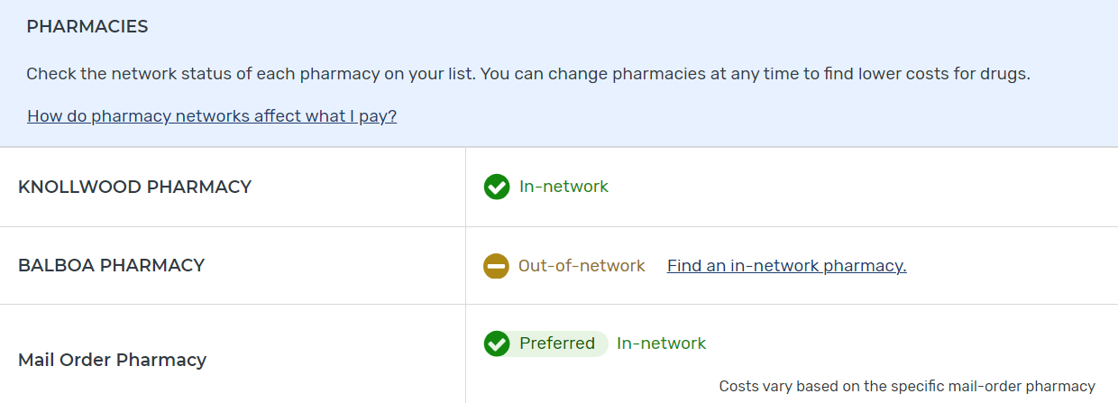
Pharmacy Network

Slide 32
Pharmacy Network (Continued)
Definition: A contracted group of pharmacies that provide incentivized rates to a plan, thereby lowering costs for the plan and patients.
Pharmacy contracts with plan
Receive lower reimbursement rates
Increased volume of business
In-Network vs. Preferred
Out-of-Network
Pharmacies
In-Network Pharmacies
Preferred Pharmacies
Notes:
Financial incentives for members
Inside pharmacy network = Drug coverage / low copays
Outside pharmacy network = No drug coverage or higher copays
Pharmacy Networks are determined by payer requirements
Access: Distance a member must travel to reach a network pharmacy (5 miles, 10 miles, etc.)
Density: Number of pharmacies available to a member within the access requirement
Networks can be:
Open - All pharmacies within a geographical area
Closed - Drug benefit is available only at designated pharmacies
Preferred - Pharmacy tiers (e.g.. 1st tier = lowest cost); subsequent tiers cost more to members

Slide 33
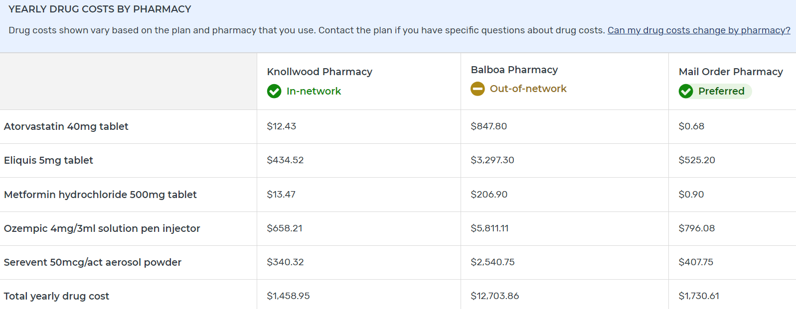
Drug Costs via Pharmacy Type

Slide 34
How to Find Plan-Specific Preferred Pharmacies
Pearl

Slide 35
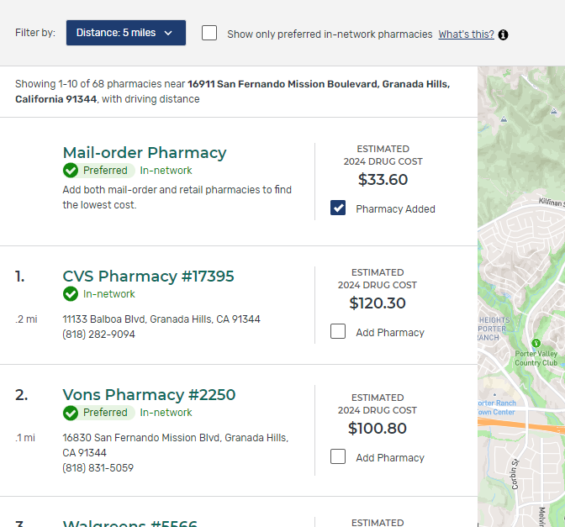
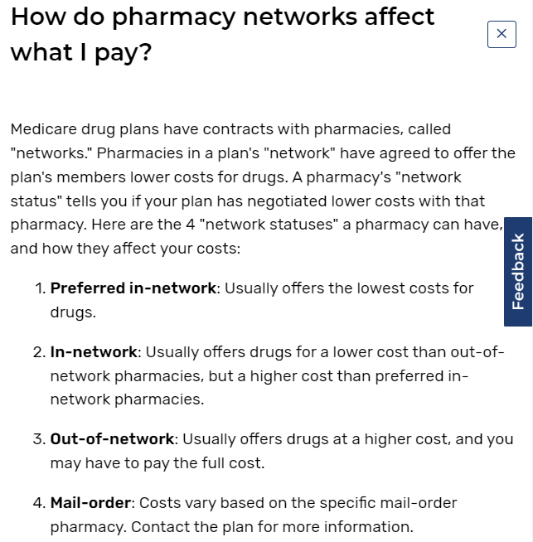
Plan Pharmacy Network—Costs
Notes:
A series of changes will be made to the Pharmacy Finder and In-Network Pharmacy Finder to help users to make the connection between pharmacy selection and drug prices clearer and easier to use, including:
Display estimated total drug costs price per pharmacy directly on In-Network Pharmacy Finder map at the associated pharmacy location
The distance between each pharmacy and the user's location is displayed below the pharmacy name on Plan Details.

Slide 36
Costs via Entered pharmacies
Pearl
When entering more than one pharmacy, make sure to look at plan details to see expected costs under each pharmacy

Slide 37
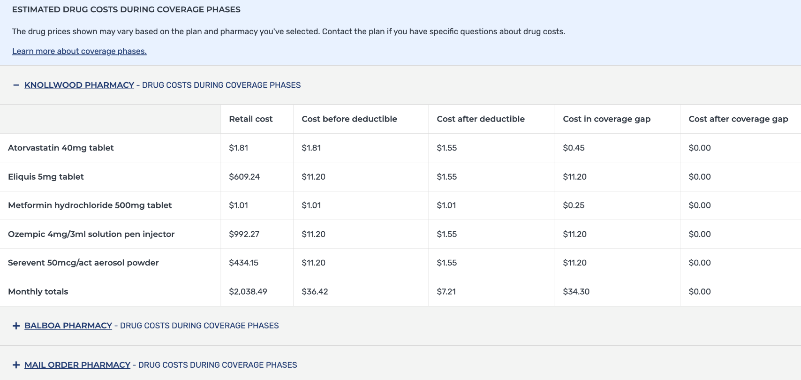
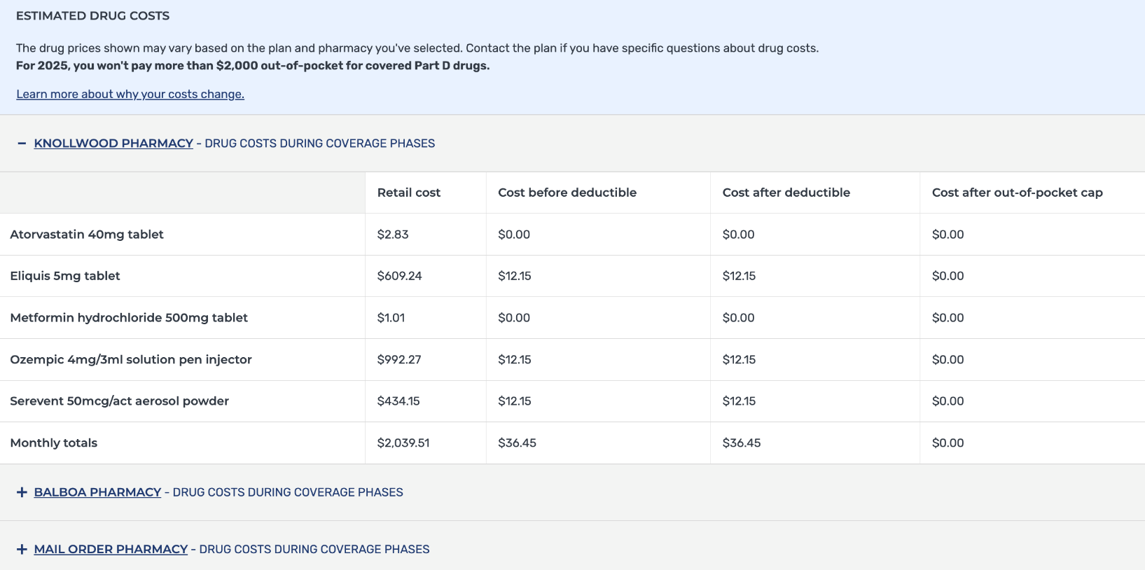
Drug Costs in Different Phases of the Part D Benefit
Drug costs - With coverage gap
Drug costs - No coverage gap

Slide 38
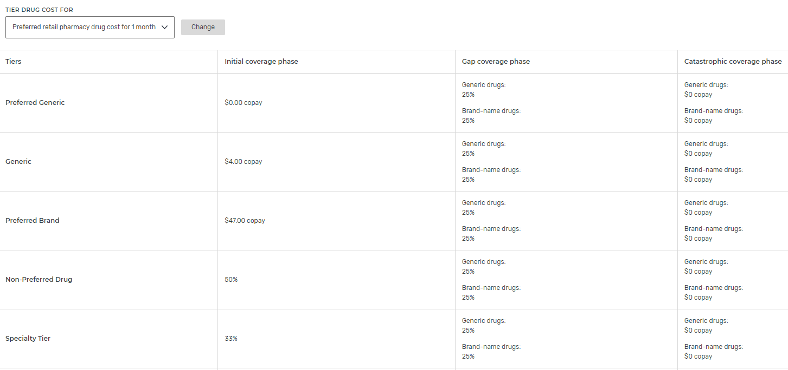
Costs via Pharmacy Type

Slide 39
Drug Restrictions

Slide 40
Drug Restrictions (Continued)
Pearl
Check to see if restrictions affect the beneficiary! (May have to contact plan or check plan website)

Slide 41
Utilization Management Tools (Plan Restrictions)

Slide 42
Utilization Management Tools: Prior Authorization
Prior Authorization (PA)
Means that the patient and/or their prescriber must contact the drug plan to determine if specific criteria are met before the patient can fill certain prescriptions.
Plans may also use PA when they cover a drug for only certain medical conditions it is approved for, but not others.
Your prescriber may need to show that the drug is medically necessary for the plan to cover it.
Notes:
To be sure that certain drugs are prescribed and used correctly, plans may have certain rules including:…
These are ways plans can manage access to covered drugs on their formularies…all 3 of above are on plan finder…but exact details only available for QL
Prior authorization -If the patient’s physician must contact the plan and establish that the drug is medically necessary for the patient; prior approval is required from the Plan before it will cover certain meds

Slide 43
Utilization Management Tools: Prior Authorization (Continued)
Call their Part D plan or visit the plan’s website to learn about specific PA requirements.
Many PA requirements can be resolved at the point of sale and don’t require any additional info from the doctor.
If the patient does NOT satisfy the PA, the patient may work with the plan & their doctor to get an exception

Slide 44
Prior Authorization
Notes:
Brand name is Pristiq (SNRI)
is indicated for the treatment of adults with major depressive disorder (MDD)
SNRIs: duloxetine (Cymbalta), venlafaxine (Effexor), venlafaxine XR (Effexor XR),
Serotonin-Norepinephrine Reuptake inhibitors (SNRIs)

Slide 45
Utilization Management Tools: Step Therapy
You must first try a certain, less expensive drug on the plan’s formulary that’s been proven effective for most people with your condition before you can move up a “step” to a more expensive drug.
For instance, some plans may require you first try a generic drug (if available)
→ a less expensive brand-name drug on their drug list
→ before you can get a similar, more expensive, brand-name drug covered.
Notes:
Type of PA
For instance, some plans may require you first try a generic drug (if available), then a less expensive brand-name drug on their drug list before you can get a similar, more expensive, brand-name drug covered.
However, if your prescriber believes that because of your medical condition it’s medically necessary for you to be on a more expensive step therapy drug without trying the less expensive drug first, you or your prescriber can contact the plan to request an exception
Your prescriber can also request an exception if he or she believes you’ll have adverse health effects if you take the less expensive drug, or if your prescriber believes the less expensive drug would be less effective. Your prescriber must give a statement supporting the request. If the request is approved, the plan will cover the more expensive drug, even if you didn’t try the less expensive drug first.

Slide 46
Utilization Management Tools: Step Therapy (Continued)
However, if your prescriber believes that because of your medical condition it’s medically necessary for you to be on a more expensive step therapy drug without trying the less expensive drug first, you or your prescriber can contact the plan to request an exception.
So, if a drug has step therapy restrictions, the patient may work with the plan & their doctor to get an exception.
Notes:
Type of PA
For instance, some plans may require you first try a generic drug (if available), then a less expensive brand-name drug on their drug list before you can get a similar, more expensive, brand-name drug covered.
However, if your prescriber believes that because of your medical condition it’s medically necessary for you to be on a more expensive step therapy drug without trying the less expensive drug first, you or your prescriber can contact the plan to request an exception
Your prescriber can also request an exception if he or she believes you’ll have adverse health effects if you take the less expensive drug, or if your prescriber believes the less expensive drug would be less effective. Your prescriber must give a statement supporting the request. If the request is approved, the plan will cover the more expensive drug, even if you didn’t try the less expensive drug first.

Slide 47
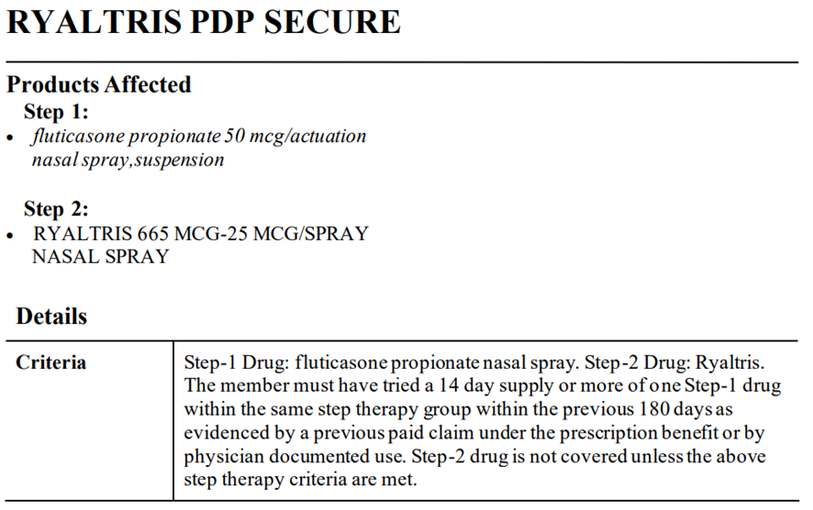
Step Therapy
Notes:
Febuxostat (Uloric)
ULORIC is a xanthine oxidase (XO) inhibitor indicated for the chronic management of hyperuricemia in adult patients with gout who have
an inadequate response to a maximally titrated dose of allopurinol,
who are intolerant to allopurinol,
or for whom treatment with allopurinol is not advisable.

Slide 48
Utilization Management Tools: Quantity Limits
For safety and cost reasons, plans may limit the amount of prescription drugs they cover over a certain period of time.
For example, a plan may cover 30 tablets every 30 days.
If your prescriber believes that, because of your medical condition, a quantity limit isn’t medically appropriate (e.g., your doctor believes you need a higher dosage of 2 tablets/day), you or your prescriber can contact the plan to ask for an exception.
Notes:
For safety & cost reasons
If the drug has a QL restriction, can contact the plan for more details OR you can find the exact QL information on the Medicare Plan Finder

Slide 49
Utilization Management Tools: Quantity Limits (Continued)

Slide 50
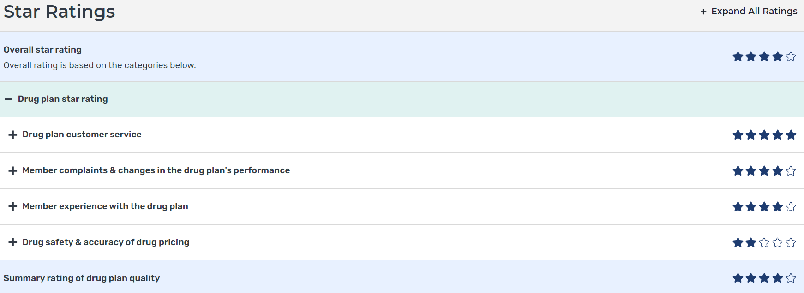
Star Ratings

Slide 51
Medicare Advantage

Slide 52
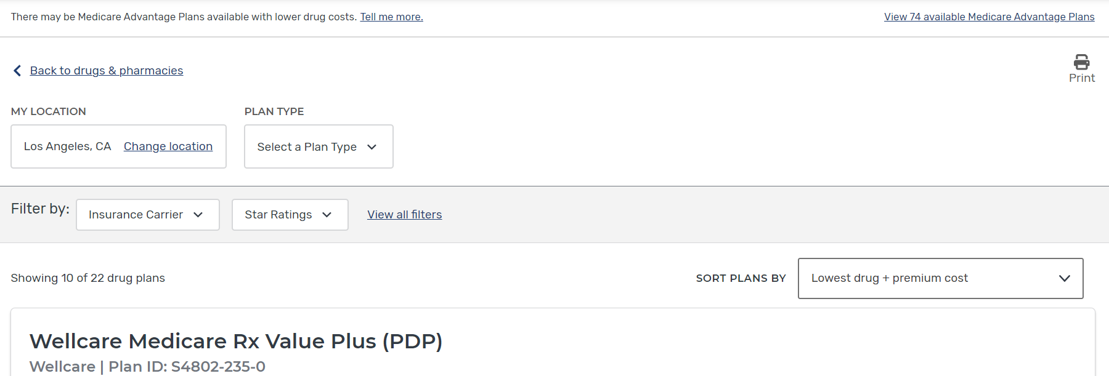
Medicare Advantage Plans

Slide 53
Medicare Advantage Plan Filters

Slide 54
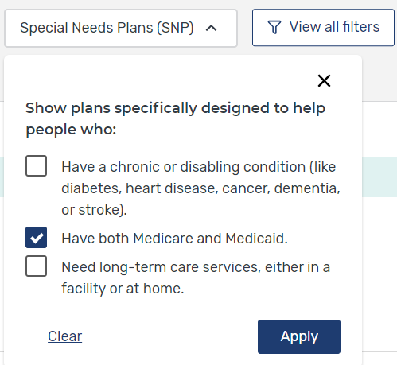
Plan Filters (Continued)

Slide 55
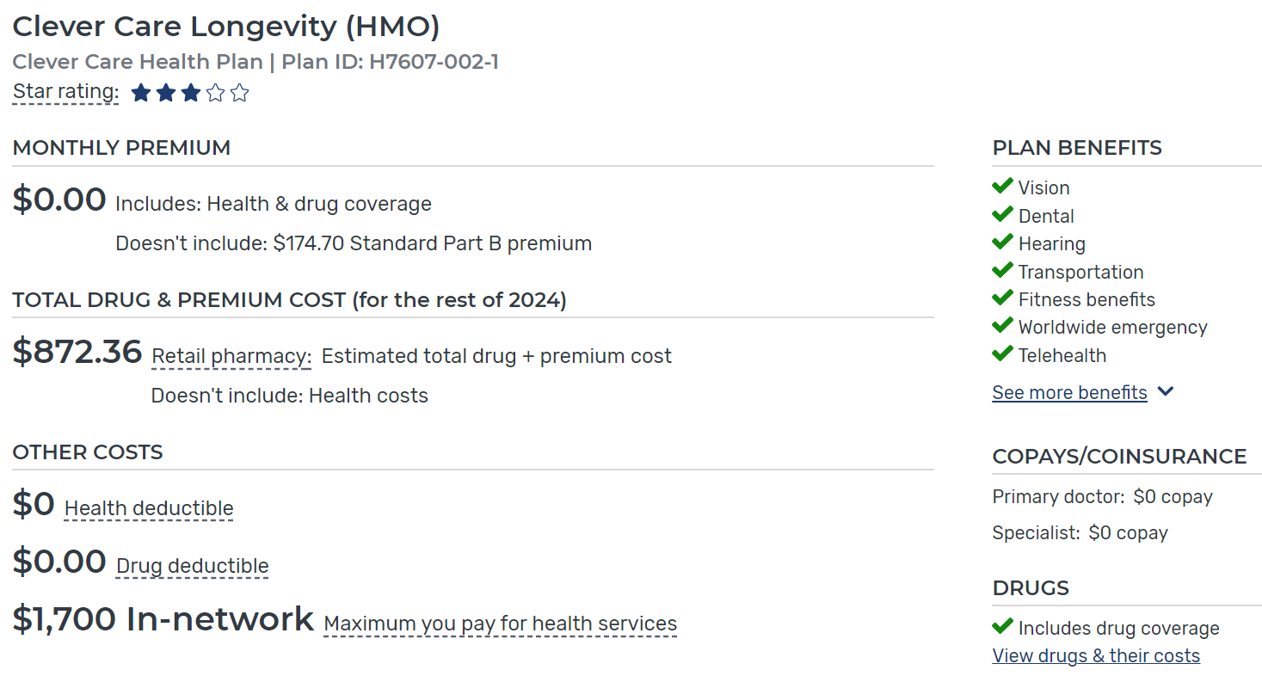
Medicare Advantage Plan Costs

Slide 56
Medicare Advantage Plans (Continued)
Pearl
Have an annual maximum OOP spending limit (‘MOOP’) on Part A and B services
Once you reach this limit, you’ll pay nothing for covered services
2024 MOOP Limit
HMOs: $8,850
PPOs: $13,300 (in/out of network)
Differs between plans
Notes:
…and can’t be sold (you can’t enroll and don’t need
If you have a Medigap policy and join a MA plan you will probably want to drop your Medigap policy (but understand that by doing so you may not be able to get it back)
The plan’s yearly limit on your out-of-pocket costs for all Part A and Part B medical services. Once you reach this limit, you’ll pay nothing for Part A- and Part B-covered services.
These out-of-pocket limits apply to Part A and B services only, and do not apply to Part D spending. These plans set a limit on what you’ll have to pay OOP each year for covered services.
This annual maximum OOP amount can be different between MA Plans, and you should consider this when you choose a plan.
Since 2011, all plans have been required to limit beneficiaries’ out-of-pocket spending to no more than $6,700….in 2022 it’s now $8,300
https://www.cms.gov/medicare/health-plans/medicareadvtgspecratestats (Visit, for MOOP)

Slide 57
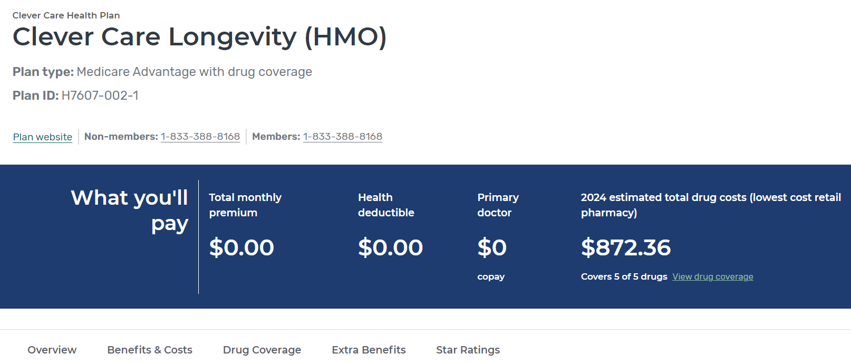
Medicare Advantage Plan Overview

Slide 58
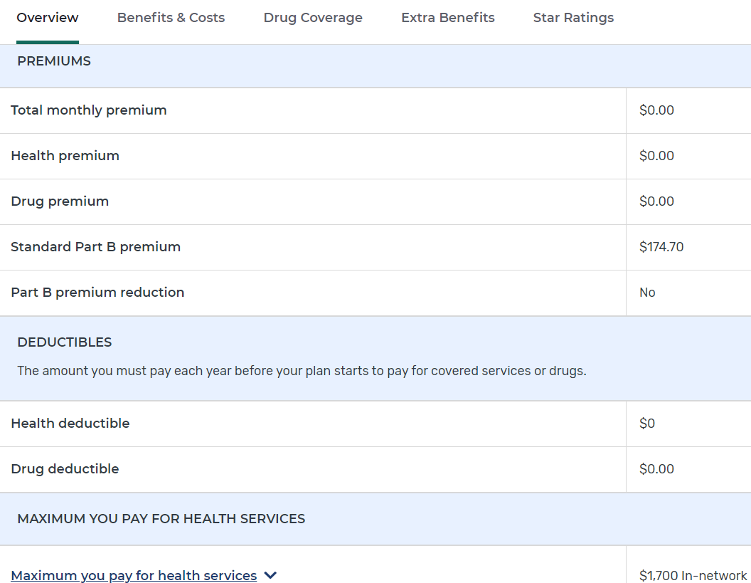
Medicare Advantage Plan Overview (Continued)

Slide 59
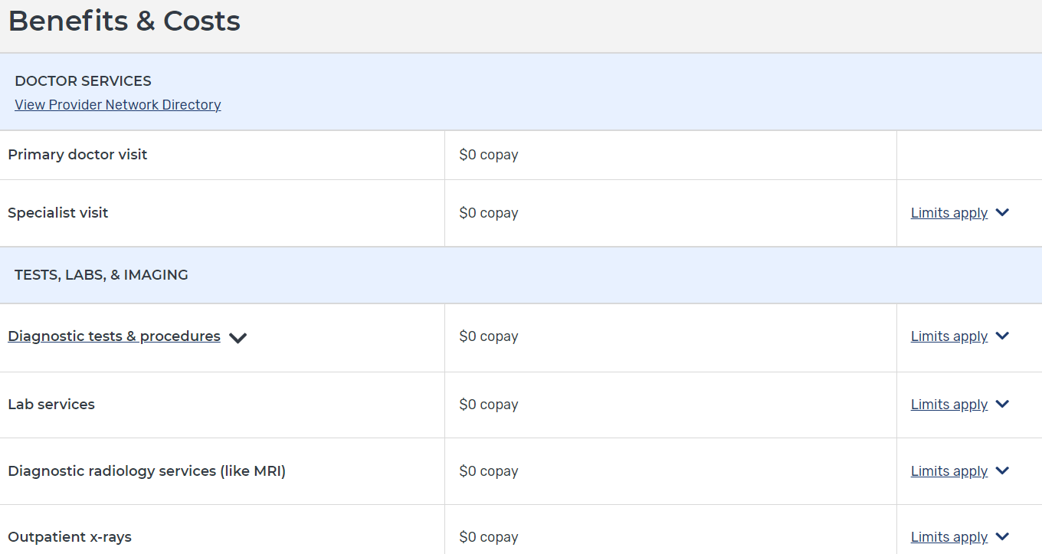
Provider Network
Pearl
Always check to make sure the beneficiary’s preferred providers are part of the plan.
Ask the beneficiary if there is a specific hospital they like to go to. Check plan website.

Slide 60
Medicare Advantage Plan Services

Slide 61
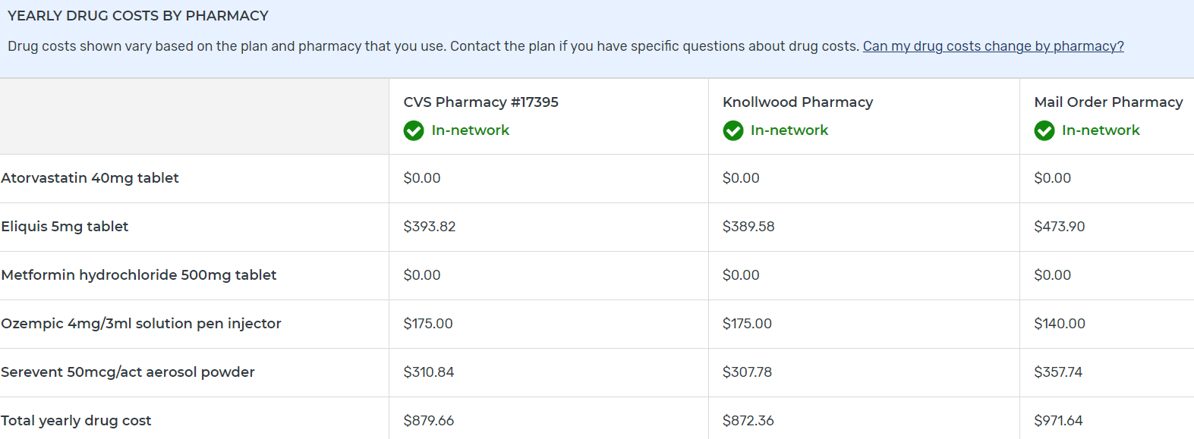
Drug Costs via Pharmacy Type

Slide 62
Medicare Advantage Plan Extra Benefits
Pearl
Ask beneficiary if there are any specific services they want covered.
Notes:
MPF will display a few additional Part C benefit services, beginning in CY25. (Hearing, Preventative dental and Comprehensive dental)
Currently, there is a single hearing aid benefit service displayed on both the Plan Compare and Plan Details pages. In CY25, the single benefit service will be replaced by 'Hearing Aids - Prescription' & 'Hearing Aids – Over The Counter.’
Currently, on the Plan Details page, MPF displays 4 preventive services & 7 comprehensive services. These benefit services will increase to 6 and 10, respectively.

Slide 63
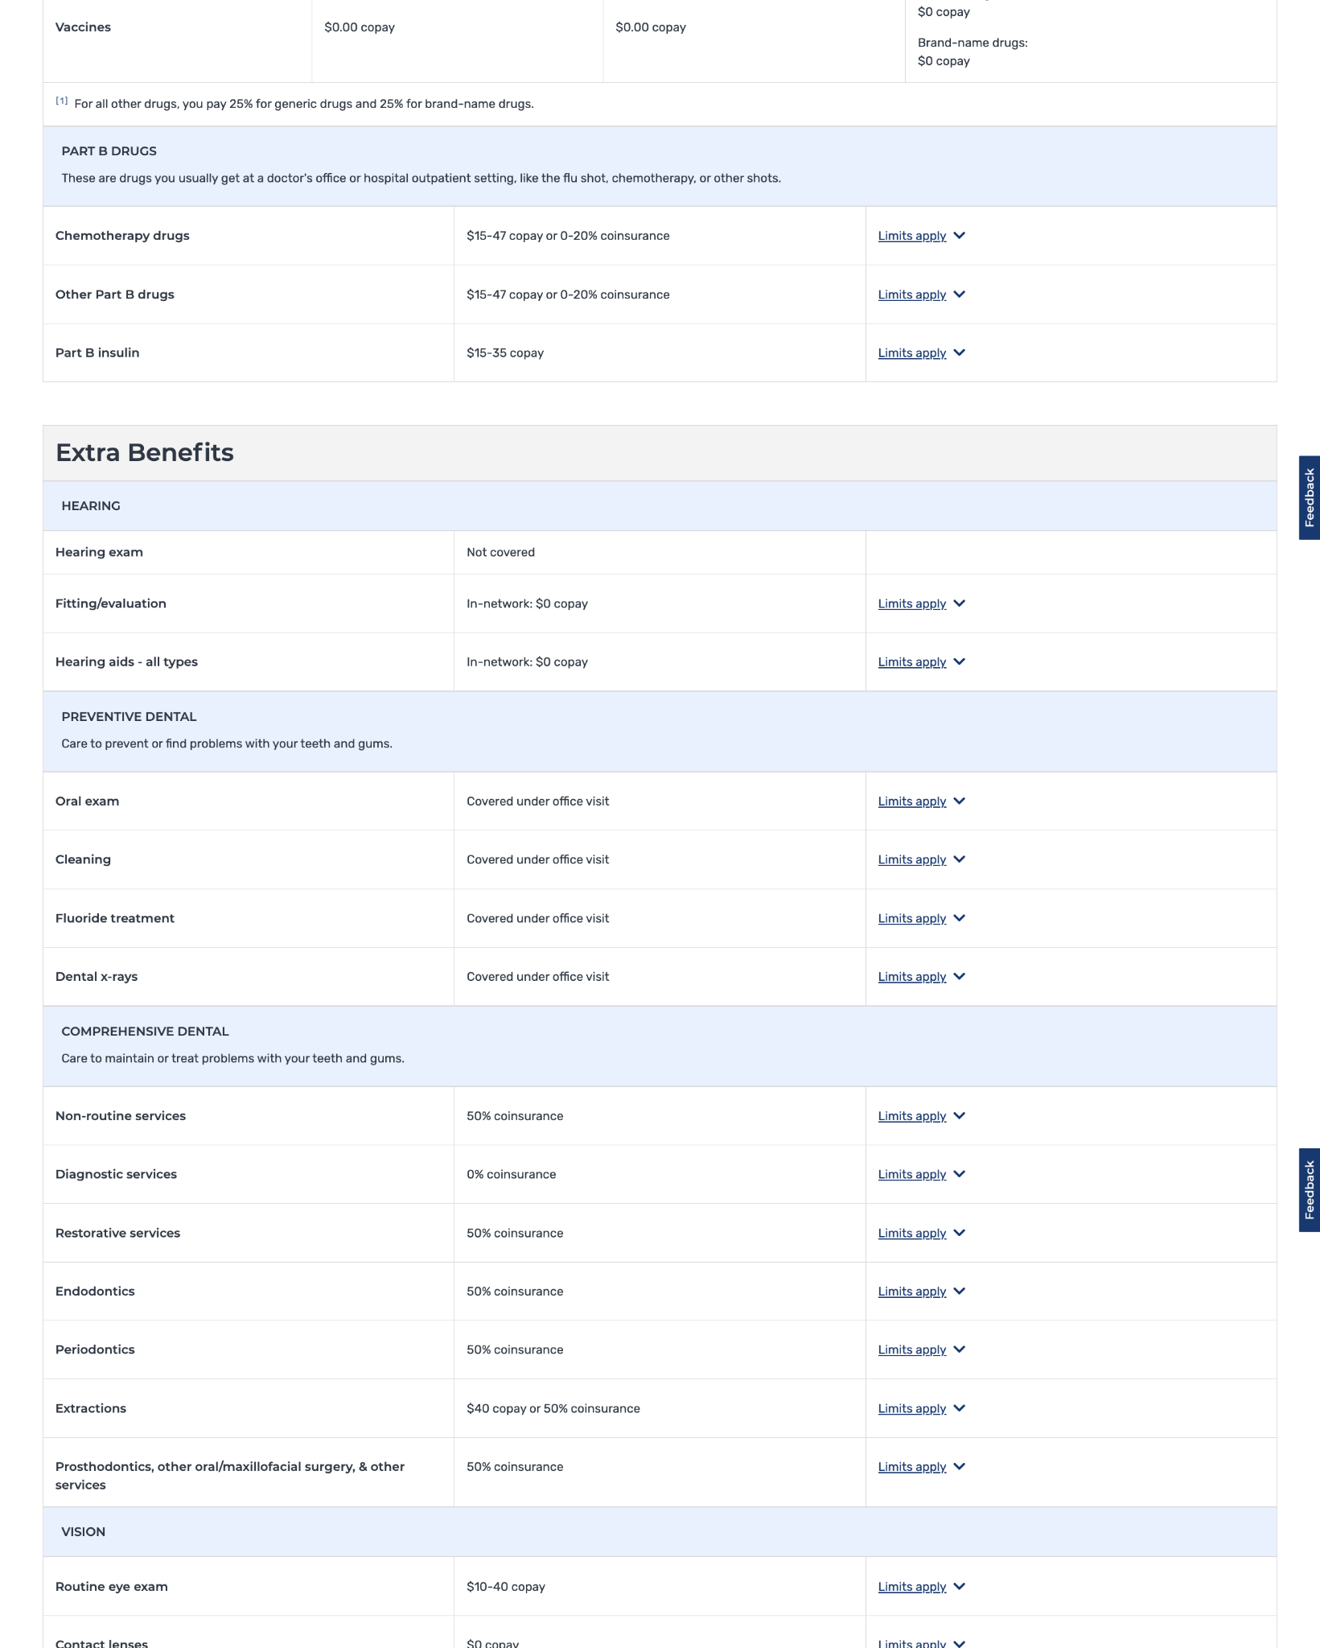
Medicare Advantage Plan Extra Benefits
Pearl
Ask beneficiary if there are any specific services they want covered.
Current
New
Notes:
MPF will display a few additional Part C benefit services, beginning in CY25. (Hearing, Preventative dental and Comprehensive dental)
Currently, there is a single hearing aid benefit service displayed on both the Plan Compare and Plan Details pages. In CY25, the single benefit service will be replaced by 'Hearing Aids - Prescription' & 'Hearing Aids – Over The Counter.’
Currently, on the Plan Details page, MPF displays 4 preventive services & 7 comprehensive services. These benefit services will increase to 6 and 10, respectively.

Slide 64
Plan Rating

Slide 65
Plan Comparison to Original Medicare

Slide 66
Personalized Plan Search

Slide 67
Personalized Search
Username/Password
Necessary Information
Beneficiary’s Medicare Card
Date of Birth
ZIP Code on file
Medication List
Drug Name
Dosage
Quantity/Frequency
Preferred Pharmacy(ies)

Slide 68
MEDICARE.GOV
Select

Slide 69
General Search

Slide 70
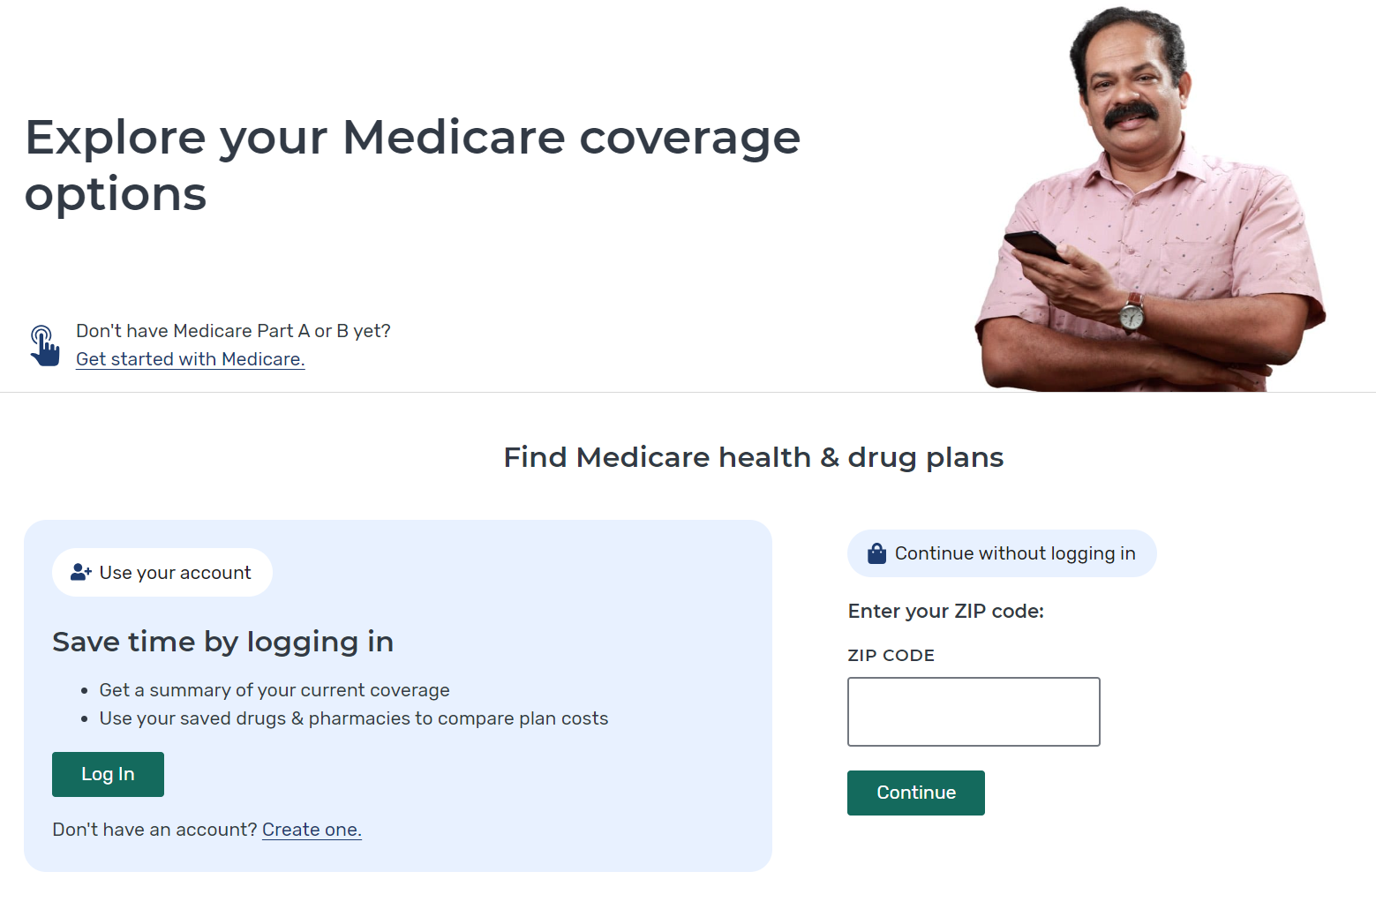
Personalized Plan Search

Slide 71
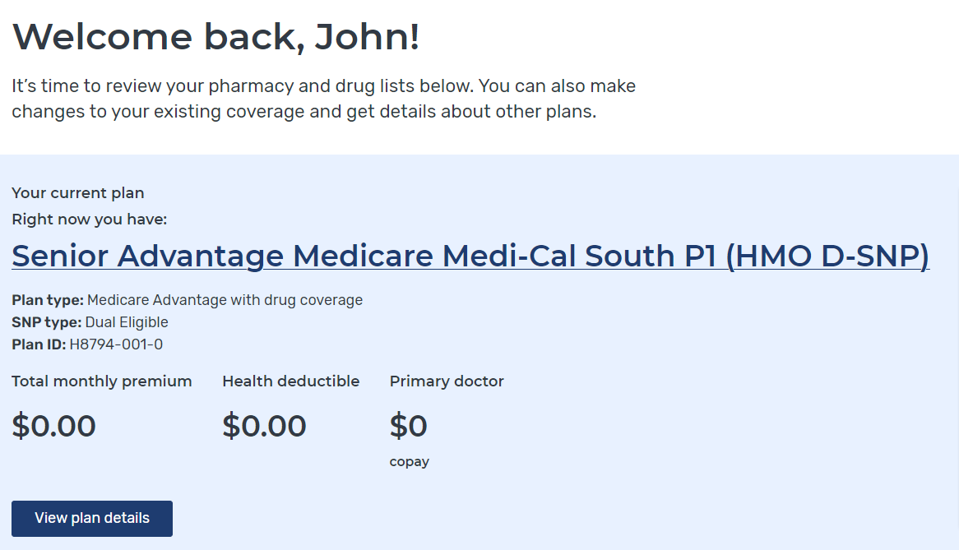
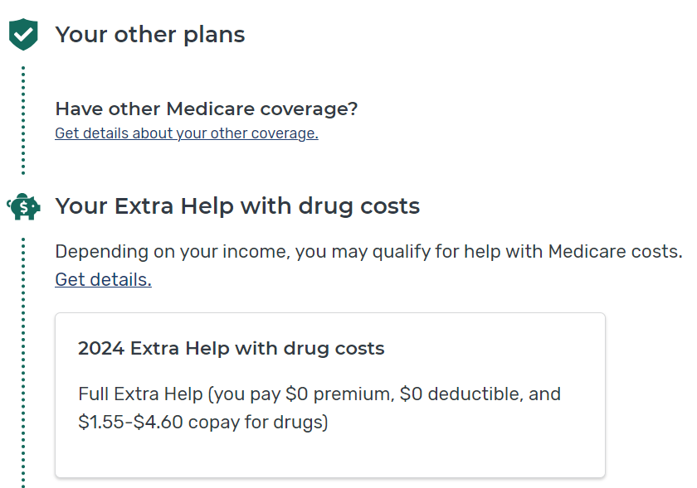
Current Plan and Subsidy Status

Slide 72
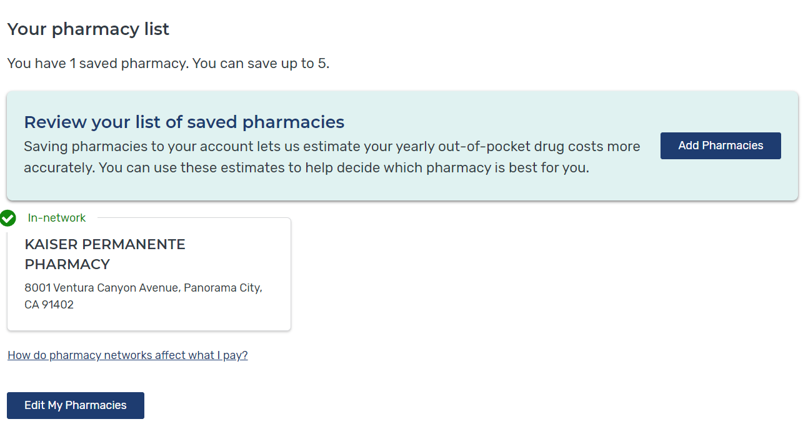
Preferred Pharmacy(ies)

Slide 73
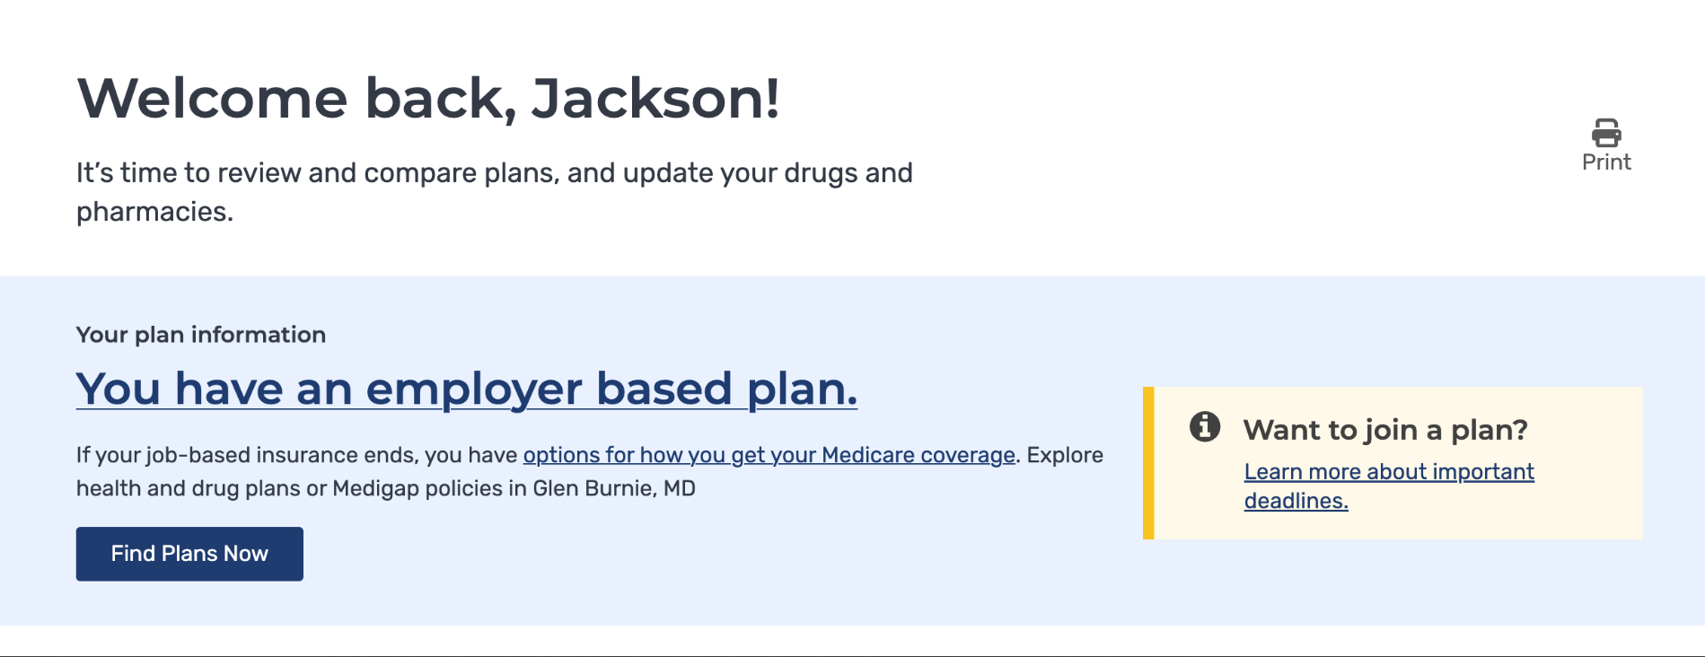
Employer Plan on Summary Page
Release Date : March 14th, 2024
Added functionality to display "Your plan information“ on Summary Page for beneficiaries who have employer-based plans
Notes:
Benes who have a M.gov account but are covered through an employer plan (aka 800 series plans) currently see messaging on the top of their summary page that says "...you haven't joined a health or drug plan yet.“

Slide 74
Claims Data

Slide 75
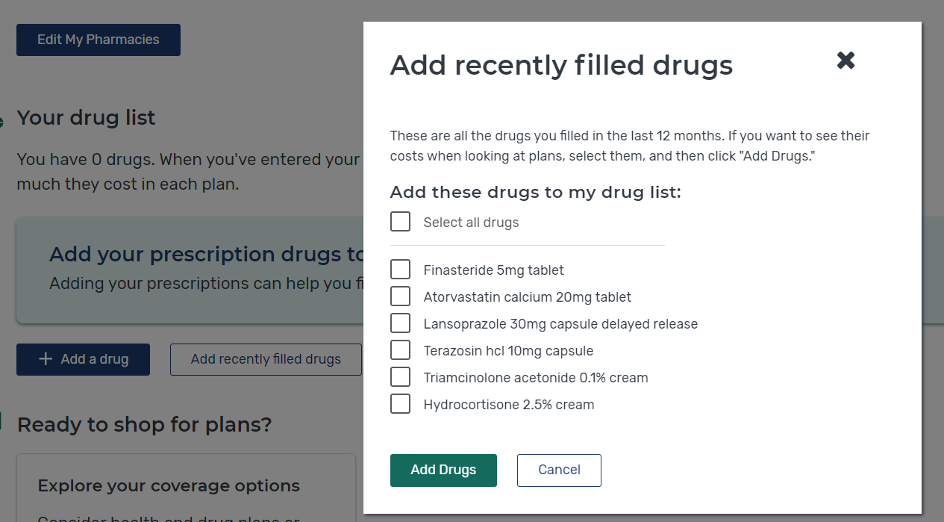
Recently Filled Drugs

Slide 76
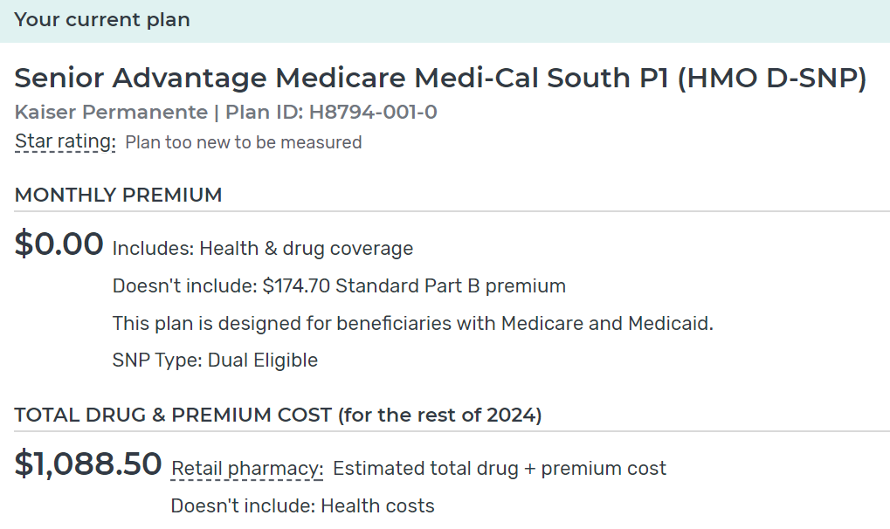
Current Plan

Slide 77
Personalized Search
Pearl
Advantages:
Current Plan
Subsidy Status
Claims Data
Updated Drug List
Preferred Pharmacy(ies)

Slide 78
Beneficiary Choices…
Each MA-PD and PDP can have its own:
Monthly premium
Deductible
Cost sharing structure
Co-insurance, Co-pays
Formulary
Coverage
Tiers
Drug restrictions (Prior Authorization, Step Therapy, Quantity Limits)
Pharmacy Network

Slide 79
Part D Plan Optimization-The need for an annual checkup
Beneficiaries and/or their advocates should annually reexamine Part D plan offerings.
Failure to do so can…
Result: Suboptimal plan selection
Over 18 years, we have found that ~75% of beneficiaries are paying more than they have to for their Part D drugs costs
Average ANNUAL cost savings through our pharmacy students’ assistance: $1,069/beneficiary
$12.64 million/11,823 assisted
Notes:
11,823 have had $12,637,75
‘Cost Minimization’

Slide 80
The Inflation Reduction Act (IRA): Part D Redesign & Manufacturer Discount Program Kristi Martin Senior Advisor Office of the Administrator Center for Medicare
Notes:
This section provides information about changes resulting from the Inflation Reduction Act.
The new law makes improvements to Medicare that will expand benefits, lower drug costs, and improve the sustainability of the Medicare program for generations to come. The law provides meaningful financial relief for millions of people with Medicare by improving access to affordable treatments and strengthening Medicare, both now and in the long run.

Slide 81
TrOOP Revised Definition
Beginning in 2025, there are changes to which costs count toward TrOOP. The definition of incurred costs will include costs for covered Part D drugs, that aren’t part of basic prescription drug coverage, reimbursed through insurance or a group health plan (supplemental coverage).
Supplemental Part D coverage provided by enhanced alternative (EA) Part D plans and other health insurance (OHI) will be counted as incurred costs and included in the calculation of TrOOP.
This includes supplemental coverage provided by Employer Group Waiver Plans (EGWPs), plan reductions in cost sharing for enrolled people with Medicare, like reductions by Medicare-Medicaid Plans and D-SNPs, and Innovation Center model benefits that reimburse costs for covered Part D drugs (unless stated otherwise in a Request for Applications).
Notes:
Presenter Notes
Beginning in 2025, section 1860D-2(b)(4)(C)(iii)(II) of the Act, as added by the IRA, makes changes to which costs count toward TrOOP by amending the definition of incurred costs to include costs incurred for covered Part D drugs that are reimbursed through insurance or a group health plan, excluding basic prescription drug coverage.
Unless otherwise stated, guidance for prior years with respect to incurred or TrOOP-eligible costs—including guidance on costs that do and don’t count as incurred costs and TrOOP-eligible and ineligible payers—continues to apply for CY 2025. The following third-party arrangements will continue to contribute to TrOOP: Extra Help cost-sharing support, qualified State Pharmaceutical Assistance Programs, Indian Health Service and certain other Native American organizations, and AIDS Drug Assistance Programs.
Manufacturer payments made under the new Manufacturer Discount Program that begins in 2025, don’t count as incurred costs and aren’t included in the calculation of TrOOP. This is different from the Coverage Gap Discount Program which, by statute, counts manufacturer payments as incurred costs and includes such payments in the calculation of TrOOP.
Finally, for people with Medicare who have opted into the Medicare Prescription Payment Plan described in section 1860D–2(b)(2)(E) of the Act, as added by section 11202 of the IRA, election into such program won’t impact how an individual moves through the Part D benefit or what counts towards TrOOP. Under section 1860D–2(b)(4)(F) of the Act, a Medicare Prescription Payment Plan participant’s TrOOP-eligible costs that are paid by their Part D plan under the Medicare Prescription Payment Plan shall be treated as incurred costs.
Note that, under section 1860D-2(b)(4)(C)(iii)(II) of the Act, only amounts reimbursed by supplemental coverage will be newly included in the calculation of TrOOP.
Source: CMS.gov/files/document/final-cy-2025-part-d-redesign-program-instructions.pdf

Slide 82
Manufacturer Discount Program
Begins January 1, 2025
Participating manufacturers provide discounts on applicable drugs, generally amounting to
10% of the negotiated price in the initial coverage phase and
20% of the negotiated price in the catastrophic phase
Manufacturer discounts are paid under the Manufacturer Discount Program for applicable drugs when dispensed to an applicable beneficiary (an individual who, on the date of dispensing a covered Part D drug, is enrolled in a Part D or MA-PD plan, isn’t enrolled in a qualified retiree prescription drug plan and has incurred TrOOP-eligible costs that exceed the defined standard deductible)
Unlike under the Coverage Gap Discount Program, the definition of “applicable beneficiary” for the Manufacturer Discount Program doesn’t exclude those who get Extra Help
Notes:
Presenter Notes
Section 11201 of the IRA added section 1860D-14C of the Act, which creates the Manufacturer Discount Program beginning January 1, 2025. The Manufacturer Discount Program replaces the Coverage Gap Discount Program, under which manufacturers pay discounts for applicable drugs in the coverage gap phase (ending January 1, 2025). Under section 1860D14C(b)(1)(A) of the Act, participating manufacturers that enter into a Discount Program agreement will provide discounts on applicable drugs, generally amounting to 10 percent of the negotiated price for enrollees in the initial coverage phase and 20 percent of the negotiated price for enrollees in the catastrophic phase in CY 2025. Detailed information about the Discount Program is provided in the Medicare Part D Manufacturer Discount Program Final Guidance and Medicare Part D Manufacturer Discount Program: Methodology for Identifying Specified Manufacturers and Specified Small Manufacturers, both of which were released on November 17, 2023.
Manufacturer discounts are paid under the Manufacturer Discount Program for applicable drugs when dispensed to an applicable beneficiary. Section 1860D-14C(g)(1)(C) of the Act defines an “applicable beneficiary” as an individual who, on the date of dispensing a covered Part D drug, is enrolled in a Part D or MA-PD plan, isn’t enrolled in a qualified retiree prescription drug plan and has incurred TrOOP-eligible costs that exceed the defined standard deductible specified in section 1860D-2(b)(1) of the Act.
Unlike under the Coverage Gap Discount Program, the definition of “applicable beneficiary” for the Manufacturer Discount Program doesn’t exclude those who get Extra Help.

Slide 83
Policy for Drugs When the Defined Standard (DS) Deductible Doesn’t Apply (covered insulin)
TrOOP-eligible costs for drugs not subject to the DS deductible, specifically covered insulin products, as well as TrOOP-eligible costs for drugs not subject to a non-DS plan deductible or drugs subject to a reduced deductible under non-DS plans, all count towards a person with Medicare’s satisfaction of the DS deductible
As a result, in CY 2025, if a person with Medicare hasn’t satisfied their plan deductible but has incurred sufficient TrOOP-eligible costs to satisfy the DS deductible, they will be both
An applicable beneficiary under the Manufacturer Discount Program, and
Be deemed to have satisfied their plan deductible.
Notes:
Presenter Notes
If a plan offers a non-Defined Standard (DS) plan deductible—whether that be a lower deductible than the DS deductible or a deductible that applies for a subset of covered Part D drugs—and a person with Medicare incurs sufficient costs to satisfy the plan deductible but hasn’t incurred TrOOP-eligible costs cumulatively across all drugs at or above the DS deductible amount, discounts under the Manufacturer Discount Program aren’t available. As such, the plan is responsible for covering the portion of costs that would be covered by the manufacturer discount if the individual were an applicable beneficiary until the beneficiary’s TrOOP exceeds the DS deductible and they become an applicable beneficiary. The same guidance applies when a person with Medicare under any Part D plan is dispensed a covered insulin product or ACIP-recommended vaccine before they have incurred TrOOP-eligible costs at or above the DS deductible amount.
For example, an Enhanced Alternative (EA) plan has a tiered formulary, doesn’t charge a deductible for tier 1 drugs, and charges 20 percent coinsurance for drugs in that tier. A person with Medicare’s first fill of the year is for a $200 tier 1 drug, meaning they pay $40 out of pocket. The individual hasn’t incurred sufficient TrOOP-eligible costs to satisfy the DS deductible of $590 (and has $390 remaining TrOOP eligible costs before they satisfy the deductible) and doesn’t meet the definition of an applicable beneficiary under the Manufacturer Discount Program. Therefore, the plan must cover the 10 percent of costs that would be covered by the manufacturer discount if the individual were an applicable beneficiary. CMS provided prescription drug event (PDE) reporting instructions later in 2024 with additional examples to demonstrate how this policy should be implemented.

Slide 84
Example: Standard Structure in 2025
Ms. Smith joins a Medicare drug plan. Her coverage begins on January 1. She doesn’t get Extra Help and uses her Medicare drug plan membership card when she buys prescriptions. She pays a monthly premium throughout the year.
Yearly Deductible | Initial coverage phase | Catastrophic coverage phase
Ms. Smith pays an amount out of pocket ($590 or less) for covered drugs before her plan starts to pay its share. | Manufacturers provide a 10% discount on certain brand-name drugs, biologics, and biosimilars. She pays a copayment, and her plan pays its share for each covered drug until she hits the out-of-pocket cap of $2,000. | Manufacturers provide a 20% discount on certain brand-name drugs, biologics, and biosimilars. She won’t have any more out-of-pocket costs on covered drugs for the rest of the coverage year once she hits the out-of-pocket cap of $2,000 in the initial coverage phase.
Notes:
Presenter Notes
The Inflation Reduction Act (IRA) redesigns the Part D benefit and revises its parameters for Plan Year 2025 as follows:
People with Medicare prescription drug coverage will benefit from a yearly cap ($2,000 in 2025) on what they pay out-of-pocket for prescription drugs. The cap on out-of-pocket costs will increase annually by the rate of inflation starting in 2026. Thus, 2025 is the only year for which the cap will be precisely $2,000.
The new discount program will require drug manufacturers to pay discounts on certain brand-name drugs and other types of drugs called biologics and biosimilars, both in the initial coverage phase and in the catastrophic phase of the Medicare prescription drug benefit. In general, manufacturers must provide a 10% discount in the initial phase and a 20% discount in the catastrophic phase. There is also a federal subsidy that contributes to lowering the drug costs in the initial and catastrophic phases.
Here’s an example showing what Ms. Smith will pay in 2025. Not all plans follow this design. Drug plan costs will vary.
Monthly premium – Most drug plans charge a monthly fee that differs from plan to plan. You pay this in addition to the Part B premium (if you have Part B). If you belong to a Medicare Advantage Plan with drug coverage (MA-PD), the monthly plan premium may include an amount for drug coverage. Between 2024 and 2029, the IRA provides for Part D premium stabilization by capping base beneficiary premium increases per year to no more than 6%.
Yearly deductible – This is the amount you pay each year for your prescriptions before your plan begins to pay. Deductible amounts are different for each plan. The maximum deductible for Plan Year 2025 is $590. Some drug plans don’t have a deductible.
Initial coverage phase – Copayments or coinsurance are the amounts you pay for your covered prescriptions after you pay the deductible (if the plan has one). You pay your share, and the drug plan pays its share, for covered drugs. Manufacturers generally pay a 10% discount.
Catastrophic coverage – Once you reach your out-of-pocket limit ($2,000 in 2025), you won’t pay any more for covered Part D drugs for the rest of the year. Manufacturers generally pay a 20% discount.
NOTE: If you get Extra Help, you won’t have some of these costs.

Slide 85
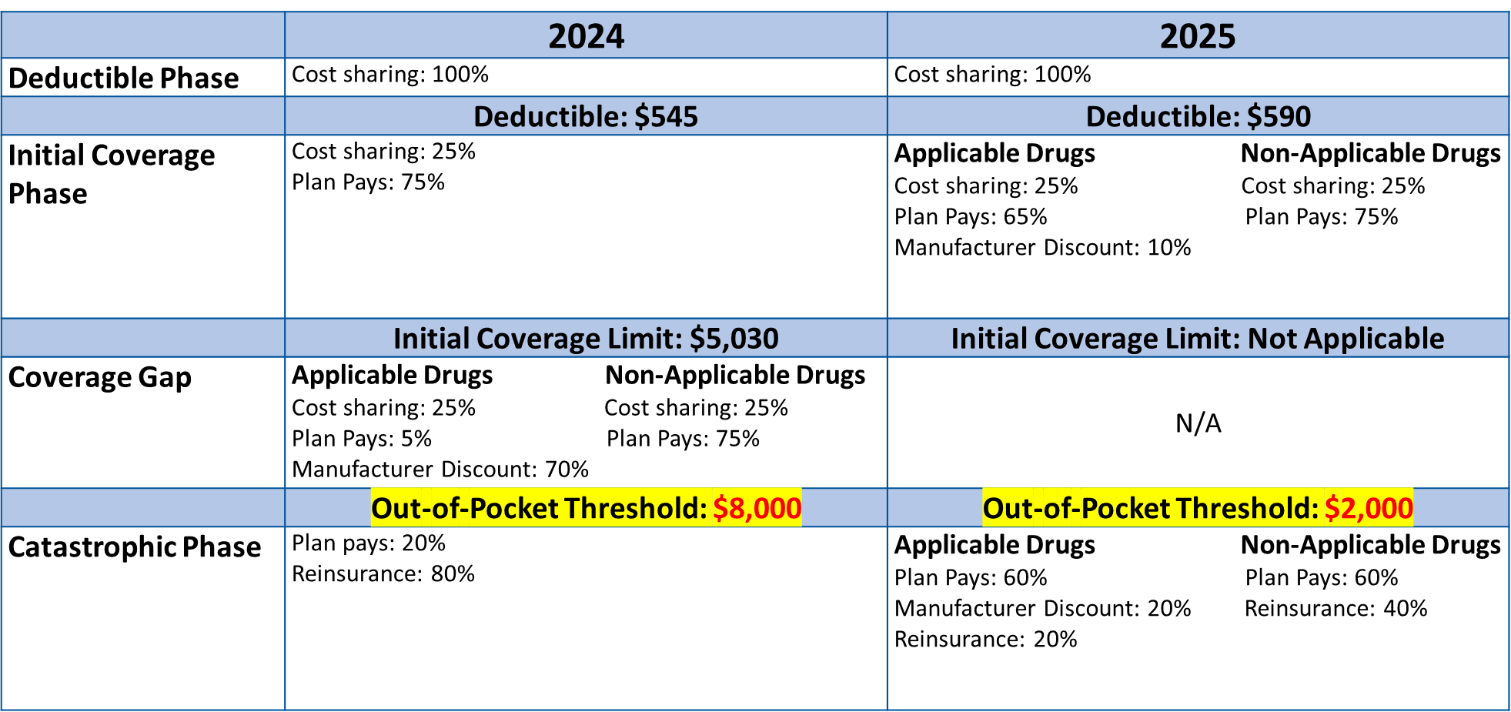
Drug Coverage Phases in Calendar Years 2024 & 2025
 | 2024 | 2025
Deductible phase | Cost sharing: 100% | Cost sharing: 100%
 | Deductible: $545 | Deductible: $590
Initial Coverage Phase | Cost sharing: 25% Plan Pays: 75% | Applicable Drugs Cost sharing: 25% Plan Pays: 65% Manufacturer Discount: 10% Non-Applicable Drugs Cost sharing: 25% Plan Pays: 75%
 | Initial Coverage Limit: $5,030 | Initial Coverage Limit: Not Applicable
Coverage Gap | Applicable Drugs Cost sharing: 25% Plan Pays: 5% Manufacturer Discount: 70% Non-Applicable Drugs Cost sharing: 25% Plan Pays: 75% | N/A
 | Out-of-Pocket Threshold: $8,000 | Out-of-Pocket Threshold: $2,000
Catastrophic Phase | Plan pays: 20% Reinsurance: 80% | Applicable Drugs Plan Pays: 60% Manufacturer Discount: 20% Reinsurance: 20% Non-Applicable Drugs Plan Pays: 60% Reinsurance: 40%
Notes:
Note to editor: the actual data table is hidden behind the image of the table.
Presenter Notes
This table shows the side-by-side comparison for Medicare drug coverage for calendar years 2024 and 2025.
Source: Part D Benefit Parameters for Defined Standard Benefit for CY 2024 and CY 2025 for Non-LIS Beneficiaries CMS.gov/files/document/final-cy-2025-part-d-redesign-program-instructions.pdf

Slide 86
Medicare Prescription Payment Plan: Communication & Outreach Stephen King Public Affairs Specialist Integrated Communications Management Staff CMS Office of Communications

Slide 87
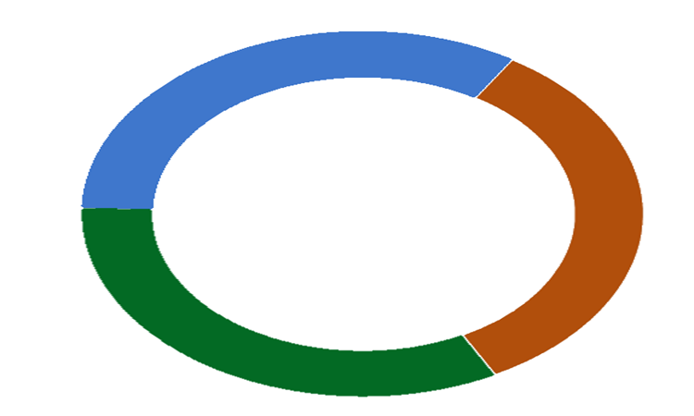
Layered & Interconnected Communications
Medicare
Pharmacists & Key Stakeholders
Education and resources for beneficiaries
Information on Medicare.gov, including interactive experience
Medicare & You Handbook
1-800-MEDICARE Scripts
Pharmacists provide point-of-sale “likely to benefit” notification & information
Partner Outreach and Training including National Training Program (SHIPS)
Local Training and Outreach
Provider Communications
Local and regional engagement of partners, such as SHIPs and state hospital and pharmacy associations
Clear, consistent language & messaging across all channels and coordinated tactics
Part D Plan Sponsors
Educate about program and cost savings programs in enrollee materials
Help all Part D enrollees understand, elect, and manage the program
Targeted communication to “likely to benefit”
Enrollment & management of program
Notify pharmacists if enrollee is “likely to benefit”
Communicate with networks providers
87
Notes:
Layered & interconnected outreach strategy among Medicare, Part D Sponsors, Pharmacists, and key stakeholders
Clear, consistent messaging across all communications partners
Use as opportunity to help people find the best program (Extra Help, MSP) for their situation
Use targeted outreach to balance promoting program to those it may benefit vs those who wouldn’t benefit

Slide 88
Learning about the Program: When & How
September 2024
Plans
Annual Notice of Change (ANOC)
Evidence of Coverage (EOC)
Medicare
Medicare & You Handbook
Medicare.gov content
Medicare.gov wizard
Fact sheet
Takeaway card
General education video English
1-800-MEDICARE scripting
During Open Enrollment
Plans
Targeted Likely to Benefit Notice
Election Approval Notice
Election Request Form with ID card
Customer Service Channels
Medicare
All Customer Service Channels
Plan Finder: Cost Preview
SHIPs
General education video Spanish
Pharmacists & Key Stakeholders
Advocates
Takeaway card at Provider Office
During Plan Year
Plans
Likely to Benefit Notice
Election Request form
Election Approval Notice
Failure to Pay & Termination Notices
Customer Service Channels
Medicare
Customer Service Channels
Medicare Plan Finder: Cost Preview
SHIPs
Pharmacists & Key Stakeholders
Likely to Benefit Notice at Point of Sale
Advocates
Takeaway card at Provider Office

Slide 89
Part D Plan Sponsors & Pharmacy/Pharmacists
Part D Plan Sponsors:
Must include information in certain required Part D communications: websites, member ID card mailings, notices (Evidence of Coverage, Annual Notice of Change, and Explanation of Benefits documents)
Required to target outreach directly to Part D enrollees likely to benefit, both prior to and during the plan year
Pharmacy/Pharmacists:
Pharmacists are a key stakeholder for outreach and education, responsible for providing “Likely To Benefit Notice” at point of sale
2 distinct areas of communication impact and responsibility:
Pharmacist Point-of-Sale Interaction
Educational Messaging Related to Pharmacy Operations
89

Slide 90
About Medicare Prescription Payment Plan (Key Messages)
All plans offer this payment option, and participation is voluntary.
You’re most likely to benefit from participating in the Medicare Prescription Payment Plan if you have high drug costs earlier in the calendar year.
This payment option might help manage monthly expenses, but it doesn’t save money or lower drug costs.
Payment option that works with enrollees' current drug coverage to spread out-of-pocket Medicare Part D drug costs across calendar year (January-December).
Many people qualify for savings and don’t realize it. Those with limited income and resources, are encouraged to find out if they are eligible for programs like Extra Help and the Medicare Savings Programs that can help lower costs.
To sign up and start participating in the Medicare Prescription Payment Plan, visit your health or drug plan’s website, or call your plan.
90

Slide 91
Medicare Prescription Payment Plan: Part of the Open Enrollment Experience
Messaging about this payment option will be integrated into Open Enrollment education along with larger, overarching initiatives like:
$2,000 out of pocket max
Closing coverage gap
LIS expansion
Insulin savings
No cost vaccines resulting from IRA
September 2024

Slide 92
Medicare Prescription Payment Plan: Wizard & Resources Amy Miner Deputy Director-Creative Services Group CMS Office of Communications

Slide 93
Medicare Prescription Payment Plan
Outreach Resources
September 2024
September 2024
NTP Medicare OEP Bootcamp 2024

Slide 94
List of Resources
Fact sheet
Takeaway card
Video
Medicare.gov content
Wizard
Cost preview in Medicare Plan Finder
“Medicare & You” handbook
Updates in other existing Part D products
NTP Medicare OEP Bootcamp 2024

Slide 95
Timing
Available now:
Fact sheet
Takeaway card
Medicare.gov content
Video - English
Wizard
“Medicare & You” handbook
Coming soon:
Video - Spanish
Cost preview in Medicare Plan Finder
Printed fact sheet and takeaway card for ordering (English and Spanish) – (URL: https://productordering.cms.hhs.gov)
September 2024
NTP Medicare OEP Bootcamp 2024

Slide 96
Fact Sheet
Provides information about the Medicare Prescription Payment Plan including what it is, how to participate, how monthly costs are calculated, and more
Available in English, Spanish, Chinese, Korean, Vietnamese
Posted on Medicare.gov
English – (Product No. 12211)
Spanish – (Product No. 12211-S)
Other languages – (Product No. 12211-C, 12211-K, and 12211-V)
https://www.medicare.gov/publications/12211-whats-the-medicare-prescription-payment-plan.pdf
September 2024
NTP Medicare OEP Bootcamp 2024
Notes:
Fact sheet provided to plans to align their content or so they can use instead of creating their own product.

Slide 97
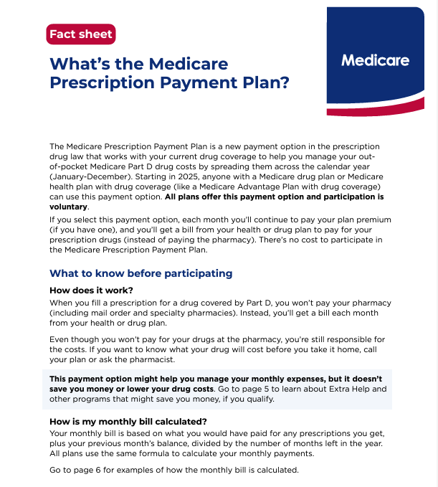
Fact Sheet Image
September 2024
NTP Medicare OEP Bootcamp 2024

Slide 98
Takeaway Card
Provides information about the Medicare Prescription Payment Plan on front and Medicare Savings Programs on back
Available in English, Spanish, Chinese, Korean, Vietnamese
Posted on Medicare.gov
English – (Product No. 12212)
Spanish – (Product No. 12212-S)
Other languages – (Product No. 12212-C, 12212-K, and 12212-V)
https://www.medicare.gov/publications/12212-manage-your-monthly-drug-costs.pdf
September 2024
NTP Medicare OEP Bootcamp 2024

Slide 99
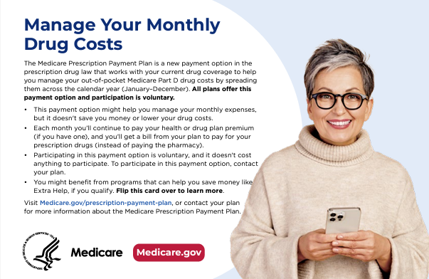
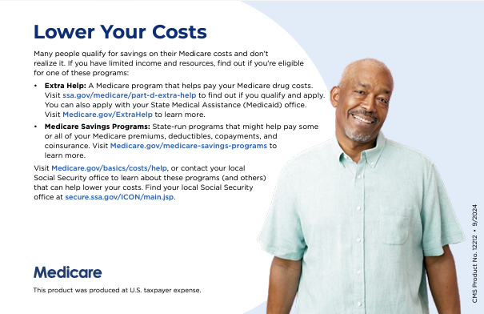
Takeaway Card Image
September 2024
NTP Medicare OEP Bootcamp 2024

Slide 100
Video
Provides general education about the Medicare Prescription Payment Plan
Posted on the Medicare Prescription Payment Plan landing page on Medicare.gov (Medicare.gov/prescription-payment-plan)
Accessible from Youtube
https://youtu.be/8JdeKQ5XbzM
Available now in English; coming soon in Spanish
September 2024
NTP Medicare OEP Bootcamp 2024

Slide 101
Medicare.gov Content
The main place to get information about the Medicare Prescription Payment Plan
Contains general information with links to resources that provide a more targeted experience – wizard (available now) and cost preview in Medicare Plan Finder (will add when this is live)
Content aligns with the fact sheet
Look and feel aligns with other Medicare.gov landing pages
URL – Medicare.gov/prescription-payment-plan

Slide 102
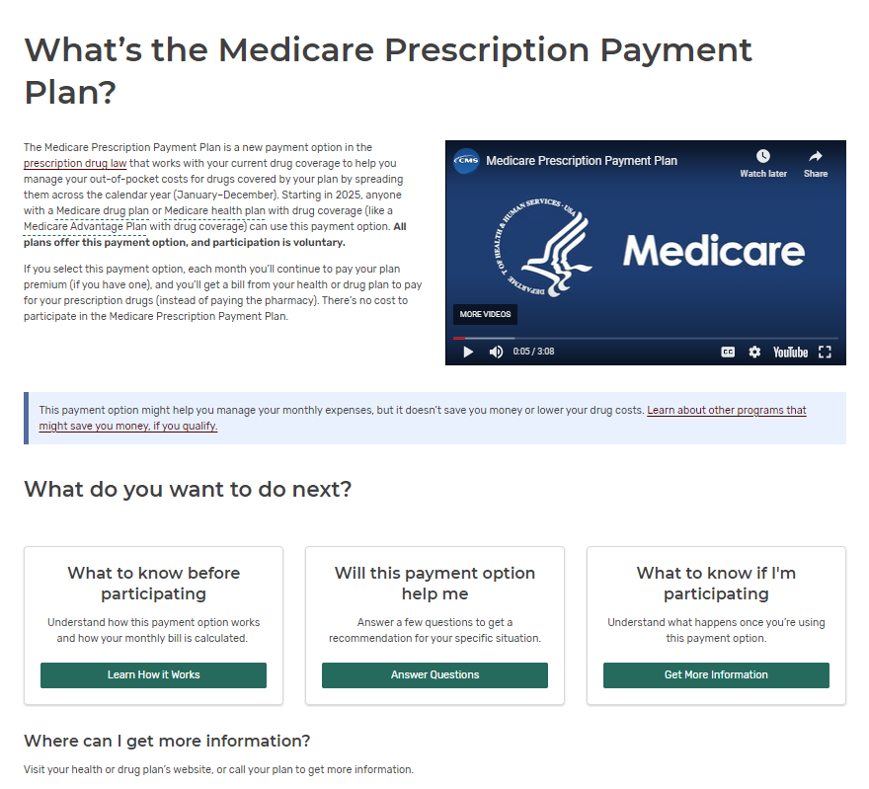
Medicare.gov Landing Page
September 2024
NTP Medicare OEP Bootcamp 2024

Slide 103
Wizard
Interactive experience where users can answer a few questions to find out if they are likely to benefit from the Medicare Prescription Payment Plan
Provides more tailored information than the main Medicare.gov page
Will add link to Plan Finder cost preview when it goes live
URL – Medicare.gov/prescription-payment-plan/will-this-help-me
September 2024
NTP Medicare OEP Bootcamp 2024

Slide 104
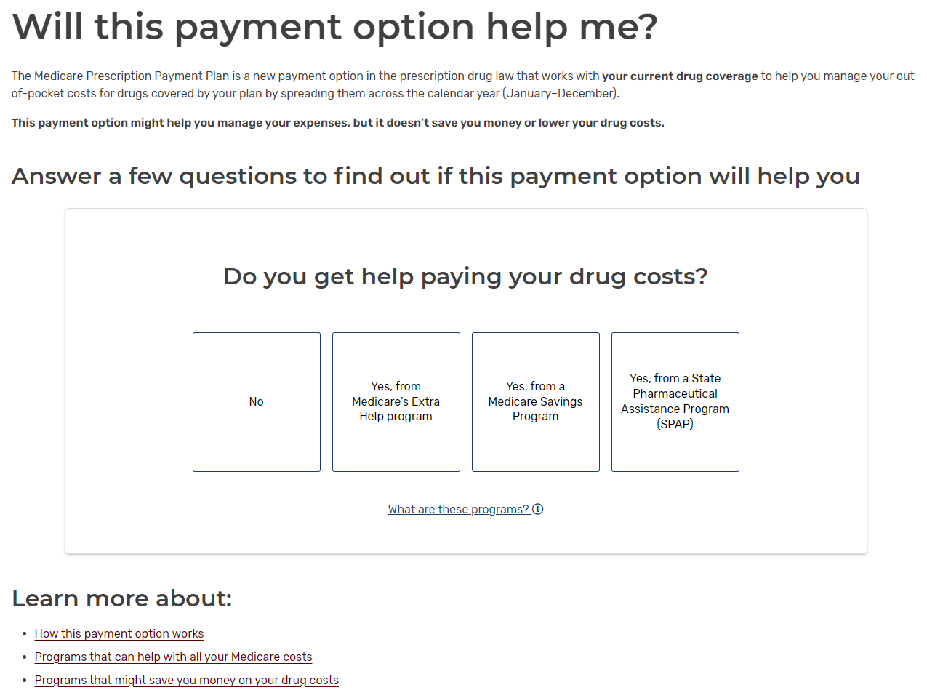
Wizard Landing Page

Slide 105
Medicare Prescription Payment Plan: Cost Preview Chuck Nethery Medicare.gov Program Manager Division of Web Development CMS Office of Communications

Slide 106
Medicare Plan Finder Cost Preview

Slide 107
Medicare Prescription Payment Information Summary Page
Show payment plan information to logged in users
On the Summary page in the “Other help with drug costs” section, below Medicare payment plan information is shown to all non-Extra Help Medicare Plan Finder users.
Show payment option information
Provide link to payment option cost preview help drawer
Notes:
Why we cannot display Medicare Prescription Payment Plan cost estimates on the Summary Page:
The Medicare Prescription Payment Plan is an IRA provision that begins in 2025.
Because the Medicare Plan Finder Summary page will reflect the people with Medicare’s 2024 Plan, we will not be able to apply payment option pricing.
As users compare CY25 Plans in Plan Finder, the payment option cost calculations will be presented on the Plan Details page(s).

Slide 108
Medicare Prescription Payment Plan: Plan Details Page
Show payment plan information to both logged in and anonymous users
For people with Medicare where their covered Part D out-of- pocket cost does meet the out-of-pocket max cap ($2K) in the first 9 months of the year.
Then, on the Plan Details page in the “Yearly drug costs by pharmacy” section below are shown.
Dismissible Medicare payment plan information
Link to payment option cost preview help drawer
Notes:
Show payment plan information to both logged in and anonymous users
For people with Medicare where their covered Part D out-of- pocket cost does meet the out-of-pocket max cap ($2K) in the first 9 months of the year.
Then, on the Plan Details page in the “Yearly drug costs by pharmacy” section below are shown.
Dismissible Medicare payment plan information
Link to payment option cost preview help drawer

Slide 109
Medicare Prescription Payment Plan: Plan Details Page (Continued)
Show payment plan information to both logged in and anonymous users
For users where their covered Part D out- of- pocket cost does not meet the out-of- pocket max cap ($2K) in the first 9 months of the year.
Then, on the Plan Details page in the “Yearly drug costs by pharmacy” section below are shown.
Medicare payment plan information
Link to payment option cost preview help drawer
Notes:
Show payment plan information to both logged in and anonymous users
For users where their covered Part D out- of- pocket cost does not meet the out-of- pocket max cap ($2K) in the first 9 months of the year.
Then, on the Plan Details page in the “Yearly drug costs by pharmacy” section below are shown.
Medicare payment plan information
Link to payment option cost preview help drawer
Note that the box isn't dismissible on this page; that was a deliberate user-experience decision with a strategy behind it.

Slide 110
Medicare Prescription Payment Plan: Cost Preview Help Drawer
Cost preview table for covered Part D prescription drugs
In a new help drawer, below are provided.
Framing content about payment option
Link to Medicare.gov static site
Pharmacy selector to show cost differences at selected pharmacies
Cost preview table with current prescription drug cost and prescription drug costs with payment option
Disclaimer that table only shows covered Part D prescription drugs
Notes:
Please not that cost estimates for excluded drugs and non-covered drugs will not be included in the payment option cost estimate table, during CY25 Open Enrollment.

Slide 111
Medicare Prescription Payment Plan: Plan Confirmation Page
Medicare Prescription Payment Plan also appears in the message center and confirmation email for those likely to benefit
Show information to logged in and anonymous users
For users where their covered Part D out-of-pocket cost does meet the out-of-pocket max cap ($2K) in the first 9 months of the year.
Then, on Open Enrollment Center confirmation page below Medicare payment plan information is shown
Payment option framing content
Provide link to payment option cost preview modal
Notes:
For logged in people with Medicare, when enrolled in plans gets a message in message center. Payment plan information will be added to the message center and confirmation email.

Slide 112
Cost Preview Frequently Asked Questions
Notes:
This section highlights the future CY 2025 Part C Benefit Service Changes for Dental and Hearing Benefits.

Slide 113
Cost Preview Frequently Asked Questions (1 of 8)
Will the Medicare Prescription Payment Plan monthly costs be shown in Plan Finder Cost Preview?
Yes, the person’s estimated monthly costs for covered drugs if they were using the Medicare Prescription Payment Plan will be displayed in Medicare Plan Finder’s Cost Preview.
A link to Cost Preview will be accessible in the Drug Coverage section of the Plan Details page.

Slide 114
Cost Preview Frequently Asked Questions (2 of 8)
Will we be able to show beneficiaries the cost/savings (or not) with Cost Preview?
The Medicare Prescription Payment Plan does NOT provide any cost savings.
This payment option might help someone manage their monthly expenses, but it doesn’t save them money or lower their drug costs.
It works with someone’s current drug coverage to help them manage their out-of-pocket Medicare Part D drug costs by spreading them across the calendar year (January-December).
Medicare Plan Finder’s Cost Preview will display an estimate of monthly pricing for covered drugs with the Medicare Prescription Payment Plan and without.

Slide 115
Cost Preview Frequently Asked Questions (3 of 8)
Will Cost Preview display for those who are not predicted to enter the catastrophic phase? Will they know if the payment plan benefits them?
Yes, the option to open Cost Preview will be displayed for people with Medicare that are not predicted to enter the catastrophic phase.
For people with Medicare that are likely to benefit from the Medicare Prescription Payment Plan, the link will be more prominently displayed.
Cost Preview will not display for anyone that is enrolled in LIS (logged in) or selects LIS (anonymous) as their monthly costs are already consistent.

Slide 116
Cost Preview Frequently Asked Questions (4 of 8)
Are the payment plan monthly costs displayed in Cost Preview estimates?
Yes, the person’s estimated costs for covered drugs if they were using the Medicare Prescription Payment Plan will be displayed in Medicare Plan Finder’s Cost Preview based on the drug list and pharmacy the person selects.
Payments will be administered by the plans and the amounts can change during the year if the person gets a new drug, refills a drug, etc.

Slide 117
Cost Preview Frequently Asked Questions (5 of 8)
Will the payment plan be reflected on Plan Finder Plan Compare feature for plan comparison purposes?
Medicare Plan Finder’s Cost Preview will only display on the Plan Details page for an individual plan.
The Medicare Prescription Payment Plan shouldn’t be used to compare plans as it doesn’t lower annual out of pocket costs.

Slide 118
Cost Preview Frequently Asked Questions (6 of 8)
Will Cost Preview calculate payment options for both Part D and Medicare Advantage Plan (with Part D included)?
Yes, Medicare Plan Finder’s Cost Preview will display for both Part D plans & Medicare Advantage with Part D plans.

Slide 119
Cost Preview Frequently Asked Questions (7 of 8)
Can I enroll in the Medicare Prescription Payment Plan using Plan Finder?
No one can enroll in the Medicare Prescription Payment Plan using Plan Finder.
All people with Medicare must enroll in the Medicare Prescription Payment Plan directly with their plan.
This is true for all Plan Finder users, including logged in users.

Slide 120
Cost Preview Frequently Asked Questions (8 of 8)
Will Cost Preview be printer-friendly?
Yes!

Slide 121
Medicare Prescription Payment Plan Cost Preview Demo

Slide 122
Medicare Prescription Payment Plan: Answers to Your Policy Questions Emma Strauss Health Insurance Specialist Medicare Plan Payment Group Center for Medicare

Slide 123
Payment Option: Frequently Asked Questions (1 of 13)
Where does an enrollee opt into the Medicare Prescription Payment Plan - with the Part D plan, through Plan Finder, or with Medicare? Do Part D enrollees opt into the Medicare Prescription Payment Plan as part of enrolling into the Part D plan?

Slide 124
Payment Option: Frequently Asked Questions (2 of 13)
Can enrollment be done at the pharmacy/point of sale?

Slide 125
Payment Option: Frequently Asked Questions (3 of 13)
Will the "good cause" plan reinstatement be available to enrollees if they lose coverage from a plan for non-payment of cost sharing as it exists for non-payment of premiums?

Slide 126
Payment Option: Frequently Asked Questions (4 of 13)
Is participation in the Medicare Prescription Payment Plan transferrable across plans? What happens when an enrollee has a special enrollment period (SEP) and changes plans mid-year?

Slide 127
Payment Option: Frequently Asked Questions (5 of 13)
How will Part D plan sponsors bill enrollees for OOP cost sharing after they opt into the Medicare Prescription Payment Plan? What entity collects the Part D monthly payment amount? How often will plans bill enrollees? Will the Part D plan’s monthly premium be billed separately?

Slide 128
Payment Option: Frequently Asked Questions (6 of 13)
What happens to enrollees who fail to pay their monthly bill for OOP cost sharing? Are they terminated from the Medicare Prescription Payment Plan? If so, what happens to their Part D coverage? Will they pay their copays at the pharmacy counter again? Are they still responsible for any outstanding balances?

Slide 129
Payment Option: Frequently Asked Questions (7 of 13)
Example 3: Start participating in April with varying costs throughout the year
Month | Your drug costs (without this payment option) | Your monthly payment (with this payment option)
January | $4.00 | $4.00
February | $4.00 | $4.00
March | $4.00 | $4.00
April | $617.00 | $220.89
May | $4.00 | $50.01
June | $4.00 | $50.59
July | $124.00 | $71.25
August | $4.00 | $72.05
September | $4.00 | $73.05
October | $124.00 | $114.39
November | $4.00 | $116.39
December | $4.00 | $120.38
Is the payment plan based on projected drug costs or does it take into account actual expenses? For example, if the beneficiary opts into the payment plan in March, does the payment plan factor in actual expenses in January and February and then projected expenses for the remainder of the year?

Slide 130
Payment Option: Frequently Asked Questions (8 of 13)
Will the Medicare Prescription Payment Plan impact the attainment of deductibles and the OOP max?

Slide 131
Payment Option: Frequently Asked Questions (9 of 13)
Do enrollees participating in the Medicare Prescription Payment Plan have to receive their prescriptions through mail order, or can they pick up prescriptions at their local pharmacy?

Slide 132
Payment Option: Frequently Asked Questions (10 of 13)
How will pharmacies be able to see that someone is opted in to the Medicare Prescription Payment Plan? What will the pharmacy staff see when they run an enrollee’s prescription drug coverage card and how will they explain to the enrollee that their co-pay amount due will be billed by the plan at a later date?

Slide 133
Payment Option: Frequently Asked Questions (11 of 13)
Are pharmacies required to notify enrollees about the Medicare Prescription Payment Plan if the cost of their prescription is over $600?

Slide 134
Payment Option: Frequently Asked Questions (12 of 13)
Will the Explanation of Benefits (EOB) explain the Medicare Prescription Payment Plan amounts?

Slide 135
Payment Option: Frequently Asked Questions (13 of 13)
Which drugs are subject to the Medicare Prescription Payment Plan? Does it only apply to certain tiers?

Slide 136
Appendices
Resources & Products

Slide 137
Appendix D : Medicare Resources
2025 Part D Base Beneficiary Premium/Part D and Part C Costs & Landscape – CMS.gov/newsroom/fact-sheets/medicare-advantage-and-medicare-prescription-drug-landscape
2025 Medicare Part A & Part B Costs announcement –(Link will be added once the costs are released)
Plan Finder – Medicare.gov/plan-compare
The “Medicare & You” handbook – Medicare.gov/Publication10050/medicare-and-you
SHIP – shiphelp.org
1-800-MEDICARE (1-800-633-4227); TTY: 1‑887-486-2048

Slide 138
Appendix D: Medicare Resources (Continued)
Open Enrollment Center on CMS.gov at CMS.gov/Medicare-Open-Enrollment
Open Enrollment Period Toolkit for outreach & media materials ‒ CMS.gov/outreach-and-education/reach-out/find-tools-to-help-you-help-others/open-enrollment-outreach-and-media-materials
Visit the product ordering website at Productordering.cms.hhs.gov
View the Medicare Communications & Marketing Guidance (MCMG) at CMS.gov/Medicare/Health-Plans/ManagedCareMarketing/ Final PartCMarketingGuidelines.html
CMS Program Data ‒ data.CMS.gov
CMS Research ‒ CMS.gov/Research-Statistics-Data-and-Systems/Research-Statistics-Data-and-Systems
CMS updates ‒ CMS.gov/newsroom

Slide 139
Appendix E: Medicare Products
CMS Product Name | CMS Product Number
Choosing Medicare Drug Coverage | 11163
Understanding Medicare Part C & D Enrollment Periods | 11219
3 Ways to Help Lower Your Medicare Prescription Drug Costs | 11417
Understanding Medicare Advantage Plans | 12026
Medicare Open Enrollment Palm Card | 12196
Notes:
“Choosing Medicare Drug Coverage,” visit Medicare.gov/publications/11163-Compare-Medicare-Drug-Coverage.pdf
“Understanding Medicare Advantage & Medicare Drug Plan Enrollment Periods,” visit Medicare.gov/Pubs/pdf/11219-understanding-medicare-part-c-d.pdf
“3 Ways to Help Lower Your Medicare Prescription Drug Costs,” visit Medicare.gov/media/9696
“Understanding Medicare Advantage Plans,” visit Medicare.gov/Pubs/pdf/12026-Understanding-Medicare-Advantage-Plans.pdf
“Medicare Open Enrollment Palm Card,” visit Medicare.gov/media/publication/12196-open-enrollment-palm-card.pdf

Slide 140
Appendix F: NTP Workshop Recordings
Social Security
Understanding Your Medicare Health Care Options
Medicare & Other Insurance – Who Pays When?
Using Plan Finder to Find the Medicare Coverage that’s Right for you
CMS Programs – Current Topics
Helping with Original Medicare Costs: Medigap
Notes:
July 2024, NTP invited subject matter experts and presenters to explain a variety of health care topics. These sessions were recorded and are available for viewing on the Course Catalog tab of the NTP website at CMSnationaltrainingprogram.cms.gov/?q=ntp-courses. You must login or create an account to view the recordings. Presentation materials and job aids are also attached to the appropriate recording and can be downloaded.

Slide 141
Stay Connected

