Slide 1
CMS’ Actions to Address the Opioid Crisis
Notes:
This session explains the actions that the Centers for Medicare & Medicaid Services (CMS) is taking to address the opioid crisis in detail as it relates to current data and coverage through Medicare, Medicaid, and the Marketplace. This training session was developed and approved by the CMS, the federal agency that administers Medicare, Medicaid, the Children’s Health Insurance Program (CHIP), and the Health Insurance Marketplace.
The information in this module was correct as of August 2020. This is an informational resource for our partners. It’s not a legal document or intended for press purposes. The press should contact the CMS Press Office at press@cms.hhs.gov. Official program legal guidance is contained in the relevant statutes, regulations, and rulings.

Slide 2
Contents
Introduction…………………………………………………….……..4-13
Opioid-Related Services and Coverage…………………...14-16
Medicare and Opioids…………………………….………………17-27
Medicaid/CHIP and Opioids…………………………………….28-38
The Marketplace and Opioids……..………………………….39-42
Additional Information and Resources………….………..43-49

Slide 3
Session Objectives
This session should help you
Review facts about the opioid crisis
Describe CMS’ actions to address the opioid crisis
Explain opioid-related services and prescription drug coverage under Medicare, Medicaid and the Marketplace
Locate opioid information resources
Notes:
This session should help you:
Review facts about the opioid crisis
Describe CMS’ actions to address the opioid crisis
Explain opioid-related services and prescription drug coverage under Medicare, Medicaid and the Marketplace
Locate opioid information resources

Slide 4
Introduction
Opioids Overview
Opioids and Older Adults
Opioid Crisis
CMS Roadmap
CMS Successes So Far
CMS Ongoing Efforts

Slide 5
Opioids Overview
Prescription opioids can be prescribed to treat moderate to severe pain, but can also have serious risks and side effects. Examples include
Oxycodone (OxyContin)
Hydrocodone (Vicodin)
Morphine
Codeine
Fentanyl is an opioid pain reliever that is many times more powerful than other opioids and is approved for treating severe pain, like advanced cancer pain. It’s also illegally made and distributed.
Methadone is both an analgesic and a MAT drug. It should be used carefully due to the number of severe interactions and it’s disproportionate share of opioid-related overdose deaths
Heroin is an illegal opioid.
Notes:
Acute pain usually occurs suddenly and has a known cause, like an injury, surgery, or infection. It normally gets better as your body heals and lasts less than three months.
Chronic pain can last weeks or months—past the normal time of healing. Chronic pain has been variably defined but is defined within the CDC guideline on prescribing opioids for chronic pain as pain that typically lasts >3 months or past the time of normal tissue healing. It can be the result of an underlying medical disease or condition, injury, medical treatment, inflammation, or an unknown cause.
Estimates of the prevalence of chronic pain vary, but it is clear that the number of persons experiencing chronic pain in the United States is substantial. Analysis of data from the 2012 National Health Interview Study showed that 11.2% of adults report having daily pain.
Prescription opioids can be prescribed to treat moderate to severe pain, but can also have serious risks and side effects. Examples of opioids include
Oxycodone (OxyContin)
Hydrocodone (Vicodin)
Morphine
Codeine
Methadone
Fentanyl is a synthetic opioid pain reliever that’s many times more powerful than other opioids and is approved for treating severe pain like advanced cancer pain. It is also illegally made and distributed.
Methadone is both an analgesic and a MAT drug. It should be used carefully due to the number of severe interactions and it’s disproportionate share of opioid-related overdose deaths
Heroin is an illegal opioid, often contaminated with substances that lead to overdoses.
Source: CDC.gov/drugoverdose/opioids/index.html

Slide 6
Opioids and Older Adults
Pain is one of the most common health problems for people older than 65 and is linked to less mobility, avoiding activity, falls, depression, anxiety, sleep disruption, and isolation
Opioids can help some older adults remain independent—a key predictor of health—and can effectively treat some debilitating pain that impacts function and quality of life
Opioid use can pose certain health risks for older adults, including constipation, breathing issues, confusion, drug interactions, and increased fall risk
Prescribers play a key role in weighing the benefits and risks of opioid use in their older patients
Notes:
Pain is one of the most common health problems for people older than 65 and is linked to less mobility, avoiding activity, falls, depression, anxiety, sleep disruption, and isolation.
Opioids can help some older adults remain independent—a key predictor of health—and can effectively treat some debilitating pain that impacts function and quality of life.
Opioid use can pose certain health risks for older adults, including constipation, breathing issues, confusion, drug interactions, and increased fall risk.
Prescribers play a key role in weighing the benefits and risks of opioid use in their older patients

Slide 7
Opioid Crisis
Notes:
The CMS Roadmap – Opioid Crisis
To view the entire roadmap, go to CMS.gov/About-CMS/Agency-Information/Emergency/Downloads/Opioid-epidemic-roadmap.pdf.

Slide 8
Centers for Medicare and Medicaid Services (CMS) Roadmap Fighting the Opioid Crisis—Overview
Scope of the problem
Key areas of focus
Successes so far
Moving forward
To view the entire CMS Opioids Roadmap, go to
CMS.gov/About-CMS/Agency-Information/Emergency/Downloads/Opioid-epidemic-roadmap.pdf
Notes:
The CMS Roadmap: Actions To Address The Opioid Crisis summarizes the scope of the problem, key areas of focus, successes so far and plans to move forward. To view the entire roadmap, go to CMS.gov/About-CMS/Agency-Information/Emergency/Downloads/Opioid-epidemic-roadmap.pdf.

Slide 9
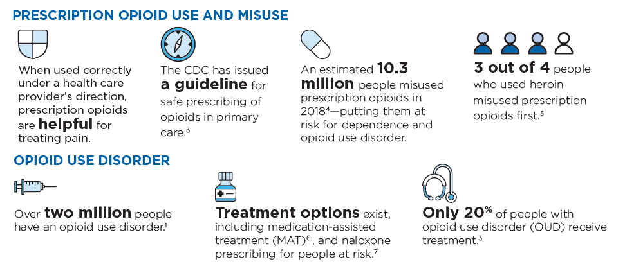
Scope of the Problem
Notes:
The CMS Roadmap – Scope of Problem
To view the entire roadmap, go to CMS.gov/About-CMS/Agency-Information/Emergency/Downloads/Opioid-epidemic-roadmap.pdf.

Slide 10
Key Areas of CMS Focus
CMS’s Opioid Roadmap is a three-pronged approach to combating the opioid epidemic focusing on:
Prevention of new cases of opioid use disorder (OUD);
Treatment of patients who have already become dependent on or have an opioid use disorder; and
Utilization of data from across the country to target prevention and treatment activities
Notes:
As one of the largest payers of healthcare services, CMS has a vital role in addressing the opioid crisis and is focused on three key areas: prevention, treatment, and data.
Prevention: Manage pain using a safe and effective range of treatment options that rely less on prescription opioids.
Treatment: Expand access to treatment for opioid use disorder.
Data: Use data to target prevention and treatment efforts and to identify fraud and abuse.

Slide 11
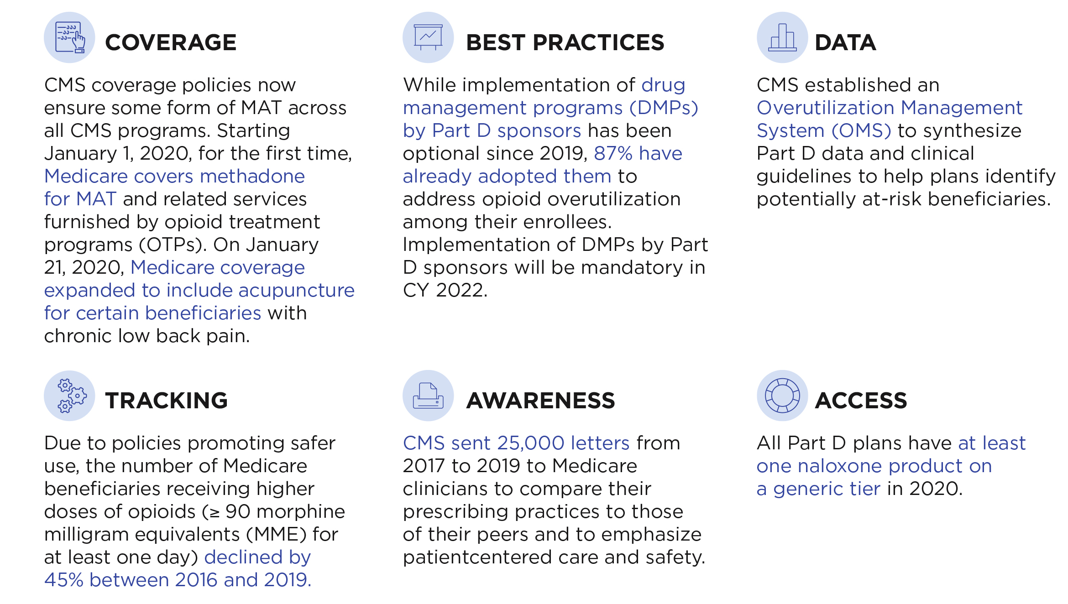
Medicare Successes So Far
Notes:
The CMS Roadmap – CMS’ Successes So Far
To view the entire roadmap, go to CMS.gov/About-CMS/Agency-Information/Emergency/Downloads/Opioid-epidemic-roadmap.pdf.

Slide 12
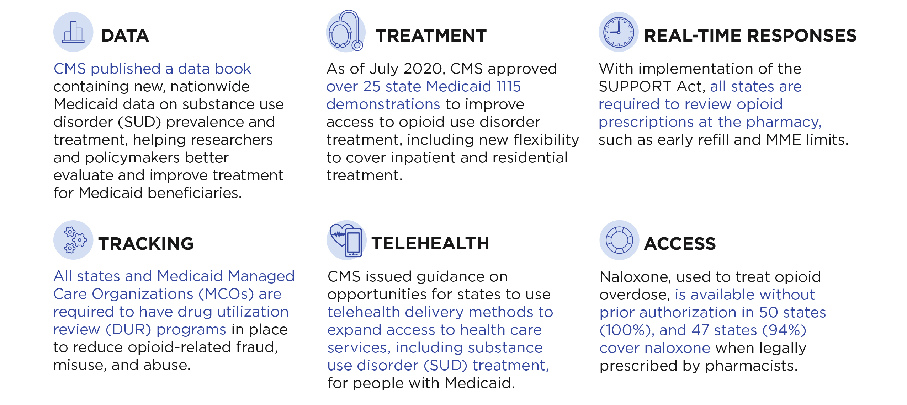
Medicaid Successes So Far
Notes:
The CMS Roadmap – CMS’ Successes So Far
To view the entire roadmap, go to CMS.gov/About-CMS/Agency-Information/Emergency/Downloads/Opioid-epidemic-roadmap.pdf.

Slide 13
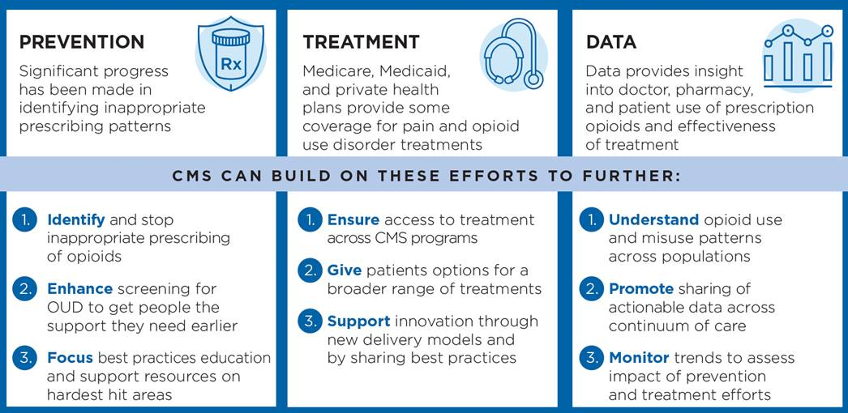
CMS Ongoing Efforts
Notes:
The CMS Roadmap – CMS Ongoing Efforts
To view the entire roadmap, go to CMS.gov/About-CMS/Agency-Information/Emergency/Downloads/Opioid-epidemic-roadmap.pdf.

Slide 14
Opioid-Related Services and Coverage
Role of payers
Medicare
Medicaid
Marketplace/Exchanges
Notes:
In this section, we will discuss opioid-related services and coverage including the role of payers, medication-assisted treatment (MAT), Medicare, Medicaid, and the Marketplace/Exchanges.

Slide 15
Role of Payers in Responding to the Opioid Crisis
Prevention
Ensure coverage of non-opioid treatments for pain
Implement system safeguards for at-risk beneficiaries who are prescribed opioids
Ensure appropriate access to opioids for all who need them when indicated
Treatment
Cover evidence-based opioid use disorder treatment
Cover overdose reversal drugs
Data
Monitor prescription opioid trends and address outliers
Notes:
Payers have a role in responding to the opioid crisis. Payers cover preventive services like non-opioid treatments for pain, implement system safeguards for at-risk beneficiaries who are prescribed opioids, and ensure appropriate access to opioids for all who need them when indicated. They cover opioid use disorder treatment. They ensure there’s coverage of treatments for pain that rely less on opioids and ensure appropriate access to opioids for all who need them. They monitor prescription opioid trends and address outliers.

Slide 16
Prevention: Department of Health and Human Services’ (HHS) Efforts to Address Pain
Established a comprehensive high-level strategy for pain IPRCC.nih.gov/sites/default/files/HHSNational_Pain_Strategy_508C.pdf
Led the Pain Management Best Practices Inter-Agency Task Force
Updated best practices and issued recommendations that address gaps or inconsistencies for managing chronic and acute pain HHS.gov/sites/default/files/pmtf-final-report-2019-05-23.pdf
Notes:
The Department of Health and Human Services (HHS) is involved in efforts to improve the treatment of pain. HHS established a comprehensive high-level strategy for pain and they lead the Pain Management Best Practices Inter-Agency Task Force. HHS proposed updates to best practices and issued recommendations that address gaps or inconsistencies for managing chronic and acute pain. For more information, visit IPRCC.nih.gov/sites/default/files/HHSNational_Pain_Strategy_508C.pdf and HHS.gov/sites/default/files/pmtf-final-report-2019-05-23.pdf.

Slide 17
Medicare and Opioids
Prevention
Prescription drug coverage (Part D) safety edits
Part D prevention through utilization management
New Medicare acupuncture benefit
Other Medicare efforts to address the opioid crisis through prevention
Treatment
Medicare coverage of substance use disorder treatment services
Medicare coverage of prescription drugs for medication assisted treatment
New Opioid Treatment Program benefit
Data
Medicare Part D Opioid Prescribing Mapping Tool
Notes:
Prevention
Prescription drug coverage (Part D) safety edits
Part D prevention through utilization management
New Medicare acupuncture benefit
Other Medicare efforts to address the opioid crisis through prevention
Treatment
Medicare coverage of substance use disorder treatment services
Medicare coverage of prescription drugs for medication assisted treatment
New Opioid Treatment Program benefit
Data
Medicare Part D Opioid Prescribing Mapping Tool

Slide 18
Medicare Part D Drug Safety Alerts
Part D drug plans may send a person’s pharmacy a safety alert before a prescription is filled for
Possible unsafe amounts of opioids
First prescription fills for opioids
Use of opioids and benzodiazepines at the same time
If a person’s prescription can’t be filled as written, the pharmacist will give them a notice explaining how they or their doctor can obtain a coverage determination
Notes:
Part D drug plans are expected to perform additional safety checks on opioid prescriptions, and may send the pharmacy an alert for review before a prescription is filled. Safety alerts may cover situations like
Possible unsafe amounts of opioids—The pharmacist or Medicare drug plan may need to review the prescription with the doctor to make sure the medications are safe
First prescription fills for opioids—A person may be limited to a 7-day supply or less if they haven’t recently taken opioids
Use of opioids and benzodiazepines at the same time
If a prescription can’t be filled as written, including the full amount on the prescription, the pharmacist will give the person a notice explaining how they or their doctor can contact the plan to ask for a coverage determination. If a person’s health requires it, a fast coverage decision can be requested. The person may also ask the plan for an exception to its rules before going to the pharmacy, to know if the plan will cover the medication.
Certain exceptions apply to each of these policies to ensure access to medically necessary pain medications, like exemptions for those with an active cancer diagnosis, with sickle cell or who are receiving long-term, hospice or palliative care.
For more information, visit CMS.gov/Medicare/Prescription-Drug-coverage/PrescriptionDrugCovContra/RxUtilization.html.

Slide 19
Part D Prevention through Utilization Management
To help prevent opioid misuse and abuse, Part D drug plans may apply certain coverage rules to Part D drugs on their formularies
Prior authorization—requires the patient or their prescriber to get approval from the plan before the plan will agree to cover the drug
Quantity limits—are limits on how much medication can be obtained at a time
Step therapy—requires the patient to try one or more similar, lower cost drugs before the plan will cover the prescribed drug
Patient or the prescriber can request an exception if they believe that a coverage rule should be waived
Notes:
CMS regulations and guidance permit Part D drug plans to apply certain coverage rules to Part D drugs on their formularies.
Prior authorization requires the patient or their prescriber to get approval from the plan before the plan will agree to cover the drug.
Quantity limits are limits on how much medication can be obtained at a time.
Step therapy requires the patient to try one or more similar, lower cost drugs before the plan will cover the prescribed drug.
The patient or the prescriber can request a type of coverage determination called an exception if they believe that one of these coverage rules should be waived.
For more information, visit CMS.gov/Medicare/Prescription-Drug-coverage/PrescriptionDrugCovContra/RxUtilization.html.

Slide 20
New Medicare Acupuncture Benefit
Medicare Part B (Medical Insurance) covers up to 12 acupuncture visits in 90 days for chronic low back pain. Chronic low back pain is defined as
Lasting 12 weeks or longer
Having no identifiable systemic cause (not associated with metastatic, inflammatory, or infectious disease)
Pain that’s not associated with surgery or pregnancy
An additional 8 sessions will be covered if you show improvement.
No more than 20 acupuncture treatments can be given yearly
If your chronic low back pain isn’t improving or is getting worse, then treatments won’t be covered
NOTE: Medicare doesn't cover acupuncture (including dry needling) for any condition other than chronic low back pain.
Notes:
Acupuncture is a technique where practitioners stimulate specific points on the body, most often by inserting thin needles through the skin. Acupuncture must be given by a doctor, or by another health care provider (like a nurse practitioner or physician assistant) who has both of these:
A masters or doctoral level degree in acupuncture or Oriental Medicine from a school accredited by the Accreditation Commission on Acupuncture and Oriental Medicine.
A current, full, active, and unrestricted license to practice acupuncture in the state where care is being provided.
Cost details aren’t yet available for this benefit.
Medicare Part B (Medical Insurance) covers up to 12 acupuncture visits in 90 days for chronic low back pain. Chronic low back pain is defined as:
Lasting 12 weeks or longer.
Having no identifiable systemic cause (not associated with metastatic, inflammatory, or infectious disease).
Pain that’s not associated with surgery or pregnancy.
An additional 8 sessions will be covered if you show improvement.
No more than 20 acupuncture treatments can be given yearly.
If your chronic low back pain isn’t improving or is getting worse, then treatments won’t be covered.
Source: Medicare.gov/coverage/acupuncture

Slide 21
Other Medicare Efforts to Address the Opioid Crisis through Prevention
Starting in 2019, Part D plans may adopt drug management programs to limit an at-risk person’s access to coverage for opioids and benzodiazepines to a selected network pharmacy/doctor or by limiting type or amount of opioid for that person
Plans must first do case management with the doctors who prescribed the drugs
CMS’ Overutilization Monitoring System (OMS) helps plans identify potentially at-risk individuals
Notes:
CMS implemented CARA (Comprehensive Addiction and Recovery Act of 2016) requirements which provide Part D plans with an important additional tool to address the opioid crisis that’s devastating families and communities across the nation. CARA required CMS to establish a framework that allows Part D plans to implement drug management programs. Under such programs, a plan can limit access to coverage for “frequently abused drugs” for those persons identified as “at-risk”.
CMS designates opioids and benzodiazepines as “frequently abused drugs.” Both depress the central nervous system (CNS); however, each has unique pharmacology, safety risks, and labeling information related to its use. Benzodiazepines are typically prescribed for treating conditions like anxiety, insomnia and seizure disorders. Use of benzodiazepines and opioids may cause sedation, respiratory, depression, coma, and death. Therefore, the FDA is requiring opioid analgesics, prescription opioid cough products, and benzodiazepines to have slightly different labeling and warnings that includes information for providers and patients about the serious risks of using these medications at the same time.
Drug management programs are integrated with CMS' existing Overutilization Monitoring System (OMS) which flags people with Medicare, who are potentially at-risk for opioid abuse or misuse, to their Part D plans for case management with the physicians who prescribed the drugs. The clinical guidelines (aka OMS criteria) that are used to determine if a person is potentially “at-risk”, are based on the person using opioids from multiple prescribers and/or multiple pharmacies.

Slide 22
Other Medicare Efforts to Address the Opioid Crisis through Prevention, continued
Person must meet certain criteria showing opioid use with multiple doctors and/or pharmacies
Doesn’t apply to Medicare beneficiaries who have cancer, get palliative care or are in hospice or long-term care
At-risk person may generally choose the pharmacy/doctor
Person receives written notice and can appeal before the limit applies
Limits the availability of the Special Enrollment Period (SEP) for people who are dually-eligible for Medicare and Medicaid or have a low-income subsidy (LIS)
Plans required to have drug management programs beginning in CY 2022
Notes:
If a person is determined to be at-risk through case management, a Part D sponsor can limit the person’s access to coverage of opioids and benzodiazepines to a selected prescriber(s) and/or pharmacy(ies), and through the use of person-specific point-of-sale (POS) claim edits. Before a Part D sponsor may use a limitation they must have case management with the prescribers of these drugs, but also provided written notice to the person. The notice states that the person can submit prescriber and pharmacy preferences and that they can also appeal an at-risk determination. CMS also exempts people who are being treated for active cancer-related pain, are receiving palliative or end-of-life care, or are in hospice or long-term care from drug management programs. CMS is limiting the availability of the Special Enrollment Period (SEP) for dually or other low-income subsidy (LIS) eligible people with Medicare who are identified as at-risk or potentially at-risk for prescription drug abuse under such drug management programs.
For more information, visit CMS.gov/Medicare/Prescription-Drug-coverage/PrescriptionDrugCovContra/RxUtilization.html.

Slide 23
Medicare Coverage— Substance Use Disorder (SUD) Treatment Services
Medicare will cover SUD treatment services if:
Services are from a Medicare-participating facility, other provider, or physician/practitioner
Services are reasonable and necessary
Covered services include:
Psychotherapy
Individual and group counseling
Patient education regarding diagnosis and treatment
Post-hospitalization follow-up
Screening, Brief Intervention, and Referral to Treatment (SBIRT) services
Alcohol misuse screening and counseling
Screening for depression
Notes:
Medicare will cover alcohol and drug misuse treatment (substance use disorder (SUD)) services if services are from a Medicare-participating facility, other provider or physician/practitioner, and the services are reasonable and necessary. Covered services include
Psychotherapy.
Individual and group counseling.
Patient education regarding diagnosis and treatment.
Post-hospitalization follow-up.
Screening, Brief Intervention, and Referral to Treatment (SBIRT) services: SBIRT is an early intervention approach for individuals with nondependent substance use to effectively help them before they need more extensive treatment. It involves: (1) Screening/assessment to quickly determine the severity of substance use and identify the appropriate level of treatment; (2) Brief intervention through a short conversation that increases insight and awareness of substance use and motivation toward behavioral change; and, (3) Referral to treatment if needed. For the SBIRT fact sheet, go to CMS.gov/Outreach-and-Education/Medicare-Learning-Network-MLN/MLNProducts/downloads/SBIRT_Factsheet_ICN904084.pdf.
Alcohol misuse screening and counseling.
Screening for depression.
For more information visit:
CMS.gov/Outreach-and-Education/Medicare-Learning-Network-MLN/MLNMattersArticles/Downloads/SE1604.pdf
CMS.gov/Medicare/Prescription-Drug-Coverage/PrescriptionDrugCovContra/Downloads/Part-D-Benefits-Manual-Chapter-6.pdf.

Slide 24
What is Medication-Assisted Treatment (MAT)
MAT, including opioid treatment programs (OTPs), combines behavioral therapy and medications to treat substance use disorders.
Can be prescribed only by certain providers | Can be prescribed by any health professional with prescribing authority
Examples: Methadone – administered at a clinic that meets certain federal opioid treatment program standards (Part of new Part B benefit) Suboxone®(Buprenorphine/Naloxone combined) – prescribed or dispensed at a doctor’s office/by a physician or practitioner meeting specific standards | Example: Vivitrol® (Naltrexone injection) is administered in a physician’s office. Used for outpatient maintenance therapy and requires a prescription
Notes:
Medication-assisted treatment (MAT), including opioid treatment programs (OTPs), combines behavioral therapy and medications to treat substance use disorders (SAMHSA). The following examples of medications used for MAT require a prescription and can be prescribed only by certain providers (check with your plan to see what is covered).
Methadone is used to treat opioid use disorders (OUD) and must be obtained at an opioid treatment program (OTP) that meets federal standards.
Suboxone® (Buprenorphine/Naloxone combined) is prescribed or dispensed in doctor’s offices by a physician or practitioner with a DATA 2000 waiver and is used for outpatient maintenance therapy
The following example of medication used for MAT can be prescribed by any health professional with prescribing authority (check with your plan to see what is covered). The amount that can be prescribed depends on the state and insurance requirements.
Vivitrol® (Naltrexone injection) is administered in a physician's office and is used for outpatient maintenance therapy. It requires a prescription.
Methadone (Dolophine, Methadose), buprenorphine (Subutex, brand discontinued in the U.S.), buprenorphine combined with naloxone (Suboxone®), and naltrexone (Depade, ReVia) are approved in the U.S. to treat opioid dependence.
Methadone isn’t a covered outpatient treatment option by Medicare at this time for substance abuse because when it’s used to treat opioid use disorder, it may only be administered or dispensed in opioid treatment programs. It’s only covered for pain management.
Methadone is covered under Part A for inpatient detox. It's not covered under Part D unless it's for pain management.
Other new drugs for opioid treatment may include Probuphine (implanted buprenorphine) and Sublocade (injectable buprenorphine).
Source: SAMHSA.gov/medication-assisted-treatment

Slide 25
Medicare Coverage — Medication-Assisted Treatment (MAT)
Medicare covers prescription drugs (methadone, buprenorphine, naltrexone) for MAT. They are covered by:
Part A when administered during a hospital stay
Part B when the drug is injectable or implantable and administered by a physician/practitioner in a physician’s office or hospital outpatient department
Part D when dispensed from a pharmacy when prescribed for MAT
Notes:
Medicare coverage of prescription drugs for Medication Assisted Treatment (MAT) (methadone, buprenorphine, naltrexone). Part A covers prescription drugs MAT when administered during a hospital stay and Part B when the drug is injectable or implantable and administered by a physician/practitioner in a physician’s office or hospital outpatient department. A treatment plan may be required in certain circumstances. Part D covers prescription drugs for MAT when prescribed for MAT and dispensed from a pharmacy.
NOTE: Methadone is covered under Part A for inpatient detox. It isn’t covered under Part D unless it’s for pain management.
For more information, visit:
CMS.gov/outreach-and-education/medicare-learning-network-mln/mlnmattersarticles/downloads/se1604.pdf and
CMS.gov/Medicare/Prescription-Drug-Coverage/PrescriptionDrugCovContra/Downloads/Part-D-Benefits-Manual-Chapter-6.pdf.

Slide 26
Opioid Treatment Program Benefit
Medicare Part B covers opioid use disorder treatment services provided by opioid treatment programs (OTPs)
You pay nothing for these services if you get them from an OTP that's enrolled in Medicare, and the Part B deductible applies
Services include medication-assisted treatment, counseling, drug testing, and individual and group therapy. Counseling and therapy services are covered in person and by virtual delivery
The new benefit establishes Medicare’s coverage of methadone for the first time, in addition to coverage of buprenorphine that was already covered
During the COVID-19 Public Health Emergency (PHE), counseling and therapy services, as well as periodic assessments, will be covered if rendered by telephone
Notes:
Opioid Treatment Program Benefit
Medicare Part B (Medical Insurance) covers opioid use disorder treatment services provided by opioid treatment programs (OTPs.)
You pay nothing for these services if you get them from an OTP that's enrolled in Medicare, and the Part B deductible applies.
Services include medication-assisted treatment, counseling, drug testing, and individual and group therapy. Counseling and therapy services are covered in person and by virtual delivery.
The new benefit establishes Medicare’s coverage of methadone for the first time, in addition to coverage of buprenorphine that was already covered
During the COVID-19 Public Health Emergency (PHE), counseling and therapy services, as well as periodic assessments, will be covered if rendered by telephone
Source: Medicare.gov/coverage/opioid-use-disorder-treatment-services
More information on the OTP benefit can be found: CMS.gov/Medicare/Medicare-Fee-for-Service-Payment/Opioid-Treatment-Program/OTP-FAQs#_Toc27400917

Slide 27
Medicare Part D Opioid Prescribing Mapping Tool
Allows providers, local health officials, and others to:
Learn about their community’s Medicare opioid prescription rate
Make geographic comparisons of Medicare Part D opioid prescription claims so they can better target prevention and treatment efforts
Notes:
The Medicare Part D Opioid Drug Mapping Tool gives providers, local health officials, and others the data about their community's Medicare opioid prescription rate so they can better target prevention and treatment efforts. It shows geographic comparisons at the state, county, and ZIP code levels and Medicare Part D opioid prescription claims with the personally identifiable information removed for prescriptions written and then submitted to be filled within the U.S.
It’s helpful to look at your area for the percentage of opioid claims. The 2017 updated version of the mapping tool presents Medicare Part D opioid prescribing rates for 2015 as well as the change in opioid prescribing rates from 2013 to 2015. New for this release is additional information on extended-release opioid prescribing rates. The tool is available at Go.CMS.gov/opioidheatmap.

Slide 28
Medicaid/CHIP and Opioids
Prevention
Pharmacy program drug use management strategies
Drug utilization review
Treatment
Coverage of SUD treatment
Opportunities for states to address mental health and substance use disorders
Medicaid Initiatives to Strengthen Treatment Capacity
Data
T-MSIS and SUD Data Book
Notes:
This section will discuss Medicaid coverage of MAT, pharmacy program drug use management strategies, drug utilization review, and opportunities for states to address mental health and substance use disorders.

Slide 29
Medicaid Pharmacy Program Drug Use Management Strategies to aid Prevention
Preferred drug list
Clinical criteria
Step therapy
Prior authorization
Quantity limits
Drug utilization review
Coordination with State Prescription Drug Monitoring Program (PDMP)
Notes:
State Medicaid programs may choose to design benefit requirements. The Medicaid Pharmacy Program outlines the following drug use management strategies.
Preferred drug list: Providers are permitted to prescribe preferred drugs without seeking prior authorization. By removing a drug from a preferred drug list to a non-preferred, it would limit the use to only those patients for whom treatment with other medications is ineffective.
Clinical criteria: If a medication remains on the preferred list, claims would be authorized only when the recipient satisfies the clinical criteria established to ensure appropriate utilization of the drug.
Step therapy: Requires that another drug is tried prior to a specific drug.
Prior authorization: Medicaid won’t pay for a drug unless the provider has obtained permission before prescribing the drug.
Quantity limits: Medicaid may impose quantity limits on medications as a way to promote safe and appropriate use of the medication, ensuring that they are not overprescribed.
Drug Utilization Review: Prospective, retrospective and concurrent drug utilization review can identify inappropriate prescribing practices.
State Prescription Drug Monitoring Program (PDMP): Data is collected from pharmacies, outpatient clinics and others on dispensed, controlled substance prescriptions. Each state designates an agency to oversee their program and programs can vary by state. PDMPs have been shown to prevent drug diversion.

Slide 30
Medicaid Drug Utilization Review (DUR) Annual Reports
State Medicaid agencies must report DUR program activities and processes to Centers for Medicare & Medicaid Services (CMS) every year for their Fee-for-Service (FFS) and Managed Care Organization (MCO) Programs
Ensures appropriate clinical policies, including appropriate opioid utilization
CMS compiles DUR information for the CMS Medicaid DUR State Comparison/Summary Report at Medicaid.gov/Medicaid/prescription-drugs/drug-utilization-review/index.html
Notes:
State Medicaid agencies are required to report annually to the Centers for Medicare & Medicaid Services (CMS) their drug utilization review (DUR) program activities and processes to ensure appropriate drug utilization, including appropriate opioid utilization, which could include placing quantity limits on opioids, monitoring the concurrent use of opioids and benzodiazepines, employing Prescription Drug Monitoring Program (PDMP) requirements, and using tools that measure morphine milligram equivalents (MME) per day.
CMS also inquires about the use of patient review and restriction programs (i.e. lock-in programs) to address potential prescription opioid misuse or abuse. CMS compiles this collected information within the CMS Medicaid DUR State Comparison/Summary Report, which is posted annually at Medicaid.gov/Medicaid/prescription-drugs/drug-utilization-review/index.html.
Medicaid Fee For Service (for the period October 2017-September 2018)
36 states (72%) have processes in place to identify potential fraudulent practices by
Prescribers
37 states (74%) have processes in place to identify potential fraudulent practices by pharmacies.
26 states (52%) also have a documented process in place that identifies potential fraud or misuse of non-controlled drugs by a beneficiary
46 states (92%) have a Lock-In program
Medicaid Managed Care Organization (MCO) (for the period October 2017-September 2018)
Of the 229 MCOs, 214 MCOs (93%) have processes in place to identify potential fraudulent practices by prescribers
216 MCOs (94%) have processes in place to identify potential fraudulent practices by pharmacies
225 (98%) have a documented process in place in which the MCO identifies potential fraud or misuse of controlled drugs by a beneficiary
202 MCOs (88%) have a Lock-In program

Slide 31
Medicaid Coverage of SUD Treatment
Medicaid is the largest payer in the country for SUD treatment
Most SUD treatment services are optional benefits.
Starting October 1, 2020, all states must cover all FDA-approved forms of MAT medications and services
Most states currently cover other optional treatment benefits like counseling, peer support services, and case management
Notes:
Most substance use disorder (SUD) services are optional Medicaid benefits for most populations. States have the option to cover SUD treatment services like counseling, psychosocial, and behavioral health therapies. States offer pharmacy benefits. They vary by state and the drug. They’re required to provide coverage of drugs meeting the definition of covered-outpatient drugs when they’re prescribed for medically-accepted indications.
In most cases, providers are permitted to prescribe covered, preferred drugs without seeking prior authorization. SUD services are required for individuals under 21 with Early and Periodic Screening, Diagnostic and Treatment (EPSDT) and the newly eligible adult group (19-64 with income at or under 133% of the Federal Poverty Level (FPL)) in states that have expanded Medicaid.
Under the SUPPORT Act, states are required to offer all three forms of MAT beginning October 1, 2020.
Additional background information for the presenter: the SUPPORT Act includes an exception for states if 1) their regular legislative session after the law became effective doesn’t end until after October 1, 2020, or 2) if they demonstrate they have a provider shortage and can’t comply by the deadline.
State flexibilities to provide additional services
For more information, see these Informational Bulletins:
Medication-Assisted Treatment for Substance Use Disorders, July 11, 2014, (Medicaid.gov/federal-policy-guidance/downloads/cib-07-11-2014.pdf)
Best Practices for Addressing Prescription Opioid Overdoses, Misuse and Addiction, January 28, 2016, (Medicaid.gov/federal-policy-guidance/downloads/cib-02-02-16.pdf)

Slide 32
Information about Medication-Assisted Treatment (MAT)
Medication-assisted treatment (MAT) is the use of medications in combination with counseling and behavioral therapies, which is effective in the treatment of opioid use disorders (OUD) and can help some people to sustain recovery.
There are three drugs approved by the FDA for the treatment of opioid dependence: buprenorphine, methadone, and naltrexone.
All three of these treatments have been demonstrated to be safe and effective in combination with counseling and psychosocial support.
Notes:
Medication-assisted treatment (MAT) is the use of medications in combination with counseling and behavioral therapies, which is effective in the treatment of opioid use disorders (OUD) and can help some people to sustain recovery.
There are three drugs approved by the FDA for the treatment of opioid dependence: buprenorphine, methadone, and naltrexone.
All three of these treatments have been demonstrated to be safe and effective in combination with counseling and psychosocial support.

Slide 33
Medicaid and CHIP Opportunities for States to Address Mental Health and Substance Use Disorders (SUDs)
Medicaid and Children’s Health Insurance Program (CHIP) Final Mental Health and SUD parity rule (CMS-2333-F)
Strengthens access to mental health and SUD benefits
Plans and/or states must disclose information on mental health and SUD benefits information
States must disclose reasons for denying reimbursement or payment
For separate CHIPs, if the state provides Early and Periodic Screening, Diagnostic and Treatment (EPSDT) benefit, the CHIP state plan was deemed in compliance with parity for populations receiving EPSDT
Notes:
There are many ways that states can address mental health and Substance Use Disorders (SUDs) for their Medicaid program.
Final Mental Health and SUD parity rule for Medicaid and Children’s Health Insurance Program (CHIP) (March 2016)
Final Rule strengthens access to mental health and SUD benefits for low-income Americans aligning with protections already required of private health plans. It maintains state flexibility while guaranteeing Medicaid and CHIP enrollees are able to access mental health and substance abuse services in a comparable manner as medical benefits (e.g.., comparable co-pays, out-of-pocket costs, limits on outpatient, etc.).
Plans must disclose information on mental health and SUD benefits upon request, including the criteria for determinations of medical necessity.
It also requires the state to disclose the reason for any denial of reimbursement or payment for services with respect to mental health and SUD benefits.
For CHIP, if states provided Early and Periodic Screening, Diagnostic and Treatment (EPSDT) benefit consistent with all Medicaid requirements, CHIP plans were deemed in compliance with parity requirements. Some states provide EPSDT to all of its CHIP population while others only provide it to some of its CHIP population.

Slide 34
Medicaid and CHIP Opportunities for States to Address Mental Health and Substance Use Disorders (SUDs), continued
CHIP Behavioral Health Coverage and the SUPPORT Act
Sec. 5022 of the SUPPORT Act requires all separate CHIPs to provide a benefit package that can prevent, diagnose, and treat a broad range of MH/SUD conditions in a culturally and linguistically appropriate manner for all CHIP populations, including children and pregnant women
States will need to demonstrate that their benefit array includes a variety services that are able to appropriately address many MH/SUD conditions, including coverage of certain MH/SUD screening and preventive services, MAT, and tobacco cessation
SUPPORT Act SHO: Medicaid.gov/sites/default/files/Federal-Policy-Guidance/Downloads/sho20001.pdf
Notes:
There are many ways that states can address mental health and Substance Use Disorders (SUDs) for their Medicaid program.
CHIP Behavioral Health Coverage and the SUPPORT Act
Sec. 5022 of the SUPPORT Act builds on the Mental Health Parity and Addiction Equity Act of 2008 by making MH/SUD benefits mandatory CHIP benefits. Parity only required states to treat any MH/SUD benefits they chose to provide in a comparable manner to M/S benefits.
Requires all state CHIP plans to cover behavioral health-related screening and preventive services for children and pregnant women, specifically those recommended by the AAP and USPSTF with Grades of A or B
CMS released a State Health Official Letter on March 2, 2020 describing the SUPPORT Act requirements for CHIP. States will submit a CHIP state plan amendment to demonstrate compliance with the SUPPORT Act.
SUPPORT Act SHO: Medicaid.gov/sites/default/files/Federal-Policy-Guidance/Downloads/sho20001.pdf

Slide 35
Medicaid Initiatives to Strengthen Treatment Capacity
Medicaid Innovation Accelerator Program (IAP)
Technical assistance provided to multiple Medicaid agencies from July 2014-September 2020 to build skills in analyzing and using SUD and MAT data.
Sec. 1003 demonstration project to increase the capacity of Medicaid providers to furnish substance use disorder treatment and recovery services.
On September 18, 2019, CMS announced $48.5 million in planning grant awards to 15 state Medicaid agencies.
Following the planning phase, 5 of these states will be selected for 36-month demonstrations with enhanced federal reimbursement for increases in SUD services.
Notes:
CMS, in cooperation with federal partners, works with states to improve their services for individuals with Medicaid who have mental health conditions and SUD.
Innovation Accelerator Program (IAP)—The goal of the IAP initiative on SUDs is to support participating states for better SUD delivery system reforms and primary care and mental health integration.
Health Homes that focus on mental health and SUD—Health homes as defined by the Affordable Care Act offer coordinated care to individuals with multiple chronic health conditions including mental health and SUDs.
Work with the Substance Abuse and Mental Health Administration (SAMHSA) on Certified Community Behavioral Health Centers.
Sec. 1003: 5-state demonstration program to increase capacity of the SUD treatment workforce.
On September 18, CMS announced $48.5 million in planning grant awards to 15 state Medicaid agencies to increase the treatment capacity of providers to furnish SUD treatment and recovery services.
The planning grants are intended to increase the capacity of Medicaid providers to deliver SUD treatment or recovery services through: an ongoing assessment of the SUD treatment needs of the state; recruitment, training, and technical assistance for Medicaid providers that offer SUD treatment or recovery services; and improved reimbursement for and expansion of the number or treatment capacity of Medicaid providers.
The planning grants are for the 18-month planning phase (September 30, 2019 to March 29, 2021), after which 5 states will be selected to implement a 36-month demonstration project.
States participating in the 36-month demonstration will receive enhanced federal reimbursement for increases in Medicaid expenditures for SUD treatment and recovery services.
For more information visit Medicaid.gov/medicaid/benefits/behavioral-health-services/index.html.

Slide 36
Medicaid Initiatives to Strengthen Treatment Capacity, Section 1115 SUD Demonstrations
Section 1115 SUD demonstrations
Improve the continuum of care for beneficiaries with a SUD by allowing states to receive federal financial participation (FFP) for the continuum of services to treat addiction to opioids or other substances, including services provided to Medicaid enrollees residing in residential treatment facilities
Goals of these demonstrations include increased rates of identification, initiation, and engagement in treatment and reduced utilization of emergency departments and inpatient hospital settings for treatment
To date, 28 have been approved
Notes:
Section 1115 SUD demonstrations
CMS offers states the opportunity to demonstrate how to implement best practices for improving OUD and other SUD treatment in ways that take into account the particular challenges raised by the opioid epidemic in each state.
Through this new section 1115 initiative, states will have an opportunity to receive federal financial participation (FFP) for the continuum of services to treat addiction to opioids or other substances, including services provided to Medicaid enrollees residing in residential treatment facilities.
Goals of the demonstrations include:
Increased rates of identification, initiation, and engagement in treatment;
Increased adherence to and retention in treatment;
Reductions in overdose deaths, particularly those due to opioids;
Fewer readmissions to the same or higher level of care where the readmission is preventable or medically inappropriate;
Improved access to care for physical health conditions among beneficiaries; and
Reduced utilization of emergency departments and inpatient hospital settings for treatment.
Each participating state must develop implementation plans describing timelines and activities it will undertake to meet six milestones that are critical steps to meeting those goals.
The milestones relate to access of care and the use of evidence-based program standards, such as requiring residential treatment facilities offer MAT on-site or facilitate access off-site.
There will be a core set of measures that all states that elect to implement this demonstration model will report on, as well as additional measures specific to particular state demonstration parameters.
To date, 28 state applications have been approved.

Slide 37
Medicaid Initiatives to Strengthen Treatment Capacity, Maternal Opioid Misuse Model
The Maternal Opioid Misuse (MOM) model under the CMS Innovation Center
The model will merge clinical care and community services critical to health, well-being, and recovery to test for improvements to care quality and reduced costs for mothers with a OUD and their infants
Notes:
The Maternal Opioid Misuse (MOM) model
The MOM model is fragmentation in the care of pregnant and postpartum Medicaid beneficiaries with opioid use disorder (OUD) through state-driven transformation of the delivery system surrounding this vulnerable population.
By supporting the coordination of clinical care and the integration of other services critical for health, wellbeing, and recovery, the MOM model has the potential to improve quality of care and reduce costs for mothers and infants.
In December 2019, CMS awarded funding to ten states selected to receive funding under the model.
The MOM Model will have a five-year period of performance beginning in January 2020 with three different types of funding, totaling approximately $50,000,000.
The pre-implementation phase of the performance period began January 2020.
Because of COVID-19, as of April 16, 2020, CMS instituted a six-month postponement of the requirement that MOM Model Recipients begin to screen and enroll beneficiaries by January 2021. The new date when awardees will be required to begin to enroll MOM Model Beneficiaries is July 1, 2021.
For more information visit Medicaid.gov/medicaid/benefits/behavioral-health-services/index.html.
For guidance visit https://www.medicaid.gov/sites/default/files/federal-policy-guidance/downloads/smd17003.pdf

Slide 38
Transformed Medicaid Statistical Information System (T-MSIS) and the Substance Use Disorder (SUD) Data Book
In October 2019, CMS published a data book derived from T-MSIS containing new, nationwide Medicaid data on substance use disorder (SUD) prevalence and treatment, helping researchers and policymakers better evaluate and improve treatment for Medicaid beneficiaries.
As required by the SUPPORT Act, the SUD Data Book will be updated every year through 2024.
Notes:
T-MSIS
Transitions state reporting from the legacy Medicaid Statistical Information System (MSIS) to a timelier and expanded data set using a modernized technology platform to collect Medicaid and CHIP data from states.
T-MSIS Substance Use Disorder (SUD) Data Book
CMS released the inaugural Substance Use Disorder (SUD) Data Book using preliminary 2017 Transformed Analytic File (TAF) data. The SUD Data Book is congressionally-mandated through the Substance Use–Disorder Prevention that Promotes Opioid Recovery and Treatment for Patients and Communities Act (P.L. 115-271) (SUPPORT Act). The SUPPORT Act seeks to address the pressing need for substance use disorder treatment and prevention services, with a focus on opioid use. The SUPPORT Act directs the U.S. Department of Health and Human Services to publish the SUD Data Book no later than October 24, 2019 and to issue an updated version of the SUD Data Book no later than January 1 of each calendar year through 2024. This initial SUD Data Book reports the number of Medicaid beneficiaries with a SUD and the services they received during calendar year 2017.

Slide 39
The Marketplace and Opioids
Prevention
Utilization management
Treatment
Mental health coverage and substance use disorder (SUD) coverage
Notes:
This section will discuss mental health coverage and substance use disorder (SUD) coverage for consumers with a Marketplace plan.

Slide 40
The Marketplace — Utilization Management
Qualified Health Plan (QHP) formularies must meet minimum federal standards for drug access, including the provision of opioid analgesics
QHPs may employ utilization management tools, such as prior authorization, step therapy, and quantity and duration of therapy limits
Notes:
Qualified Health Plan (QHP) formularies must meet minimum federal standards for drug access, including the provision of opioid analgesics. QHPs may employ utilization management tools, such as prior authorization, step therapy, and quantity and duration of therapy limits
For more information, please see 45 CFR Part 156 Subpart B, 45 CFR 156.122, and “Information on Essential Health Benefits (EHB) Benchmark Plans” available at CMS.gov/cciio/resources/data-resources/ehb.”

Slide 41
The Marketplace—Mental Health and Substance Use Disorder (SUD) Coverage
Essential health benefits (EHB) rules require coverage for key categories of benefits
Specific benefits depend on your state, but the health plan must include coverage for
Mental and behavioral health treatment (including Opioid Use Disorder (OUD) and SUD treatment)
Prescription drugs
Notes:
All Marketplace plans cover essential health benefits (EHB). Specific benefits depend on your state and the health plan but must include coverage for mental and behavioral health services, substance use disorder (SUD) benefits, including opioid use disorder (OUD) services, and prescription drug coverage. For more information, HealthCare.gov/coverage/mental-health-substance-abuse-coverage/.

Slide 42
The Marketplace—Mental Health and Substance Use Disorder (SUD) Coverage (continued)
Other protections for Marketplace plans include
Cost sharing for EHB benefits must count towards the plan’s annual limitation
No yearly or lifetime dollar limits, when services are in-network
Must comply with “parity" protections
Must not discriminate
Notes:
There are other protections for Marketplace plans including
Cost sharing for EHB benefits must count towards the plan’s annual limitation
No yearly or lifetime dollar limits on coverage for EHB benefits
Must comply with “parity" protections between mental health and substance use disorder benefits and medical benefits
Prohibited from discriminating based on an individual's age, expected length of life, present or predicted disability, degree of medical dependency, quality of life, or other health conditions. Issuers are allowed to use reasonable medical management

Slide 43
Additional Information and Resources
Notes:
This section contains additional information and resources about opioids.

Slide 44
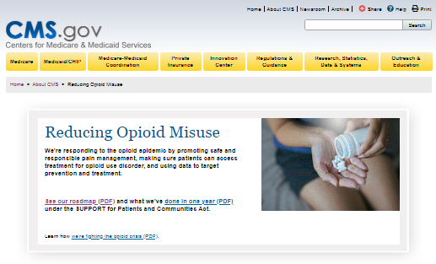
CMS’ Opioid Resources
CMS.gov/about-cms/story-page/reducing-opioid-misuse.html
Medicaid.gov/medicaid/prescription-drugs/drug-utilization-review/combatting-opioid-misuse-and-abuse/index.html
Notes:
CMS is responding to the opioid crisis by promoting safe and responsible pain management, making sure patients can access treatment for opioid use disorder, and using data to target prevention and treatment. For more information, visit CMS.gov/about-cms/story-page/reducing-opioid-misuse.html.

Slide 45
CMS Collaboration With Federal and Private Partners
Collaboration with SAMHSA on implementation of new Part B OTP benefit
“Informational Bulletin on Medication-Assisted Treatment (MAT) for Substance Use Disorders”
Surgeon General’s letter campaign on the prescription drug crisis
Centers for Disease Control and Prevention’s (CDC) “Guideline for Prescribing Opioids for Chronic Pain”
Discussions about expanding the evidence base to inform coverage determinations for alternative therapies
Healthcare Fraud Prevention Partnership (HFPP)
Collaboration with SAMHSA and the Agency for Healthcare Research and Quality (AHRQ) on Medicaid provider capacity demonstrations
Notes:
CMS engages with other Department of Health and Human Services (HHS) operating divisions to share best practices and coordinate efforts. Examples include
Collaboration with SAMHSA on implementation of new Part B OTP benefit
Released “Informational Bulletin on Medication-Assisted Treatment (MAT) for Substance Use Disorders with CDC, Substance Abuse and Mental Health Services Administration (SAMHSA) and National Institutes of Health (NIH)” – July 2014 (Medicaid.gov/federal-policy-guidance/downloads/cib-07-11-2014.pdf).
Facilitated Surgeon General’s letter campaign to 2.3 million clinicians to “Turn the Tide” on the prescription drug crisis (for more information visit addiction.surgeongeneral.gov/sites/default/files/Spotlight-on-Opioids_09192018.pdf).
Disseminating Centers for Disease Control and Prevention’s (CDC) “Guideline for Prescribing Opioids for Chronic Pain” through CMS Quality Improvement Organization- Quality Innovation Network (QIO-QIN) efforts to reduce adverse drug events for opioids (CDC.gov/drugoverdose/prescribing/guideline.html).
Discussions with CDC, Food & Drug Administration (FDA) and NIH about expanding the evidence base to inform coverage determinations for alternative therapies
Healthcare Fraud Prevention Partnership (HFPP)
Example: Creation of an HFPP-branded White Paper entitled “Healthcare Payer Strategies to Reduce the Harms of Opioids: The Healthcare Fraud Prevention Partnership’s Commitment to the Management of Opioid Misuse and Opioid Use Disorder” (HFPP.cms.gov).
SAMHSA and the Agency for Healthcare Research and Quality (AHRQ) provide consultation to CMS on implementing the section 1003, the demonstration project to increase the treatment capacity of Medicaid providers to deliver substance use disorder treatment and recovery services.

Slide 46
U.S. Department of Health and Human Services (HHS) Opioid Resources
HHS Opioids Initiative HHS.gov/opioids
Substance Abuse & Mental Health Services Administration SAMHSA.gov
Centers for Disease Control and Prevention CDC.gov/drugoverdose/opioids/index.html
U.S. Food and Drug Administration
FDA.gov/drugs/information-drug-class/opioid-medications
National Institute on Drug Abuse Drugabuse.gov/publications/research-reports/prescription-drugs/opioids
Health Resources & Services Administration HRSA.gov/opioids
Administration for Community Living (ACL) ACL.gov/search/node?keys=opioids&=Search
Agency for Healthcare Research and Quality AHRQ.gov/topics/opioids.html
Notes:
HHS has made it a priority to address opioid abuse, dependence, and overdose. Several agencies within HHS have joined the effort.
HHS Opioids Initiative HHS.gov/opioids
Substance Abuse & Mental Health Services Administration SAMHSA.gov
Centers for Disease Control and Prevention CDC.gov/drugoverdose/opioids/index.html
U.S. Food and Drug Administration FDA.gov/drugs/information-drug-class/opioid-medications
National Institute on Drug Abuse Drugabuse.gov/publications/research-reports/prescription-drugs/opioids
Health Resources & Services Administration HRSA.gov/opioids
Administration for Community Living (ACL) ACL.gov/search/node?keys=opioids&=Search
Agency for Healthcare Research and Quality AHRQ.gov/topics/opioids.html

Slide 47
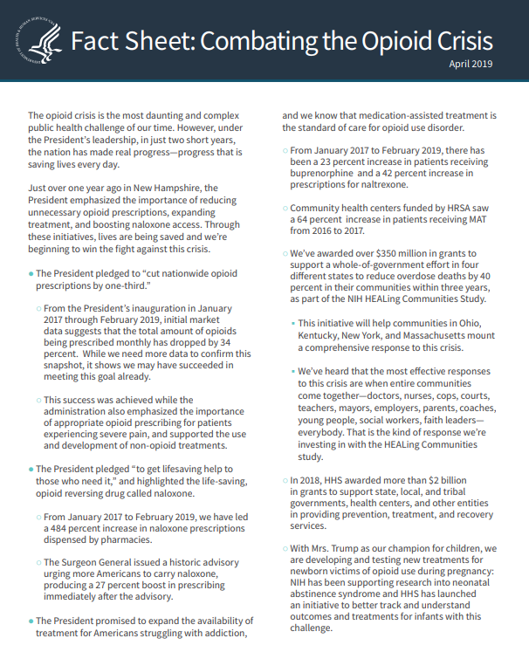
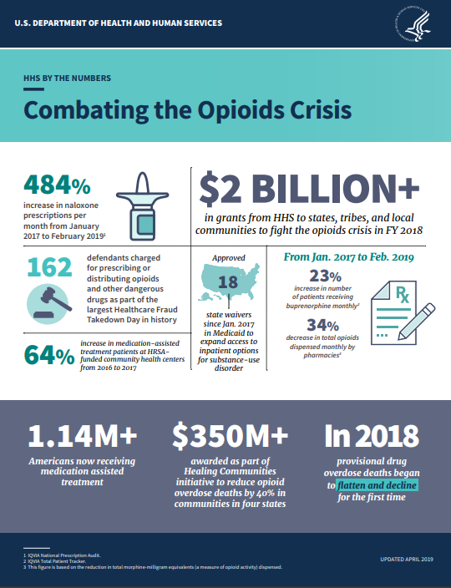
U.S. Department of Health and Human Services (HHS) Combatting the Opioid Crisis
Fact sheet HHS.gov/sites/default/files/opioids-fact-sheet-april-2019.pdf
Infographic HHS.gov/sites/default/files/opioids-infographic-april-2019.pdf
Watch HHS Secretary Azar explain the HHS 5-point plan for combating the opioid crisis
Notes:
There is a HHS Combatting the Opioids Crisis fact sheet and infographic.
Fact sheet HHS.gov/sites/default/files/opioids-fact-sheet-april-2019.pdf
Infographic HHS.gov/sites/default/files/opioids-infographic-april-2019.pdf
Watch HHS Secretary Azar explain the HHS 5-point plan for combating the opioid crisis

Slide 48
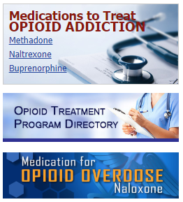
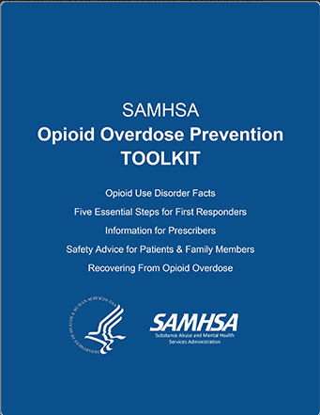
Substance Abuse & Mental Health Services Administration (SAMHSA) Resources
Opioid Overdose Prevention Toolkit
Medications to treat opioid addition
Opioid treatment program directory
SAMHSA National Helpline
Notes:
There are multiple resources available on the Substance Abuse & Mental Health Services Administration (SAMHSA) website, SAMHSA.gov/find-help. The graphic shows a portion of the SAMHSA website with the following resources: Behavioral Health Treatment Services Locator, SAMHSA National Helpline, and Treatment Program Locators (buprenorphine and methadone) for opioid addiction. The “Medication-Assisted Treatment of Opioid Use Disorder Pocket Guide” offers guidance for doctors on the use of medication-assisted treatment for patients with opioid use disorder.
store.samhsa.gov/product/Opioid-Overdose-Prevention-Toolkit/SMA18-4742
samhsa.gov/medication-assisted-treatment/treatment/opioid-overdose

Slide 49
Centers for Disease Control and Prevention (CDC) Resources for Providers
Quick Reference for Healthcare Providers
Urine Drug Testing
Opioid Prescribing Guideline Mobile App
Pharmacists’ Brochure
Pocket Guide: Tapering
Guideline for Prescribing Opioids for Chronic Pain: Recommendations
Checklist for Prescribing Opioids for Chronic Pain
Non-opioid Treatments for Chronic Pain
Assessing Benefits and Harms of Opioid Therapy
Calculating Dosage
Prescription Drug Monitoring Programs (PDMP)
Infographic
Alcohol Screening and Brief Intervention
Turn the Tide Pocket Guide
CDC.gov/drugoverdose/prescribing/clinical-tools.html
Notes:
Here are a few of the CDC resources that are available for providers. Some of these include a mobile app, pharmacists’ brochure, fact sheets and pocket guides. Visit CDC.gov/drugoverdose/prescribing/clinical-tools.html to review the resources.

Slide 50
CMS National Training Program (NTP)
Stay connected.
Visit CMSnationaltrainingprogram.cms.gov to view NTP training materials and to subscribe to our email list.
Contact us at training@cms.hhs.gov.
Notes:
Stay connected. Visit CMSnationaltrainingprogram.cms.gov to view NTP training materials and to subscribe to our email list. Contact us at training@cms.hhs.gov.

