Slide 1
Medicare & Medicaid Fraud, Waste, & Abuse Prevention
Notes:
Presenter Notes​
You can use Microsoft PowerPoint’s presenter view to view your presentation with speaker notes on one computer (your laptop, for example), while only the slides themselves appear on the screen that your audience sees (like a larger screen you're projecting to). See this link for instructions: support.microsoft.com/en-us/office/start-the-presentation-and-see-your-notes-in-presenter-view-4de90e28-487e-435c-9401-eb49a3801257​.
Introduction to Module Content​
The “Medicare & Medicaid Fraud, Waste, & Abuse Prevention” training module explains Medicare and Medicaid fraud, waste, and abuse prevention.​
Disclaimer​
This training module was developed and approved by the Centers for Medicare & Medicaid Services (CMS), the federal agency that administers Medicare, Medicaid, the Children’s Health Insurance Program (CHIP), and the Health Insurance Marketplace®.
The information in this module was correct as of April 2024. To check for an updated version, visit: CMSnationaltrainingprogram.cms.gov. The CMS National Training Program provides this information as a resource for our partners. It’s not a legal document or intended for press purposes. The press can contact the CMS Press Office at press@cms.hhs.gov. Official Medicare Program legal guidance is contained in the relevant statutes, regulations, and rulings.
This communication was printed, published, or produced and disseminated at U.S. taxpayer expense.
Health Insurance Marketplace is a registered service mark of the U.S. Department of Health & Human Services (HHS).

Slide 2
Table of Contents
Lesson 1: Fraud, Waste, & Abuse Overview..............................................4–19
Lesson 2: Organizations & Strategies to Detect & Prevent Fraud & Abuse………………………………………………….....20–45
Lesson 3: How People with Medicare & Medicaid Can Fight Fraud.........46–65
Key Points to Remember.........................................................................66
Appendices:
Examples of Successful Fraud Takedowns………..………...................67
Medicare Fraud & Abuse Resource Guide…….…...……………………68–70
Acronyms..............................................................................................71
Notes:
Presenter Notes​
The lessons in this module, “Medicare and Medicaid Fraud, Waste, & Abuse Prevention,” explain common fraud schemes and how CMS and partner organizations combat fraud, waste, and abuse in health care programs.
These materials are for information givers/trainers who are familiar with the Medicare Program, and who use the information for their presentations.
This module includes 72 slides and speaker’s notes and includes check your knowledge questions. It takes about 1.5 hours to present. You may need to add more time for additional activities you want to include.

Slide 3
Session Objectives
At the end of this session, you’ll be able to:
Define health care fraud, waste, and abuse
Identify causes of improper payments
Discuss how the Centers for Medicare & Medicaid Services (CMS) fights fraud and abuse
Explain how you can fight fraud and abuse
Find sources of additional information
Notes:
Presenter Notes​
At the end of this session, you’ll be able to:
Define health care fraud, waste, and abuse
Identify causes of improper payments
Discuss how CMS fights fraud and abuse
Explain how you can fight fraud and abuse
Find sources of additional information

Slide 4
Lesson 1
Fraud, Waste, & Abuse Overview
Notes:
Presenter Notes​
Lesson 1 provides an overview of fraud, waste, and abuse, including:
Defining health care fraud, waste, and abuse
Protecting the Medicare Trust Funds and other public resources
Examples of Medicare and Medicaid fraud
Who commits fraud
Causes of improper payments

Slide 5
Lesson 1 Objectives
At the end of this lesson, you’ll be able to:
Define health care fraud, waste, and abuse
Discuss how the Centers for Medicare & Medicaid Services (CMS) protects program integrity
Recognize examples of Medicare and Medicaid fraud
Explain who can commit fraud
Describe causes of improper payments
Notes:
Presenter Notes
At the end of this lesson, you’ll be able to:
Define health care fraud, waste, and abuse
Discuss how the Centers for Medicare & Medicaid Services (CMS) protects program integrity
Recognize examples of Medicare and Medicaid fraud
Explain who can commit fraud
Describe causes of improper payments

Slide 6
Fraud, Waste, & Abuse: What’s the Difference?
Fraud
When someone knowingly deceives, conceals, or misrepresents to obtain money or property from any health care benefit program.
Waste
Overusing services or other practices that directly or indirectly result in unnecessary costs to any health care benefit program.
Abuse
When health care providers or suppliers perform actions that directly or indirectly result in unnecessary costs to any health care benefit program.
NOTE: Gauges represent the level of intent and cost to the system for each definition.
Notes:
This slide has animation.
Presenter Notes​
Medicare and Medicaid fraud, waste, and abuse, affect every American by draining critical resources from our health care system and contributing to the rising cost of health care. Taxpayer dollars lost to fraud, waste, and abuse harm some of our most vulnerable citizens. The difference between fraud, waste, and abuse depends on circumstances, intent, and knowledge. The meter on the slide indicates the level of intent for each designation. Let’s take a closer look.
Fraud occurs when someone knowingly deceives, conceals, or misrepresents themselves or their services to get money or property from a health care benefit program. CMS works to prevent and identify possible fraud. Medicare and Medicaid fraud is considered a criminal act. Ultimately, our judicial system determines if someone committed an act of fraud. An example would be a health care provider who:
Repeatedly and intentionally bills Medicare for services or supplies they didn’t provide.
Knowingly bills for services at a level of complexity higher than services actually provided or documented in the medical records.
Knowingly bills for services or supplies not furnished or provided (or both), including falsifying records to show delivery of such items.
Knowingly orders medically unnecessary items or services for patients.
Pays for referrals of federal health care program beneficiaries.
Bills Medicare for appointments patients fail to keep.
In contrast, waste is overusing services or other practices that directly or indirectly result in unnecessary costs to any health care benefit program. Generally, waste isn’t considered to be a criminal act, but rather the misuse of resources. Examples of waste include:
Using medically-unnecessary services, durable medical equipment (DME), or prescription drugs.
Using more disposable DME or drugs (like syringes, diabetic test strips, disposable diapers or underpads) than needed over a period of time.
Performing a procedure in a more expensive hospital setting when it can be safely done in a provider’s office.
Abuse describes practices that may directly or indirectly result in unnecessary costs to any health care benefit program. Abuse includes any practice that doesn’t provide patients with medically necessary services or meet professionally recognized standards of care. The difference between abuse and fraud depends on specific facts, circumstances, intent and knowledge. Examples of abuse include:
Charging excessively for services or supplies
Misusing codes on a claim like upcoding or unbundling codes (upcoding is when a provider assigns an inaccurate billing code to a medical procedure or treatment to increase reimbursement).

Slide 7
Level of Intent
Result in waste: Ordering excessive diagnostic tests
Result in abuse: Improper billing practices (like upcoding)
Result in errors: Incorrect coding that’s not widespread
Inefficiencies
Bending the rules
Result in fraud: Billing for services or supplies that weren’t provided
Mistakes
Intentional deceptions
NOTE: Since fraud is ultimately determined by our judicial system, typically we note “potential fraud” until the judicial system has made a decision.
Notes:
This slide has animation.
Presenter Notes​
Honest mistakes can occur. They don’t rise to the level of concern as fraud, waste, and abuse because they are unintended. If the errors become widespread, the effect increases and reflects a systematic problem with an inefficient billing process, which could lead to the level of waste. From there, the level of intent and cost to the system raise to the following classifications. The Medicare Learning Network’s (MLN) “Medicare Fraud & Abuse: Prevent, Detect, Report” booklet shows these examples to demonstrate the escalating nature of actions that result in errors, waste, abuse, and fraud. To access this booklet, visit CMS.gov/Outreach-and-Education/Medicare-Learning-Network-MLN/MLNProducts/Downloads/Fraud-Abuse-MLN4649244.pdf.
NOTE: Since fraud is ultimately determined by our judicial system, typically we note "potential fraud" until the judicial system has concluded.

Slide 8
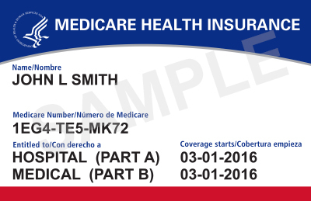
Examples of Possible Fraud
Medicare or Medicaid is billed for services or equipment you never got or you returned
A provider bills Medicare or Medicaid for services that would be considered impossible
Someone changes documents to get a higher payment
Dates, descriptions of services, or your identity are misrepresented
A company uses false information to mislead you into joining a Medicare health or drug plan
Someone else uses your Medicare or Medicaid card
Notes:
This slide has animation.
Presenter Notes​
Remember, fraud denotes high-level of intent, someone knowingly and purposefully acted to deceive in order to benefit. Some examples of possible fraud include:
A provider knowingly bills Medicare or Medicaid for services you never got, or for equipment you either never got or you returned
A provider knowingly bills Medicare or Medicaid for services that would be considered impossible (like a provider billing for therapy that totals more than 24 hours within a given day)
Someone intentionally changes documents to get a higher payment
Dates, descriptions of furnished services, or your identity are intentionally misrepresented
A company intentionally uses false information to mislead you into joining a Medicare health or drug plan
Someone else intentionally uses your Medicare or Medicaid card with or without your knowledge

Slide 9
Anyone Can Commit Fraud
Doctors, pharmacists, other health care providers, and staff
Durable medical equipment (DME) suppliers, hospitals, pharmacies, home health organizations, ambulance services, and billing companies
Individuals with Medicare and/or Medicaid, or individuals who have stolen their identities
Telemarketing
companies and health plans
Notes:
This slide has animation.
Presenter Notes​
Most individuals and organizations that work with Medicare and Medicaid are honest, but some aren’t. A small minority of doctors or employees of health care providers may commit fraud, or intentionally abuse program rules. We call these individuals and organizations “problematic providers.”
Sometimes organized crime is at the root of the problem, resulting in financial losses that easily climb into millions of dollars. In less common instances, people who have Medicare, or individuals who have stolen their identities, may commit fraud. CMS is continually taking necessary steps to identify and prosecute offenders.
In addition to doctors, pharmacists, and other health care providers and their staff, any of the following are capable of being involved in Medicare and Medicaid fraud, waste, and abuse:
DME suppliers, hospitals, pharmacies, ambulance services, and home health organizations
People with Medicare/Medicaid, or individuals who have stolen their identities
Telemarketing companies
It’s important to be aware of the various entities that have been caught up in fraud schemes. Those who commit fraud could be individuals who are in, or pretend to be in, any of the above-mentioned groups.

Slide 10
Improper Payments
Shouldn’t have been made
Were made in an incorrect amount
Can indicate fraud schemes
Don’t meet CMS program requirements
Are due mostly to unintentional errors, like data entry mistakes
Notes:
This slide has animation.
Presenter Notes​
An improper payment, according to the Payment Integrity Information Act of 2019, is any payment that shouldn’t have been made or that was made in an incorrect amount (including overpayments and underpayments) under statutory, contractual, administrative, or other legally applicable requirements.
It’s important to understand that improper payments are payments that don’t meet CMS program requirements. They can be overpayments, underpayments, or payments where insufficient information was provided to determine whether a payment was proper. Most improper payments involve a situation when a state, contractor, or provider misses an administrative step. While CMS’ improper payments reporting programs are designed to protect the integrity of CMS programs, not all improper payments are fraud or abuse. CMS’s program integrity activities target all causes of improper payments—from honest mistakes to intentional deception.
Causes of improper payments include errors, waste, abuse, and fraud—also known as mistakes, inefficiencies, bending the rules, and intentional deception.
Contrary to common perception, not all improper payments are fraud (that is, an intentional misuse of funds). In fact, most improper payments are due to unintentional errors. For example, an error may occur because a program doesn’t have documentation to support someone’s eligibility for a benefit, or an eligible person gets a payment that’s too high—or too low—due to a data entry mistake or inefficiencies.

Slide 11
Common Causes of Medicare Fee-for-Service Improper Payments: Fiscal Year 2023
Dollar amounts listed in the chart are in billions
Notes:
Presenter Notes​
Many of the Medicare Fee-for-Service (FFS) improper payments are payments that were labeled improper due to a lack of documentation. CMS believes that having sufficient documentation would show that many of these overpayments were actually proper, and the amount of improper payments actually lost by the government would be even lower than the estimated loss.
CMS must report improper payment information each year in the annual Department of Health & Human Services Agency Financial Report. You may access this report by visiting HHS.gov/sites/default/files/fy-2023-hhs-agency-financial-report.pdf. This chart from The U.S. Department of Health & Human Services’ (HHS’) financial report data shows fiscal year (FY) 2023 Medicare FFS Estimated Improper Payments by Type of CERT Error (Dollar Amounts in Millions).
More data for this report and more details about improper payments are available at CMS.gov/research-statistics-data-and-systems/monitoring-programs/medicare-ffs-compliance-programs/cert/additionaldata.
Past reports are at HHS.gov/about/agencies/asfr/finance/financial-policy-library/agency-financial-reports/index.html.
Causes (as shown in chart):
63% ($19.61 Billion) – Insufficient Documentation
15% ($4.69 Billion) – Medically Unnecessary
11% ($3.63 Billion) – Incorrect Coding
7% ($2.14 Billion) – Other (claims are placed into this category if they don’t fit into any of the other categories, for example, duplicate payment error, non-covered or unallowable service)
4% ($1.16 Billion) – No Documentation
*HHS’ report displays these amounts in the Millions. NTP converted the figures to Billions for simplicity.

Slide 12
Improper Payment Transparency: Medicare
10% Statutory Threshold
Medicare Fiscal Year (FY) 2023 Improper Payment Rate: 7.38%
Notes:
Presenter Notes​
The factors contributing to improper payments are complex and vary from year to year, but the primary causes of Medicare FFS improper payments continue to be insufficient documentation and documentation provided didn’t sufficiently demonstrate medical necessity.
Per the Office of Management and Budget, Medicare FFS is considered a high-priority program. CMS developed the Comprehensive Error Rate Testing (CERT) program to estimate the Medicare FFS improper payment rate. Each year, the CERT program reviews a statistically valid stratified random sample of Medicare FFS claims to determine if they were paid properly under Medicare coverage, coding, and payment rules.
This graph shows the rate reduction goal for each fiscal year. The FY 2023 improper payment rate was 7.38% (representing $31.23 billion in improper payments), marking the 7th consecutive year this figure has been below the 10% threshold for compliance established in the Payment Integrity Information Act of 2019.
For improper payment rate information, visit CMS.gov/Research-Statistics-Data-and-Systems/Monitoring-Programs/Improper-Payment-Measurement-Programs/CERT and CMS.gov/data-research/monitoring-programs/improper-payment-measurement-programs/comprehensive-error-rate-testing-cert/improper-payment-rates-and-additional-data.
Paymentaccuracy.gov also provides information and keeps scorecards for improper payments processed throughout the federal government.
For the HHS FY23 Financial Report, which includes target rate tables, visit HHS.gov/sites/default/files/fy-2023-hhs-agency-financial-report.pdf.
For the 2023 press release regarding improper payment rates for CMS Programs, visit CMS.gov/newsroom/fact-sheets/fiscal-year-2023-improper-payments-fact-sheet.

Slide 13
Improper Payment Transparency: Medicare Advantage
N/A
MA Fiscal Year (FY) 2023 Improper Payment Rate: 6.01%
NOTE: FY23 establishes a new baseline due to methodology changes from prior reporting years
Notes:
Presenter Notes​
The Medicare Advantage (MA) program (also known as Part C) payment error estimate reflects the extent to which plan-submitted diagnoses of a national sample of enrollees are substantiated by medical records. If the medical records don’t support the diagnoses submitted to CMS, the diagnoses may be inaccurate and result in payment errors. CMS performs a validation of diagnoses in medical records for sampled beneficiaries during CMS’s annual Medical Record Review process, where 2 separate certified coders review medical records in the process of confirming discrepancies for sampled beneficiaries. Validation results from the sample are then extrapolated to the Medicare Advantage population resulting in the Part C gross payment error amount. In FY 2023, CMS reported an estimated Part C improper payment estimate of 6.01% or $16.55 billion. In FY 2023, CMS implemented a revised sample allocation methodology to reallocate the sampled beneficiaries across the strata proportionally according to stratum size rather than evenly. By evaluating the variances within and between strata, CMS determined the alternative sample allocation method would yield a more precise overall error estimate and a more efficient sample. In FY 2021 and FY 2022, CMS implemented methodology and policy changes, and FY 2023 establishes a baseline. The FY 2023 error rate calculation follows those previously implemented policy changes. While FY 2023 and FY 2022 are comparable, they aren’t directly comparable to earlier reporting years.
CMS estimates Medicare Advantage improper payments using the Part C Improper Payment Measure (IPM) methodology.
CMS calculates an annual capitated payment for each Medicare beneficiary enrolled in an MA Organization (MAO) based on diagnosis data previously submitted to CMS by the MAO. The diagnosis data are used to determine risk scores and calculate risk-adjusted payments to MAOs for their enrollees. Inaccurate or incomplete diagnosis data may result in improper payments made to MAOs.
CMS conducts the annual Part C IPM activity to estimate the improper payments for the Medicare Part C program due to unsubstantiated risk adjustment data.
Part C IPM reviews the medical record documentation for a statistically valid stratified random sample of Medicare Part C enrollees to ensure the diagnosis data used to determine payment to the MAO are present and in accordance with CMS rules and regulations.
The majority of Part C improper payments fall into 3 categories:
The MAO’s supporting documentation fails to substantiate the beneficiary diagnosis data submitted for payment.
Invalid documentation, such as illegible documentation.
Missing documentation
For more information visit HHS.gov/sites/default/files/fy2023-performance-plan.pdf, HHS.gov/sites/default/files/fy-2023-hhs-agency-financial-report.pdf, and CMS.gov/data-research/monitoring-programs/improper-payment-measurement-programs/medicare-part-c-ipm

Slide 14
Improper Payment Transparency: Medicare Part D
Part D Fiscal Year (FY) 2023 Improper Payment Rate: 3.72%
Notes:
Presenter Notes​
The Part D program improper payment rate measures the payment error related to Prescription Drug Event (PDE) data. CMS measures inconsistencies between information reported on PDEs and supporting documentation submitted by Part D sponsors: prescription record hardcopies (or medication orders as appropriate) and detailed claims information. Based on these reviews, each PDE in the audit sample is assigned a gross drug cost error. A representative sample of beneficiaries undergoes a simulation to determine the Part D improper payment estimate. Improper payments due to drug or drug pricing discrepancies occur when the prescription documentation submitted indicates that an overpayment occurred. Underpayments result when prescription record hard copies (or medication orders) indicates that CMS should have paid more. CMS then extrapolates those improper payments to the entire Part D population to produce the Part D improper payment estimate. In FY 2023, CMS reported a Part D improper payment estimate of 3.72% or $3.35 billion. There isn’t a FY 2024 target as of March 2023.
In FY 2023, CMS implemented methodology refinements that contributed to an increase in the FY 2023 improper payment rate estimate. Specifically, CMS adjusted the methodology to recognize payment errors resulting from the use of incorrect benefit parameters. In those instances, sponsors weren’t using CMS-approved benefit parameters in the original processing of a PDE. Other technical methodology changes included: improving the accuracy of the simulation by using a more appropriate sampling unit, decreasing the number of simulation iterations to align to statistical literature, aligning the confidence interval calculation to the estimation method, and improving the simulation by applying more accurate parameter assumptions when benefit parameters are missing or incomplete. Due to the methodology changes introduced in FY 2023, the rates for FY 2022 and FY 2023 aren’t comparable.
For more information, visit HHS.gov/sites/default/files/fy2023-performance-plan.pdf and HHS.gov/sites/default/files/fy-2023-hhs-agency-financial-report.pdf.

Slide 15
Improper Payment Transparency: Medicaid
Medicaid FY 2023 Improper Payment Rate: 8.58%
NOTE: CMS targets not available for 2019-2021; Data doesn’t capture PHE unwinding. These will be included in future report periods.
Notes:
Presenter Notes​
Medicaid is the primary health coverage for more than 88 million Americans. The FY 2023 improper payment rate was 8.58%, or $50.3 billion, a decrease from the 2022 reported rate of 15.62%. Of the 2023 Medicaid improper payments, 82% were the result of insufficient documentation. These payments typically involve situations where a state or provider missed an administrative step and don’t necessarily indicate fraud or abuse.
These figures are calculated through CMS’ Payment Error Rate Measurement (PERM) program, which uses a 17-states-per-year, 3-year rotation to identify and measure improper payments in Medicaid and the Children’s Health Insurance Program (CHIP). The FY23 rate was comprised of reviews in 2021, 2022, and 2023.
The improved performance in the national Medicaid improper payment estimates reflect: 1) reviews that accounted for certain flexibilities afforded to states during COVID-19, such as suspended eligibility determinations and reduced requirements around provider enrollment and revalidations, which were typically included in the PERM reviews prior to the COVID-19 Public Health Emergency or PHE; and 2) improved state compliance with other program requirements. While it is unclear how much the decrease is attributable to the PHE flexibilities versus improved state compliance, it appears that the PHE flexibilities had an impact on lowering the rate. Please note that the data doesn’t capture any effects of the PHE unwinding, as these will be included in future report periods.
For more information, visit CMS.gov/Research-Statistics-Data-and-Systems/Monitoring-Programs/Improper-Payment-Measurement-Programs/PERM. Visit Medicaid.gov/medicaid/program-integrity/index.html for more information about Medicaid fraud prevention efforts.

Slide 16
Protecting Patients
We put patients first by:
Supporting innovative approaches
Protecting Medicare Trust Funds
Protecting the public resources that fund Medicaid Programs
Improving program integrity and oversight
Excluding providers with histories of fraud
Preventing provider reimbursement for services without proper documentation
Notes:
This slide has animation.
Presenter Notes​
CMS puts patients first in all our programs. This includes supporting innovative approaches to improve quality, accessibility, and affordability, while finding the best ways to use innovative technology to support patient-centered care. To improve affordability, CMS must protect the Medicare Hospital Insurance (HI) (Part A) Trust Fund and the Supplementary Medical Insurance (SMI) (Part B) Trust Fund.
The Medicare Hospital Insurance Trust Fund pays for Part A benefits, like inpatient hospital care, skilled nursing facility (SNF) care, home health care, and hospice care. It’s funded by payroll taxes, income taxes paid on Social Security benefits, interest earned on trust fund investments, and Part A premiums from people who aren’t eligible for premium-free Part A.
The Supplementary Medical Insurance Trust Fund pays for Part B benefits including doctor services, outpatient hospital care, home health care not covered under Part A, DME, certain preventive services, lab tests, Medicare drug coverage (Part D), and Medicare Program administrative costs. Its funding is authorized by Congress from Part B premiums, Medicare drug plan (Part D) premiums, and interest earned on trust fund investments.
The federal government contributes to annual Medicaid expenditures, and CMS must protect the public resources that fund the Medicaid Programs operated by the states, the District of Columbia, and U.S. Territories. To view CMS’ Comprehensive Medicaid Integrity Plan, visit CMS.gov/files/document/comprehensive-medicaid-integrity-plan-fys-2019-2023.pdf.
CMS has to manage the careful balance between paying claims quickly and limiting provider burden and conducting reviews that prevent and detect fraud. CMS improves program integrity and oversight by monitoring and analyzing claims data. The Office of Inspector General (OIG) excludes providers for a variety of reasons, including having fraudulent histories that could exploit patients with federally funded health coverage and prevents provider reimbursement for services not supported by evidence. The primary effect is no payment will be made for any items or services furnished, ordered, or prescribed by an excluded individual or entity. This includes Medicare, Medicaid, and all other Federal plans and programs that provide health benefits funded directly or indirectly by the United States (other than the Federal Employees Health Benefits (FEHB) Plan).

Slide 17
Check Your Knowledge: Question 1
A doctor’s office submitted a bill with the wrong procedure code on it. Upon review, this occurs very frequently, but there isn’t any evidence the doctor is purposely advising her staff to improperly bill Medicare. This is an example of _____________.
Fraud
Waste
Abuse
Simple errors
Notes:
This slide has animation.
Presenter Notes​
Check Your Knowledge—Question 1
A doctor’s office submitted a bill with the wrong procedure code on it. Upon review, this occurs very frequently, but there isn’t any evidence the doctor is purposely advising her staff to improperly bill Medicare. This is an example of _____________.
Fraud
Waste
Abuse
Simple errors
ANSWER: c. Abuse
Abuse happens when health care providers or suppliers perform actions that directly or indirectly result in unnecessary costs to any health care benefit program, like billing Medicare for services that aren’t covered or properly coded. In this case, the provider hasn’t knowingly and intentionally misrepresented the facts to obtain payment. If they had, it would elevate the abuse to the fraud level. Medicare abuse can also expose providers to criminal and civil liability. Abuse includes any practice that doesn’t provide patients with medically necessary services or meet professionally recognized standards.

Slide 18
Check Your Knowledge: Question 2
Improper payments are mostly the result of fraud and abuse schemes.
True
False
Notes:
This slide has animation.
Presenter Notes​
Check Your Knowledge—Question 2
Improper payments are mostly the result of fraud and abuse schemes.
a. True
b. False
ANSWER: b. False
Contrary to common perception, not all improper payments are fraud (that is, an intentional misuse of funds). In fact, most improper payments are due to unintentional errors. For example, an error may occur because a program doesn’t have documentation to support someone’s eligibility for a benefit, or an eligible person gets a payment that’s too high—or too low—due to a data entry mistake or inefficiencies.

Slide 19
Check Your Knowledge: Question 3
You have to work in a medical provider’s office to engage in health care fraud.
True
False
Notes:
This slide has animation.
Presenter Notes​
Check Your Knowledge—Question 3
You have to work in a medical provider’s office to engage in health care fraud.
ANSWER: b. False
Anyone can commit health care fraud. While providers and their office staff can commit fraud, others like durable medical equipment (DME) suppliers, hospitals, pharmacies, ambulance services, and home health organizations, people with Medicare/Medicaid, or identity theft criminals, telemarketing companies, and organized crime groups can all engage in health care fraud schemes.

Slide 20
Lesson 2
Organizations & Strategies to Detect & Prevent Fraud & Abuse
Notes:
Presenter Notes​
Lesson 2 discusses the following organizations and the strategies they use to detect and prevent fraud and abuse:
The Centers for Medicare & Medicaid Services (CMS)
CMS’ Center for Program Integrity (CPI)
CMS Program Integrity Contractors
CMS administrative actions
Law enforcement actions
The Health Care Fraud Prevention Partnership (HFPP)
Health Care Fraud Prevention & Enforcement Action Team (HEAT)
Education efforts

Slide 21
Lesson 2 Objectives
At the end of this lesson, you’ll be able to:
Recognize fraud schemes
Explain how to protect yourself from fraud
Describe what to do if you have quality of care concerns
Describe organizations and strategies to detect and prevent fraud
Notes:
Presenter Notes
At the end of this lesson, you’ll be able to:
Recognize fraud schemes
Explain how to protect yourself from fraud
Describe what to do if you have quality of care concerns
Describe organizations and strategies to detect and prevent fraud

Slide 22
COVID-19 Public Health Emergency End: Fraud Schemes
Keep in mind:
Applying for or renewing your Medicaid coverage is always free.
Keep your contact information up-to-date with Social Security and your state. If you get a call from someone claiming to be from Medicaid, hang up and call your Medicaid office directly to be sure.
If someone promises you free testing, gifts, or money in exchange for your health care number, it’s probably a scam.
Always:
Guard your Medicare and/or Medicaid cards like a credit card
Check claims summary forms for errors
Hang up if someone calls asking for your Medicare or Medicaid Number
Notes:
This slide has animation.
Presenter Notes​
The COVID-19 public health emergency has ended, but fraudsters continue to try and bill Medicare and Medicaid for sham tests or treatments and are targeting individuals to illegally get money or Medicare/Medicaid Numbers. If anyone asks you for your Medicare or Medicaid Number to get a vaccine, booster, or to get a free COVID-19 test, it’s probably a scam.
While states work through their Medicaid renewal processes, you should remember these facts to safeguard yourself against scams:
Applying for Medicaid is always free. You don’t need to pay anything or provide a credit card number when applying for benefits through your state.
Renewal or redetermination of Medicaid benefits is always free.
You don’t need to pay to continue getting Medicaid benefits.
If you have moved, Medicaid may need to use methods other than mail to reach you. If you get a call from someone claiming to be from Medicaid, tell them you will call Medicaid directly and use a trusted phone number to do so.
People with Medicare and Medicaid are at higher risk. If they’re unaware of these schemes, they may give away their medical and financial data. The personal information collected can be used to fraudulently bill federal health care programs and commit medical identity theft.
Check Medicaid’s Fraud and Scams Messaging for resources to educate people about potential scams related to Medicaid renewals Medicaid.gov/resources-for-states/coronavirus-disease-2019-covid-19/unwinding-and-returning-regular-operations-after-covid-19/medicaid-and-chip-renewals-outreach-and-educational-resources/index.html#.

Slide 23
Preventing Fraud in Medicare Health & Drug Plans
The plan’s giving free meals at a marketing event.
A plan representative visited my home uninvited and encouraged me to enroll.
Who to call if you have a concern:
1-800-MEDICARE:
(1-800-633-4227)
TTY:
1-877-486-2048
A plan’s offering cash if I join.
I got an unwanted email without an “opt-out” function.
I’m getting calls and texts from a plan without my permission, and I’m not a member.
A representative tried to talk with me about their plan in the hospital patient room.
Notes:
This slide has animation.
Presenter Notes​
Providers aren’t the only ones who can prevent Medicare fraud. Medicare health and drug plans have responsibilities beyond billing. Plans are responsible for marketing to people with Medicare in responsible ways that protect them and the Medicare Program from fraud. This includes the plan’s agents or brokers who represent them.
Here are some examples of activities that Medicare plans and people who represent them aren’t allowed to do:
Send unwanted emails without an “opt-out” function
Visit homes uninvited to encourage enrollment in their plan
Call or text non-members (unless given permission)
Offer cash to join their plan (nominal, noncash gifts under $15 are allowed)
Give free meals at sales or marketing events (Plans can provide meals at educational events; marketing events are limited to light snacks and refreshments)
Talk about their plan in restricted areas like exam rooms, hospital patient rooms, treatment areas, and pharmacy counters (areas where people get health care)
For more information, visit CMS.gov/medicare/health-drug-plans/managed-care-marketing/medicare-guidelines.
To report plans that ask for your personal information over the telephone or that call you without your permission to enroll you in a plan, call 1-800-MEDICARE (1-800-633-4227); TTY: 1-877-486-2048.

Slide 24
Common Fraud Examples: Remote Patient Monitoring
This FRAUD SCHEME involves unsolicited contact to set up monthly billing for remote patient monitoring regardless of medical necessity.
Scammers target Medicare enrollees through calls, texts, and internet ads.
Scammers steal Medicare numbers and other personal information.
Scammers then bill Medicare for services that are unnecessary or never provided.
Notes:
This slide has animation.
Presenter Notes​
The U.S. Department of Health & Human Services (HHS) Office of Inspector General (OIG) is alerting the public about a fraud scheme involving monthly billing for remote patient monitoring. This scam involves signing up Medicare enrollees for remote patient monitoring (RPM). Legitimate RPM involves using medical devices like scales, glucose monitors, blood pressure cuffs, cardiac rhythm devices, and other equipment to remotely monitor for anomalies in patients with chronic medical conditions. This treatment is beneficial for those whose condition might deteriorate quickly, where monitoring can reduce complications, hospitalizations, or death.
Unscrupulous companies are signing up Medicare enrollees for this service, regardless of medical necessity. Scammers have several ways to make contact. It may involve phone solicitations (“cold calling”), internet ads (“click bait”), or television advertising. These contacts may originate from a Durable Medical Equipment (DME) company or pharmacy. Equipment may or may not be sent. When equipment is sent, it may not be Food & Drug Administration (FDA)-approved. Billing then occurs for set-up, patient teaching, and monthly monitoring of data. Most often, the monthly monitoring never happens, but the enrollee is billed monthly anyway.
Keep a record of any suspicious encounters and report them to 1-800-HHS-TIPS (1-800-447-8477) or OIG.HHS.gov/fraud/hotline.
CMS is aware of this issue and continues to review complaints and to investigate instances of abuse of COVID-19 Over-the-Counter (OTC) test kit billing. This involves working with our law enforcement partners on these and other fraud schemes that exploited the COVID-19 pandemic. Because of the nature in working with law enforcement, we won’t be able to get back to individuals about their specific cases. As a result of these complaints, CMS has taken immediate action implementing over 150 provider payment suspensions and recouping overpayments when suspensions have been terminated.
If you’re concerned that your personal identifiable information (PII) has been breached, or if you would like a new Medicare beneficiary number as a result of these test kit billings, call 1-800-MEDICARE to get assistance from a CMS caseworker.

Slide 25
Common Fraud Examples: Urinary Catheter Scams
SCAMMERS are targeting Medicare enrollees by offering free services, medical equipment, or gifts cards in order to obtain their Medicare number to commit fraud.
Scammers target Medicare Enrollees through various communication methods to obtain enrollee’s personal information.
Scammers steal or obtain Medicare numbers and other personal information.
Scammers then bill Medicare for medical equipment that’s unnecessary or not provided.
Notes:
This slide has animation.
Presenter Notes​
The U.S. Department of Health and Human Services Office of Inspector General (HHS-OIG) is alerting the public about a fraud scheme involving Durable Medical Equipment (DME), specifically urinary catheters.
Scammers are targeting Medicare enrollees through phone calls, internet ads, and text messages with offers of free services, medical equipment, or gift cards upon confirming their personal information and eligibility for specific Medicare services. Often, the enticement for the individual is that they are “qualified” for items “at no cost” or “free.” Once the scammers obtain the enrollee’s personal information, monthly billing to Medicare will begin for medically unnecessary urinary catheters that may or may not actually be sent to the enrollee.
Keep a record of any suspicious encounters and report them to 1-800-HHS-TIPS (1-800-447-8477) or OIG.HHS.gov/fraud/hotline.
CMS is aware of this issue and continues to review complaints and investigate instances of abusive billing of catheters to Medicare beneficiaries. CMS works closely with the HHS OIG and the Department of Justice to investigate health care fraud schemes, and refer cases to law enforcement partners as appropriate to pursue criminal and civil charges. CMS can take swift actions to address suspected fraud, including preventing payments from being made and revoking a provider’s or supplier’s enrollment in Medicare so that they can no longer bill the Medicare program. Additionally, if CMS determines an overpayment was made, the agency works to recover those funds.
Because of the nature in working with law enforcement, CMS won’t be able to loop back to individuals with information regarding their specific cases. If you’re concerned that your personal identifiable information (PII) has been breached, or if you would like a new Medicare beneficiary number as a result of these billings, call 1-800-MEDICARE to get assistance from a CMS caseworker.

Slide 26
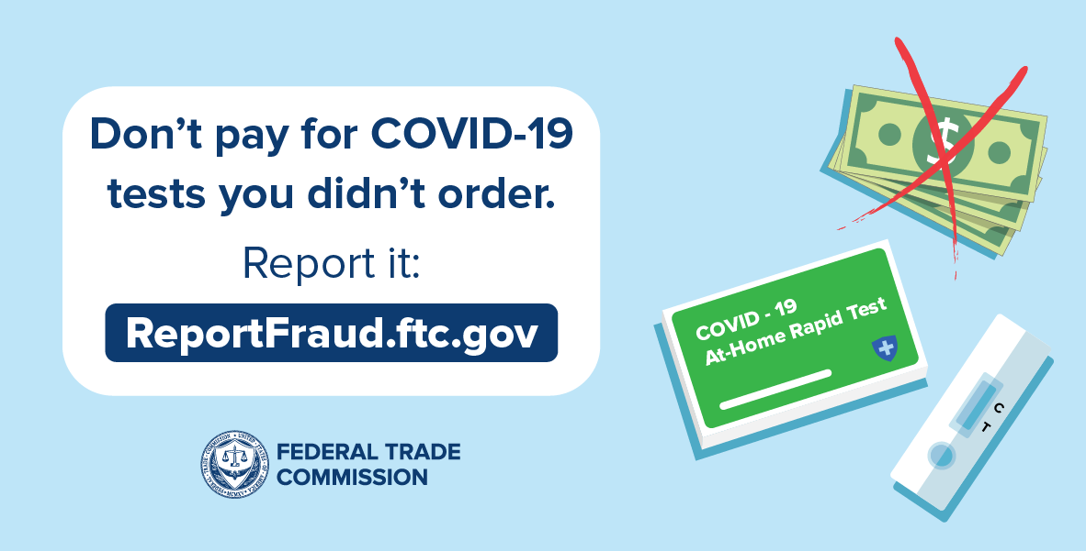
Telemarketing & Fraud: Durable Medical Equipment (DME)
Potential DME scams:
Calls or visits from people saying they represent Medicare
Phone or door-to-door selling techniques
Requests for your Medicare number
Getting items you didn’t order
Notes:
This slide has animation.
Presenter Notes​
There are telemarketing rules for DME. DME suppliers (people who sell equipment like diabetic supplies and power wheelchairs), and anyone representing the supplier are prohibited by law from directly selling their products to people with Medicare (unless given prior consent). This includes contacting you by telephone, text message, computer, e-mail, instant messaging, and in-person contact. DME suppliers must be in compliance with the supplier standards of 42 C.F.R. 424.57(c). See CMS.gov/Medicare/Provider-Enrollment-and-Certification/MedicareProviderSupEnroll/Downloads/DMEPOSSupplierStandards.pdf and ECFR.gov/current/title-42/chapter-IV/subchapter-B/part-424/subpart-D#p-424.57(c) for complete details.
Potential DME scams include:
Calls or visits from people saying they represent Medicare
Phone or door-to-door selling techniques
Equipment or service, like “free” diabetic testing supplies, heating pads, braces or orthotics, is offered for free and then you're asked for your Medicare number for what they claim is “record-keeping purposes”
Being told that Medicare will pay for the item or service if you give them your Medicare number
Supplies you never ordered are delivered to you
A main goal of these scams is to get your Medicare number and bill Medicare for services or items that you don’t need or never get. Or they may ship you supplies that you never ordered and then bill your Medicare number. You’re under no obligation to accept items that you didn’t order and should refuse delivery or return to the sender. Keep a record of the sender’s name and the date you returned the item(s).
In response to concerns related to auto-shipments and delivery of Durable Medical Equipment, Prosthetics, and Orthotics (DMEPOS) supplies that may no longer be needed or not needed at the same level of frequency/volume, CMS instituted policies to require suppliers to contact you prior to dispensing DME refills. CMS finalized its proposal to codify with some changes to its long-standing refill policy. Medicare now requires documentation indicating you confirmed the need for the refill within the 30-day period prior to the end of the current supply. Additionally, Medicare has a requirement that delivery of DME items (that is, date of service) be no sooner than 10 calendar days before the expected end of the current supply. This rule also clarifies the longstanding Medicare definition of brace to provide clarification on the scope of the Medicare Part B (Medical Insurance) benefit for leg, arm, back, and neck braces and, as a result, classifies certain exoskeleton-type devices as braces for Medicare payment purposes. For more information visit federalregister.gov/documents/2023/11/13/2023-24455/medicare-program-calendar-year-cy-2024-home-health-hh-prospective-payment-system-rate-update-hh.
It’s important to review your Medicare Summary Notice (MSN) or claims statements from your Medicare plan for charges that you don’t recognize. If you suspect fraud, report it to Medicare. To report suspected DME scams or any other suspected Medicare fraud, call 1-800-MEDICARE (1-800-633-4227); TTY: 1-877-486-2048.

Slide 27
Competitive Bidding Program (CBP)
Suppliers compete to become Medicare contract suppliers
An essential tool to help Medicare:
Set market-based payment rates for DMEPOS items
Save money for people with Medicare and taxpayers
Limit fraud, waste, and abuse in the Medicare Program
Temporary Gap Period as of January 1, 2024
Medicare-enrolled suppliers may furnish items and services to patients
CMS will complete the formal rule making process to implement changes intended to improve the program
Notes:
This slide has animation. Presenter Notes​
The DMEPOS Competitive Bidding Program (CBP) was established by the Medicare Prescription Drug, Improvement, and Modernization Act of 2003 (MMA). The DMEPOS CBP has been an essential tool to help Medicare set market-based payment rates for DMEPOS items, save money for people with Medicare and taxpayers, and limit fraud, waste, and abuse in the Medicare Program. The DMEPOS CBP has saved billions of dollars since it was started, while ensuring access to quality items and services.
CMS previously announced Round 2021 single payment amounts (SPAs) for 2 product categories: Off-The-Shelf (OTS) back braces and OTS knee braces. Round 2021 contracts started on January 1, 2021, and ended on December 31, 2023.
As of January 1, 2024, there’s a temporary gap period for the DMEPOS CBP. During the temporary gap period, Medicare-enrolled DMEPOS suppliers may furnish DMEPOS items and services to patients. Here are the payment rules: 1) Adjusted fees in former competitive bidding areas (CBAs) are based on 100% of the single payment amount for the CBA increased by the projected percentage change in the Consumer Price Index for All Urban Consumers (CPI-U) from January 2023–January 2024; and 2) Adjusted fees in non-CBAs are based on fully adjusted rates per the applicable methodology under 42 CFR 414.210(g).
Visit CMS.gov/medicare/payment/fee-schedules/dmepos-competitive-bidding and CMS.gov/medicare/payment/fee-schedules/dmepos-competitive-bidding/health-status-monitoring.
CMS will start bidding for the next round after we:
Complete the formal public notice and comment rulemaking process
Implement necessary DMEPOS CBP changes to:
Establish sustainable prices
Save money for Medicare patients and taxpayers
Help limit fraud, waste, and abuse in the Medicare Program
Ensure patient access to quality items and services
To participate in the DMEPOS CBP, suppliers compete by submitting a bid for selected products. Medicare evaluates the bids based on the supplier’s eligibility, its financial stability, and its bid price. Medicare awards contacts to suppliers that offer the best price and meet applicable quality and financial standards. Contract suppliers must agree to accept Medicare assignment on all claims for bid items and will be paid the single payment amount.

Slide 28
Quality of Care Concerns
Your Beneficiary and Family Centered Care-Quality Improvement Organization (BFCC-QIO) can address:
Medication errors
Change in condition not treated
Discharged from the hospital too soon
Incomplete discharge instructions and/or arrangements
Notes:
This slide has animation.
Presenter Notes​
There’s a specific Quality Improvement Organization (QIO) dedicated to addressing the concerns of people with Medicare and their families called the Beneficiary and Family Centered Care (BFCC)-QIO.
Patient quality of care concerns aren’t necessarily fraud. Examples of quality of care concerns that your BFCC-QIO can address include:
Medication errors (being given the wrong medication, being given medication at the wrong time, being given a medication to which you’re allergic, or being given medications that interact in a negative way). The BFCC-QIO can evaluate if the situation merits Medicare Drug Integrity Contractor (MEDIC) intervention.
A change in your condition that’s not treated, like not getting treatment after abnormal test results or when you developed a complication.
Being discharged from the hospital too soon.
Incomplete discharge instructions and/or arrangements.
To get the address and phone number of the BFCC-QIO for your state or territory, visit qioprogram.org/locate-your-bfcc-qio and search for information on the topic of “Complaints about my care or services.” Or, call 1-800-MEDICARE (1-800-633-4227); TTY: 1-877-486-2048.

Slide 29
Efforts to Stop Fraud, Waste, & Abuse
CMS actions include:
Conducting rigorous screenings for health care providers and suppliers
Temporarily restricting enrollment in high-risk areas
Barring or terminating providers and suppliers from all Medicaid Programs and Children’s Health Insurance Programs (CHIP) who have their Medicare billing privileges revoked
Temporarily stopping Medicare payments in cases of credible allegations of fraud
Providing outreach and education to reach program objectives
Coordinating with private and public health payers and other stakeholders to detect and deter fraudulent behaviors within the health care system
Notes:
This slide has animation.
Presenter Notes​
CMS takes a proactive and transparent approach to stopping health care fraud by:
Creating a rigorous screening process for providers and suppliers enrolling in Medicare, Medicaid, and CHIP.
Temporarily restricting enrollment of new providers and suppliers in high-risk areas. Medicare and state agencies watch for trends that may indicate a significant potential for health care fraud, and can temporarily stop enrollment of a category of providers or suppliers, or enrollment of new providers or suppliers, in a geographic area that has been identified as high risk. The Market Saturation and Utilization Data Tool includes an interactive map and a data set that show national, state, and county-level provider services and utilization data for selected health service areas. The interactive trend graph shows the nation and state-level trends for the user-selected geographies over time for the available metrics and health service areas. CMS can use the data to monitor market saturation as a means to help prevent potential fraud, waste, and abuse. The data can also be used to reveal the degree to which use of a service is related to the number of providers servicing a geographic region. Visit data.CMS.gov/market-saturation/states-and-counties to access the Market Saturation and Utilization Data Tool.
Requiring cross-termination among federal and state health programs, so providers and suppliers whose participation has been terminated or barred by a State Medicaid Program or any other federal health care program may have their Medicare billing privileges revoked. Providers and suppliers who have their Medicare billing privileges revoked based on a “for-cause reason” like a felony conviction are barred or terminated from all other CHIPs and Medicaid Programs.
Temporarily stopping Medicare payments in cases of credible allegations of fraud.
Providing outreach and education to key stakeholders to reach key program objectives.
Coordinating with private and public health payers and other stakeholders to detect and deter fraudulent behaviors within the health care system.

Slide 30
CMS’ Center for Program Integrity (CPI)
Provider Enrollment
Data Analysis
Medical Reviews & Audits
Collaboration with States
Notes:
This slide has animation.
Presenter Notes​
Within CMS, the Center for Program Integrity (CPI) coordinates the Medicare and Medicaid Program integrity activities focused on detecting and preventing fraud, waste, and abuse.
Provider Enrollment
CPI builds systems and manages programs to enroll providers in the Medicare and Medicaid Programs.
Visit CMS.gov/Medicare/Provider-Enrollment-and-Certification for more information about provider enrollment.
Data Analysis
CPI identifies and seeks to prevent fraud, waste, and abuse though predictive analytics like the Market Saturation and Utilization map tool.
Visit data.CMS.gov/summary-statistics-on-use-and-payments/program-integrity-market-saturation-by-type-of-service/market-saturation-utilization-state-county to use the Market Saturation and Utilization tool.
Medical Reviews and Audits
CPI oversees medical reviews and audits to safeguard the Medicare and Medicaid Programs.
Visit CMS.gov/Research-Statistics-Data-and-Systems/Monitoring-Programs/Medicare-FFS-Compliance-Programs/Medical-Review for more information about the medical review program.
Collaboration with States
CPI offers support and venues for states to collaborate and share best practices to fight fraud.
Visit CMS.gov/medicaid-integrity-institute to see resources for state Medicaid employees.

Slide 31
Program Integrity Contractors
Unified Program Integrity Contractors (UPIC)
Plan Program Integrity Medicare Drug Integrity Contractor (PPI MEDIC)
Recovery Audit Program
Investigations Medicare Drug Integrity Contractor (I-MEDIC)
Notes:
This slide has animation.
Presenter Notes​
Program Integrity Contractors are a nationally coordinated Medicare/Medicaid Program integrity team of contractors that cut across regions. They include:
Unified Program Integrity Contractors (UPIC)
Recovery Audit Program
Plan Program Integrity Medicare Drug Integrity Contractor (PPI MEDIC)
Investigations Medicare Drug Integrity Contractor (I-MEDIC)
For an interactive listing of Medicare Program Integrity Contractors, visit CMS.gov/Research-Statistics-Data-and-Systems/Monitoring-Programs/Medicare-FFS-Compliance-Programs/Review-Contractor-Directory-Interactive-Map.

Slide 32
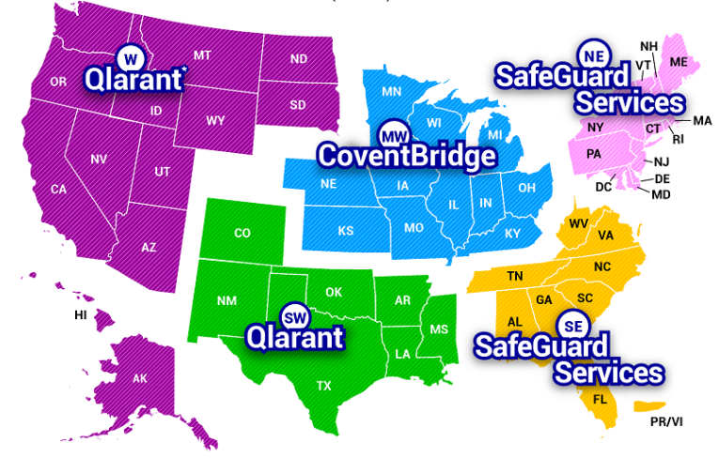
Unified Program Integrity Contractor (UPIC)
Notes:
Presenter Notes​
The Unified Program Integrity Contractors (UPICs) perform fraud, waste, and abuse detection, deterrence and prevention activities for Medicare and Medicaid claims processed in the United States. Specifically, the UPICs perform integrity related activities associated with Medicare Part A (Hospital Insurance), Part B, Durable Medical Equipment (DME), Home Health and Hospice (HH+H), Medicaid, and the Medicare-Medicaid data match program (Medi-Medi). The UPIC contracts operate in 5 separate geographical jurisdictions in the U.S. and combine and integrate functions previously performed by the Zone Program Integrity Contractor (ZPIC), Program Safeguard Contractor (PSC) and Medicaid Integrity Contractor (MIC) contracts.

Slide 33
Medicare-Medicaid (Medi-Medi) Data Matching
Collaboration between State Medical Assistance (Medicaid) offices
Conduct data analyses and investigations
State participation is voluntary
Activities are separate tasks under the Unified Program Integrity Contractor UPIC contracts
Notes:
This slide has animation.
Presenter Notes​
Medicare-Medicaid (Medi-Medi) funding allows for CMS to match Medicaid and Medicare claims and other related data to identify improper billing and utilization patterns. This data matching can show trends that aren’t obvious from each program’s claims data alone. Medi-Medi is a funding stream that has been incorporated into the regular activities of the UPICs as they collaborate with states on investigations and audits that have the greatest potential for uncovering fraud, waste, and abuse. UPICs use the matched data to identify fraud, waste, and abuse to conduct investigations with state Medicaid agencies.
States voluntarily choose to participate in Medi-Medi, and Medi-Medi activities are carried out as separate tasks under the CMS program integrity contracts.

Slide 34
Recovery Audit Programs
Mission
Reduce improper Medicare payments by:
Detecting and collecting overpayments
Identifying underpayments
Implementing actions that will prevent future improper payments
State Programs
Medicaid Recovery Audit Contractor (RAC) programs:
Identify overpayments and underpayments
Coordinate efforts with federal and state auditors
Notes:
This slide has animation.
Presenter Notes​
The Recovery Audit Program’s mission is to reduce improper Medicare payments by efficiently detecting and collecting overpayments, identifying underpayments, and implementing actions that will prevent future improper payments.
States must establish Medicaid Recovery Audit Contractor (RAC) programs, and the programs must:
Identify and recover overpayments and identify underpayments.
Coordinate their efforts with other auditing entities, including state and federal law enforcement agencies. CMS and states work to minimize the likelihood of overlapping audits.
States are required to report all overpayments and underpayments to CMS. For more information, visit Medicaid.gov/medicaid/finance/state-expenditure-reporting/index.html.

Slide 35
Medicare Drug Integrity Contractors (MEDICs)
Key responsibilities include:
Being Responsive
Investigating potential fraud, waste, and abuse in Medicare plans
Investigating complaints alleging Medicare fraud
Referring potential fraud cases to law enforcement agencies
Being Proactive
Analyzing data
Identifying program vulnerabilities
Auditing Medicare Advantage Plans and Medicare drug plans
Providing outreach and education to plan sponsors
Notes:
Presenter Notes​
CMS has 2 Medicare Drug Integrity Contractors (MEDICs). The Plan Program Integrity (PPI) MEDIC and the Investigations MEDIC (I-MEDIC) monitor fraud, waste, and abuse in Medicare health and drug plans. The I-MEDIC has investigators throughout the country who work with federal, state, and local law enforcement authorities and other stakeholders.
Qlarant is the program integrity contractor for CMS under the PPI MEDIC contract as well as the I-MEDIC contract. Qlarant’s key responsibilities include:
Investigating potential fraud, waste, and abuse.
Investigating complaints alleging Medicare fraud.
Performing proactive data analyses.
Identifying program vulnerabilities.
Referring potential fraud cases to law enforcement agencies.
Conducting Medicare Advantage Plan and Medicare drug plan audits.
Providing outreach and education to plan sponsors.
Qlarant’s website at qlarant.com/contracts has all forms (Data Analysis Request for Information, Request for Assistance, Investigations MEDIC Complaint, and Compromised ID Report) under the I-MEDIC section. Referrals should be submitted to the I-MEDIC Complaints email address at I-MEDICComplaints@qlarant.com. Items forwarded from the OIG Hotline should be submitted to the I-MEDIC OIG Hotline email address at I-MEDIC_OIG_Hotline@qlarant.com.

Slide 36
CMS Administrative Actions
When CMS suspects fraud, administrative actions include:
Automatically denying payments
Suspending payments
Editing prepayments
Revoking billing privileges
Conducting post-payment reviews
Making referrals to law enforcement
Notes:
This slide has animation.
Presenter Notes​
CMS has several tools to address fraud:
Automatic denials—a “don’t pay claim” status for items or services ordered or prescribed by a specific provider.
Payment suspensions—a “hold on paying claims” status until an investigation or request for information is completed.
Prepayment edits—coded system logic that either automatically pays, denies, or suspends all or part of a claim, so a trained analyst can review the claim and associated documentation to make coverage and payment determinations.
Revocation of billing privileges—occurs for noncompliance, provider or supplier conduct, felonies, falsifying information, and other such reasons set forth in 42 CFR §424.535 (eCFR.gov/current/title-42/chapter-IV/subchapter-B/part-424/subpart-P/section-424.535). Revoked providers are barred from participating in the Medicare Program for a minimum of one year, but not greater than 10 years, depending on the severity of the basis for revocation. If providers are revoked from Medicare a second time, the bar can last for up to 20 years. Providers can appeal all revocation basis by submitting a reconsideration rights request. If the revocation basis is based wholly or partially on (a)(1) noncompliance authority, that is the only time CMS would consider a corrective action plan submission specific to the noncompliance issue.
Post-payment reviews, to see if there were overpayments and potential overpayment collection actions.
Referrals to law enforcement.

Slide 37
Law Enforcement & Judicial System Actions
Barring providers/companies from the programs
Restricting providers/companies from billing Medicare, Medicaid, or CHIP
Fining providers/companies
Making arrests and convictions
Negotiating Corporate Integrity Agreements
Notes:
This slide has animation.
Presenter Notes​
When law enforcement and the judicial system determine fraudulent activities have occured, the following enforcement actions may occur:
Providers/companies are barred from the programs. HHS OIG has the authority to exclude individuals and entities from participating in federally funded health care programs.
Providers/companies can’t bill Medicare, Medicaid, or CHIP once they’re excluded.
Providers/companies are fined.
Arrests and convictions.
Corporate Integrity Agreements may be negotiated between OIG and health care providers and other entities as part of the settlement of federal health care program investigations arising under a variety of civil false claims statutes. Providers or entities agree to the obligations, and in exchange, OIG agrees not to seek their exclusion from participation in Medicare, Medicaid, or other federal health care programs.

Slide 38
Health Care Fraud & Abuse Control (HCFAC) Program
Jointly directed by U.S. Attorney General and the Secretary of the U.S. Department of Health & Human Services (HHS)
Designed to coordinate federal, state, and local law enforcement actions with respect to health care fraud and abuse
Reports annually on efforts
Efforts include:
Health Care Fraud Strike Force Teams
Health Care Fraud Prevention and Enforcement Action Team (HEAT)
Health Care Fraud Prevention Partnership (HFPP)
Major Case Coordination
Notes:
This slide has animation.
Presenter Notes​
The Health Care Fraud & Abuse Control (HCFAC) Program was established in 1996 as part of the Health Insurance Portability and Accountability Act (HIPAA). The U.S. Attorney General and the Secretary of HHS, acting through the Inspector General jointly direct and collaborate federal, state, and local law enforcement activities with respect to health care fraud and abuse.
HCFAC reports on its efforts each year. To see the latest report, visit OIG.HHS.gov/publications/docs/hcfac/FY2021-hcfac.pdf.
HCFAC’s efforts include (but aren’t limited to):
Health Care Fraud Strike Force Teams
Health Care Fraud Prevention and Enforcement Team (HEAT)
Health Care Fraud Prevention Partnership (HFPP)
Major Case Coordination

Slide 39
Medicare Fraud Strike Force Teams
Are located in fraud “hot spot” areas
Use advanced data analysis to identify high-billing levels
Coordinate national takedowns
Notes:
This slide has animation.
Presenter Notes​
The joint HHS/U.S. Department of Justice (DOJ) Medicare Fraud Strike Force is a multi-agency team of federal, state, and local investigators designed to fight Medicare fraud.
The wide geographic spread of Medicare Fraud Strike Force team locations shows that Medicare Fraud is a nationwide problem. Current operations are running in identified fraud hot spots including Baton Rouge, Brooklyn, Chicago, Dallas, Detroit, Houston, Los Angeles, Miami-Dade, and Tampa Bay.
Strike Force teams use advanced data analysis techniques to identify high-billing levels in health care fraud hot spots.
Interagency teams can target emerging or wandering schemes, along with chronic fraud by criminals masquerading as health care providers or suppliers.
CMS is working collaboratively with federal and state law enforcement partners to increase the recovery of improper payments and fraud by giving data and other support during Health Care Fraud Prevention & Enforcement Action investigations and prosecutions, and by suspending payments to providers subject to credible allegations of fraud. For Strike Force news and activities, visit OIG.HHS.gov/fraud/strike-force.

Slide 40
Health Care Prevention & Enforcement Action Team (HEAT)
Helps prevent fraud, waste, and abuse in Medicare and Medicaid Programs
Reduces health care costs and improves the quality of care
Targets doctors who prescribe opioids outside legitimate medical practice scope
Highlights best practices of providers and public sector employees seeking to end waste, fraud, and abuse in Medicare
Builds on existing partnerships between HHS and the U.S. Department of Justice (DOJ) to reduce fraud and recover taxpayer dollars
Notes:
This slide has animation.
Presenter Notes​
The Health Care Fraud Prevention & Enforcement Action Team (HEAT) is a joint anti‐fraud initiative between HHS and DOJ. HEAT task forces are interagency teams comprised of top-level law enforcement and professional staff members. The team builds on existing partnerships, including those with state and local law enforcement organizations, to prevent fraud and enforce anti-fraud laws. HEAT uses interagency collaboration to reduce and prevent fraud in federal health care programs. By deploying law enforcement and trained agency personnel, HHS and DOJ increase coordination, data sharing, and training among investigators, agents, prosecutors, analysts, and policymakers. Project HEAT has been highly successful in bringing forth health care fraud cases and prosecuting them quickly and effectively.
The mission of HEAT is to:
Marshal significant resources across government to help prevent fraud, waste, and abuse in the Medicare and Medicaid programs and crack down on fraud perpetrators who abuse and cost the system billions of dollars.
Reduce health care costs and improve the quality of care, by ridding the system of perpetrators who prey on people with Medicare and Medicaid.
Target doctors who prescribe opioids outside the scope of legitimate medical practice and often charge Medicare and/or Medicaid for these visits.
Highlight best practices of providers and public sector employees dedicated to ending fraud, waste, and abuse in Medicare.
Build upon existing partnerships between HHS and DOJ, like its Strike Force Teams, to reduce fraud and recover taxpayer dollars.

Slide 41
Health Care Fraud Prevention Partnership (HFPP)
Improves the detection and prevention of health care fraud by:
Exchanging data and information between public and private sectors
Leveraging analytic tools against data sets provided by HFPP partners
Providing a forum for public/private leaders and subject matter experts to share successful anti-fraud practices
Notes:
This slide has animation.
Presenter Notes​
The Healthcare Fraud Prevention Partnership (HFPP) is a statutorily required public-private partnership of voluntary members from the federal government, state agencies, law enforcement, private health insurance plans, and healthcare anti-fraud associations, and is overseen by the Centers for Medicare & Medicaid Services (CMS). The goal of the partnership is to identify and reduce fraud, waste, and abuse across the healthcare sector through collaboration, data and information sharing, and cross-payer research studies. Given its broad membership, the HFPP is uniquely positioned to examine emerging fraud, waste, and abuse trends.
The overall mission of the HFPP is to position itself as a leading body for the health care industry to reduce fraud, waste, and abuse by:
Providing an unparalleled cross-payer data source, representing the full spectrum of the health care industry, to enable the performance of sophisticated data analytics and information-sharing for the benefit of all partners;
Achieving meaningful participation by partners and establishing strategic collaborations with diverse stakeholders; and
Leveraging HFPP resources and relationships to generate real-time, comprehensive approaches that materially impact efforts to reduce health care fraud, waste, and abuse.
For more HFPP information, visit CMS.gov/hfpp/about. To view the HFPP’s Biennial Report to Congress visit CMS.gov/files/document/hfpprtc92023.pdf

Slide 42
Major Case Coordination (MCC)
Provides an opportunity for Medicare and Medicaid policy experts, law enforcement officials, clinicians, and fraud investigators to collaborate before, during, and after the development of fraud leads, resulting in:
4,000 reviews
2,500+ law enforcement referrals
Nationwide enforcement actions
Notes:
This slide has animation.
Presenter Notes​
In FY 2018, CMS began a Major Case Coordination (MCC) initiative that includes representation from the HHS OIG, DOJ, and CMS. This initiative provides an opportunity for Medicare and Medicaid policy experts, law enforcement officials, clinicians, and fraud investigators to collaborate before, during, and after the development of fraud leads.
This level of collaboration has contributed to several successful coordinated law enforcement actions and helped CMS to better identify national fraud trends and program vulnerabilities. As a result of the MCC, there has been a marked increase in the number and quality of law enforcement referrals from CMS. As of FY 2022, there have been over 4,000 cases reviewed at MCC and law enforcement partners have made over 2,500 requests for CMS to refer reviewed cases. CMS program integrity activities and investigations will continue to contribute to law enforcement investigations, CMS administrative actions and CMS initiatives. In FY 2022, CMS reviewed 1,052 cases at MCC meetings, and law enforcement partners made 476 requests for CMS to refer reviewed cases.
Examples of CMS-provided support to the OIG and DOJ in FY2021 include:
On May 26, 2021, DOJ announced approximately 14 law enforcement indictments of individuals involved in COVID-19 related fraud schemes in a coordinated law enforcement action with the HHS-OIG and CMS. CMS separately announced that day that it took administrative actions against over 50 DME suppliers for their involvement in health care fraud schemes relating to abuse of CMS programs during the pandemic.
On September 17, 2021, DOJ announced criminal charges against 138 defendants, including 42 doctors, nurses, and other licensed medical professionals, in 31 federal districts across the United States for their alleged participation in various health care fraud schemes that resulted in approximately $1.4 billion in alleged losses. In addition, CMS took administrative action against 28 providers on behalf of people with Medicare and to protect the Medicare Trust Fund.

Slide 43
Provider Education
Helps correct vulnerabilities so that providers:
Maintain proper documentation
Reduce inappropriate claim submissions
Protect patient and provider identity information
Establish a broader culture of compliance
Notes:
This slide has animation.
Presenter Notes​
CMS is using education efforts to shift focus to the prevention of improper payments and fraud while continuing to be vigilant in detecting and pursuing problems when they occur. CMS uses provider education and outreach to help avoid billing errors and uses its payment suspension authorities in cases of suspected fraud. CMS also uses claim edits and pre and post-pay medical reviews to verify potential errors and take corrective actions. These activities are designed to make sure legitimate providers and suppliers get paid correctly for the appropriate and reasonable services and supplies they give to people with Medicare.
Provider education helps correct vulnerabilities so that providers:
Maintain proper documentation.
Reduce inappropriate claim submissions on common billing mistakes.
Protect patient identity information.
Establish a broader culture of compliance.
For provider resources, visit CMS.gov/About-CMS/Components/CPI/CPI-Resources.html, CMS.gov/Outreach-and-Education/Medicare-Learning-Network-MLN/MLNProducts/Downloads/Fraud-Abuse-MLN4649244.pdf and CMS.gov/Outreach-and-Education/MLN/WBT/MedicareFraudandAbuse/FraudandAbuse/story.html.

Slide 44
Check Your Knowledge: Question 4
Since the COVID-19 Public Health Emergency (PHE) has ended, related health care scams have declined significantly.
True
False
Notes:
This slide has animation.
Presenter Notes​
Check Your Knowledge—Question 4
Since the COVID-19 Public Health Emergency (PHE) has ended, related health care scams have declined significantly.
ANSWER: b. False
The COVID-19 PHE has ended, but fraudsters continue to try and bill Medicare and Medicaid for sham tests or treatments and are targeting individuals to illegally get money or Medicare/Medicaid Numbers. If anyone asks you for your Medicare or Medicaid Number to get a vaccine, booster, or to get a free COVID-19 test, it’s probably a scam.
While states work through their Medicaid renewal processes, you should remember these facts to safeguard yourself against scams:
Applying for Medicaid is always free. You don’t need to pay anything or provide a credit card number when applying for benefits through your state.
Renewal or redetermination of Medicaid benefits is always free.
You don’t need to pay to continue getting Medicaid benefits.
If you have moved, Medicaid may need to use methods other than mail to reach you. If you get a call from someone claiming to be from Medicaid, tell them you will call Medicaid directly and use a trusted phone number to do so.

Slide 45
Check Your Knowledge: Question 5
While visiting your father in the hospital, you notice he’s been given the wrong dosage of his medication. This is an example of ___________.
Abuse
Quality of Care Concern
Fraud
Waste
Notes:
This slide has animation.
Presenter Notes​
Check Your Knowledge—Question 5
While visiting your father in the hospital, you notice he’s been given the wrong dosage of his medication. This is an example of _____________.
ANSWER: b. Quality of Care Concern
This is a quality of care concern. It’s not the same type of error that’s usually related to Medicare fraud, waste, or abuse like a billing error would be. As a result, it needs to be reported to a Quality Improvement Organization (QIO). People with Medicare and their families should contact the specific QIO intended to serve them called the Beneficiary and Family Center Care (BFCC) QIO. To get the address and phone number of the BFCC-QIO for your state or territory, visit qioprogram.org/locate-your-bfcc-qio and search for information on the topic of “Complaints about my care or services.” Or, call 1-800-MEDICARE (1-800-633-4227); TTY: 1-877-486-2048.

Slide 46
Lesson 3
How People with Medicare & Medicaid Can Fight Fraud
Notes:
Presenter Notes​
Lesson 3 discusses organizations, resources, and strategies that help people with Medicare and Medicaid fight fraud:
Senior Medicare Patrol (SMP)
Medicare.gov/basics/reporting-medicare-fraud-and-abuse
Medicare Summary Notices (MSNs)
Secure Medicare Account
“4 Rs” for fighting Medicare fraud
1-800-MEDICARE
Protecting Personal Information, ID, and Medical ID Theft
Reporting Medicaid Fraud

Slide 47
Lesson 3 Objectives
At the end of this lesson, you’ll be able to:
Understand why it’s important to protect your information
Identify resources to help you fight fraud
Explain the 4 Rs for fighting Medicare fraud
Describe how to prevent and report identity theft
Know how to report suspected Medicare and Medicaid fraud
Notes:
Presenter Notes
At the end of this lesson, you’ll be able to:
Understand why it’s important to protect your information
Identify resources to help you fight fraud
Explain the 4 Rs for fighting Medicare fraud
Describe how to prevent and report identity theft
Know how to report suspected Medicare and Medicaid fraud

Slide 48
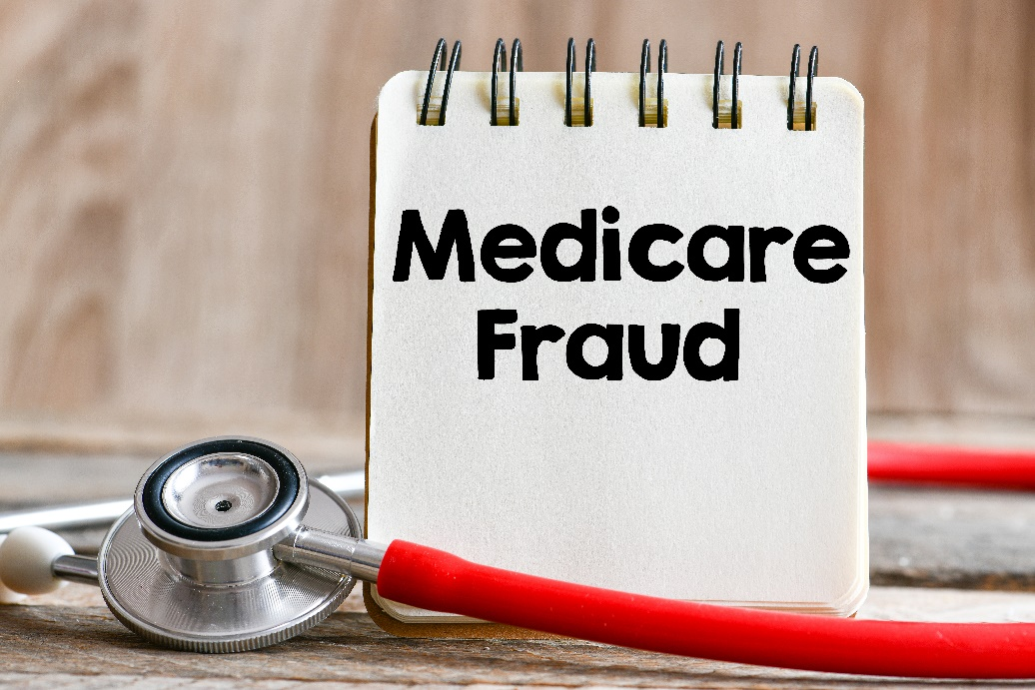
Consequences of Sharing Your Health Care Card or Number
Your medical records could be wrong
You could be charged with health care fraud
You might lose your benefits
You could be placed into a lock-in or a Drug Management Program
Notes:
This slide has animation.
Presenter Notes​
There are consequences if you share your health care card or number with anyone other than your health care providers or a trusted caregiver.
Your medical records could be wrong—the next time you go to the doctor, you’ll have to explain what happened, so you don’t get the wrong kind of care.
If you intentionally participated, you could be charged with health care fraud and spend time in jail if found guilty.
You might lose your benefits.
If you have Medicaid, you can be limited to certain doctors, drug stores, or hospitals. This is called a lock-in program. If you have Medicare drug coverage, you could be placed under a Drug Management Program.
Lock-in may be used for people with Medicaid who are:
Visiting hospital emergency department for non-emergency health concerns
Using 2 or more hospitals for emergency department services
Using 2 or more doctors resulting in duplicated medications and/or treatments
Exhibiting possible drug-seeking behavior, like:
Requesting a specific scheduled medication (narcotics)
Requesting early refills of scheduled medications
Reporting frequent losses of scheduled medications
Using multiple pharmacies to fill prescriptions
The Medicaid and Children’s Health Insurance Program (CHIP) Payment Access Committee (MACPAC) published the “Pharmacy and Provider Lock-in Programs in Medicaid Fee for Service” briefing paper. It’s available at MACPAC.gov/publication/pharmacy-and-provider-lock-in-programs-in-medicaid-fee-for-service.
For more information about Medicaid fraud prevention efforts, visit Medicaid.gov/medicaid/program-integrity/index.html.

Slide 49
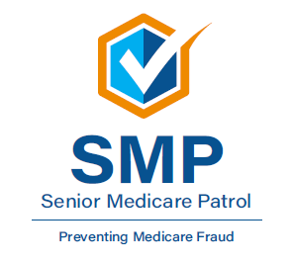
The Senior Medicare Patrol (SMP)
Educates people with Medicare on preventing, identifying, and reporting health care fraud
Seeks volunteers to represent their communities
Hears complaints from people with Medicare
NOTE: SMP has active programs in all states, the District of Columbia, Puerto Rico, U.S. Virgin Islands, and Guam
Notes:
This slide has animation.
Presenter Notes​
Through outreach, counseling, and education, the SMPs empower and help people with Medicare, their families, and caregivers to prevent, detect, and report health care fraud, errors, and abuse. SMPs are grant-funded projects of the U.S. Department of Health & Human Services (HHS), Administration for Community Living (ACL). Their work covers 3 main areas:
Conduct outreach and education. SMPs give presentations to groups, show materials at event exhibits, and work one-on-one with people with Medicare. The SMP program engages approximately 5,300 volunteers nationally who collectively conduct group outreach events.
Engage volunteers to protect older persons’ health, finances, and medical identity while saving Medicare dollars.
Get complaints from people with Medicare. When people with Medicare, caregivers, and family members bring their complaints to the SMP, the SMP makes a determination about whether or not they suspect fraud, errors, or abuse. They seek to resolve errors. When they suspect fraud or abuse, they make referrals to the appropriate state and federal agencies for investigation.
There are SMP programs in each state, the District of Columbia, Puerto Rico, Guam, and the Virgin Islands. Each Centers for Medicare & Medicaid Services (CMS) office location has an SMP liaison. SMPs seek volunteers to represent the program in their communities.
For an in-depth overview of the SMP program, and for information for your local area, visit smpresource.org, or call the nationwide toll-free number at 1-877-808-2468. Callers get information about the SMP program and are connected to the SMP in their state for individualized assistance. You can also email them at info@smpresource.org.

Slide 50
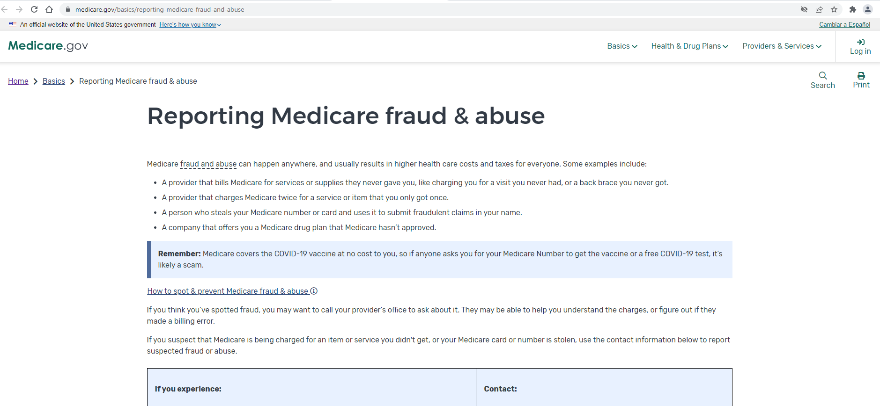
Fraud & Abuse Information on Medicare.gov
Notes:
This slide has animation.
Presenter Notes​
You’re the first line of defense against Medicare fraud, and Medicare.gov/basics/reporting-medicare-fraud-and-abuse is a good place to learn about resources available to protect yourself, your loved ones, and Medicare, like:
Tips to prevent fraud
How to spot fraud
How to report fraud (to 1-800-MEDICARE, the Medicare Drug Integrity Contractor, or the HHS Office of Inspector General (OIG))
Rules for people selling Medicare plans

Slide 51
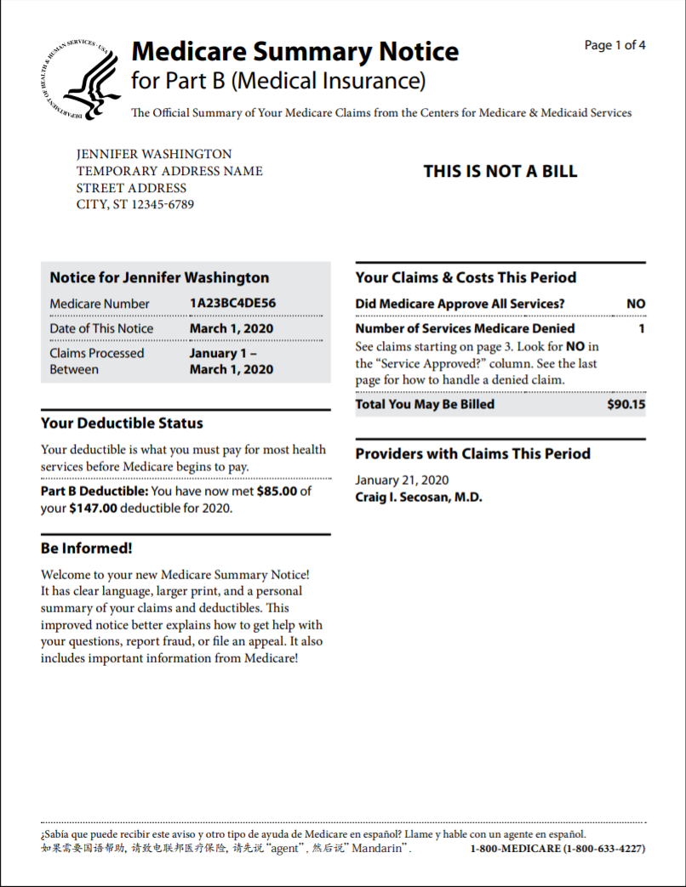
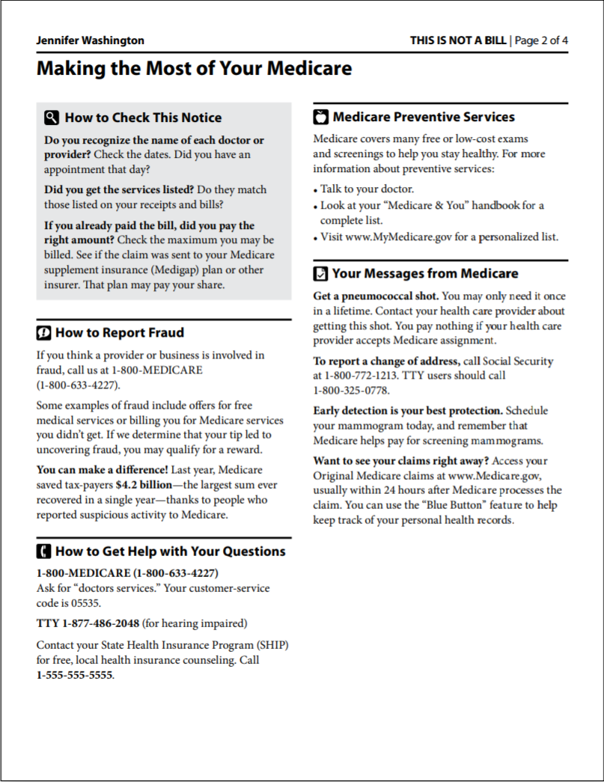
Medicare Summary Notice (MSN)
Notes:
This slide has animation.
Presenter Notes​
There are Medicare Summary Notices (MSNs) for Medicare Part A (Hospital Insurance), Medicare Part B (Medical Insurance), and durable medical equipment (DME). The MSN shows:
All services and supplies that were billed to Original Medicare
What Medicare paid
What you owe each provider
Review your MSNs carefully to make sure you got all of the services and supplies listed. If you have other insurance, check to see if it covers anything Medicare didn’t. Keep your receipts and bills and compare them to your MSN to be sure you got all the services, supplies, or equipment. If you paid a bill before you got your notice, compare your MSN with the bill to make sure you paid the right amount. If an item or service is denied, call your doctor’s or health care provider’s office to make sure they submitted the correct information. If not, the office may resubmit. If you disagree with any decision made, you can file an appeal. If you find items listed in your claims that you don’t have a record of, it’s possible that you or Medicare may have been billed for services or items you didn’t get. If you think a charge is incorrect and you know the provider, you may want to call their office to ask about it. The person you speak to may help you better understand the services or supplier you got. Or, your provider may realize a billing error was made. If you’ve contacted the provider and you suspect that Medicare is being charged for items or services you didn’t get, or you don’t know the provider on the claim, report the suspected fraud to 1-800-MEDICARE (1-800-633-4227); TTY: 1-877-486-2048. For more information or to view samples of the Part A, Part B, and/or DME MSNs, visit Medicare.gov/basics/forms-publications-mailings/mailings/costs-and-coverage/medicare-summary-notice.
Part A MSN: Medicare.gov/pubs/pdf/summarynoticea.pdf
Part B MSN: Medicare.gov/Pubs/pdf/summarynoticeb.pdf
DME MSN: Medicare.gov/pubs/pdf/SummaryNoticeDME.pdf
You can also access MSNs electronically (eMSNs) by logging into (or creating) your secure account on Medicare.gov (see the next slide).

Slide 52
Electronic Medicare Summary Notice (eMSN)
You can sign up to get your MSNs electronically (eMSN)
You’ll get an email every month when your MSNs are available in your Medicare account
You don’t have to wait 3 months
You’ll no longer get the mailed paper copy
Notes:
This slide has animation.
Presenter Notes​
The eMSN is an electronic version of your Original Medicare claims statements. If you choose eMSNs, you won’t get printed copies of your MSNs in the mail. You’ll get an email every month when MSNs are available in your Medicare account, instead of waiting 3 months for a paper copy. With eMSNs, you can:
Eliminate stacks of paper—save or print only what you need
Track your monthly claims and costs
Check your remaining deductible amount
Catch errors in billing and services
Help prevent fraud by making sure you’re billed only for the services you’ve gotten
How to sign up for eMSNs:
Log into (or create) your Medicare account at Medicare.gov/account/login.
Under “Edit my…” select “Account Settings.“
Email and document settings will include options to select paper or electronic versions of the MSN and the “Medicare & You” handbook.
NOTE: If you haven’t gotten Medicare-covered services or supplies during that 3-month period, you won’t get an MSN.

Slide 53
Medicare Account on Medicare.gov
Access your Medicare information anytime to:
Print an official copy of your Medicare card
Access and share your electronic health information
Pay your Original Medicare premiums online
View your Original Medicare claims
Find plans in your area
Create a list of your drugs
Get help through live chat
Notes:
This slide has animation.
Presenter Notes​
Create a secure personal account to access your Medicare information anytime and have a more personalized experience. Keep your username and password secure—don’t share it with anyone you don’t trust. With your account, you can:
Print an official copy of your Medicare card.
Access and share your electronic health information (only share your information with trusted entities).
Pay your Original Medicare premiums online.
Review personal Medicare information, like Original Medicare claims, as soon as they’re processed and check for fraudulent claims.
Check your health and drug plans or find new plans in your area.
Create and save a list of your drugs.
Get help through live chat.

Slide 54
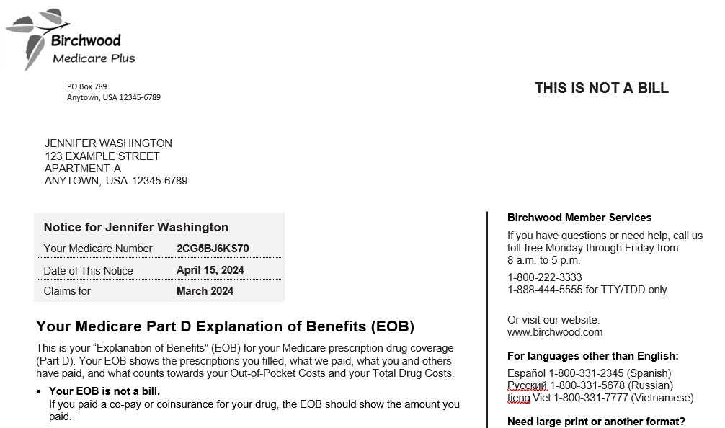
Explanation of Benefits (EOB)
Provided by Medicare Advantage Plans and Medicare drug plans
Gives enrollees clear and timely information about their medical and/or drug claims
Notes:
This slide has animation.
Presenter Notes​
Medicare Advantage Plans and Medicare drug plans provide a monthly Explanation of Benefits (EOB) that offers similar information.
The EOB is an enrollee communication that gives enrollees clear and timely information about their medical and/or drug claims, to support informed decisions about their health care options.
Plans are required to issue EOBs that include the information reflected in the CMS-developed templates. To see the templates and instructions, visit CMS.gov/Medicare/Health-Plans/ManagedCareMarketing/MarketngModelsStandardDocumentsandEducationalMaterial.html and CMS.gov/medicare/coverage/prescription-drug-coverage-contracting/part-d-model-materials. Medicare Part D sponsors must make sure that enrollees who use their Medicare drug coverage get their EOBs by the end of the month following the month in which they used their drug coverage.

Slide 55
“4 Rs” for Fighting Medicare Fraud
Record appointments and services
Review services provided
Report suspected fraud
Remember to protect personal information (“guard your card”)
For more information, visit Medicare.gov/publications to review “4 Rs for Fighting Medicare Fraud” (Medicare Product No. 11610)
Notes:
This slide has animation.
Presenter Notes​
The 4 Rs for fighting Medicare fraud are:
Record the dates of doctor’s appointments on a calendar. Note the tests and services you get, and save the receipts and statements from your providers. If you need help, ask a friend or family member. Contact your local Senior Medicare Patrol (SMP) program to get a free “Personal Health Care Journal.” Use the SMP locator at smpresource.org, or call 1-877-808-2468 to find the SMP program in your area.
Review your MSNs or similar statements from your plan for signs of fraud, including claims you don’t recognize. Compare the dates and services on your calendar with the statements your get from Medicare or your Medicare plan to make sure you got each service listed and that all the details are correct. If you see items listed in your claims that you don’t have a record of, it’s possible you, Medicare, or your Medicare plan may have been billed for services or items you didn’t get. To review your Medicare Part A and Part B claims, log into (or create) your secure Medicare account at Medicare.gov, or call 1-800-MEDICARE (1-800-633-4227); TTY: 1-877-486-2048. You can get help from your local SMP program with checking your MSNs for errors or suspected fraud. If you’re in a Medicare Advantage Plan or Medicare drug plan, call your plan for more information about a claim.
Report suspected Medicare fraud by calling 1-800-MEDICARE (1-800-633-4227); TTY: 1-877-486-2048. Have your Medicare card or Number and the claim or MSN ready. If you identify errors or suspect fraud, the SMP can also help you make a report to Medicare.
Remember to protect your Medicare number. Don’t give it out, except to people you know should have it, like your doctor or other health care provider. Never give your Medicare number in exchange for a special offer. Medicare will never contact you and ask for personal information, like your Medicare or bank account numbers. Never let someone use your Medicare card, and never use another person’s card.
For more information, visit Medicare.gov/publications to review “4 Rs for Fighting Fraud,” (CMS Product No. 11610).

Slide 56
Contact Medicare
Call to make a complaint and report fraud
Have this information ready:
Provider’s name and any identifying number you have
Information about the item or service, including date and payment amount
Date on your MSN
Your name and Medicare number
If you have concerns call Medicare at 1-800-MEDICARE (1-800-633-4227); TTY: 1-877-486-2048
Notes:
This slide has animation.
Presenter Notes​
People with Medicare can call 1-800-MEDICARE (1-800-633-4227); TTY: 1-877-486-2048 to make a complaint and report fraud.
1-800-MEDICARE has an Interactive Voice Response (IVR) system available for people who haven’t signed up for access to their secure account on Medicare.gov/account/login.
The IVR can access 15 months of Original Medicare claims processed on their behalf.
The data gathered helps the Centers for Medicare & Medicaid Services (CMS) to:
Target providers or suppliers with multiple consumer complaints for further review.
Track fraud complaints to show when fraud scams are heating up in new areas. Using existing data in this innovative way lets CMS target providers and suppliers with multiple consumer complaints for further investigation.
Carefully review the facts before you report errors, fraud, or abuse, and have the following information ready when you call 1-800-MEDICARE:
Provider’s name and any identifying number you may have
Information on the service or item you’re questioning
The date the service or item was supposedly given or delivered
Payment amount approved and paid by Medicare
The date on your MSN
Your name and Medicare number (as listed on your Medicare card)

Slide 57
Fighting Fraud Can Pay
You may get a reward if:
The fraud you report is proven as potential fraud and formally referred to the U.S. Department of Health & Human Services (HHS) Office of the Inspector General (OIG)
You aren’t an “excluded individual”
The person or organization being reported isn’t already under investigation by law enforcement
Your report leads directly to the recovery of at least $100 of Medicare money
To report suspected fraud, call:
1-800-HHS-TIPS (1-800-447-8477), or
1-800-MEDICARE (1-800-633-4227); TTY: 1-877-486-2048
Notes:
This slide has animation.
Presenter Notes​
To report suspected fraud, you call either 1-800-HHS-TIPS (1-800-447-8477), or 1-800-MEDICARE (1-800-633-4227); TTY: 1-877-486-2048.
You may get a reward of up to $1,000 if you meet all of these conditions:
The suspected Medicare fraud you report must be proven as potential fraud by the Medicare contractors responsible for investigating potential fraud and abuse, and formally referred to the U.S. Department of Health & Human Services (HHS) Office of Inspector General (OIG) for further investigation as part of a case by one of the contractors.
You aren’t an “excluded individual.” For example, you didn’t participate in the fraud offense being reported. Or, there isn’t another reward that you qualify for under another government program.
The person or organization you’re reporting isn‘t already under investigation by law enforcement.
Your report leads directly to the recovery of at least $100 of Medicare money.
For more information, call 1-800-MEDICARE.
Review the Code of Federal Regulations at 42 CFR 420.405 “Rewards for information relating to Medicare fraud and abuse” at eCFR.io/Title-42/se42.3.420_1405.

Slide 58
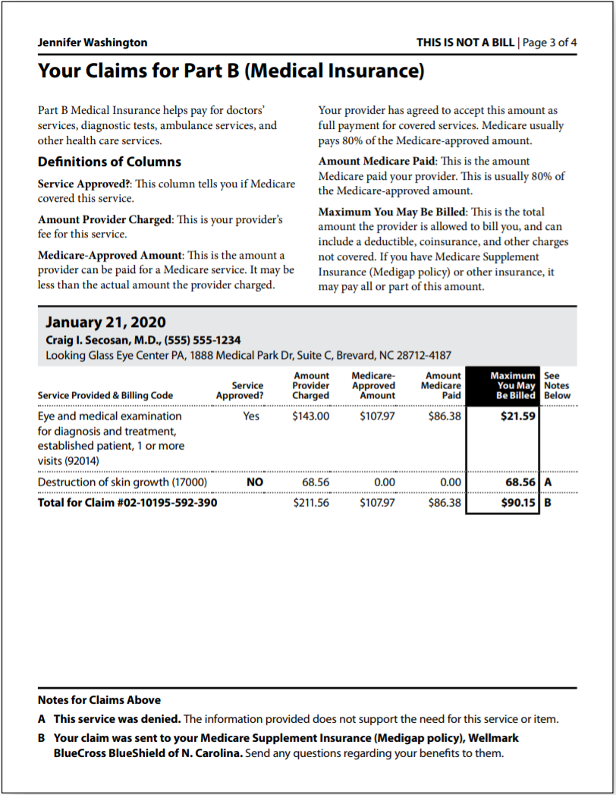
Learning Activity
Jennifer has concerns and wants to discuss her MSN with you.
What are some things that might indicate fraud?
Notes:
This slide has animation.
Presenter Notes​
Learning Activity:
Jennifer has concerns and wants to discuss her MSN with you.
What parts of the MSN should she look at to be sure there were no mistakes or fraud?
(Discussion is on the next slide.)

Slide 59
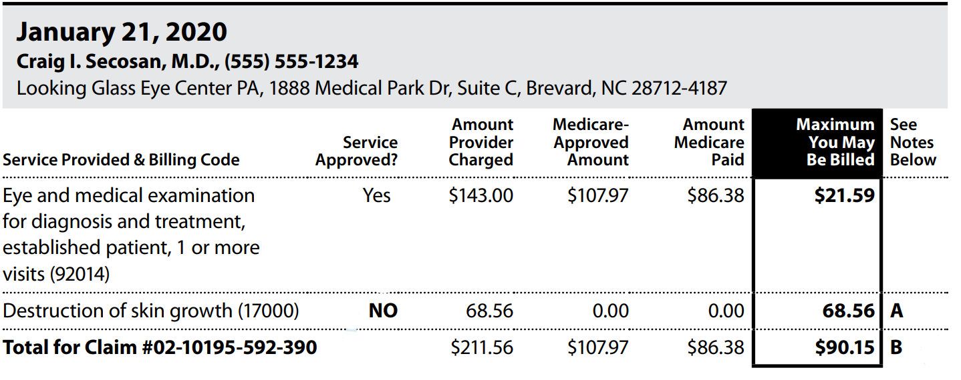
Learning Activity (continued)
Does she know the provider/facility?
Did she get these services?
Is the date of service correct?
Do any services appear twice when they shouldn’t?
3
1
2
4
Notes:
This slide has animation.
Presenter Notes​
MSN Activity—What questions should you ask while reviewing the MSN?
Does she know the provider/facility?
Did she get these services? Was she charged for any medical services she didn’t get?
Is the date of service correct?
Do any services appear twice when they shouldn’t?
After reviewing the MSN:
What other documents should Jennifer check?
Does her credit report show any unpaid bills for medical services or equipment she didn’t get?
Has she gotten any collection notices for medical services or equipment she didn’t get?

Slide 60
Protecting Personal Information
Your Medicare card has a number that’s unique to you
Only share personal information with people you trust:
Doctors, other health care providers, and plans approved by Medicare
Insurers who pay benefits on your behalf
Trusted people in the community who work with Medicare
Notes:
This slide has animation.
Presenter Notes​
Your Medicare card has a Medicare number that’s unique to you, instead of your Social Security Number (SSN). Providers may refer to your Medicare number as your Medicare Beneficiary Identifier (MBI).
Keep your personal information like your Medicare number, SSN, credit card and bank account numbers safe. Only share this information with people you trust, like:
Your doctors, other health care providers, and plans approved by Medicare
Insurers who pay benefits on your behalf
Trusted people in the community who work with Medicare, like your State Health Insurance Assistance Program (SHIP) or Social Security office
If you aren’t sure if a provider is approved by Medicare or someone calls you and asks for your Medicare number or other personal information, call 1-800-MEDICARE (1‑800‑633‑4227); TTY: 1‑877‑486‑2048.

Slide 61
Identity Theft
Identity theft is when someone else uses your personal information, like your Social Security Number (SSN)
If you think someone is using your information:
Visit identitytheft.gov
Visit FTC.gov/idtheft for more information about identity theft or to file a complaint online
Call the Federal Trade Commission’s ID Theft Hotline at 1-877-438-4338; TTY: 1-866-653-4261
Notes:
This slide has animation.
Presenter Notes​
Identity theft occurs when someone else uses your personal information, like your SSN. If they’re using your Medicare or Medicaid Numbers, it’s considered medical identity theft. It’s a serious crime.
If you suspect identity theft, or feel like you gave your personal information to someone you shouldn’t have, you can:
Visit identitytheft.gov
Call the Federal Trade Commission’s ID Theft Hotline at 1-877-438-4338; TTY: 1-866-653-4261
Visit FTC.gov/idtheft for more information about identity theft or to file a complaint online

Slide 62
Medical Identity Theft
To replace your card, call Medicare at 1-800-MEDICARE (1-800-633-4227); TTY: 1-877-486-2048
Medical identity theft can result in:
False or missed diagnoses
Treatment for conditions you don’t have
Incorrect lab results
Bills for services you didn’t get
Denied services or prescriptions
Inaccurate medical history records
View OIG’s Public Service Announcement about medical identity theft
Notes:
This slide has animation.
Presenter Notes​
Medical identify theft is a special type of identity theft where someone uses your Medicare or Medicaid Number to submit fraudulent claims to Medicare, Medicaid, or other insurers without your permission.
Medical identity theft can result in:
False or missed diagnoses.
Treatment for conditions you don’t have.
Incorrect lab results.
Bills for services you didn’t get.
Denied services or prescriptions.
Inaccurate medical history record.
If you need to replace your card because you think that someone else is using your Medicare number, report it right away:
Call 1-800-MEDICARE (1-800-633-4227); TTY: 1-877-486-2048.
View a Public Service Announcement about Medical Identity Theft from OIG at youtube.com/watch?time_continue=4&v=r_RNBFGgw1Q&feature=emb_logo.

Slide 63
Reporting Suspected Medicaid Fraud
You can report suspected Medicaid fraud to:
Medicaid Fraud Control Unit
(MFCU)
Office of Inspector General
(OIG)
State Medical Assistance (Medicaid)
office
Notes:
This slide has animation.
Presenter Notes​
You may report suspected Medicaid errors, fraud, or abuse to these organizations:
Medicaid Fraud Control Units (MFCUs) investigate and prosecute Medicaid fraud as well as patient abuse and neglect in health care facilities. You may file complaints of suspected Medicaid fraud directly to an MFCU. Download contacts at OIG.HHS.gov/fraud/medicaid-fraud-control-units-mfcu/files/contact-directors.pdf. OIG certifies and annually re-certifies each MFCU.
Contact OIG or HHS
Report fraud online: tips.OIG.HHS.gov
Report fraud by mail: HHS Tips Hotline, P.O. Box 23489, Washington, DC 20026-3489
Call: 1-800-447-8477; TTY: 1-800-377-4950 to report fraud
You can also report suspected fraud and abuse to your State Medical Assistance (Medicaid) office. You may locate them at Medicaid.gov/about-us/beneficiary-resources/index.html#statemenu.
Learn more about Medicaid fraud at Medicaid.gov/medicaid/program-integrity/index.html.

Slide 64
Check Your Knowledge: Question 6
You give your uninsured son your ID and Medicaid Card to get treatment. What consequences could happen? (select all that apply)
You could be charged with health care fraud
Your medical records will be inaccurate
You could be placed in a Medicaid lock-in program
You could lose your benefits
Notes:
This slide has animation.
Check Your Knowledge—Question 6
You give your uninsured son your ID and Medicaid card to get medical treatment. What consequences could happen? (select all that apply)
ANSWER: a., b., c., d. All of these are possible consequences of sharing your Medicaid card.
As compassionate as your intentions are, sharing your Medicaid Number can have serious consequences. You should only share your health care card or number with your health care providers or a trusted caregiver for your own medical needs. As a result of sharing your card, since you intentionally participated, you could be charged with health care fraud and spend time in jail if found guilty. Your medical records could be wrong—the next time you go to the doctor, you’ll have to explain what happened so you don’t get the wrong kind of care. You might lose your benefits. Since you have Medicaid, you could now be limited to certain doctors, drug stores, or hospitals. This is called a lock-in program.

Slide 65
Check Your Knowledge: Question 7
In reviewing your Medicare Summary Notice (MSN), you notice Medicare was billed for diabetic supplies, but you’ve never been diagnosed with diabetes. What should you do?
Call 1-800-MEDICARE
Contact your local Senior Medicare Patrol (SMP) office
Submit a complaint to the U.S. HHS Office of Inspector General (OIG)
Any of the above
Notes:
This slide has animation.
Presenter Notes​
Check Your Knowledge—Question 7
In reviewing your MSN, you notice Medicare was billed for diabetic supplies, but you’ve never been diagnosed with diabetes. What should you do?
ANSWER: d. Any of the above.
You’re doing your part in preventing fraud, waste, and abuse by reviewing your MSN. Any items that don’t match with your medical records could be an indication of fraud or identity theft. Calling 1-800-MEDICARE, contacting your local Senior Medicare Patrol (SMP), or submitting a complaint to the U.S. Department of Health & Human Services (HHS) Office of Inspector General (OIG) can start the process for additional review.

Slide 66
Key Points to Remember
Differences between fraud, waste, and abuse depend on circumstances, intent, and knowledge
Improper payments are often mistakes
Program Integrity Contractors and partnerships with organizations help CMS fight fraud, waste, and abuse
Check online resources for the most up-to-date fraud schemes information
Fight fraud, waste, and abuse by recording details about your visits, reviewing statements, reporting suspicious activity, and remembering to protect your information (the 4 Rs)
Notes:
This slide has animation.
Presenter Notes​
Here are some key points to remember:
Differences between fraud, waste, and abuse depend on circumstances, intent, and knowledge.
Fraud occurs when someone intentionally deceives, conceals, or makes misrepresentations to get money or property from a health care benefit program. Ultimately, our judicial system determines if someone committed an act of fraud.
In contrast, waste is the overuse of services, or other practices that, directly or indirectly, add avoidable costs to the Medicare Program. Generally, waste isn’t considered to be a criminal act, but rather the misuse of resources.
Abuse happens when health care providers or suppliers perform actions that directly or indirectly result in unnecessary costs to any health care benefit program.
While there are many causes of improper payments, many are honest mistakes.
The most common error is insufficient documentation.
CMS fights fraud, waste, and abuse with support from Program Integrity Contractors and through partnerships with organizations like Senior Medicare Patrols (SMPs). Suspected fraud must be forwarded to law enforcement for additional investigation and prosecution.
Fraud schemes can change frequently. Check online resources for the most up-to-date information.
You can help fight fraud, waste, and abuse with the 4 Rs: record, review, report, and remember.
You are the first line of defense.
Education and outreach about fraud help combat the problem.

Slide 67
Examples of Medicare & Medicaid Fraud in the News
National Enforcement Action Results in 78 Charged for $2.5B in Health Care Fraud
Convicted Lab Owner Ordered to Forfeit over $187M in Health Care Fraud
Former Executive at Medicare Advantage Organization Charged for Multimillion-Dollar Medicare Fraud Scheme
FL Nurse Practitioner Convicted in $200M Medicare Fraud Scheme
Psychiatrist Arrested for Alleged Medicaid Fraud
Notes:
Presenter Notes​
Examples of Medicare & Medicaid Fraud in the News
National Enforcement Action Results in 78 Charged for $2.5B in Health Care Fraud
Convicted Lab Owner Ordered to Forfeit over $187M in Health Care Fraud
Former Executive at Medicare Advantage Organization Charged for Multimillion-Dollar Medicare Fraud Scheme
FL Nurse Practitioner Convicted in $200M Medicare Fraud Scheme
Psychiatrist Arrested for Alleged Medicaid Fraud

Slide 68
Medicare & Medicaid Fraud & Abuse Resource Guide
Centers for Medicare & Medicaid Services (CMS) | Call 1-800-MEDICARE (1-800-633-4227); TTY: 1-877-486-2048 CMS.gov Medicare.gov/fraud CMS.gov/Medicare-Medicaid-Coordination/Fraud-Prevention/Medicaid-Integrity-Program/Education
Social Security | SSA.gov/fraud
Senior Medicare Patrol (SMP) | Call 1-877-808-2468 smpresource.org
National Health Care Anti-Fraud Association | nhcaa.org
Notes:
Presenter Notes​
This slide (and the 2 that follow) provides information about additional resources. You may want to highlight those that are most relevant to your audience.​
Continued on next slide.​

Slide 69
Medicare & Medicaid Fraud & Abuse Resource Guide (continued)
U.S. Department of Health & Human Services (HHS) Office of the Inspector General (OIG) | Call 1-800-HHS-TIPS; (1-800-447-8477); TTY: 1-800-377-4950 tips.OIG.HHS.gov
PPI MEDIC and I-MEDIC Parts C and D Fraud Investigations Contractor | Call 1-877-7SAFERX (1-877-772‑3379) I-MEDICComplaints@qlarant.com I-MEDIC_OIG_Hotline@qlarant.com
Notes:
Continued on next slide.​

Slide 70
Medicare Fraud & Abuse Resource Guide
To review the Medicare products listed in this table and other helpful products, visit Medicare.gov/publications and search by keyword or product number.
“Medicare Fraud: Don’t Give Them a Chance” (Guard Your Medicare Card Campaign) | youtube.com/watch?v=vScAG7rtPe8&list=PLaV7m2-zFKpiuxlWwMfKHNUrQ2Mxhay4b
“Medicare & You: Preventing Medicare Fraud” (CMS Video) | youtube.com/watch?v=zKZuVdL-GC0
“Medicare Fraud: Coronavirus Scams” (CMS Video) | youtube.com/watch?v=N_iI1IkTQZo
“Protecting Yourself & Medicare from Fraud” | CMS Product No. 10111
“4 Rs for Fighting Medicare Fraud” | CMS Product No. 11610
To order multiple copies (partners only), visit Productordering.cms.hhs.gov. You must register your organization.
Notes:
Presenter Notes
Educating people with Medicare and Medicaid helps strengthen the fight against fraud, by teaching them to identify and report suspected fraud.
For a copy of the “Medicaid Program Integrity: Beneficiary Card Sharing Toolkit,” visit CMS.gov/medicare-medicaid-coordination/fraud-prevention/medicaid-integrity-education/beneficiary-education-toolkits/beneficiary-toolkit.html.
“Protecting Yourself & Medicare from Fraud” is a free publication to help people with Medicare get information on how to detect and protect against fraud and identity theft. To read or download this publication, visit Medicare.gov/Pubs/pdf/10111-Protecting-Yourself-and-Medicare.pdf.

Slide 71
Acronyms
BFCC-QIO Beneficiary and Family-Centered Care Quality Improvement Organization
CBA Competitive Bidding Area
CBP Competitive Bidding Program
CHIP Children’s Health Insurance Program
CMS Centers for Medicare & Medicaid Services
COVID-19 Novel Coronavirus 2019
CPI Center for Program Integrity
DME Durable Medical Equipment
DOJ U.S. Department of Justice
EOB Explanation of Benefits
FEHB Federal Employees Health Benefits
FFS Fee-for-Service
FY Fiscal Year
HCFAC Health Care Fraud & Abuse Control
HEAT Health Care Fraud Prevention & Enforcement Action Team
HFPP Health Care Fraud Prevention Partnership
HHS U.S. Department of Health & Human Services
MEDIC Medicare Drug Integrity Contractor
MFCU Medicaid Fraud Control Unit
MSN Medicare Summary Notice
NTP National Training Program
OIG Office of Inspector General
PPI Plan Program Integrity
QIO Quality Improvement Organization
SMP Senior Medicare Patrol
SSN Social Security Number
TTY Teletypewriter
UPIC Unified Program Integrity Contractor
ZPIC Zone Program Integrity Contractor

Slide 72
Stay Connected
To view available training materials, or subscribe to our email list, visit
CMSnationaltrainingprogram.cms.gov.
Contact us at training@cms.hhs.gov.
Notes:
Presenter Notes​
Stay connected. Visit CMSnationaltrainingprogram.cms.gov to view NTP training materials and to subscribe to our email list. Contact us at training@cms.hhs.gov.

