Slide 1
Health Insurance Marketplace® Basics Find Health Options for Your Needs & Budget
Notes:
Presenter Notes
Hyperlinks in slides are active, but the URLs in the presenter notes section of this PowerPoint aren’t active because PowerPoint doesn’t support that feature. To access any of the URLs in the presenter notes, copy the URL and paste it into your browser.
You can use Microsoft PowerPoint’s presenter view to view your presentation with speaker notes on one computer (your laptop, for example), while only the slides themselves appear on the screen that your audience sees (like a larger screen you're projecting to). See this link for instructions: support.microsoft.com/en-us/office/start-the-presentation-and-see-your-notes-in-presenter-view-4de90e28-487e-435c-9401-eb49a3801257
Introduction to Module Content
“Health Insurance Marketplace® Basics: Find Health Options that Meet Your Needs & Fit Your Budget,” explains the Marketplace and other health coverage options.
Disclaimer
This training module was developed and approved by the Centers for Medicare & Medicaid Services (CMS), the federal agency that administers Medicare, Medicaid, the Children’s Health Insurance Program (CHIP), and the Health Insurance Marketplace®.
The information in this module was correct as of August 2022. To check for an updated version, visit CMSnationaltrainingprogram.cms.gov. The CMS National Training Program provides this information as a resource for our partners. It’s not a legal document or intended for press purposes. The press can contact the CMS Press Office at press@cms.hhs.gov. Official Marketplace Program legal guidance is contained in the relevant statutes, regulations, and rulings.
This communication was printed, published, or produced and disseminated at U.S. taxpayer expense. Health Insurance Marketplace® is a registered service mark of the U.S. Department of Health & Human Services (HHS).

Slide 2
Table of Contents
Lesson 1: Overview of the Marketplace..................................................4–8
Lesson 2: Overview of Qualified Health Plans..……….….………….......9–17
Lesson 3: Eligibility & Enrollment Basics ….....………………….............18–26
Lesson 4: Applying for Coverage……………………………………......... 27–34
Lesson 5: After Applying for Coverage................................................... 35–41
Lesson 6: Other Health Coverage Options …………………………........42–52
Lesson 7: Options for Small Employers……………………………………53–58
Key Points to Remember………………………………………………….... 59–60
Resources …………………………….……….………………………………61–63
Notes:
Presenter notes
The lessons in this training module explain Marketplace Basics. These materials are for information givers/trainers who want to present an overview of the Marketplace and would like to have prepared information for their presentations.
The module consists of 63 slides with speaker’s notes and check your knowledge questions. It takes about 60 minutes to present. Allow approximately 15 more minutes for discussion, questions, and answers. You should consider adding more time for additional activities you want to include.

Slide 3
Session Objectives
By the end of this session, you’ll be able to:
Understand the Marketplace
Define who might be eligible for Marketplace coverage
Define options for people with limited income
Describe the enrollment process
Provide information for people with other health coverage
Find resources and assistance
Notes:
Presenter notes
In this session, we’ll discuss the basics of the Marketplace. It will help you:
Understand the Marketplace
Define who might be eligible for Marketplace coverage
Discuss options for people with limited income
Describe the enrollment process
Provide information for people with other health coverage
Find resources and assistance

Slide 4
Lesson 1
Health Insurance Marketplace Overview
Notes:
Presenter notes
Lesson 1 provides an overview of the Marketplace.
What is the Marketplace?
How does the Marketplace work?
How do I use the Marketplace?

Slide 5
Lesson 1 Objectives
By the end of this lesson, you’ll be able to:
Define the Health Insurance Marketplace
Explain how the Marketplace works
Describe the Marketplace application process
Notes:
Presenter notes
By the end of this lesson you’ll be able to:
Define the Health Insurance Marketplace
Explain how the Marketplace works
Describe the Marketplace application process

Slide 6
What is the Health Insurance Marketplace?
A service that helps people shop for and enroll in health insurance online, over the phone or with in-person help
Allows you to compare private health plans on the basis of price, benefits, quality, and other factors
Small businesses can use the Small Business Health Options Program (SHOP) Marketplace to provide health and/or dental insurance for their employees
Notes:
Presenter notes
The Marketplace is a service that helps people shop for and enroll in health insurance. The federal government operates the Health Insurance Marketplace on HealthCare.gov for most states. Some states run their own Marketplaces.
The Health Insurance Marketplace® (also known as the “Marketplace” or “exchange”) provides health plan shopping and enrollment services online, over the phone or with in-person help.
The Marketplace allows you to compare private health plans on the basis of price, benefits, quality, and other factors.
Created by the Patient Protection and Affordable Care Act.
Small businesses can use the Small Business Health Options Program (SHOP) Marketplace to provide health and/or dental insurance for their employees. This will be discussed in more detail in Lesson 7.
SHOP plans are available through issuers, agents, and brokers, not through HealthCare.gov.
Source: HealthCare.gov/glossary/health-insurance-marketplace-glossary

Slide 7
How Marketplaces Work
States that manage all Marketplace functions are State-based Marketplaces (SBM)
Some states have a SBM that uses the federal platform (SBM-FPs)
States that choose to have the federal government manage all Marketplace functions are federally-facilitated Marketplaces (FFM), commonly called the Marketplace
Some states with an individual market FFM also operate their own SHOP Marketplace
Notes:
Presenter notes
Generally, states are the primary regulators of health insurance companies, and they are responsible for enforcing statutory requirements for health insurance and provisions of the Patient Protection and Affordable Care Act—both inside and outside of the Marketplaces.
States that manage all Marketplace functions are State-based Marketplaces (SBM), commonly called the Marketplace. Some states have a SBM that uses the federal platform (SBM-FPs), meaning they’re responsible for managing Marketplace functions, but rely on the federal HealthCare.gov platform to manage their eligibility and enrollment functions.
States that choose to have the federal government manage all Marketplace functions have federally-facilitated Marketplaces (FFM). Some states with an individual market FFM also operate their own SHOP Marketplace.
For more information about the Marketplace in your state, visit HealthCare.gov/marketplace-in-your-state.

Slide 8
Streamlined Application Process
You can submit a single application online, by phone, on paper, or in- person for:
Medicaid and the Children’s Health Insurance Program (CHIP)
A Marketplace plan, including:
Premium tax credits
Cost sharing reductions
If eligible, you may be able to enroll immediately
Notes:
Presenter notes
States may choose to use the Centers for Medicare & Medicaid Services (CMS)-developed model single, streamlined application, or may develop an alternative single, streamlined application and submit the application for CMS approval. Individuals must be able to submit a single application for all health insurance affordability programs and be able to apply online, by phone, on paper, or in-person.
Through the single application, you may apply for:
Medicaid and Children’s Health Insurance Program (CHIP)
A Marketplace plan
Premium tax credits (which can reduce what you pay for a Marketplace plan)
Cost sharing reductions (which are discounts that lower your out-of-pocket costs for deductibles, coinsurance, and copayments)
If eligible, you may be able to enroll in coverage immediately. It also depends on the program(s) and your state’s enrollment process. People can enroll in Medicaid/CHIP immediately if eligible. Consumers must meet certain qualifications to enroll in Marketplace coverage if it’s not the Open Enrollment Period.

Slide 9
Lesson 2
Marketplace Health Plans Overview
Notes:
Presenter notes
Lesson 2 explains an overview of Marketplace health plans.
Who can sell health plans in the Marketplace
Marketplace health plan requirements
Essential health benefits
Health plan categories
Catastrophic health plans

Slide 10
Lesson 2 Objectives
By the end of this lesson, you’ll be able to:
List the requirements for health insurance companies to sell Marketplace plans
List Marketplace plan requirements
Describe the Marketplace application process
Compare the 4 categories of Marketplace plans
Explain catastrophic health plans
Notes:
Presenter notes
By the end of this lesson, you’ll be able to:
List the requirements for health insurance companies to sell Marketplace plans
List Marketplace health plan requirements
Describe the Marketplace application process
Compare the 4 health plan categories
Explain catastrophic health plans

Slide 11
Health Insurance Company Requirements for Selling Marketplace Plans
Health insurance companies must:
Be licensed by the state and in good standing
Offer plans that cover essential health benefits, follow cost-sharing requirements, and are certified as qualified health plans (QHPs)
Offer at least one Silver plan and one Gold plan
Charge the same premium whether offered through a Marketplace or outside a Marketplace
Notes:
Presenter notes
Marketplaces offer and certify each Marketplace plan sold in a state. Health insurance companies using the Marketplace must:
Be licensed by the state and in good standing
Offer plans that cover essential health benefits, follow cost-sharing requirements, and are certified as qualified health plans (QHPs)
Offer at least one Silver plan and one Gold plan
Charge the same premium whether offered through a Marketplace or outside a Marketplace

Slide 12
Marketplace Plan Requirements
Marketplace plans must
Provide qualifying health coverage with at least the essential health benefits
Follow established limits on cost sharing, like deductibles, copayments, and out-of-pocket maximum amounts
Meet certain requirements for nondiscrimination and network adequacy
Notes:
Presenter notes
Marketplace plans must
Provide qualifying health coverage, at least including a set of benefits called “Essential Health Benefits”
Follow established limits on cost sharing, like deductibles, copayments, and out-of-pocket maximum amounts
Meet certain requirements for nondiscrimination and network adequacy (some state-based Marketplaces have other requirements)

Slide 13
Essential Health Benefits
All Marketplace plans cover these 10 essential health benefits:
Ambulatory patient services, like doctor and clinic visits
Emergency services, like ambulance, first aid, and rescue squad
Hospitalization
Pregnancy, maternity, and newborn care
Mental health and substance use disorder services, including behavioral health treatment
Prescription drugs
Rehabilitative and habilitative services and devices, like therapy sessions, wheelchairs, and oxygen
Laboratory services
Preventive and wellness services and chronic disease management, like blood pressure screening, and immunizations
Pediatric services, including dental and vision care
Notes:
Presenter notes
All plans offered in the Marketplace cover these 10 essential health benefits:
Ambulatory patient services, like doctor and clinic visits
Emergency services, like ambulance, first aid, and rescue squad
Hospitalization
Pregnancy, maternity, and newborn care
Mental health and substance use disorder services, including behavioral health treatment
Prescription drugs
Rehabilitative and habilitative services and devices, like therapy sessions, wheelchairs, and oxygen
Laboratory services
Preventive and wellness services and chronic disease management, like blood pressure screening, and immunizations
Pediatric services, including dental and vision care
NOTE: Routine adult dental coverage isn't included as an essential health benefit and most Marketplace plans don't offer it. However, consumers may purchase stand-alone dental plans if available. Dental coverage is an essential health benefit for children. This means if you’re getting health coverage for someone 18 or younger, dental coverage must be available for the child either as part of a medical Marketplace plan or as a stand-alone plan.

Slide 14
Comparing the 4 “Metal” Categories
How you and your insurance plan pay for your care
Bronze
Silver
Gold
Platinum
Monthly Premium
Lowest
Moderate
High
Highest
Cost when you need care
Highest
Moderate
Low
Lowest
Deductibles
Can be in the 1000s of dollars per year
Usually lower than Bronze plan
Usually low
Very low
Insurance company pays
60%
70%
80%
90%
You pay
40%
30%
20%
10%
NOTE: If you qualify for cost-sharing reductions, you must pick a Silver plan to get the extra savings.
Notes:
Presenter notes
There are 4 “metal” categories of health insurance plans in the Marketplace: Bronze, Silver, Gold, and Platinum. “Catastrophic” plans are also available to some people. (Each category may include several types of plans and provider networks, like health maintenance organizations (HMOs) and preferred provider organizations (PPOs) and are described on the next slide). Also, each metal category is based on how you and your insurance plan pay for your care, and have nothing to do with the quality of care you get. For each Marketplace plan category, the insurance company pays a percentage and you pay a percentage. The table on this slide displays estimated averages for a typical population. Your costs will vary. For example:
Bronze:
Lowest monthly premium
Highest costs when you need care
Deductibles—the amount of medical costs you pay before your insurance plan starts to pay—can be thousands of dollars a year.
The insurance company pays 60% and you pay 40%
Good choice if: You want a low-cost way to protect yourself from worst-case medical scenarios, like serious sickness or injury. Your monthly premium will be low, but you’ll have to pay for most routine care yourself.
Silver:
Moderate monthly premium
Moderate costs when you need care
Silver deductibles are usually lower than those of Bronze plans
The insurance company pays 70% and you pay 30%
Good choice if: You qualify for “extra savings”—or, if not, if you’re willing to pay a slightly higher monthly premium than Bronze to have more of your routine care covered
If you qualify for cost-sharing reductions, you must pick a Silver plan to get the extra savings. For more information about cost-sharing reductions, visit HealthCare.gov/lower-costs/save-on-out-of-pocket-costs.
Gold:
High monthly premium
Low costs when you need care
Deductibles are usually low
The insurance company pays 80% and you pay 20%
Good choice if: You’re willing to pay more each month to have more costs covered when you get medical treatment. If you use a lot of care, a Gold plan could be a good value.
Platinum:
Highest monthly premium
Lowest costs when you get care
Deductibles are very low, meaning your plan starts paying its share earlier than for other categories of plans.
The insurance company pays 90% and you pay 10%
Good choice if: You usually use a lot of care and are willing to pay a high monthly premium, knowing nearly all other costs will be covered.
Note: These are estimated averages for a typical population.

Slide 15
Catastrophic Health Plans
Health plans that:
Have high deductibles and generally lower premiums
Include at least 3 primary care visits per year and certain recommended preventive services with no out-of-pocket costs before the plan's deductible is met
Protect you from high out-of-pocket costs
You pay all medical costs for covered care up to the annual limit on cost sharing for the plan year
You’re eligible if you’re under 30 at the time of enrollment or if you qualify for a hardship or affordability exemption
Notes:
Presenter notes
Catastrophic health plans are plans that meet all of the requirements like other Marketplace plans but don't cover any benefits (other than at least 3 primary care visits per year and certain preventive services) before the plan's deductible is met. The premium amount you pay each month for health care is generally lower than for other Marketplace plans, but the out-of-pocket costs for deductibles, copayments, and coinsurance are generally higher. To qualify for a catastrophic plan, consumers must be under 30 years old before the beginning of the plan year, or get a “hardship exemption” or an “affordability exemption” because the Marketplace determined that the consumers were unable to afford health coverage. Each member of a family must meet the eligibility requirements each plan year to purchase a catastrophic plan.
If you enroll in a catastrophic plan, you can’t use premium tax credits to lower your monthly premiums. Regardless of consumers’ income, you’ll pay the standard price for the catastrophic plan.

Slide 16
Check Your Knowledge: Question 1
What are the 4 metal categories based on?
When you’re eligible to enroll
How you and your plan split costs
The quality of the plan
None of the above
Notes:
Presenter notes
Check Your Knowledge: Question 1
What are the 4 metal categories based on?
When you’re eligible to enroll
How you and your plan split costs
The quality of the plan
None of the above
ANSWER: b. How you and your plan split costs
Each metal category is based on how you and your insurance plan pay for your care, and have nothing to do with the quality of care you get. For each Marketplace plan category, the insurance company pays a percentage and you pay a percentage. Your costs will vary.

Slide 17
Check Your Knowledge: Question 2
Which of the following is characteristic of a Catastrophic plan?
Low deductibles and higher premiums
High deductibles and lower premiums
High out-of-pocket costs
Only available to people over 65
Notes:
Presenter notes
Check Your Knowledge: Question 2
Which of the following is characteristic of a Catastrophic plan?
Low deductibles and higher premiums
High deductibles and lower premiums
High out-of-pocket costs
Only available to people over 65
ANSWER: b. High deductibles and lower premiums
Catastrophic health plans are plans that meet all of the requirements like other Marketplace plans but don't cover any benefits (other than at least 3 primary care visits per year and certain preventive services) before the plan's deductible is met. The premium amount you pay each month for health care is generally lower than for other Marketplace plans, but the out-of-pocket costs for deductibles, copayments, and coinsurance are generally higher.

Slide 18
Lesson 3
Eligibility & Enrollment Basics
Notes:
Presenter notes
Lesson 3 talks about eligibility and enrollment basics.
Who’s eligible for coverage
Affordability programs
Premium tax credits
Cost-sharing Reductions
Coverage options for American Indians and Alaskan Natives (AI/ANs)

Slide 19
Lesson 3 Objectives
By the end of this lesson, you’ll be able to:
Identify coverage eligibility through the Marketplace
Explain the Affordability Program
List the special benefits for American Indian/Alaska Natives
Notes:
Presenter notes
By the end of this lesson, you’ll be able to:
Identify coverage eligibility through the Marketplace
Explain the Affordability Program
List the special benefits for American Indian/Alaska Natives

Slide 20
Who’s Eligible for Coverage Through the Marketplace
To be eligible, you must:
Live in the U.S. in a state served by the Marketplace where you’re applying
Be a U.S. citizen, U.S. national, or lawfully-present immigrant for the entire time you plan to have coverage
Not be incarcerated (unless pending disposition of charges)
Notes:
Presenter notes
To be eligible for coverage through a Marketplace you must:
Live in the U.S. in a state served by the Marketplace where you’re applying
Be a U.S. citizen, U.S. national, or lawfully-present immigrant for the entire time you plan to have coverage
Not be incarcerated (unless pending disposition of charges)

Slide 21
Affordability Program: Premium Tax Credits
Advance payments of the premium tax credit (APTC) are only available if you enroll in a Marketplace plan
If eligible, you can use all, some, or none of the tax credit in advance to lower your monthly premiums
You can qualify for the premium tax credit if your household income for the coverage year was between 100%–400% of the Federal Poverty Level (FPL) (if you met other eligibility criteria)
The American Rescue Plan allows some consumers with higher incomes to qualify for 2021 and 2022
You may qualify if your household income is under 100% of the FPL and you aren’t eligible for Medicaid based on immigration status (you met other eligibility requirements)
Notes:
Presenter notes
Advance payments of the premium tax credit (APTC) are only available if you enroll in a Marketplace plan
If eligible, you can use all, some, or none of the tax credit in advance to lower your monthly premiums
As the Patient Protection and Affordable Care Act (PPACA) was originally passed, you could qualify for the premium tax credit if your household income for the coverage year was between 100%–400% of the Federal Poverty Level (FPL), if you met other eligibility criteria
The American Rescue Plan allows some consumers with higher incomes to qualify for 2021 and 2022
You may qualify if your household income is under 100% of the FPL and you aren’t eligible for Medicaid based on immigration status (and you met other eligibility requirements)

Slide 22
Affordability Program: Premium Tax Credits (continued)
The amount of the premium tax credit you’re eligible for can differ from the advance payments due to changes in household income or size, or other factors
When you file your income taxes, you‘ll have to reconcile the premium tax credit you’re eligible for based on your tax filing information with the amount that was paid in advance.
If you got:
More tax credit in advance than you’re eligible for, you may have to repay all or some of the difference when you file your federal income tax return
Less tax credit in advance than you’re eligible for, you may get the additional tax credit as a refund
Notes:
Presenter notes
The amount of premium tax credit you’re eligible for may change throughout the coverage year, if there are changes to your household income, household size, or certain other factors.
You should report life changes to the Marketplace as soon as possible.
When you file your income taxes, you‘ll have to reconcile the premium tax credit you’re eligible for based on your tax filing information with the amount that was paid in advance.
If you got:
More tax credit in advance than you’re eligible for, you may have to repay all or some of the difference when you file your federal income tax return.
Less tax credit in advance than you’re eligible for, you may get the additional tax credit as a refund.
If your income changes, you can update your Marketplace application online, by phone, or in person— but not by mail. For more information on reporting income changes, visit HealthCare.gov/reporting-changes/how-to-report-changes for more information.

Slide 23
Affordability Programs: Cost-Sharing Reductions (CSRs)
If you qualify for premium tax credits, you might also qualify for cost-sharing reductions (CSRs), called “extra savings”. To be eligible for CSR based on income, you must:
Have a household income under 250% of the FPL
Be eligible for premium tax credits
Enroll in a Silver plan through the Marketplace
Notes:
Presenter notes
A cost-sharing reduction (CSR) is a discount that lowers the amount you have to pay for deductibles, copayments, and coinsurance. If you apply for coverage through the Marketplace and qualify for premium tax credits, you might also qualify for CSR, which is often called “extra savings.” If you qualify, you must enroll in a plan in the Silver category to get the extra savings.
To be eligible for CSR based on income, you must:
Have a household income under 250% of the FPL
Be eligible for premium tax credits
Enroll in a Silver plan through the Marketplace
For more information about CSRs, visit HealthCare.gov/lower-costs/save-on-out-of-pocket-costs.

Slide 24
Special Benefits for American Indian/Alaska Natives (AI/AN)
If you get services from an Indian Health Care provider, you won’t have any out-of-pocket costs
If your income is between 100%–300% of the FPL, you can:
Enroll in a “zero cost-sharing” plan through the Marketplace, which means you’ll have no out-of-pocket costs, like deductibles or copayments, for covered services
If your income is above 300% of the FPL, you can:
Enroll in a “limited cost-sharing” plan through the Marketplace, which means you’ll have no out-of-pocket costs, like deductibles or copayments, for covered services from your Marketplace plan with a referral from an Indian Health Care provider
You can enroll in a Marketplace health insurance plan anytime, and you can change plans as often as once a month
Tribal members and non-tribal members should enroll in separate plans to take advantage of all potential savings
Notes:
Presenter notes
There are special benefits if you’re American Indian/Alaska Native (AI/AN):
If you get services from an Indian Health Care provider, you won’t have any out-of-pocket costs
If your income is between 100%–300% of the FPL, you can enroll in a “zero cost-sharing” plan through the Marketplace, which means you’ll have no out-of-pocket costs, like deductibles or copayments, for covered services
If your income is above 300% of the FPL, you can enroll in a “limited cost-sharing” plan through the Marketplace, which means you’ll have no out-of-pocket costs, like deductibles or copayments, for covered services from your Marketplace plan with a referral from an Indian Health Care provider
You can enroll in a Marketplace health insurance plan anytime, and you can change plans as often as once a month
Tribal members and non-tribal members should enroll in separate plans to take advantage of all potential savings
NOTE: A member of a federally recognized tribe won’t be able to use the special cost-sharing savings if they enroll in the same Marketplace plan with a non-tribal member. For more information, visit HealthCare.gov/american-indians-alaska-natives.

Slide 25
New Special Enrollment Period
Consumers eligible for APTC and whose household income doesn’t exceed 150 percent of the federal poverty line (FPL)
Available during periods of time when APTC benefits are available such that the applicable taxpayers’ applicable percentage is set at zero
Qualified individual who meets the criteria, but who qualifies for a maximum APTC amount of zero dollars, is not considered APTC eligible
Notes:
Presenter Notes
HHS added a a new paragraph at § 155.420(d)(16) to establish a monthly special enrollment period for qualified individuals or enrollees, or the dependents of a qualified individual or enrollee, who are eligible for APTC and whose household income doesn’t exceed 150 percent of the federal poverty line (FPL), in order to provide low-income individuals who generally will have access to a premium-free silver plan with a 94 percent actuarial value (AV) with more opportunities to enroll in coverage. This monthly special enrollment period will be available during periods of time when APTC benefits are available such that the applicable taxpayers’ applicable percentage is set at zero, such as during tax years 2021 and 2022, as provided by section 9661 of the American Rescue Plan Act of 2021 (Pub. L. 117-2) (ARP). HHS also clarifies, for purposes of the special enrollment periods provided at § 155.420(d), that a qualified individual who meets the criteria at § 155.305(f), but who qualifies for a maximum APTC amount of zero dollars, is not considered APTC eligible. This approach will ensure that § 155.420 reflects appropriate special enrollment period eligibility for qualifying individuals who qualify for a maximum APTC amount of zero dollars and for those who become eligible for APTC amounts greater than zero.
45 CFR 155.420(d)(16): https://www.ecfr.gov/current/title-45/subtitle-A/subchapter-B/part-155/subpart-E/section-155.420#p-155.420(d)(16)

Slide 26
Check Your Knowledge: Question 3
If you qualify for premium tax credits, you might also qualify for extra savings called cost-sharing reductions (CSR).
True
False
Notes:
Presenter notes
Check Your Knowledge: Question 3
If you qualify for premium tax credits, you might also qualify for extra savings called cost-sharing reductions (CSR).
True
False
ANSWER: a. True
A cost-sharing reduction (CSR) is a discount that lowers the amount you have to pay for deductibles, copayments, and coinsurance. If you apply for coverage through the Marketplace and qualify for premium tax credits, you might also qualify for CSR, which is often called “extra savings.” If you qualify, you must enroll in a plan in the Silver category to get the extra savings.

Slide 27
Lesson 4
Applying for Coverage
Notes:
Presenter notes
Lesson 4 explains how to apply for coverage through the Health Insurance Marketplace.
When to enroll
How to enroll
Enrollment help
Marketplace Call Center
In-person help

Slide 28
Lesson 4 Objectives
By the end of this lesson, you’ll be able to:
Explain the timeline and steps of applying to the Marketplace
Find resources for getting help
Notes:
Presenter notes
By the end of this lesson, you’ll be able to:
Explain the timeline and steps of applying to the Marketplace
Find resources for getting help

Slide 29
When to Enroll
You can enroll in or change Marketplace plans during the annual Open Enrollment Period (OEP) or during a Special Enrollment Period (SEP)
Exception: If you’re American Indian/Alaska Native, you can enroll in the Marketplace or change plans throughout the year
In the federally-facilitated Marketplace, the OEP is November 1–January 15
Certain life events may qualify you for an SEP
Losing health coverage
Moving
Getting married
Having a baby/adopting a child
Notes:
Presenter notes
You can enroll in or change Marketplace plans during the annual Open Enrollment Period (OEP) or during a Special Enrollment Period (SEP). However, if you’re American Indian/Alaska Native, you can enroll in the Marketplace or change plans throughout the year, not just during the yearly OEP or during an SEP.
In the federally-facilitated Marketplace for individuals and families, the OEP is November 1 - January 15. In most cases, coverage can begin as soon as January 1.
January 1, 2023: Coverage begins for 2023 plans chosen by December 15, 2022.
January 15, 2023: Open Enrollment ends for 2023.
February 1, 2023: Coverage begins for 2023 plans chosen between December 16, 2022 and January 15, 2023.
For more key dates, go to Marketplace.cms.gov/outreach-and-education/key-dates-health-insurance-marketplace.pdf.
Life changes can qualify you for an SEP. You can:
Enroll in or change plans
At any time of the year, you can submit or update your Marketplace application to see if you qualify for Medicaid or the Children’s Health Insurance Program (CHIP)
For more information on qualifying for an SEP, visit HealthCare.gov/coverage-outside-open-enrollment/special-enrollment-period.

Slide 30
Applying for Marketplace Coverage
Marketplace Call Center number is 1-800-318-2596; TTY: 1-855-889-4325
You can apply for Marketplace coverage through:
HealthCare.gov (English) and CuidadoDeSalud.gov (Spanish)
Some Marketplace plan issuers
Marketplace Call Center
Marketplace enrollment assisters
Marketplace-registered agents and brokers, or web-broker sites
Paper application
NOTE: Language assistance is available through interpreters, Call Center support, print, and web resources
Notes:
Presenter notes
You can apply for Marketplace coverage through:
HealthCare.gov (English) and CuidadoDeSalud.gov (Spanish)
Directly through some Marketplace plan issuers
The Marketplace Call Center
Marketplace enrollment assisters
Marketplace-registered agents and brokers, or web-broker sites
Paper application
Language assistance is available through interpreters, Call Center support, print, and web resources:
Help is available to complete an application
Job aids in 33 languages can be found at: Marketplace.cms.gov/applications-and-forms/individuals-and-families-forms.html

Slide 31
Marketplace Call Center
Marketplace Call Center number is 1-800-318-2596; TTY: 1-855-889-4325
Helps you in federally-facilitated Marketplaces (FFMs) or State-based Marketplace on the Federal platform (SBM-FP)
Customer service representatives are available 24/7
Help with eligibility, enrollment, and referrals
Assistance in English and Spanish
Oral interpretations in over 240 additional languages
SBMs have their own call centers
Notes:
Presenter notes
There’s a Marketplace Call Center if you live in states with a federally-facilitated Marketplace or State-based Marketplace on the Federal Platform (SBM-FP). When you call, you’ll be asked what state you live in.
Customer service representatives are available 24 hours a day, 7 days a week, including New Year's Day. The Call Center is closed on Memorial Day, Independence Day (July 4), Labor Day, Thanksgiving, and Christmas.
Customer service representatives can help you complete the application and enrollment process, including reviewing your options and helping you enroll in a plan.
The Call Center gives objective information in English and in Spanish. It also uses a language line to assist in more than 240 additional languages.
You may be referred to your State-based Marketplace if you’re looking for coverage in a state that runs their own Marketplace or Small Business Health Options Program (SHOP).

Slide 32
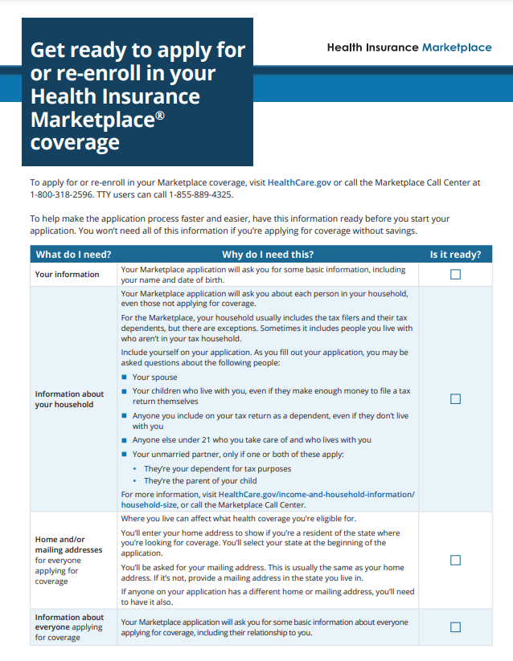
Steps for Applying to the Marketplace on HealthCare.gov
1. Create a Marketplace account
2. Get ready to apply
3. Get “Eligibility Results” right away
4. Enroll in health coverage
Notes:
Presenter notes
1. Create a Marketplace account
Go to HealthCare.gov/create-account and enter some basic information, like your name, address, and email address
If your state runs a Marketplace, you’ll be sent to their website
Help is available for creating your account
2. Get ready to apply
Use the checklist on HealthCare.gov to gather everything you need
Learn how to estimate your income for your application.
3. Get “Eligibility Results” right away
Submit your application to see if you qualify for:
A Marketplace health insurance plan with savings, like tax credits to help pay monthly premiums, or lower copayments, coinsurance, and deductibles.
Free or low-cost coverage through Medicaid and the Children’s Health Insurance Program (CHIP).
See if you’ll save. Get an estimate before you apply.
4. Enroll in health coverage
Compare health plans and prices available in your area
Pick your plan
Pay your premium to your insurance company for your coverage to start
Resources:
HealthCare.gov/create-account
HealthCare.gov/tips-and-troubleshooting/creating-an-account
HealthCare.gov/downloads/apply-for-or-renew-coverage.pdf

Slide 33
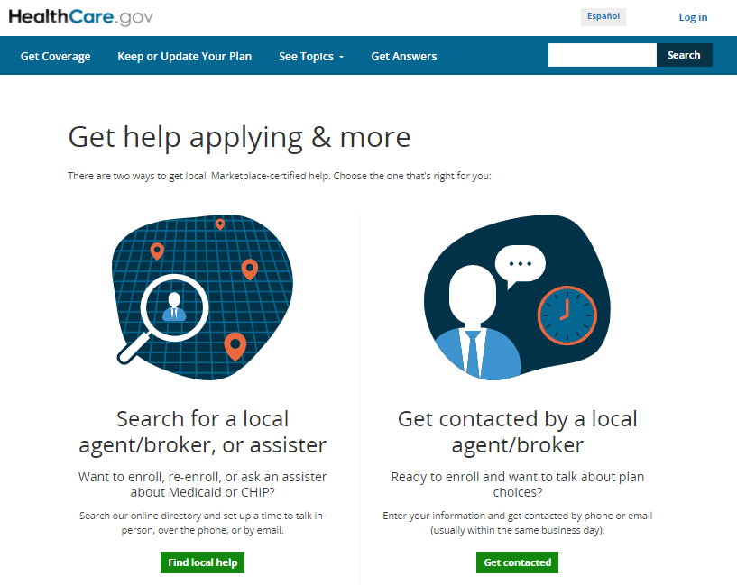
How to Get Help
Marketplace-approved help is available through several programs to help you apply and enroll in health insurance coverage, including:
Navigators
Certified Application Counselors
Agents and Brokers
Notes:
Presenter notes
Marketplace-approved help is available through several programs to help you apply and enroll in health insurance coverage, including navigators, certified application counselors and agents and brokers.
You can use Find Local Help at HealthCare.gov to search for a list of local people and organizations who can help you apply, pick a plan, and enroll in Marketplace coverage.

Slide 34
Check Your Knowledge: Question 4
How can you apply for Marketplace coverage?
HealthCare.gov
The Marketplace Call Center
Paper application
All of the above
Notes:
Presenter notes
Check Your Knowledge: Question 4
How can you apply for Marketplace coverage?
HealthCare.gov
The Marketplace Call Center
Paper application
All of the above
ANSWER: d. All of the above
You can apply for Marketplace coverage through:
HealthCare.gov (English) and CuidadoDeSalud.gov (Spanish)
Directly through some Marketplace plan issuers
The Marketplace Call Center
Marketplace enrollment assisters
Marketplace-registered agents and brokers, or web-broker sites
Paper application

Slide 35
Lesson 5
Marketplace Coverage
Notes:
Presenter notes
Lesson 5 explains what to do after applying for Marketplace coverage.
Premium payments
Reporting life changes
Cancellation of coverage
Marketplace appeals

Slide 36
Lesson 5 Objectives
By the end of this lesson, you’ll be able to:
Explain Marketplace plan premiums
Describe how to report life changes
List the steps to canceling coverage
Explain the Marketplace appeal process
Notes:
Presenter notes
By the end of this lesson, you’ll be able to:
Explain Marketplace plan premiums
Describe how to report life changes
List the steps to canceling coverage
Explain the Marketplace appeal process

Slide 37
Your Monthly Premium
For coverage to become effective, you must pay the first month’s premium directly to your insurance company by the plan’s deadline.
You must pay the premium each month or you could lose coverage.
Marketplace plans must accept the following payment methods:
Paper check
Cashier’s check
Money order
Electronic fund transfer (EFT)
General-purpose pre-paid debit card
Some plans may also accept online, credit card, or debit card payments
Notes:
Presenter notes
Once you select a plan, you must pay your first premium directly to the plan—not to the Marketplace. You’ll receive a link to the plan’s payment site, if the plan provided one. Some Marketplace plans may accept payment online at the time of plan selection. If there's no link, or if you make a plan selection using the Call Center, you should contact the Marketplace plan directly to ask about other options to make premium payments.
You must pay your first month’s premium by the plan’s deadline to get coverage (you must pay the premium each month or you could lose coverage).
Plans are required to accept a variety of payment methods, including paper checks, money orders, cashier's checks, electronic fund transfers (EFT), and all general-purpose pre-paid debit cards. They don’t have to accept credit card or debit card payments unless states make that a requirement, although many plans accept all of these forms of payment. Therefore, it may vary from state to state and between plans. Check with your plan.
Plans set their own payment deadline based on regulations. Some plans may accept your first payment after the date the coverage will become effective. You should contact your plan to find out when they need to make payment.

Slide 38
Reporting Your Life Changes
Update your Marketplace application if you have a:
Change to your income or household, like a pay raise
New household member, or
Dependent getting other coverage
Some of these changes:
Will qualify you for a Special Enrollment Period (SEP), allowing you to change your plan
May affect your savings or coverage eligibility, like a change in your income
If you don’t update your life changes, you may:
Miss out on additional savings
Have to pay when you file your taxes
Update your application online by:
Using your HealthCare.gov account
By calling the Marketplace Call Center
By finding local help (localhelp.healthcare.gov/#/)
Notes:
Presenter notes
Update your Marketplace application if you have a change to your income or household, like a pay raise, a new household member, or a dependent getting other coverage. Some of these changes:
Will qualify you for a Special Enrollment Period (SEP), allowing you to change your plan
May affect your savings or coverage eligibility, like a change in your income
If you don’t update your life changes, you may:
Miss out on additional savings
Have to pay when you file your taxes
You can update your application online using your HealthCare.gov account, by calling the Marketplace Call Center, or by finding local help (localhelp.HealthCare.gov/#/)
For more information, go to HealthCare.gov/reporting-changes.

Slide 39
Canceling Marketplace Coverage
Marketplace Call Center number is 1-800-318-2596; TTY: 1-855-889-4325
For some people on the application
For everyone on the application
Call the Marketplace Call Center on the day you want the member’s coverage to end
In some cases, your coverage won’t end immediately, like when the household members who remain enrolled in coverage qualify for an SEP and must re-enroll
Log in to your HealthCare.gov account
Call the Marketplace Call Center
You can request that your coverage end immediately, or you can set it for a date in the future
Notes:
Presenter notes
To end coverage for just some people on the application, call the Marketplace Call Center at 1-800-318-2596; TTY: 1-855-889-4325 on the day you want the member’s coverage to end.
NOTE: Don’t change or end Marketplace coverage online unless you’re ending coverage for everyone on the application.
In most cases, the removed member’s coverage will end right away, but in some cases, coverage won’t end immediately, including when the household members who remain enrolled in coverage qualify for an SEP. The best way to make sure coverage ends on the right date is to call the Marketplace Call Center and request the change.
You may need to end your Marketplace plan if you get other health coverage, or for another reason. To end Marketplace coverage for everyone on the application, including yourself:
Log in to your HealthCare.gov account if you’re the only one covered
Call the Marketplace Call Center at 1-800-318-2596; TTY: 1-855-889-4325
Your cancelation of coverage can take effect as soon as the day you cancel, or you can set the Marketplace coverage end date to a day in the future, like if you know your new coverage will start on the first day of the following month.
NOTE: Don't end your Marketplace plan until you know for sure when your new coverage starts. Once you end Marketplace coverage, you can’t re-enroll until the next annual Open Enrollment Period (unless you qualify for an SEP).
Source: HealthCare.gov/how-to-cancel-a-marketplace-plan

Slide 40
Marketplace Appeals
You can appeal these Marketplace decisions:
Not eligible for advance payments of the premium tax credit (APTC)
Eligible for APTC, but the amount is wrong
Not eligible for a Special Enrollment Period
Not eligible to buy a Marketplace plan
Not eligible to choose a Catastrophic plan
Not eligible for an exemption from the requirement to have health insurance
NOTE: If you live in Alabama, Alaska, Louisiana, Montana, New Jersey, Virginia, West Virginia or Wyoming, you can also appeal a denial of Medicaid or CHIP eligibility
Notes:
Presenter notes
If you don’t agree with a decision made by the Health Insurance Marketplace®, you may be able to file an appeal. You generally have 90 days from the date of your Eligibility Notice to ask for an appeal.
The Marketplace Appeals Center can review these types of issues:
Not eligible for advance payments of the premium tax credit (APTC)
Eligible for APTC, but the amount is wrong
Not eligible for a Special Enrollment Period
Not eligible to buy a Marketplace plan
Not eligible to choose a Catastrophic plan
Not eligible for an exemption from the requirement to have health insurance
Starting with tax year 2019, the penalty for not maintaining qualifying health coverage is now $0; however, if you’re 30 years old or older you may still apply for a hardship or affordability exemption to qualify for Catastrophic coverage.
NOTE: If you live in Alabama, Alaska, Louisiana, Montana, New Jersey, Virginia, West Virginia or Wyoming, you can also appeal a denial of Medicaid or CHIP eligibility.

Slide 41
Check Your Knowledge: Question 5
If you’re canceling coverage for yourself, your coverage will always end immediately.
a. True
b. False
Notes:
Presenter notes
Check Your Knowledge: Question 5
If you’re canceling coverage for yourself, your coverage will always end immediately.
True
False
ANSWER: b. False
You can request that your coverage ends immediately, but in some cases, your coverage won’t end immediately.

Slide 42
Lesson 6
Other Health Coverage Options
Notes:
Presenter notes
Lesson 6 explains other health coverage options:
Qualifying health coverage
Medicaid and the Marketplace
Medicaid eligibility based on categorical requirements
Determining Medicaid eligibility through the Marketplace
Marketplaces and people with Medicare
Short-term, limited-duration insurance

Slide 43
Lesson 6 Objectives
By the end of this lesson, you’ll be able to:
Define qualifying health coverage
List coverage types that are considered qualifying health coverage
Explain Marketplace work/affects other coverage programs (Children’s Health Insurance Program (CHIP), Medicaid, Medicare and Short-term, Limited-Duration Insurance (STDLI))
Notes:
Presenter notes
By the end of this lesson, you’ll be able to:
Define qualifying health coverage
List coverage types that are considered qualifying health coverage
Explain Marketplace work/affects other coverage programs (Children’s Health Insurance Program (CHIP), Medicaid, Medicare and Short-term, Limited-Duration Insurance (STDLI))

Slide 44
Qualifying Health Coverage
Qualifying health coverage:
Is any health insurance that meets the Affordable Care Act requirement for coverage
Includes Marketplace plans, most Medicaid coverage, and the Children’s Health Insurance Program (CHIP)
Notes:
Presenter notes
Qualifying health coverage is any health insurance that meets the Affordable Care Act (ACA) requirement for coverage. It includes Marketplace plans, most Medicaid coverage, and the Children’s Health Insurance Program (CHIP).

Slide 45
Qualifying Health Coverage (continued)
These coverage types are also considered qualifying health coverage:
Most individual plans bought outside the Marketplace, if they meet the standards for qualified health plans
Medicare Part A (Hospital Insurance) or Medicare Advantage Plan (Part C) Coverage under a parent's plan
Most student health plans (ask your school if the plan counts)
TRICARE
Plans sold through the Small Business Health Insurance Program (SHOP) Marketplace
Health coverage for Peace Corps volunteers
Certain types of veterans health coverage through the Department of Veterans Affairs
Any "grandfathered" individual insurance plan you’ve had since March 23, 2010, or earlier
Department of Defense Nonappropriated Fund Health Benefits Program
Refugee Medical Assistance
State high-risk pools for plan or policy years that started on or before December 31, 2014
Notes:
Presenter notes
Qualifying health coverage is any health insurance that meets the Affordable Care Act requirement for coverage. It includes Marketplace plans, most Medicaid coverage, and the Children’s Health Insurance Program (CHIP). Generally, if you’re eligible for qualifying health coverage either through a job, school, or a government program you aren’t eligible for savings paying the cost of their Marketplace coverage.
These coverage types are also considered qualifying health coverage:
Most individual plans bought outside the Marketplace, if they meet the standards for qualified health plans
Medicare Part A (Hospital Insurance) or Medicare Advantage Plan (Part C) (but Medicare Part B (Medical Insurance) and Medicare drug coverage (Part D) by themselves don’t count)
Coverage under a parent's plan
Most student health plans (ask your school if the plan counts)
TRICARE
Plans sold through the Small Business Health Insurance Program (SHOP) Marketplace
Health coverage for Peace Corps volunteers
Certain types of veterans health coverage through the Department of Veterans Affairs
Any "grandfathered" individual insurance plan you’ve had since March 23, 2010, or earlier
Department of Defense Nonappropriated Fund Health Benefits Program
Refugee Medical Assistance
State high-risk pools for plan or policy years that started on or before December 31, 2014 (check with your high-risk pool plan to see if it counts as qualifying health coverage)
For more information on qualifying health coverage, visit HealthCare.gov/glossary/qualifying-health-coverage. For the full list of coverage types that are considered qualifying health coverage, visit HealthCare.gov/fees/plans-that-count-as-coverage.

Slide 46
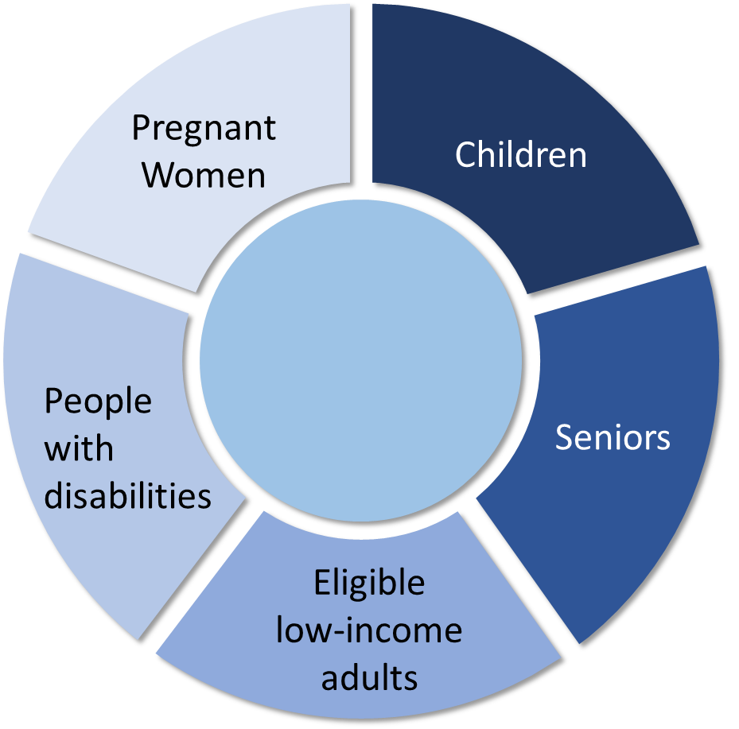
Medicaid/Children’s Health Insurance Plan (CHIP)
Provides free or low-cost health coverage to millions of Americans
Some states cover eligible adults with income as high as 133% (138% with the 5% disregard) of the federal poverty level (FPL)
If you’re eligible for Medicaid or CHIP coverage you’re generally not eligible for financial assistance for a Marketplace plan.
Medicaid/ CHIP
Notes:
Presenter notes
Medicaid and CHIP provide free or low-cost health coverage to millions of Americans, including eligible low-income adults, children, pregnant women, elderly adults, and people with disabilities. These programs are funded jointly by states and the federal government.
Some states have expanded their Medicaid programs to cover eligible adults with income as high as 133% (138% with the 5% disregard) of the federal poverty level (FPL); income thresholds vary by state.
If you’re eligible for Medicaid or CHIP coverage you’re generally not eligible for financial assistance for a Marketplace plan.

Slide 47
Marketplace & Medicaid/CHIP Assessment or Determination
If you’re assessed or determined eligible for Medicaid/CHIP, your application information will be sent by secure, electronic transfer to your state Medicaid/CHIP Agency
If you’re referred to your state with a:
Medicaid/CHIP assessment, you’ll get information about next steps, including a request for any information needed to complete the eligibility determination
Medicaid/CHIP determination, you’ll get enrollment/coverage information, or a notice requesting information needed to complete the eligibility determination/enrollment, as applicable
If you aren’t eligible for Medicaid/CHIP, you’ll be evaluated for eligibility for Marketplace coverage that may include financial help
Notes:
Presenter notes
When you fill out a Marketplace application, the Marketplace will assess or determine your eligibility for Medicaid and CHIP (depending on your state’s process)
If you’re assessed or determined eligible for Medicaid or CHIP, your application information will be sent by secure, electronic transfer to your state Medicaid/CHIP Agency
If you’re referred to the state with a:
Medicaid/CHIP assessment, you’ll get information about next steps, including a request for any information needed to complete the eligibility determination. For information about eligibility assessment, visit HealthCare.gov/glossary/eligibility-assessment.
Medicaid/CHIP determination, you’ll get enrollment/coverage information, or a notice requesting information needed to complete the eligibility determination/enrollment, as applicable.
If you aren’t eligible for Medicaid/CHIP, you’ll be evaluated for eligibility for Marketplace coverage, that may include financial help. You can also request a full determination of Medicaid/CHIP eligibility by the state agency.

Slide 48
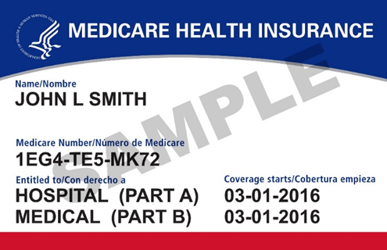
The Marketplace & Medicare
If you’re almost 65 and applying for coverage through a Marketplace, know the benefits of enrolling in Medicare as soon as you become eligible
You may have to pay higher premiums, if you don’t:
Sign up for Medicare during your Initial Enrollment Period (IEP); and
Have job-based coverage based on current employment (or a spouse’s employment), including coverage through:
SHOP Marketplace
Individual coverage Health Reimbursement Arrangement (HRA)
If you’re considered eligible for Medicare, you’re generally not eligible for financial help through the Marketplace
Notes:
Presenter notes
If you’re almost 65 and applying for coverage through a Marketplace, know the benefits of enrolling in Medicare as soon as you become eligible.
You may have to pay higher premiums when you sign up for Medicare later, if:
You don’t sign up for Medicare during your Initial Enrollment Period; and
You don’t have job-based coverage based on current employment (or a spouse’s employment), including coverage through a SHOP Marketplace or an individual coverage Health Reimbursement Arrangement (HRA)
If you already have Medicare, you can’t enroll in Marketplace plans through a Marketplace because it’s against the law for a private insurer to sell a Marketplace plan to someone who has Medicare coverage when they know the plan will provide duplicate benefits.
If you’re considered eligible for Medicare, you’re generally not eligible for financial help through the Marketplace.
For more information about the Marketplace and becoming eligible for Medicare, go to the Medicare & the Marketplace PowerPoint: Marketplace.cms.gov/technical-assistance-resources/training-materials/medicare-and-marketplace.pptx

Slide 49
Job-based Coverage & the Marketplace
Many people have health care coverage through their employer or a family member’s employer
If you can get coverage through your employer, you can't get cost-sharing reductions or premium tax credits in the Marketplace, unless your employer's coverage:
Doesn't meet certain coverage standards; or
Is considered unaffordable
Notes:
Presenter notes
Many people have health care coverage through their employer or a family member’s employer.
If you can get coverage through your employer, you can't get cost-sharing reductions or premium tax credits in the Marketplace, unless employer's coverage doesn't meet certain coverage standards or it's considered unaffordable.
For more information, go to HealthCare.gov/have-job-based-coverage.

Slide 50
Short-term, Limited-Duration Insurance (STLDI)
Is a type of health insurance coverage meant to fill temporary gaps in coverage
Offers coverage when you’re switching to different health care coverage
Isn’t required to follow Marketplace rules
Isn’t considered qualifying health coverage
Isn’t sold in the Marketplace
Notes:
Presenter notes
Short-term, limited-duration insurance (STLDI):
Is a type of health insurance coverage that’s meant to fill temporary gaps in coverage
Offers coverage when you’re transitioning to different health care coverage
Isn’t required to follow Marketplace rules
Isn’t considered qualifying health coverage
Isn’t sold on the Marketplace

Slide 51
Short-term, Limited-Duration Insurance (STLDI) (continued)
STLDI issuers and plans:
Can deny coverage due to a pre-existing condition
May include annual limits on the amount an insurer will pay
Aren’t legally required to cover essential health benefits
You can’t get advance payments of the premium tax credit to pay for STLDI premiums and aren’t eligible for CSRs for STLDI coverage
You can’t qualify for a Special Enrollment Period (SEP) to enroll in Marketplace coverage based on losing STLDI, regardless of whether the plan ends or you voluntarily end your STLDI coverage
Notes:
Presenter notes
STLDI issuers and plans:
Can deny coverage due to a pre-existing condition
May include annual limits on the amount an insurer will pay
Aren’t legally required to cover essential health benefits
You can’t get advance payments of the premium tax credit to pay for STLDI premiums and aren’t eligible for cost sharing reductions for STLDI coverage.
You can’t qualify for a Special Enrollment Period to enroll in Marketplace coverage based on losing STLDI, regardless of whether the plan ends or you voluntarily end your STLDI coverage.

Slide 52
Check Your Knowledge: Question 6
If you already have Medicare, you can’t enroll in Marketplace plans.
a. True
b. False
Notes:
Presenter notes
Check Your Knowledge: Question 6
If you already have Medicare, you can’t enroll in Marketplace plans.
True
False
ANSWER: a. True
If you already have Medicare, you can’t enroll in Marketplace plans through a Marketplace because it’s against the law for a private insurer to sell a Marketplace plan to someone who has Medicare coverage when they know the plan will provide duplicate benefits.

Slide 53
Lesson 7
Options for Small Employers
Notes:
Presenter notes
Lesson 7 reviews options for small employers including information about the Small Business Health Options Program (SHOP) Marketplace, Qualified Small Employer Health Reimbursement Arrangement (QSEHRA), and individual coverage Health Reimbursement Arrangement (HRA).

Slide 54
Lesson 7 Objectives
By the end of this lesson, you’ll be able to:
Define the Small Business Health Options Program (SHOP) and enrollment periods
Explain Qualified Small Employer Health Reimbursement Arrangement (QSEHRA)
Individual Coverage Health Reimbursement Arrangements (ICHRA)
Notes:
Presenter notes
By the end of this lesson, you’ll be able to:
Define the Small Business Health Options Program (SHOP) and enrollment periods
Explain Qualified Small Employer Health Reimbursement Arrangement (QSEHRA)
Individual Coverage Health Reimbursement Arrangements (ICHRA)

Slide 55
Small Business Health Options Program (SHOP)
SHOP is for small employers who want to provide health and/or dental insurance to their employees
Employers generally must have 1–50 employees
SHOP plans are available through issuers, agents, and brokers
Employers may offer SHOP coverage to employees anytime during the year
Notes:
Presenter notes
SHOP is for small employers who want to provide health and/or dental insurance to their employees
Generally must have 1–50 employees
Review SHOP insurance options with the tools at HealthCare.gov
SHOP plans are available through issuers, agents, and brokers
May start offering SHOP coverage to employees any time of year
For more information about SHOP, go to HealthCare.gov/small-businesses/choose-and-enroll/shop-marketplace-overview/

Slide 56
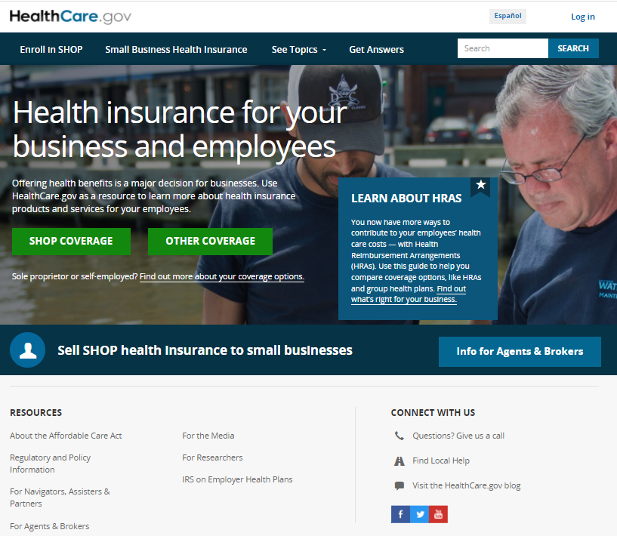
When to Enroll in Small Business Health Options Program (SHOP) Marketplaces
In the SHOP Marketplaces, eligible small employers:
Decide on their group’s annual Open Enrollment Period (OEP)
Can usually do a group enrollment at any time throughout the year
Notes:
Presenter notes
In the SHOP Marketplaces, eligible small employers determine their group’s annual Open Enrollment Period (OEP) (for themselves and their eligible employees/dependents). Small employers can generally complete a group enrollment at any time throughout the year. For more information, go to HealthCare.gov/small-businesses/.

Slide 57
Qualified Small Employer Health Reimbursement Arrangement (QSEHRA)
For small employers who don’t offer health coverage to their employees to help them pay for medical expenses
Can be used to help pay your household’s health care costs (like monthly premiums) for qualifying health coverage
The QSEHRA amount will change the premium tax credit amount you’re eligible for (some or no tax credit)
NOTE: If the QSEHRA makes Health Insurance Marketplace coverage affordable, you wouldn’t be eligible for a premium tax credit. Use the QSEHRA tool to determine whether you may need to reduce or decline APTC.
Notes:
Presenter notes
Small employers who don’t offer health coverage to their employees can help employees pay for medical expenses through a QSEHRA.
If your employer offers you a QSEHRA, you can use it to help pay your household’s health care costs (like monthly premiums) for qualifying health coverage, such as a Health Insurance Marketplace plan.
The amount of QSEHRA you get will change the premium tax credit amount you’re eligible for. You may either be eligible for some or no premium tax credit.
You can use this QSEHRA tool to determine whether you may need to reduce or decline advance premium tax credit (APTC): HealthCare.gov/downloads/qsehra-worksheet.pdf
NOTE: If the QSEHRA makes Health Insurance Marketplace® coverage affordable, you wouldn’t be eligible for a premium tax credit. Use the QSEHRA tool to determine whether you may need to reduce or decline APTC.

Slide 58
Individual Coverage Health Reimbursement Arrangements (HRA)
Employers can offer you an individual coverage HRA instead of traditional group health plan coverage
Individual coverage HRA can be used to reimburse medical expenses, like monthly premiums and out-of-pocket costs
To use an individual coverage HRA , you must be enrolled in individual health insurance coverage, like the Marketplace, or in Medicare Part A (Hospital Insurance) and Part B (Medical Insurance) or a Medicare Advantage Plan (Medicare Part C)
If you’re eligible, you aren’t eligible for financial help through the Marketplace, unless it doesn’t meet minimum standards for affordability and you opt out of it
Prior to submitting a Marketplace application, employees can also use the HRA tool (HealthCare.gov/job-based-help) for an estimate of whether their ICHRA may be affordable
Notes:
Presenter notes
Employers can offer you an individual coverage HRA, which:
Is instead of traditional group health plan coverage
Can be used to reimburse medical expenses, like monthly premiums and out-of-pocket costs
To use an individual coverage HRA, you must be enrolled in individual health insurance coverage, like the Marketplace, or in Medicare Part A (Hospital Insurance) and Part B (Medical Insurance) or a Medicare Advantage Plan (Medicare Part C)
If you’re eligible for an individual coverage HRA, you aren’t eligible for financial help through the Marketplace, unless it doesn’t meet minimum standards for affordability and you opt out of it
Prior to submitting a Marketplace application, employees can also use the HRA tool (HealthCare.gov/job-based-help) for an estimate of whether their individual coverage HRA may be affordable

Slide 59
Key Points to Remember
A Marketplace is a way for you, if you qualify, to find and buy health insurance.
The Marketplace Open Enrollment Period (OEP) runs from November 1–January 15 and coverage begins January 1 (enrollment period dates in state-based Marketplaces (SBMs) may differ).
You may enroll in or change plans during a Special Enrollment Period (SEP), if you qualify.
You can enroll in Medicaid or the Children’s Health Insurance Program (CHIP) anytime.
States have flexibility to have their own Marketplace. You can find more information on whether your state has its own Marketplace at HealthCare.gov/marketplace-in-your-state.
Notes:
Presenter notes
A Marketplace is a way for you, if you qualify, to find and buy health insurance.
The Open Enrollment Period (OEP) runs from November 1–January 15 and coverage begins January 1. The enrollment period dates in state-based Marketplaces (SBM) may differ. Here are some key dates:
December 15, 2022: Enroll by this date for coverage that starts January 1, 2023.
December 31, 2022: Coverage ends for 2022 Marketplace plans.
January 1, 2023: Coverage begins for 2023 plans chosen by December 15, 2022.
January 15, 2023: Open Enrollment ends for 2023. February 1, 2023: Coverage begins for 2023 plans chosen between December 16, 2022 and January 15, 2023.
Marketplace.cms.gov/outreach-and-education/key-dates-health-insurance-marketplace.pdf
You may enroll in or change plans during a Special Enrollment Period (SEP), if you qualify. You can enroll in Medicaid or the Children’s Health Insurance Program (CHIP) at anytime.
States have flexibility to have their own Marketplace. You can find more information on whether your state has its own Marketplace at HealthCare.gov/marketplace-in-your-state.

Slide 60
Key Points to Remember (continued)
You may be eligible for lower costs on your monthly premiums and out-of-pocket costs.
There’s help available through the Marketplace Call Center at 1-800-318-2596; TTY: 1-855-889-4325, Marketplace enrollment assisters, and agents and brokers.
If you don’t agree with a decision made by a Marketplace, you may be able to file an appeal at HealthCare.gov/marketplace-appeals.
If you’re almost 65 and applying for coverage through a Marketplace, know the benefits of enrolling in Medicare as soon as you become eligible.
There are insurance options for employers like Small Business Health Options Program (SHOP), Qualified Small Employer Health Reimbursement Arrangement (QSEHRA), and individual coverage Health Reimbursement Arrangements (HRA).
Notes:
Presenter notes
You may be eligible for lower costs on your monthly premiums and out-of-pocket costs.
There’s help available through the Marketplace Call Center at 1-800-318-2596; TTY: 1-855-889-4325, Marketplace enrollment assisters, and agents and brokers.
If you don’t agree with a decision made by a Marketplace, you may be able to file an appeal at HealthCare.gov/marketplace-appeals.
If you’re almost 65 and applying for coverage through a Marketplace, know the benefits of enrolling in Medicare as soon as you become eligible.
There are insurance options for employers like Small Business Health Options Program (SHOP), Qualified Small Employer Health Reimbursement Arrangement (QSEHRA), and individual coverage Health Reimbursement Arrangements (HRA).

Slide 61
Resources
Sign up to get email and text alerts at HealthCare.gov/subscribe
CuidadoDeSalud.gov for HealthCare.gov in Spanish
Updates and resources for organizations are available at Marketplace.cms.gov
Twitter.com/HealthCareGov
Facebook.com/Healthcare.gov
Notes:
Presenter notes
Do you need more information about the Marketplace?
Sign up to get email and text alerts at HealthCare.gov/subscribe/.
CuidadoDeSalud.gov/ is HealthCare.gov in Spanish.
Updates and resources for partner and stakeholder organizations are available at Marketplace.cms.gov.
Like us on Facebook and follow us on Twitter!
Twitter.com/HealthCareGov
Facebook.com/Healthcare.gov
Materials are available online for print or download, or can be ordered at no cost from the Centers for Medicare & Medicaid Services (CMS) Product Ordering Website, productordering.cms.hhs.gov.

Slide 62
Acronyms
ACA Affordable Care Act
AI/AN American India/Alaska Natives
APTC Advance Payments of the Premium Tax Credit
CHIP Children’s Health Insurance Program
CSR Cost-sharing Reductions
EFT Electronic Fund Transfer
FFM Federally-facilitated Marketplaces
FPL Federal Poverty Level
HHS Department of Health & Human Services
HRA Health Reimbursement Arrangement
IEP Initial Enrollment Period
OEP Open Enrollment Period
QHP Qualified Health Plans
QSEHRA Explain Qualified Small Employer Health Reimbursement Arrangement
SBM State-based Marketplaces
SEP Special Enrollment Period
SHOP Small Business Health Options Program
STDLI Short-term, Limited-Duration Insurance

Slide 63
Stay Connected
To view available training materials, or subscribe to our email list, visit
CMSnationaltrainingprogram.cms.gov.
Contact us at training@cms.hhs.gov.
Notes:
Presenter notes
Stay connected. Visit CMSnationaltrainingprogram.cms.gov to view NTP training materials and to subscribe to our email list. Contact us at training@cms.hhs.gov.

