Slide 1
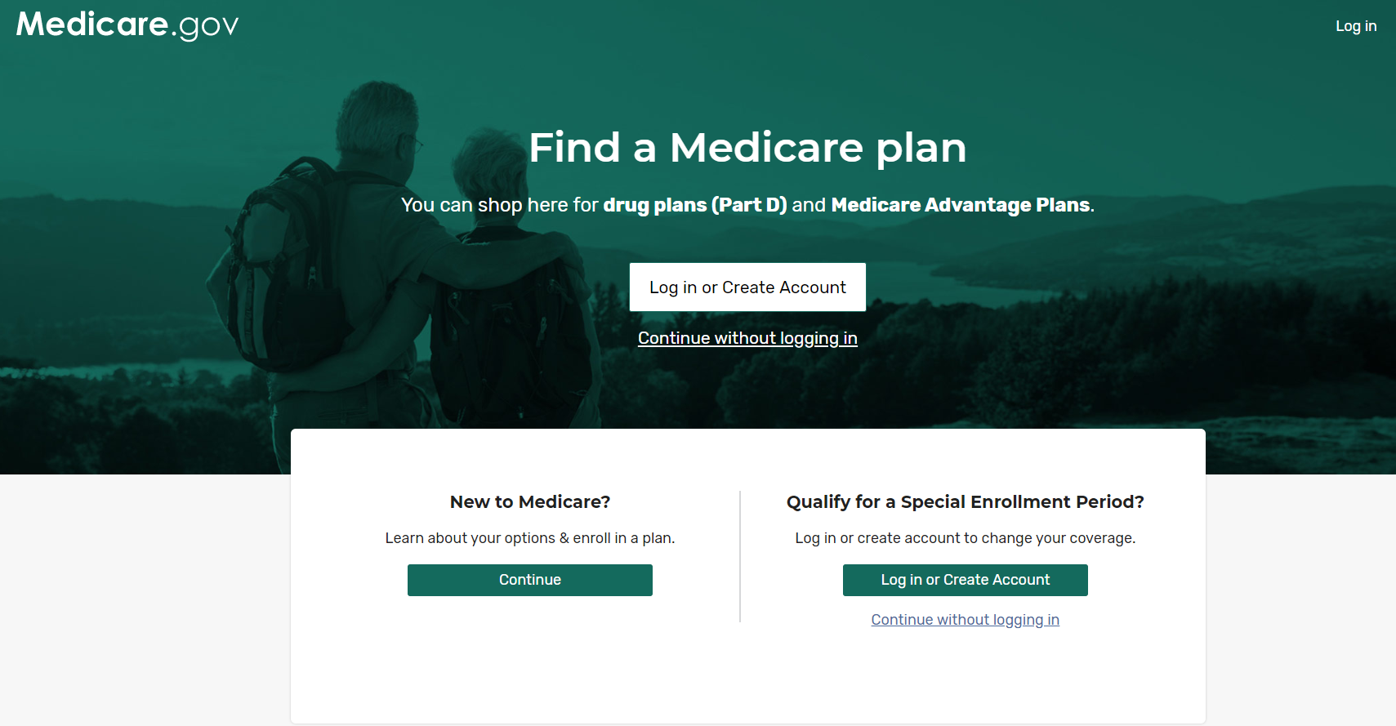
What Medicare tools can help me?
Introduction: eMedicare
Audience Segmentation
MyMedicare
The new Medicare Plan Finder

Slide 2
Audience Segmentation – Medicare.gov
Our starting point for testing the tools and strategies we have for providing more personalized experiences
Privacy policy to protect users
Implementing with Open Enrollment
Targeted user groups
Beneficiary
Coming of Ager
Caregivers

Slide 3
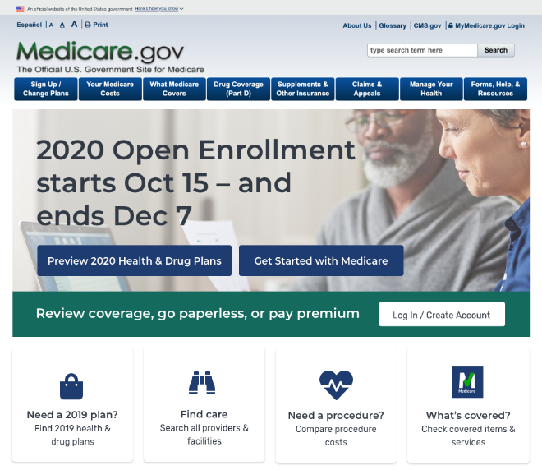
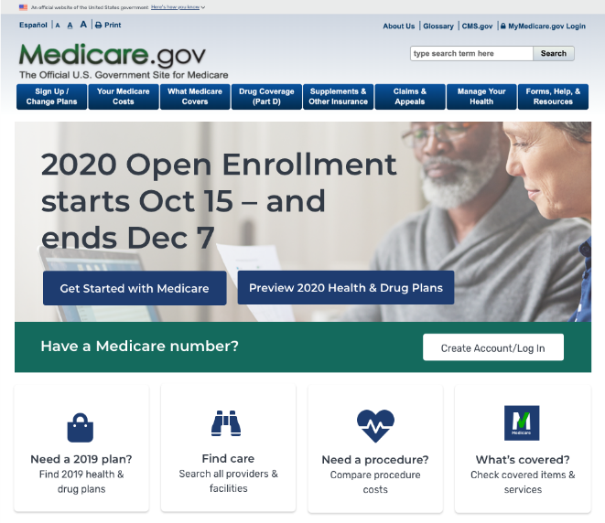
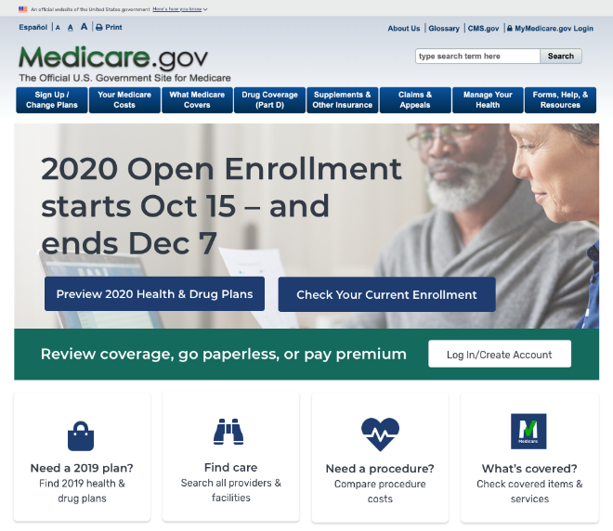
Preview Period: Oct 1 – Oct 14
Current Experience (“Control”)
Coming of Agers
Beneficiaries

Slide 4
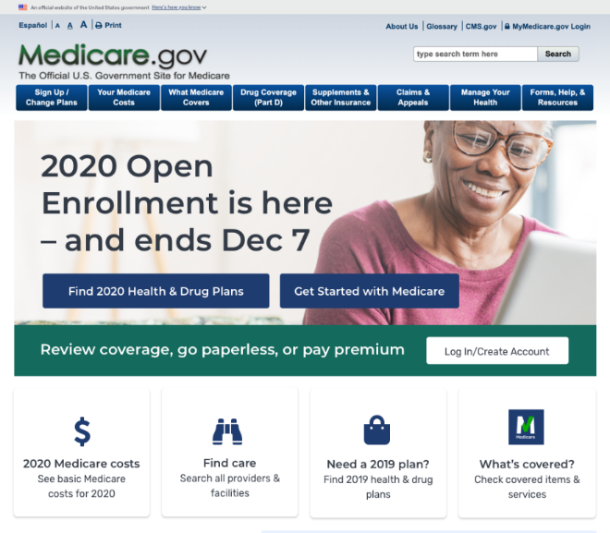
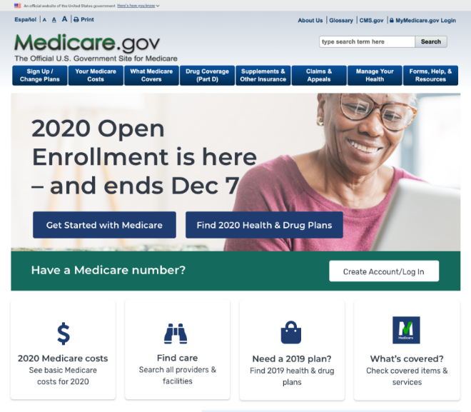
Open Enrollment: Oct 15 – Nov 30
Current Experience (“Control”)
Coming of Agers
Beneficiaries
Note: From 11/21-11/30, the last two CTA cards on all 3 versions will change to

Slide 5
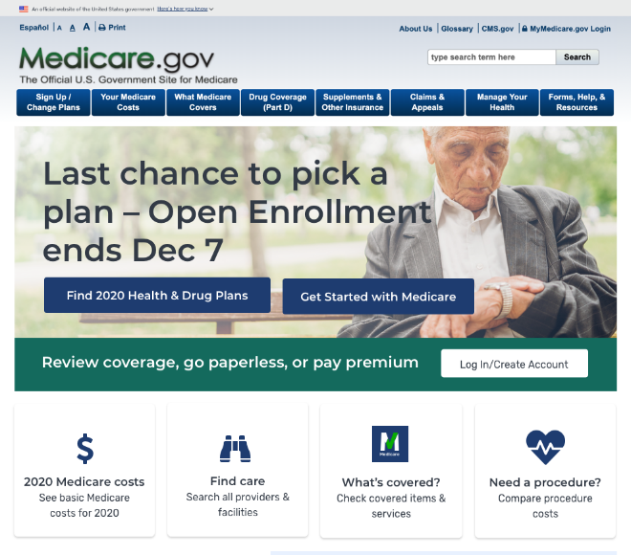
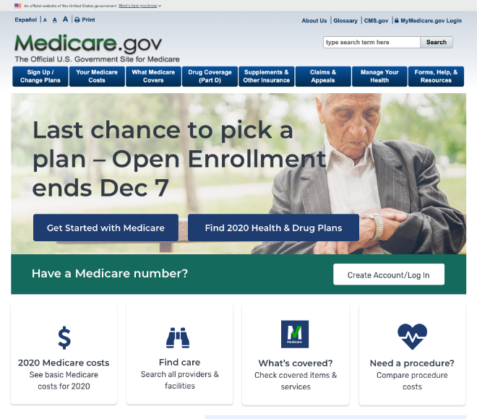
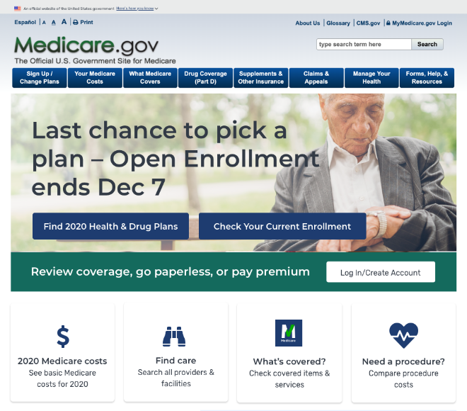
Last Week: Dec 1– Dec 7
Current Experience (“Control”)
Coming of Agers
Beneficiaries

Slide 6
MyMedicare

Slide 7
New Medicare Plan Finder
What is the new Medicare Plan Finder?
Key Points
Timeline for release
Where to get more information

Slide 8
Old Plan Finder
Notes:
If you’ve logged into Medicare.gov and selected “find health plans” you’ve seen this page. The banner at the top invites you to try the new Plan Finder.

Slide 9
New Medicare Plan Finder Home Page
Notes:
I’m not going to give a full demonstration, but want to point out a few key features. We have a link on our website where you can access a recorded webinar demonstration of the new Plan Finder. I’ll share that link in a minute.

Slide 10
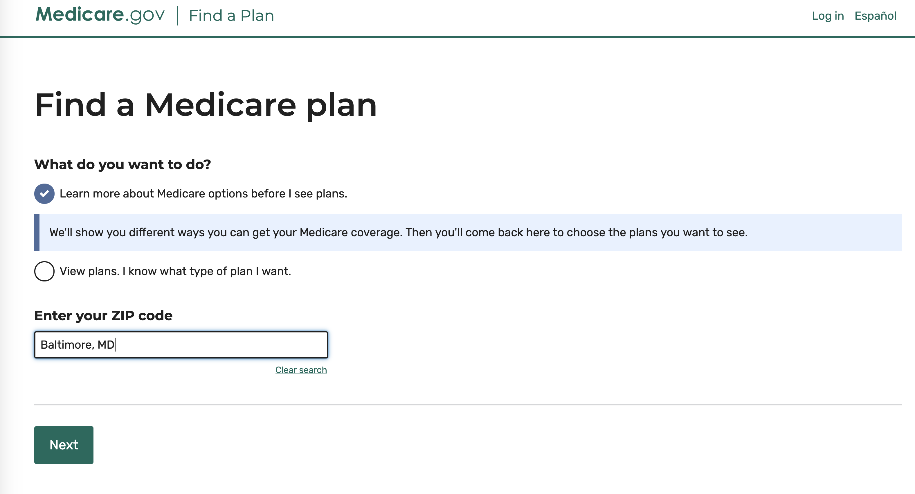
New Coverage Wizard Medicare.gov/medicarecoverageoptions
Notes:
Integrated with the new Plan Finder, we’ve now packaged all of the information previously available in our Coverage Wizard tool in a way that supports consumers who are looking for a plan but also want more information about Medicare coverage options. This is also accessible as a standalone tool (direct link or from the “Getting Started with Medicare” page).

Slide 11
Two ways to Medicare
Notes:
The Coverage Wizard lets you explore the two ways you can take your Medicare benefits, Original Medicare or through a Medicare Advantage plan.

Slide 12
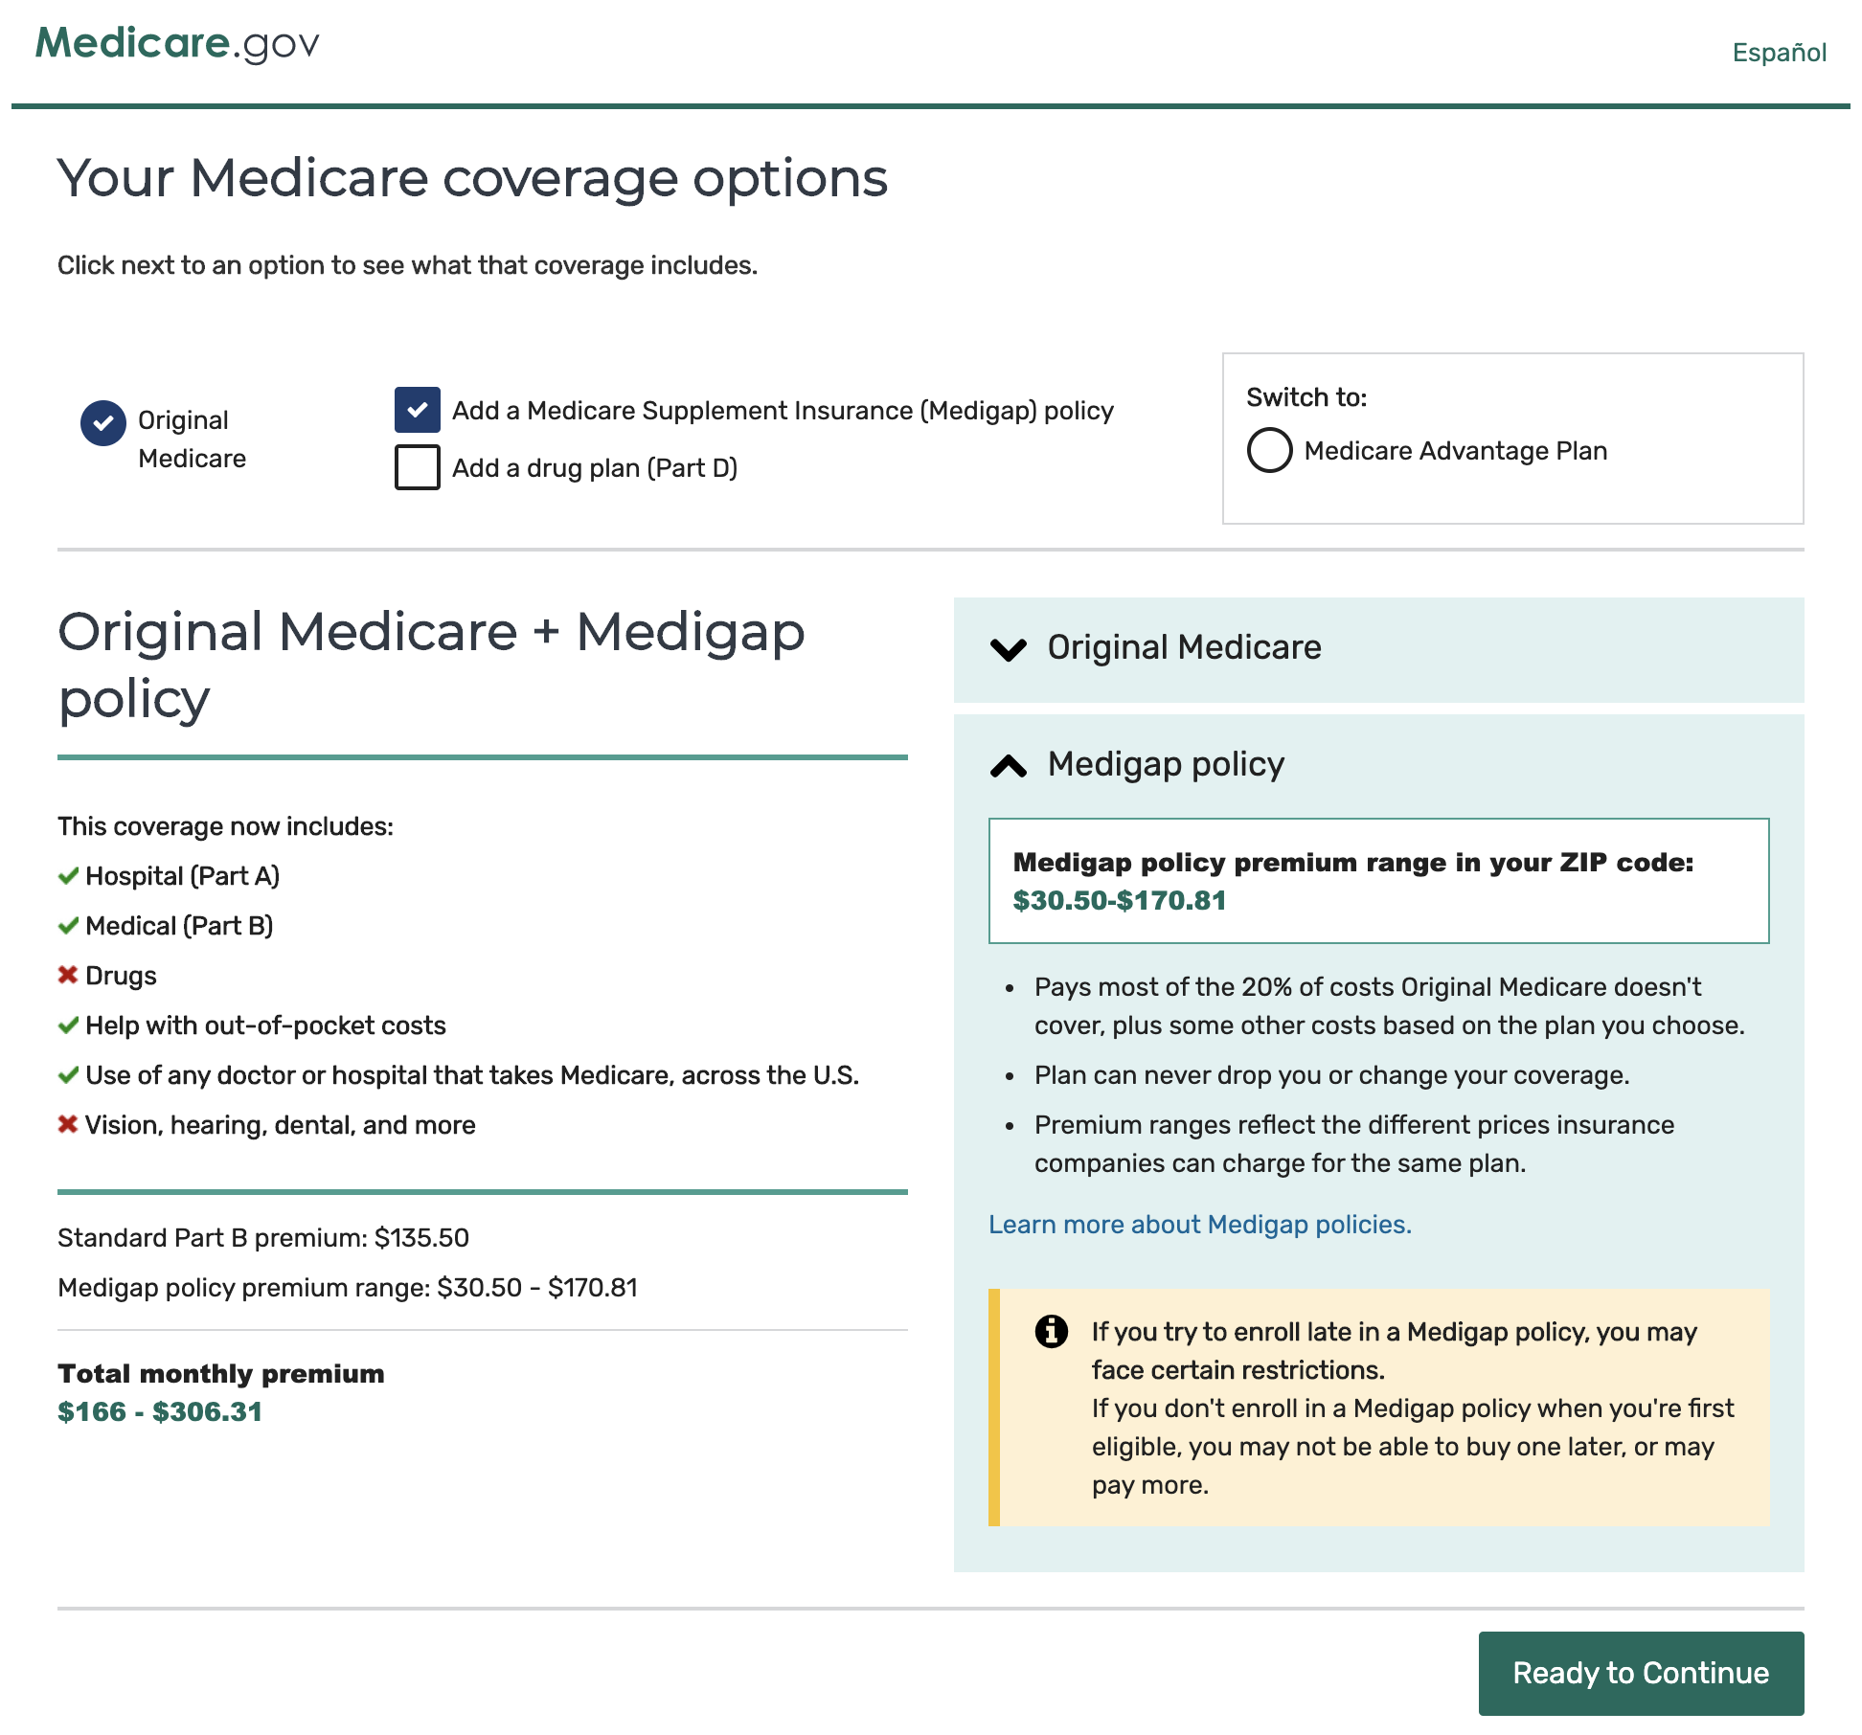
Benefits, tradeoffs, and costs for each coverage option
Notes:
You can explore what is covered through Original Medicare, and what happens when you add options like a Medicare Drug Plan or a Medigap Policy. There’s lots of information here, organized in a way that our interviews with seniors show is the easiest way for them to understand and learn.

Slide 13
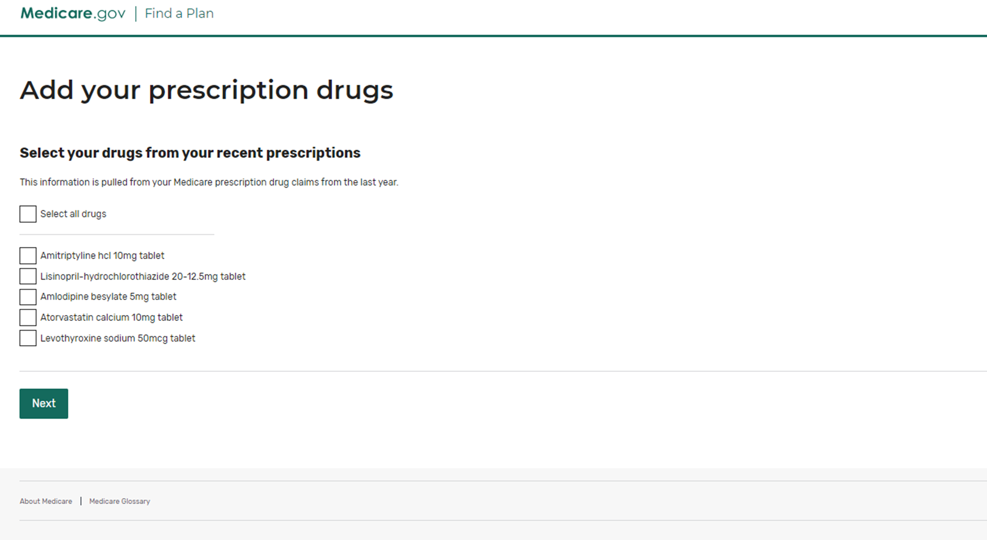
Add Prescription Drugs
Notes:
If you log in to the Plan Finder using your MyMedicare username and password, you’ll be able to start your personal drug list by accessing a suggested list based on your Medicare drug claims over the past year. You can click the box next to each drug you still take, or just click the “Select all drugs” box at the top. Then you can add new drugs or edit your dosages, etc. There’s also a new “Live Chat” function when you’ve logged in that allows you to reach a Customer Service Rep at the 1-800-Medicare call center while you’re in the plan finder – but only if you log in.

Slide 14
Key Points
2019 Plan Data is still available for people gaining Medicare entitlement or with a SEP to make a change in 2019.
2020 Plans will only be available through the new Medicare Plan Finder
You get the best experience if you log in with your MyMedicare.gov username and password
Some of the changes in the new Medicare Plan Finder:
Overall look and feel is more modern and personalized
Optimized for mobile devices
When logged in, the prescriptions you’ve filled through Medicare are shown to start your drug list
You must be logged in to save your drug list
Now you can price up to 40 drugs (vs. 25 before)
Live chat help is available from 1-800-Medicare
Notes:
The new Medicare Plan Finder has been in use at the 1-800-Medicare call center since July, and was released to the public in late August. We continue to make improvements based on feedback and as new functions are ready. For example, while we have always intended to have a total out-of-pocket sort (that is, premiums plus drug costs) that wasn’t ready in time for the August public release, but it will be released in time for OEP. 2020 Plan data, as it is every year, will be made available in advance of OEP, as will 2020 star ratings.

Slide 15
Where to get more information
Informational materials are available on the NTP website at: CMSnationaltrainingprogram.cms.gov/?q=spotlight&nid=197
Included are:
Recordings of prior webinars (August 16 and September 5)
A new “Top Ten Questions” document
A handy infographic
Another webinar on the new Plan Finder is planned on October 9
Notes:
We’ve been posting all our new Plan Finder materials for partners on the NTP website, including two new additions this week: the Top 10 questions and infographic. I’ll also be answering questions in the Plan Finder Q&A booth at the end of this webinar so feel free to stop in. I’d recommend you read that Top 10 questions list first, since I’ll doubtless get more questions that I can answer during the time the booth is open.

